Slide 1
Decentralized Optimization of Vehicle Route Planning GRACE JENNINGS
Ilias Gerostathopoulos, Raphael Stern
Department of Informatics
Technical University Munich, Germany

Slide 2
1. General Problem and Context
Rise of connected and autonomous vehicles introduces new possibilities in vehicle and traffic routing
Already have connectivity using smartphones with routing applications like Google Maps and Waze
System Optimal SO route assignment
Suggesting routes for each individual and optimize these routes based on the network state
Notes:
But currently with the mapping apps whether you take the suggested route is unknown and not enforceable
And their level of system optimization is unknown, because it is dependent on the number of people using the apps, and do they coordinate between apps

Slide 3
2. Human-Cyberphysical System Problem
Traffic control is a complex problem depending on human desires, physical constraints and computing limitations
Explore different `levels of altruism’ of the drivers
Local v. Global objectives
Also compare across cities with different structural characteristics
Connecting the EPOS decentralized optimization software with the SUMO traffic simulation application
In this simulation an individual agent is an autonomous vehicle
Notes:
Take into account traffic laws, traffic patterns, the number of times that routes can be re-evaluated on large networks
Altruism plays in because it is basically how likely are people to follow the routing suggestions, especially when it might make their route slightly longer but it is best for the network and reducing traffic as a whole
So SUMO runs the simulation and invokes EPOS at time points to give direction to SUMO

Slide 4
3. Challenges in Reaching a Functional System
Finding the right data
Added a feature to the simulation that assigned vehicles specific origins and destinations on the map
Couldn’t find widespread OD data for various cities
Used ZIP codes and populations to choose the origins Length of simulation run time
Had to perform various optimizations to reduce the run time of the simulations

Slide 5
4. The Technical Problem and Research Setting
One simulation run was designed to represent morning rush hour traffic
The number of cars was determined by the number of people commuting to work by car in each city
A simulation time of 30 minutes was chose to represent average commute time in the US
Ran 11 simulation for each of the four cities
11 values of the parameter in the optimization software that controlled the selfishness of each agent
Compared the local and global costs between cities for each level of selfishness

Slide 6
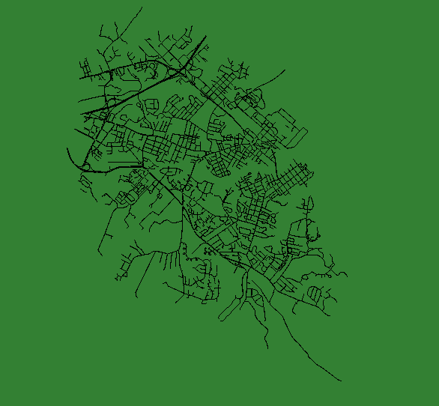
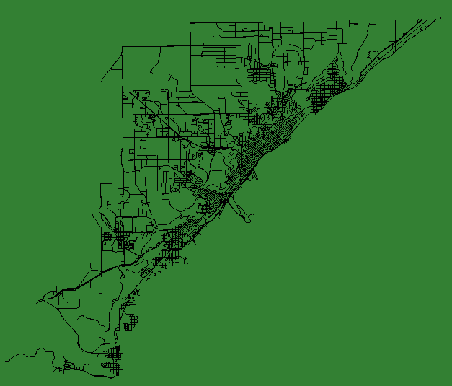
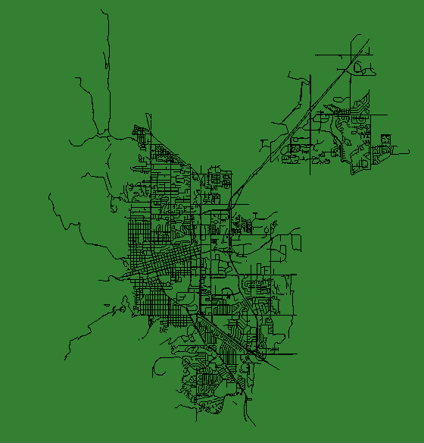
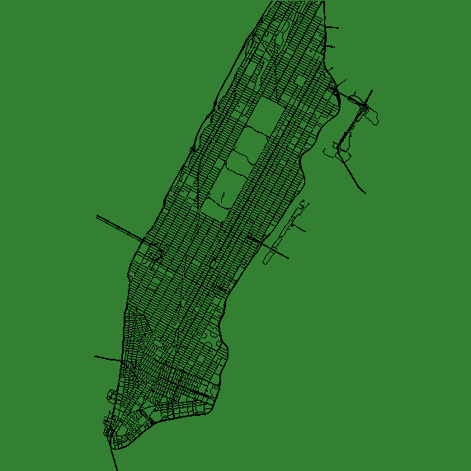
TRAFFIC NETWORKS
A
C
A. Annapolis B. Boulder
C. Duluth D. Manhattan
B
D

Slide 7
5. Future Research
Expanding the route assignment for more accurate destinations
To better simulate traffic patterns and congestion
Explore the differences in route assignment for sparse v. dense networks
Adding a fairness objective to the decision making of the individual vehicles
Notes:
Fairness objective would be like ensuring that it doesn't’t decrease all the trip times by a little to make some cars trip times increase by double

