Slide 1
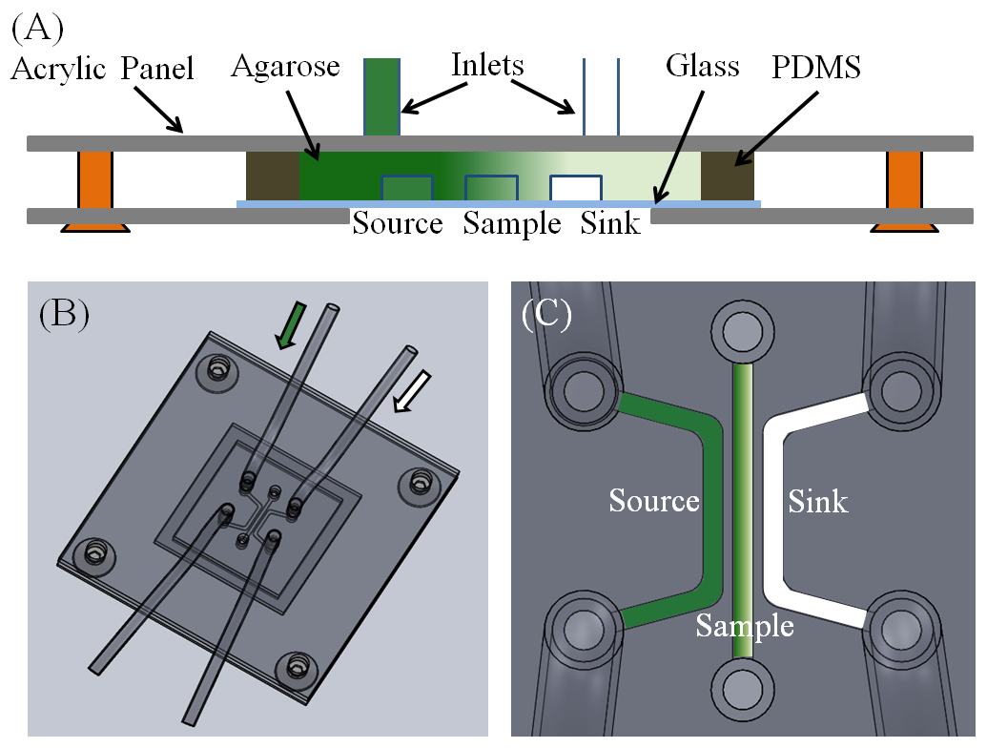
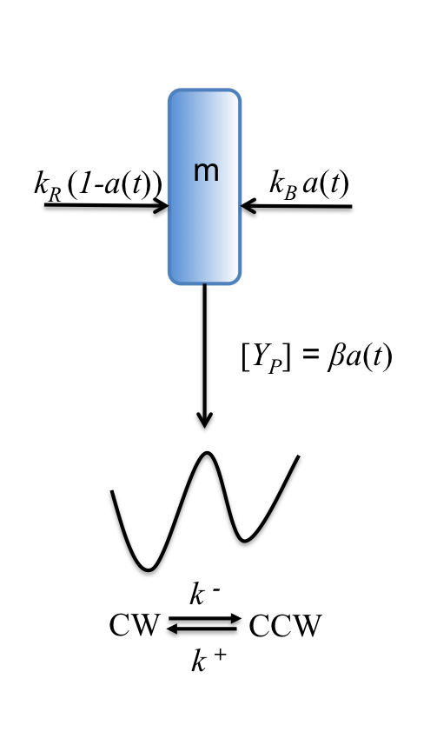
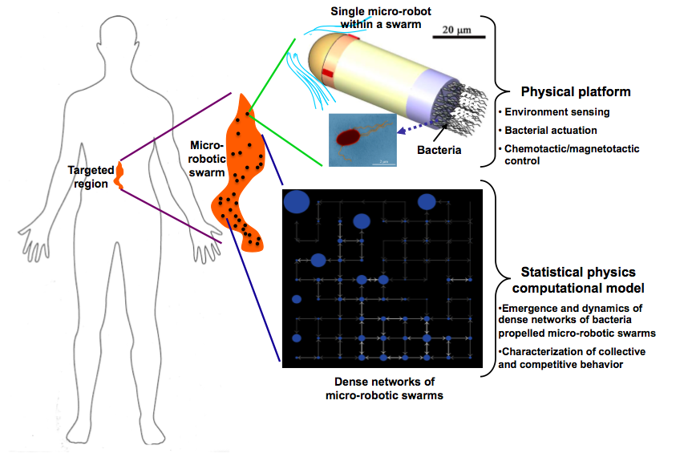
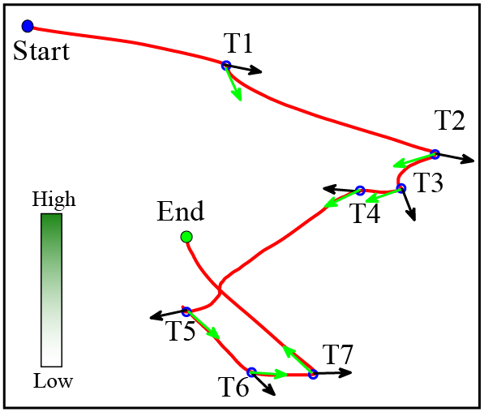
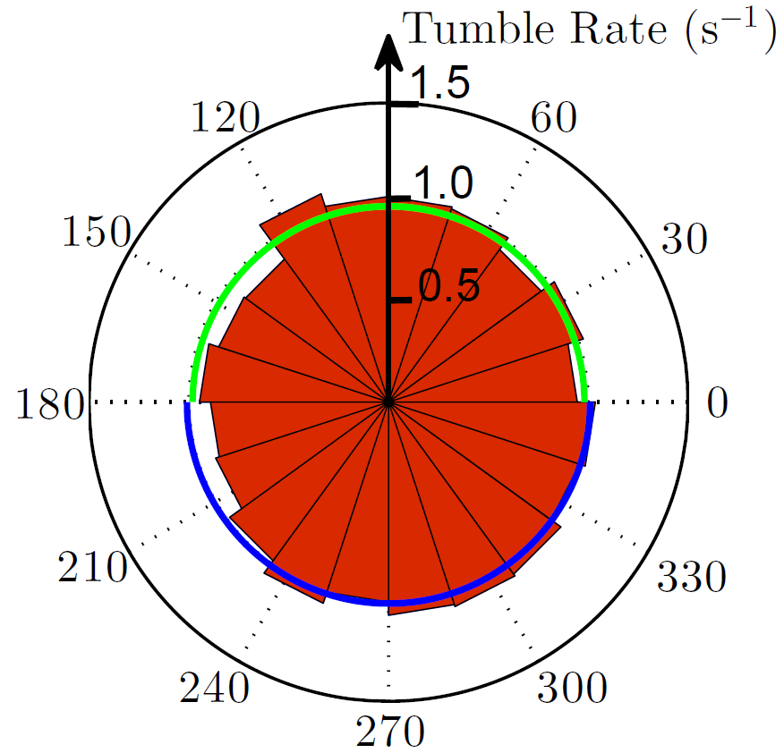
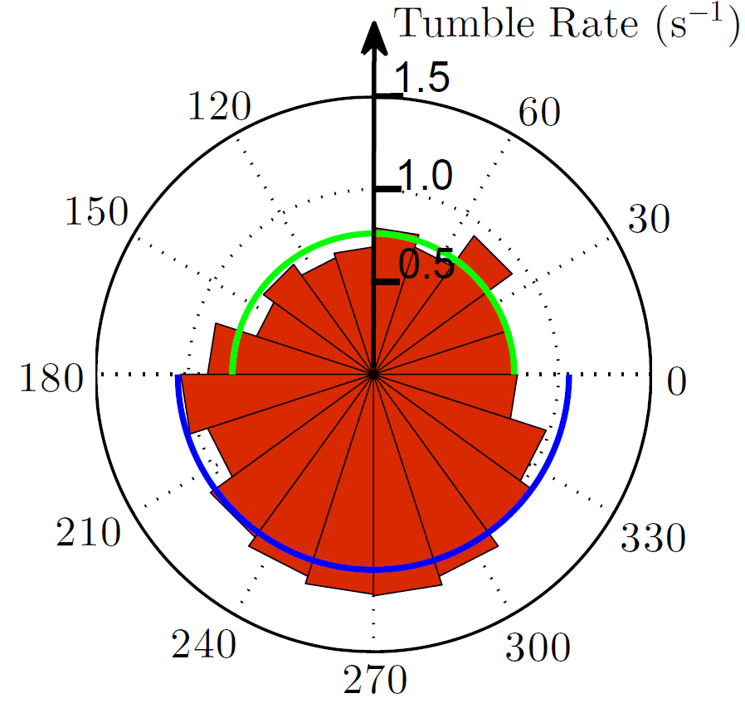
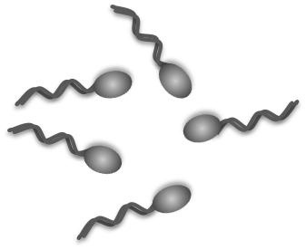
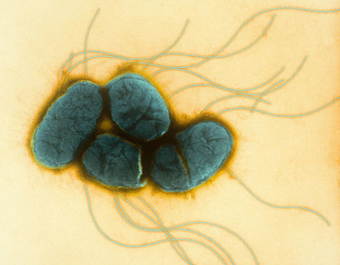
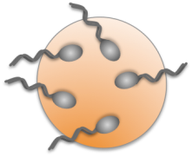
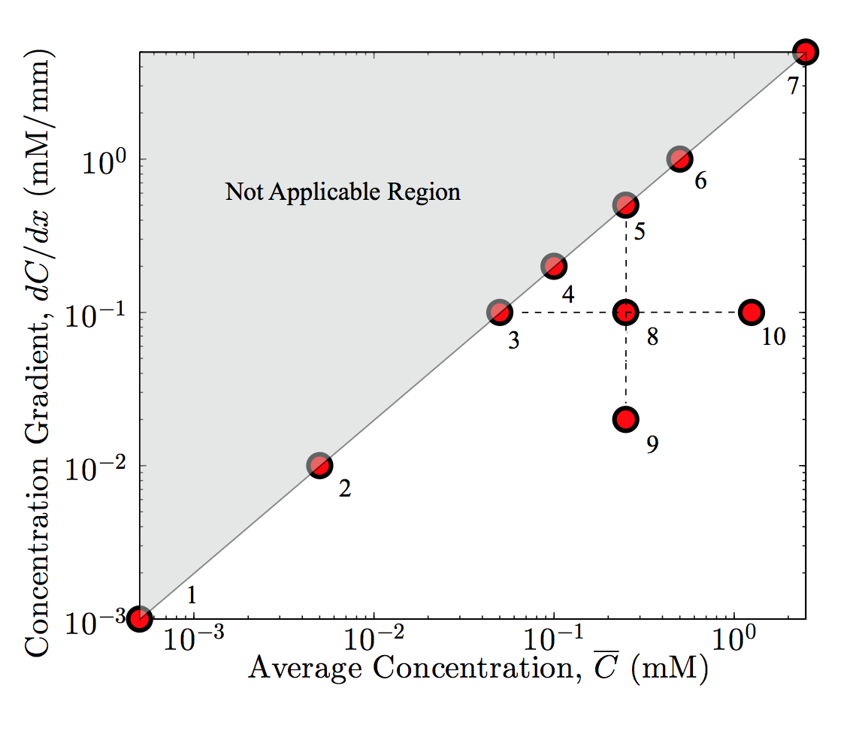
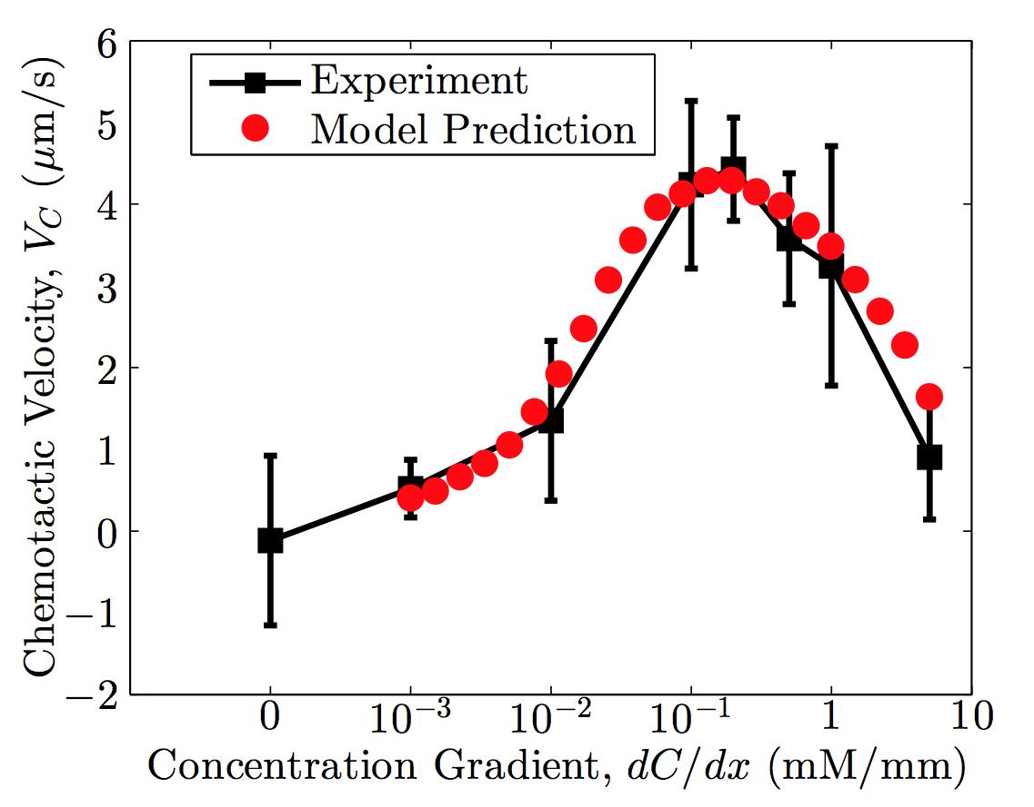
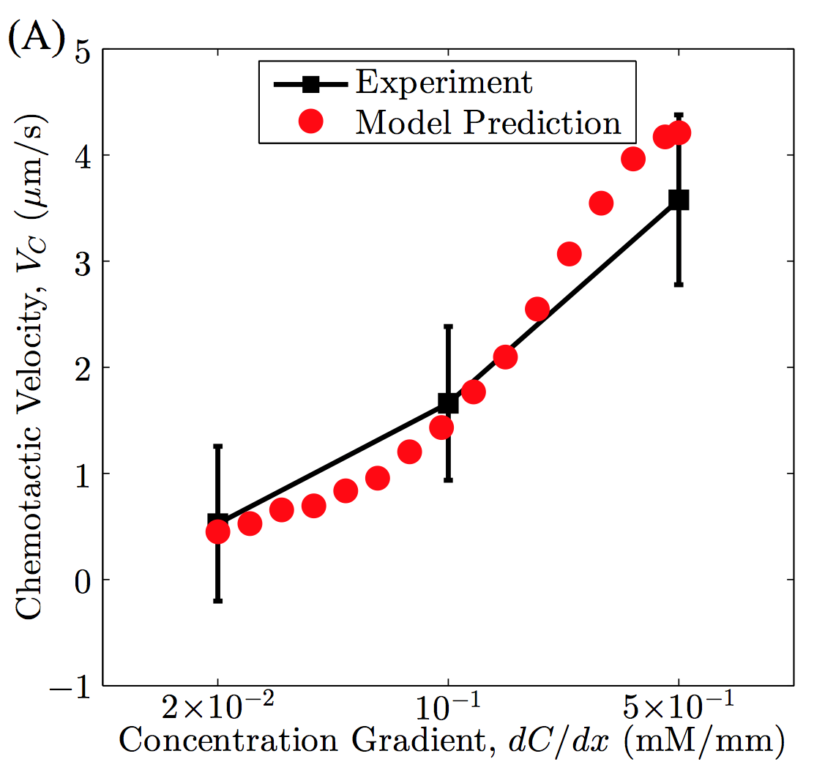
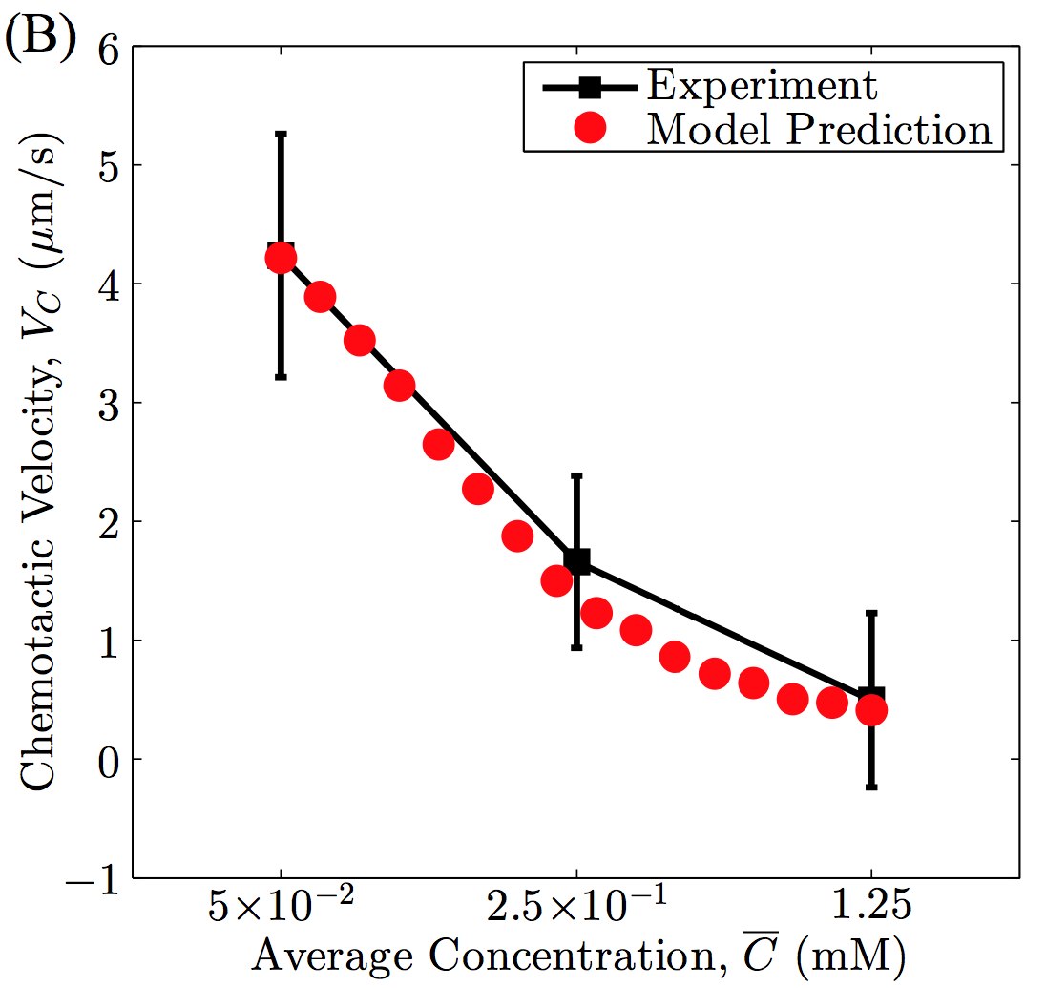
CPS-Medium: Dense Networks of Bacteria Propelled Micro-Robotic Swarms
Radu Marculescu, Metin Sitti, Philip LeDuc
Rika Carlsen, Matthew Edwards, Cecile Pacoret, Guopeng Wei, Jiang Zhuang
Overview
Statistical Physics Model
Physical Platform
Objective: Develop a new computational dense network framework for designing and analyzing stochastic micro-robotic swarms and building a new physical platform by using attached bacteria as on-board actuators and chemotaxis and magnetotaxis as passive and active steering control methods, respectively.
Mathematical model of chemotactic response
Chemotactic behavior of S. marcescens
Chemoreceptor (SPEC model):
Method:
Average activity of the receptor:
where N is the number of receptors Tar in a receptor complex, m is the methylation level, [L] is the ligand concentration
Free energy difference (Monod-Wyman-Changeux model):
where K_{a} and K_{i} are the dissociation constants of the ligand to the active and inactive receptors, respectively
The impact of receptor methylation on its free energy is considered to be linear:
where α ≈ 1.7 and m₀ ≈ 1
For a near perfect adapted system, the methylation kinetics is assumed to have the following linear form:
where k_{R} and k_{B} are the methylation and demethylation rates, respectively
Objective: Quantify the chemotactic response of S. marcescens to L-aspartate over range of concentration gradients (1.0x10⁻³ – 5 mM/s) and average concentrations (0.5x10⁻³ – 2.5 mM)
Experimental set-up: Three-channel linear gradient generator as shown on left
The average swimming speed (ν) and tumble rate bias (p⁻, p⁺) was measured for a significant number of individual bacteria
The chemotactic velocity (V_{c}) can be computed from the measured parameters:
Application: The goal is to use these micro-robotic swarms for minimally invasive medical diagnosis and treatment applications, such as drug delivery, in regions of the body that contain stagnant or low velocity fluids (e.g. vitreous humour of the eye, cerebral spinal fluid in the spinal cord and brain, etc.)
1 mm
Experimental Results:
Phosphorylation relay and flagellar motor:
The concentration of phosphorylated CheYp is assumed to be proportional to the kinase without considering the nonlinear dependence:
We use a two-state model to simulate the flagella motor, describing clockwise (CW) and counter-clockwise (CCW) rotations of the flagella with transition rates k⁻ and k⁺, respectively:
where w₀, g₀, g₁, and K_{D} are parameters chosen to fit the experimental data
Tumble detection based on angle threshold
Control
0.2 mM/mm
Conceptual sketch of the proposed CPS using statistical physics based computational dense network models and a physical platform to design and analyze bacteria propelled swimming micro-robotic swarms.
The average 3-D swimming speed is 34 µm/s
The average tumble rate for the control (no chemotactic gradient) is 1.0 s⁻¹
The average tumble rates when bacteria travel up (p⁻) or down (p⁺) a 0.2 mM/mm gradient are 0.75 s⁻¹ and 1.05 s⁻¹, respectively
No change in tumble rate when swimming down the gradient, but tumble rate decreases when swimming up the gradient
For a linear gradient of 0.2 mM/mm, the bias generates a drift velocity towards higher concentration regions
Selected Bio-Acuator: Serratia marcescens
Bacterial Dynamics
Bio-hybrid
Microsystem Dynamics
Results (Experiment vs. Model Prediction)
Bacterial Swarm
Serratia Marcescens
Kwangshin Kim, Science Photo Library
Good agreement between model and experiments
Non-linear sensing of chemoattractant cocentration
Relative gradient sensing
Senses a wide range of concentration gradients (3 – 4 decades)
Strongest chemotactic behavior: 0.2 mM/mm (0.1 mM)
Serratia marcescens: Multi-flagellated bacterium
Rod-shaped body: 0.5 µm in diameter, 2 µm long
Flagellum: 20 nm in diameter, 10 µm long
Swimming speed: 26 ± 8 µm/s (20°C)
Micro-robotic Swarm
Scanning electron microscope (SEM) image of 30 µm bead with attached bacteria
Bacteria-propelled micro-robot: Bacteria attached to polystyrene microspheres (diameters 5 – 30 µm)
Instantaneous speeds: 0.5 – 10 µm/s
Experimentally measured data points
Chemotactic velocities at different gradients
(data points 1-7)
Example 30 second trajectory of a single bacterium
Example trajectory of a bacteria-propelled microsphere
(data points 5, 8, 9)
(data points 3, 8, 10)
Carnegie Mellon University, Pittsburgh, PA
CNS-1135850

