Slide 1


Design Environments and Manufacturing Integration
CPS PI Meeting
October 4, 2012
Presented by:
Mark T. Traband, PhD
mtt1@arl.psu.edu

Slide 2
DARPA’s Adaptive Vehicle Make (AVM) Portfolio of Programs
…seeks to revolutionize the design and build process for complex defense systems by compressing the development timelines at least five fold while increasing the nation’s pool of innovation by several factors of 10.
iFAB - Instant Foundry Adaptive through Bits
The creation of a flexible, programmable, distributed production capability able to accommodate a wide range of systems and variants with extremely rapid reconfiguration timescales.
A network of Information, Material, and Agreements

Slide 3
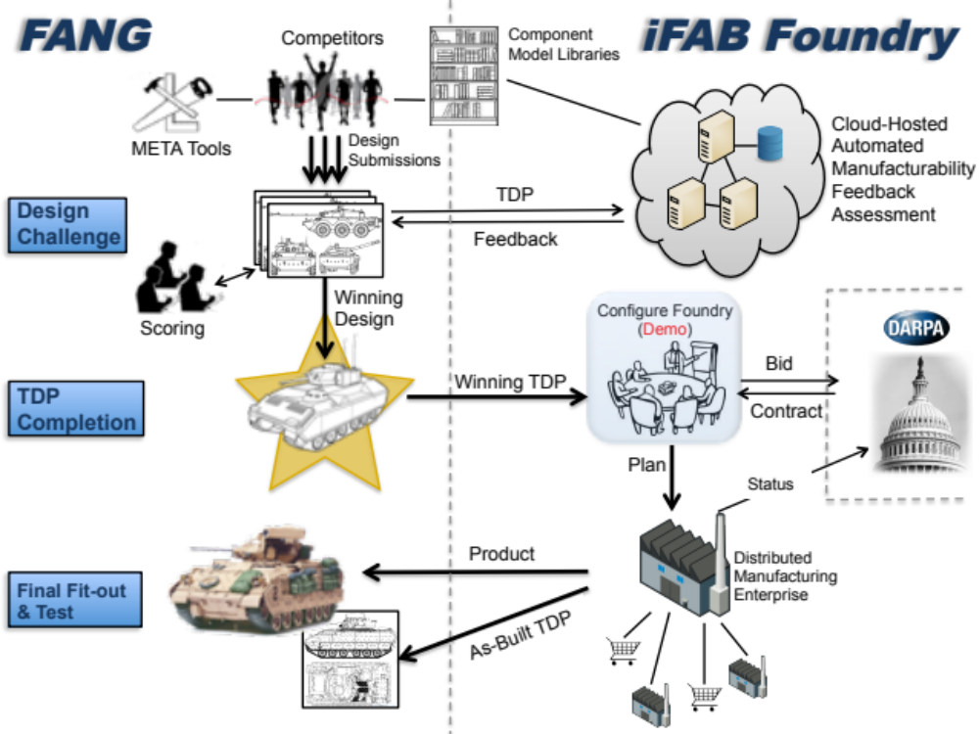

Slide 4
Key Challenges for iFAB
Answer 1000+ queries/day as to whether a design is manufacturable
Define Pareto front of feasible fabrication and assembly approaches for each design (cost versus lead-time).
For a particular foundry configuration, generate
  CNC instruction sets for all manufacturing equipment
  Human work instructions
Execute build across a heterogeneous, distributed enterprise

Slide 5
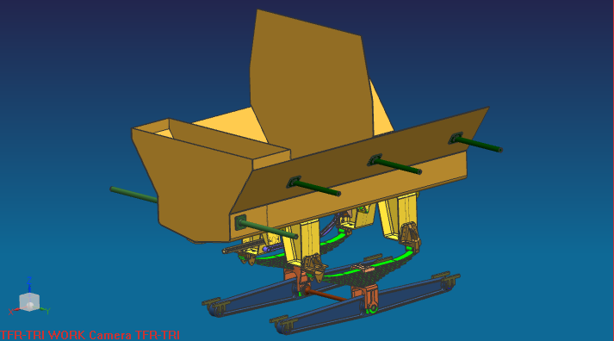
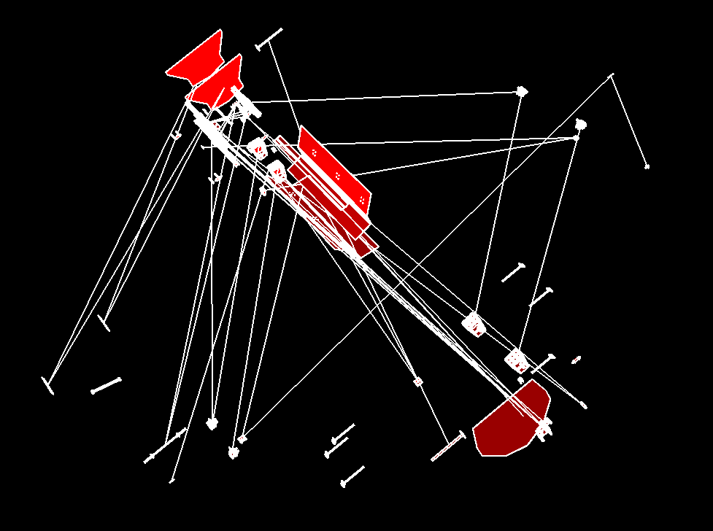
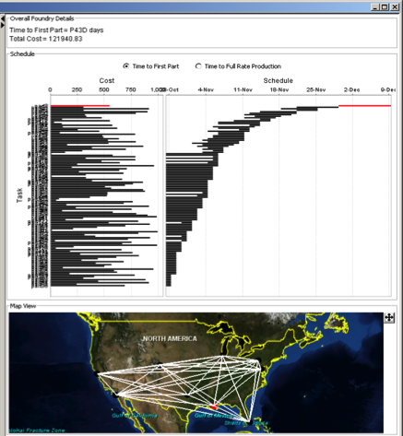
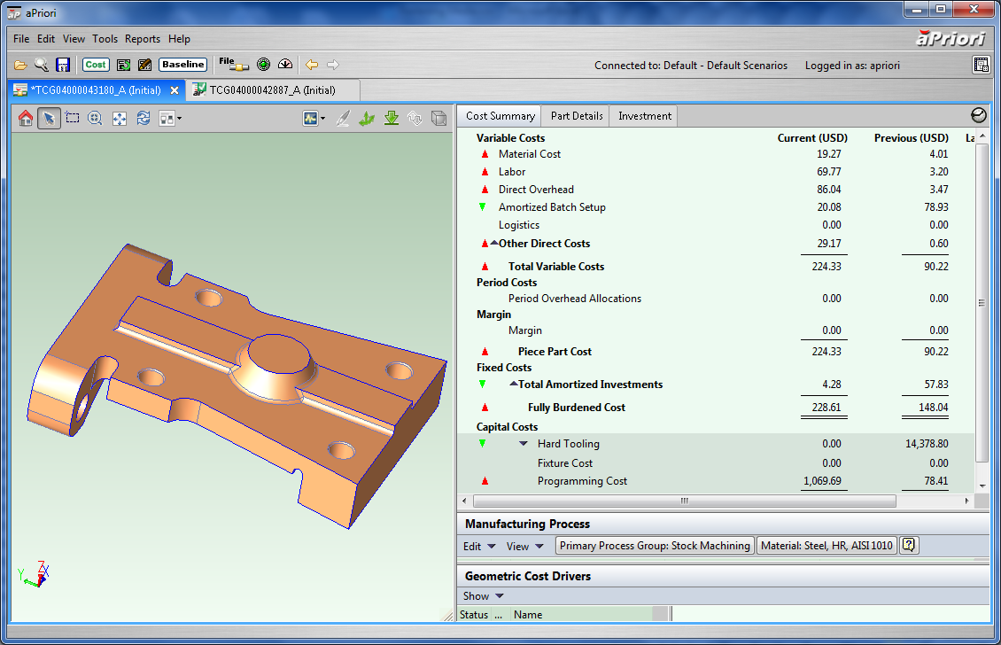
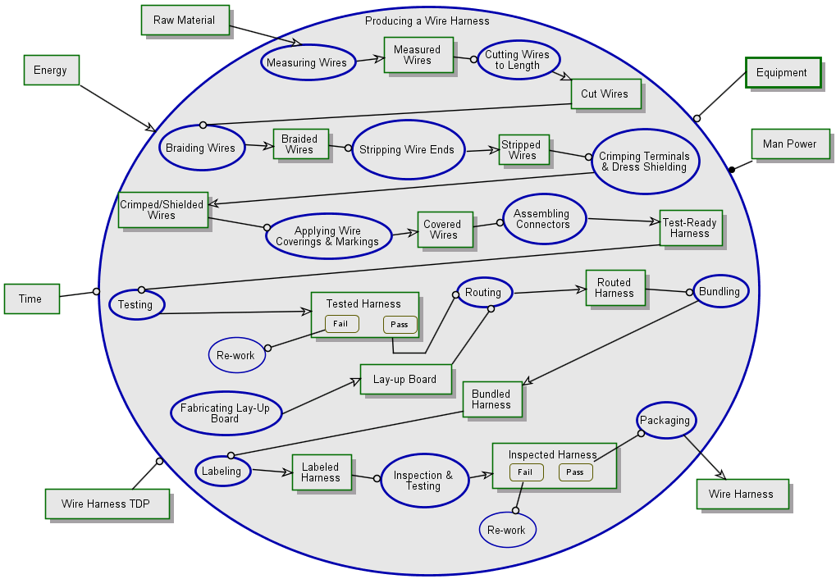
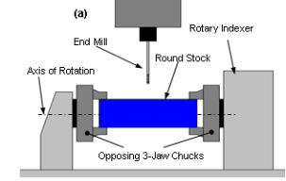
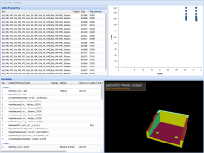
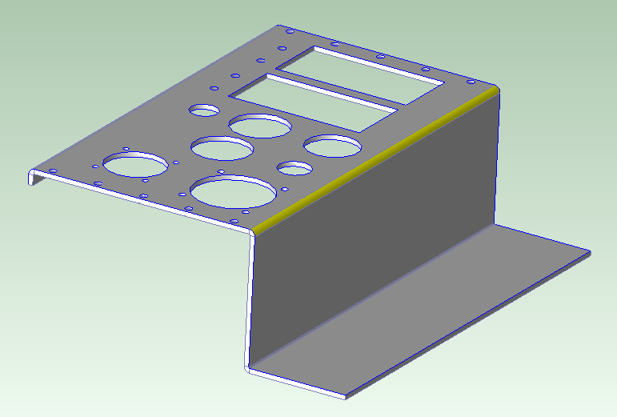
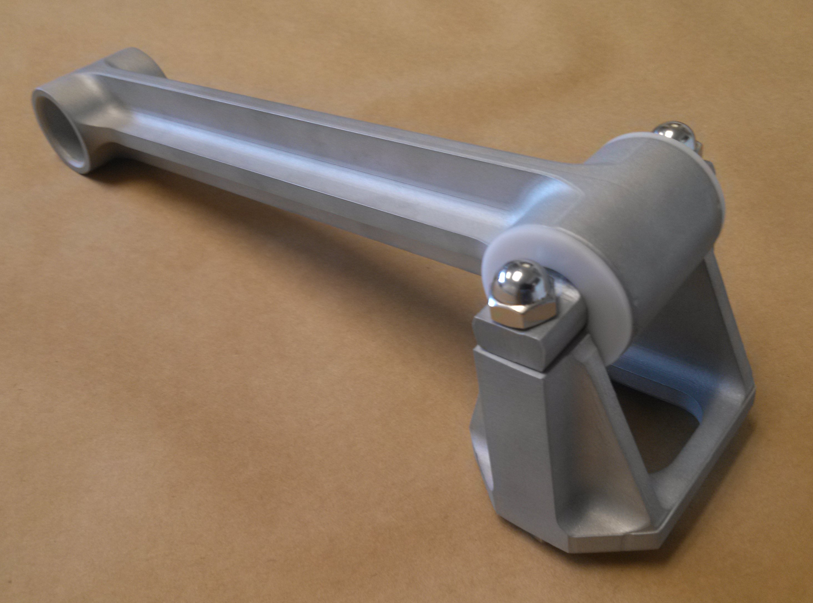
Challenge Design
Manufacturability Assessment
Load STEP Assembly
Deterministic & stochastic
Scheduling algorithms & visualization
Decompose Model
Software & algorithms
Auto-Generated Component Liaison Graph
aPriori
Virtual Production Environment
Machined, cast, plate, tubing
Assembly Planner
Software & algorithms
MFG Analysis for Each Piece Part
Schedule
ARL Manufacturing
Model Library Components
Feedback
Yes – Cost & Schedule
No – Cause & Correction
CNC-Rapid Prototyping
Iowa State Univ.
Automated Manufacturability
Feedback Assessment (PARC)
Feedback: Below recommended bend radius – may cause surface cracking

Slide 6
Possible CPS Contribution Areas to Manufacturing
Geometric Reasoning (on real-world sized problems)
  Feature extraction/mapping – design to manufacturing
  Analysis – tooling, fixturing, path planning
Sequential decision making under uncertainty
  Problem dimensionality precludes a priori preference capture
  Compounded in distributed enterprise
Enabling democratized design – promoting the AVM paradigm, while:
  Protecting IP in an agent marketplace
  Facilitating business agreements
  Expanding enterprise reach/appeal
  End Game: Flash Mob Manufacturing

