Slide 1
Designing-in Cyber Security
Dr. Darren Cofer
Advanced Technology Center
NSF Cyber Physical Systems Panel Discussion
18 October 2013

Slide 2
RW questions
How is the attack surface changed when considering CPS systems?
Can protections be designed-in and, if so, where in the design of components and more broadly, CPS systems?
Are there metrics that we can use to measure progress?

Slide 3


Classes of vulnerabilities
No security
Faulty components
Unintended interactions/interfaces

Slide 4
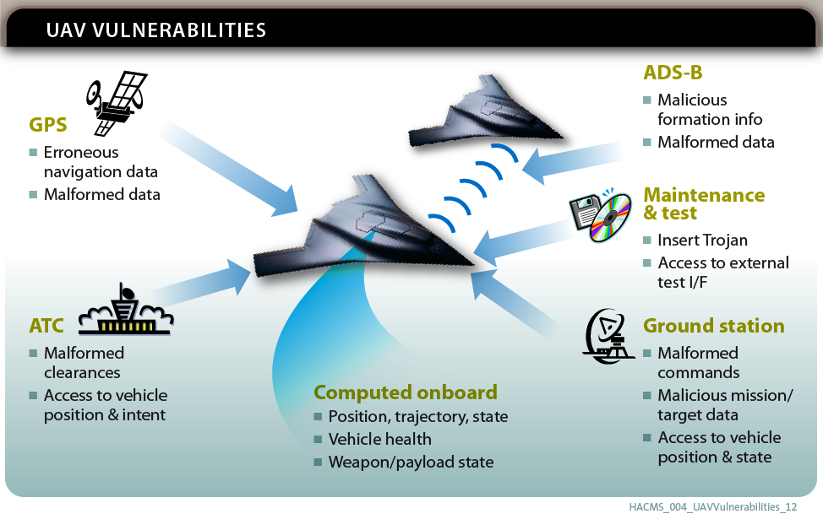
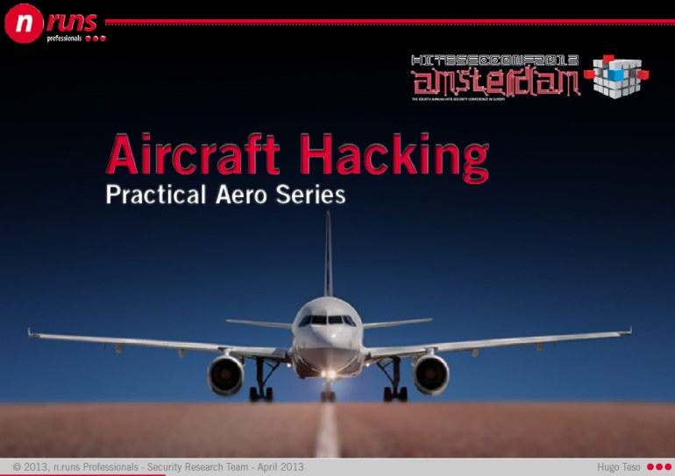
Aircraft may be susceptible to cyber attack
Security vulnerabilities
that can lead to
safety hazards
Growing awareness among customers, regulators, and public
FAA close to issuing new guidance

Slide 5

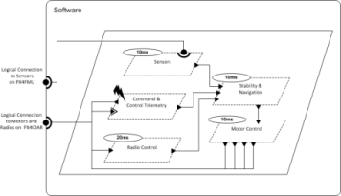
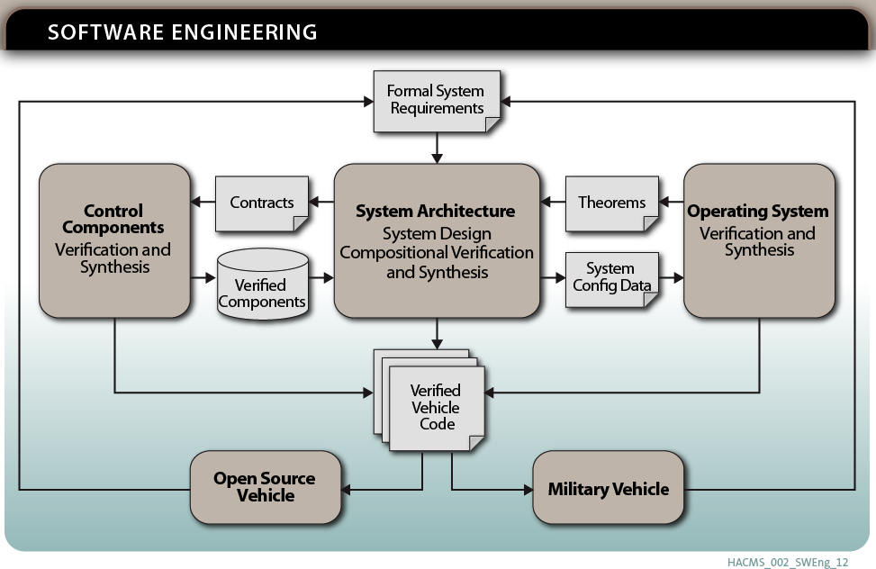
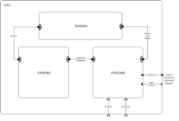
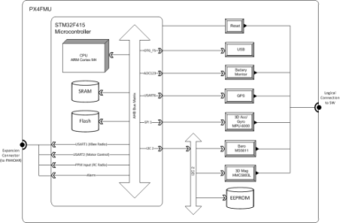
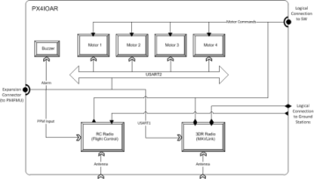
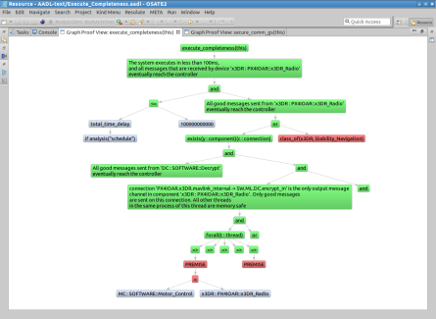
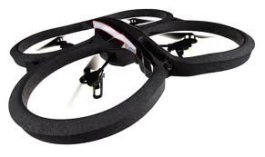
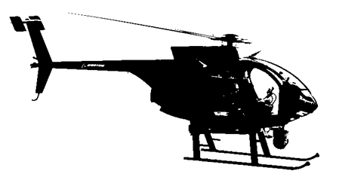
DARPA: High Assurance Cyber Military Systems (Air Team)
Key Problem
Many vulnerabilities occur at component interfaces.
How can we use formal methods to detect these vulnerabilities and build provably secure systems?
TA4 – Research Integration and
Formal Methods Workbench
Rockwell Collins and
University of Minnesota
ARCHITECTURE-CENTRIC PROOF
Secure Mathematically Assured Composition of Control Models
Accomplishments
Created AADL model of vehicle hardware & software architecture
Identified system-level requirements to be verified based on input from Red Team evaluations
Developed Resolute analysis tool for capturing and evaluating assurance case arguments linked to AADL model
Developed example assurance cases for two security requirements
Developed synthesis tool for auto-generation of configuration data and glue code for OS and platform hardware
Technical Approach
Develop a complete, formal architecture model for UAVs that provides robustness against cyber attack
Develop compositional verification tools driven from the architecture model for combining formal evidence from multiple sources, components, and subsystems
Develop synthesis tools to generate flight software for UAVs directly from the architecture model, verified components, and verified operation system
Open source tools available at github.com/smaccm

Slide 6




Architecture-centric approach
Notes:
The scope of the effort is to develop working implementations of formally verified secure unmanned air vehicle (UAV) systems and to transition the implementations to a military platform. These implemented systems will demonstrate protection from security vulnerabilities, safety hazards and any compromise of mission.
Roles of team members

Slide 7
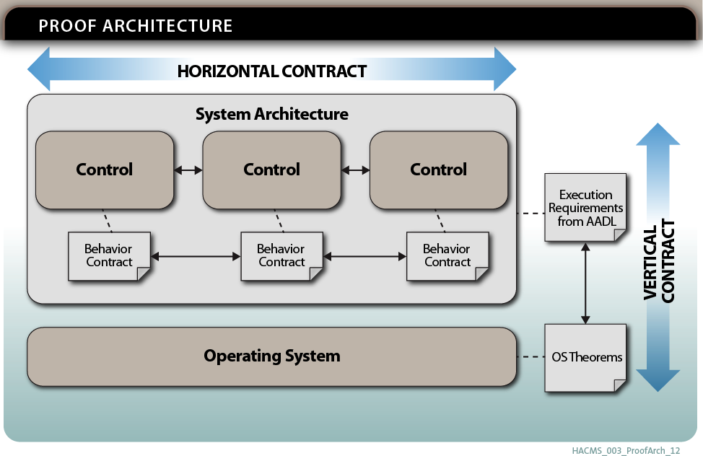
Composition using contracts
Compositional verification
Verified
EDSL
components
Verified microkernel

Slide 8
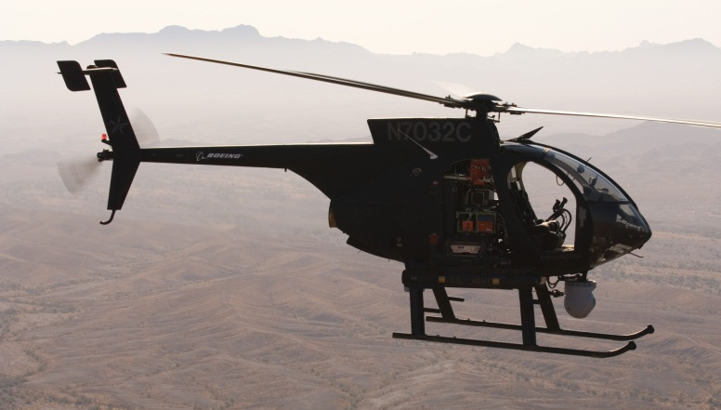

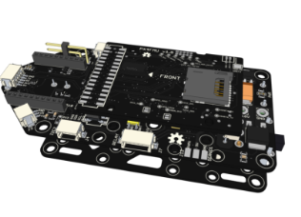
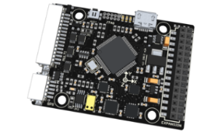
Air Team Platforms
AR.DRONE QUADCOPTER
(RESEARCH VEHICLE)
/* The STM32F405 has 1024Kb of FLASH beginning at address 0x0800:0000 and
* 192Kb of SRAM. SRAM is split up into three blocks:
*
* 1) 112Kb of SRAM beginning at address 0x2000:0000
* 2) 16Kb of SRAM beginning at address 0x2001:c000
* 3) 64Kb of TCM SRAM beginning at address 0x1000:0000
*
* When booting from FLASH, FLASH memory is aliased to address 0x0000:0000
* where the code expects to begin execution by jumping to the entry point in
* the 0x0800:0000 address range.
*
* HWF4: In the original linker script, the first 0x4000 of flash was
* reserved for the bootloader. For now, we'll place the application
* at the start of flash until we start using a boot loader again.
*/
MEMORY
{
/* flash (rx) : ORIGIN = 0x08004000, LENGTH = 1008K */
flash (rx) : ORIGIN = 0x08000000, LENGTH = 1024K
sram (rwx) : ORIGIN = 0x20000000, LENGTH = 128K
ccsram (rwx) : ORIGIN = 0x10000000, LENGTH = 64K
}
/* Top of the user mode stack. */
_estack = 0x20020000; /* top of 128KiB of SRAM */
/* Error in the linker if heap and stack don't fit. */
_min_heap_size = 0;
_min_stack_size = 0x400;
OUTPUT_ARCH(arm)
ENTRY(Reset_Handler)
/*
* Ensure that abort() is present in the final object. The exception handling
* code pulled in by libgcc.a requires it (and that code cannot be easily avoided).
*/
/* EXTERN(abort) */
BOEING UNMANNED LITTLE BIRD (AH-6)
NEW ELECTRONICS TO HOST PROVABLY SECURE SOFTWARE

Slide 9
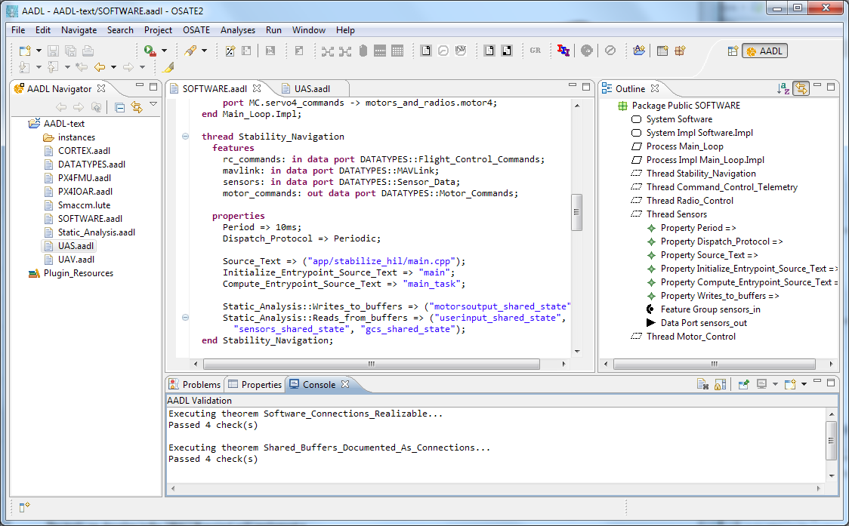


Formal Methods Workbench
Security vulnerabilities arise at interfaces
Resolute
OSATE
AGREE
Trusted
Build
Lute
Architecture Models
Architecture Translation
Architecture Analysis
A
C
Assumption: Input < 20
Guarantee: Output < 2*Input
Assumption: none
Guarantee: Output = Input1 + Input2
B
CAmkES
seL4
Assumption: Input < 20
Guarantee: Output < Input + 15
Assumption: Input < 10
Guarantee: Output < 50
B-RTOS

Slide 10
Objectives
Protect high-assurance embedded systems against cyber attack
Use architectural modeling, compositional analysis, and formal methods tools to verify important safety and security properties
Reduce software integration costs through early detection and elimination of errors
Develop technology solutions that are transferrable to other commercial and military platforms

