Slide 1

Designing Decision-Support Systems for Air Traffic Flow Management: A Cyber-Physical Systems Challenge
Sandip Roy
Presentation at the 2012 CPS Grantee’s Conference, October 4th, 2012.

Slide 2
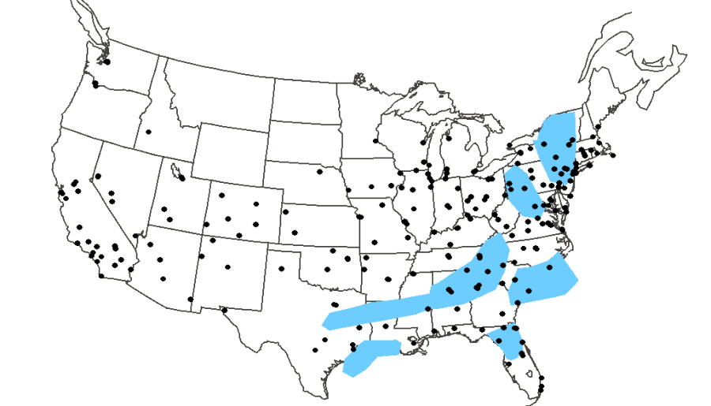
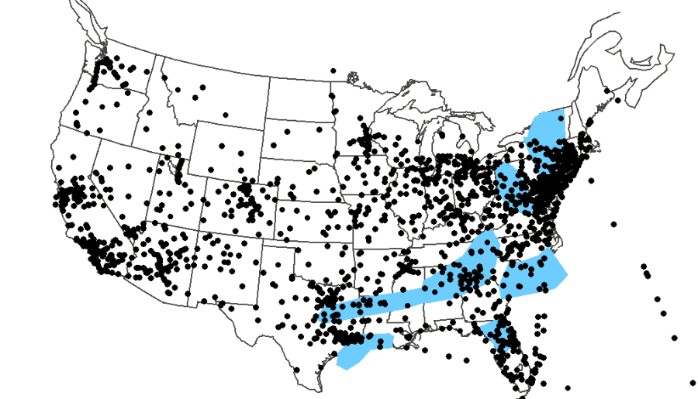
Background
Air traffic flow management shapes traffic flows to meet capacities – hopefully, efficiently.
  Terminal-area and en-route traffic are capacitated.
  Capacities are largely determined by humans’ ability to maintain safe (collision-free) operation; they’re weather dependent.
TFM has grown up with the National Airspace System (NAS).
  Needed more and more frequently
  Must be coordinated over longer time horizons and larger spatial scales
  Benefits from a range of technological advances – in radar, communications, computing, decision-support.
More
Growing
Pains:
3X traffic=
10X delay
(Sheth and
Sridhar)

Slide 3
Strategic Traffic Flow Management: Need for Decision-Support
NAS-wide management at a 2-24 hr horizon is still largely manual.
  Telecon involving ATCSCC, Centers, airlines.
  Stakeholders have limited info.
  Decisions are experience driven.
This strategic problem is becoming 1) more important and 2) harder.
  Growing densities and TFM costs
  Increased heterogeneity (in traffic, TMIs, constraints/adversaries).
  Lower profit margins.
Tools are needed to inform and guide stakeholders.
Command Center (ATCSCC)
((see FAA
documents)
Airlines
ARTCC N
ARTCC 1

Slide 4
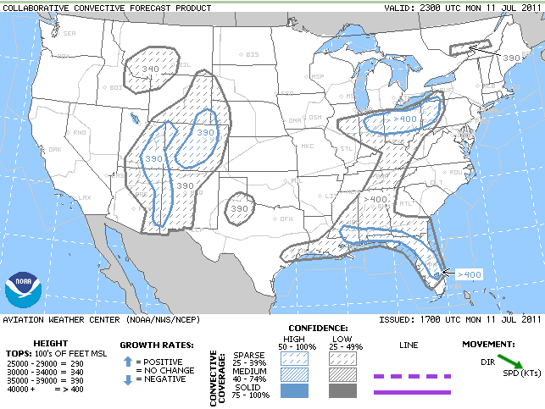
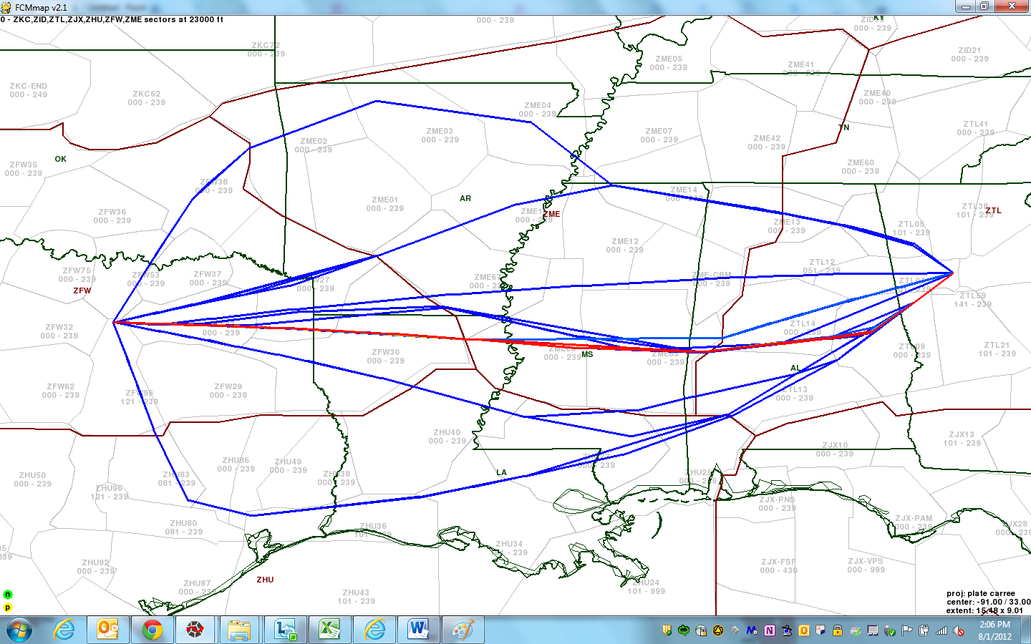
STFM Decision-Support: Goals and Challenges
Goal - Give stakeholders:
  High-level contingency plans for imposing TMIs across the NAS throughout the day
  A priori statistical characterizations of plan performance
Key Challenges:
  Weather-impact and demand uncertainty;
  Complex networked interactions of traffic, weather, and management
  Constraints…

Slide 5
Is This a CPS Problem?
I think so…
STFM requires understanding and leveraging deeply-integrated cyber-and physical components.
  Traffic flow and weather (physical), communication and decision-making (cyber-), human players (both?).
STFM also requires integration of methodologies from diverse domains: weather forecasting, operations research, control theory, nonlinear systems, sleep/fatigue sciences, visualization, etc.

Slide 6
Toward a Solution: Research Highlights
Several R&D efforts are underway, to develop decision-support tools for STFM.
  Involve governmental, industry, and university partners.
I would like to highlight outcomes from my projects which show “CPS-ness”.
  Focus on a Flow-Contingency-Management (FCM) solution being developed by the MITRE Corporation, involving WSU and UNT.
    Key idea: build contingencies based on weather-impact scenarios.
  Some farther-sighted outcomes.

Slide 7
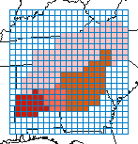
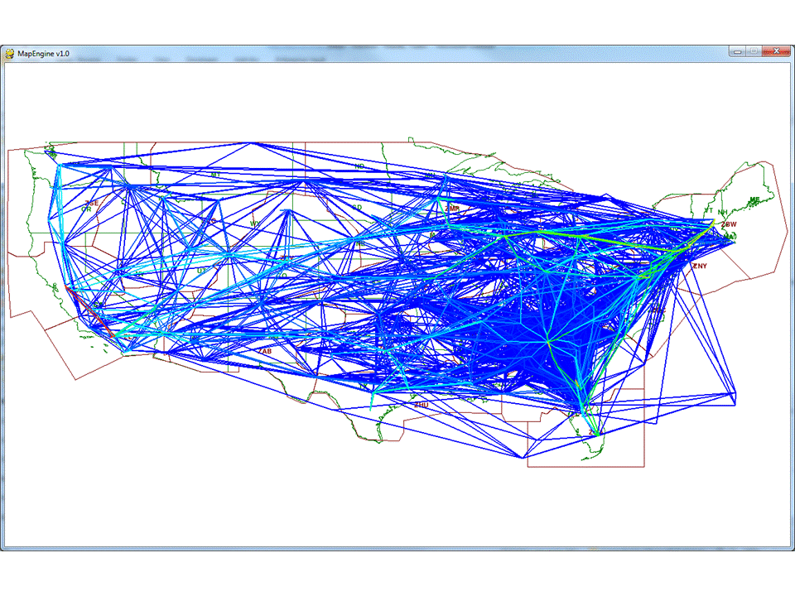
Research Highlight: The FCM Solution
Weather forecast shows potential for adverse impact
Translate probabilistic weather models into potential air traffic impact scenarios
Simulation computes impact
(SREF
forecast)
Interface enables what-if scenario generation for plans and provides quantitative feedback on impact due to weather and flow actions
Interface provides details of impact for resources of interest
Delays by Sector
Delays by Sector
Weather Induced
ZTL34
Delays by Airport
ZTL10
ZTL22
ZTL20
ZTL34
ZTL34
ZTL10
ZTL20
Contingency Plan
ZTL22
ZTL10
ZTL22
ZTL20
(see Taylor et al)
Notes:
(Describe each stage briefly)
The focus of this paper is on the traffic simulation model, and more specifically, on how traffic demand, an input to this model, is characterized at the time the prediction is made and the simulation is run. Note that resource capacity estimates are also needed, and this is addressed in other papers we have published on this concept.

Slide 8
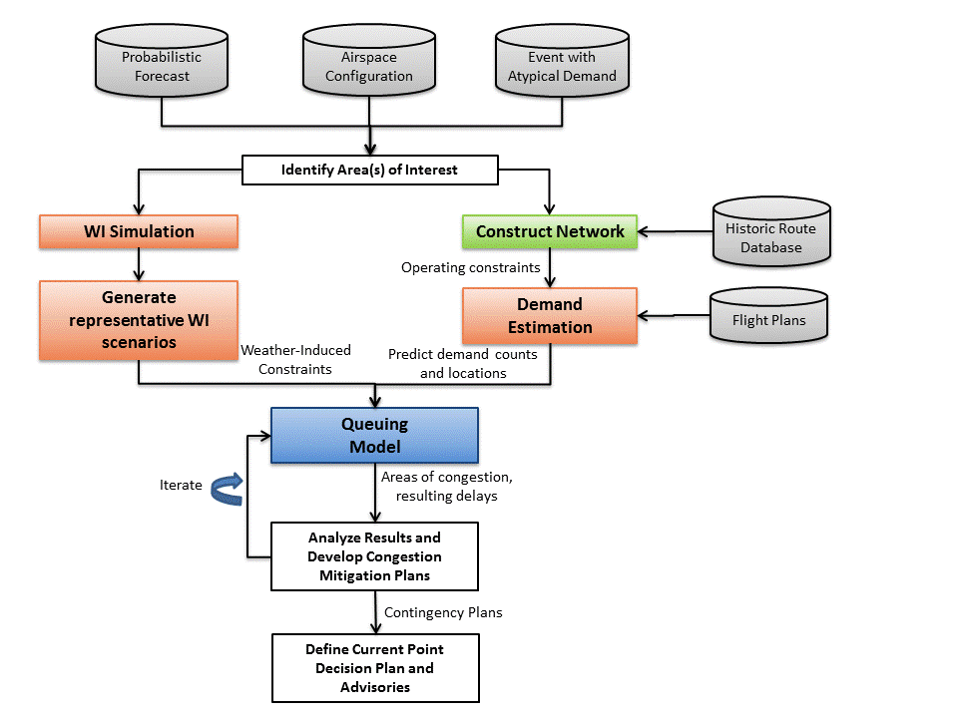
FCM: Solution Components
(see Taylor, Wanke, Wan,
and Roy, 2011-2012).

Slide 9
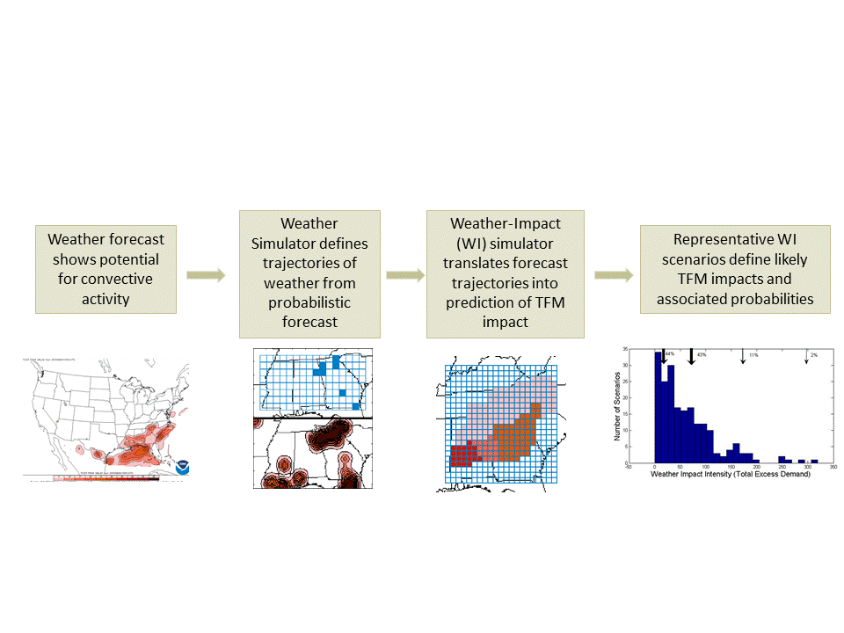
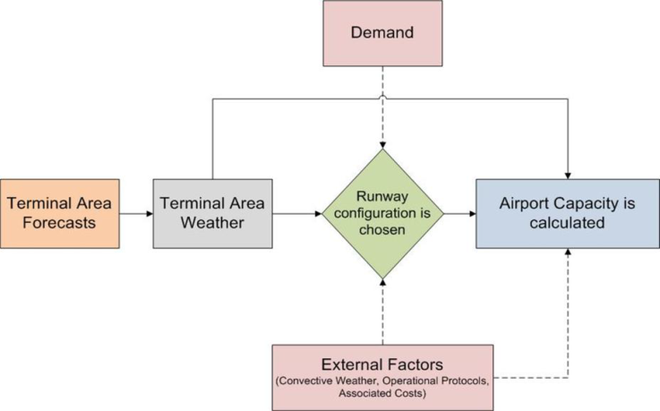
FCM : Weather-Impact and Demand Modeling

Slide 10
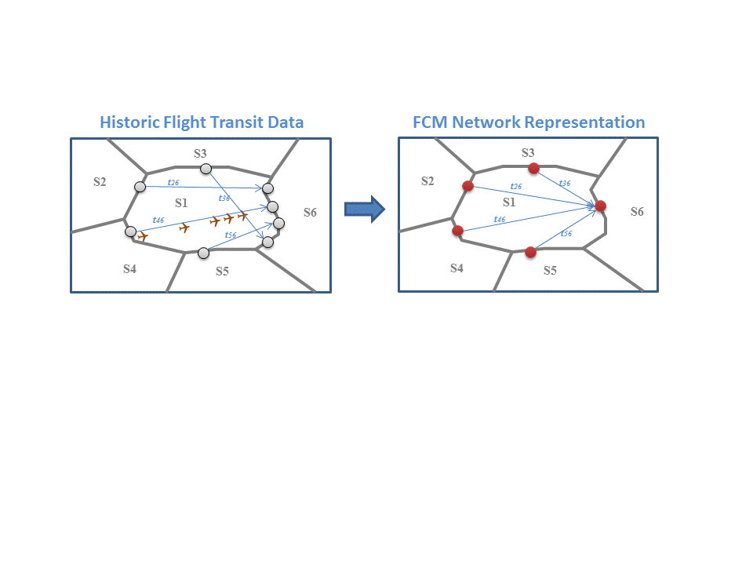
FCM: Network Definition and Queueing-Model Engine

Slide 11
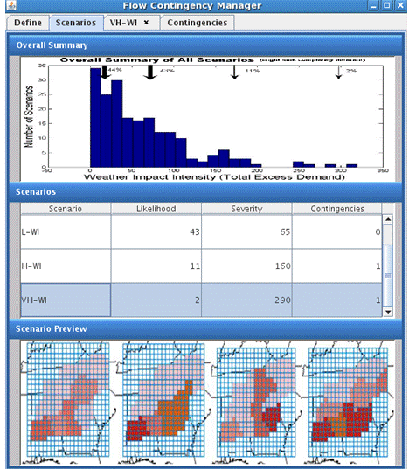
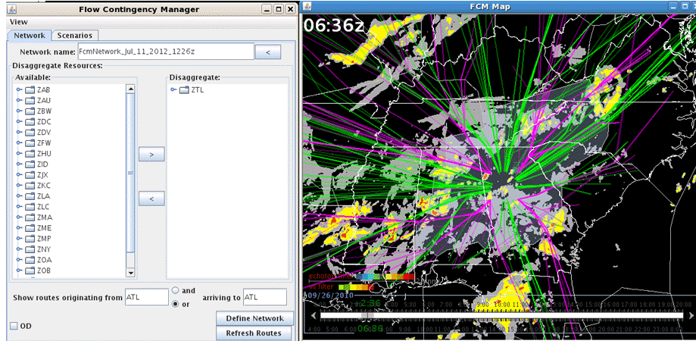
FCM Outcomes: Simulation Interface

Slide 12
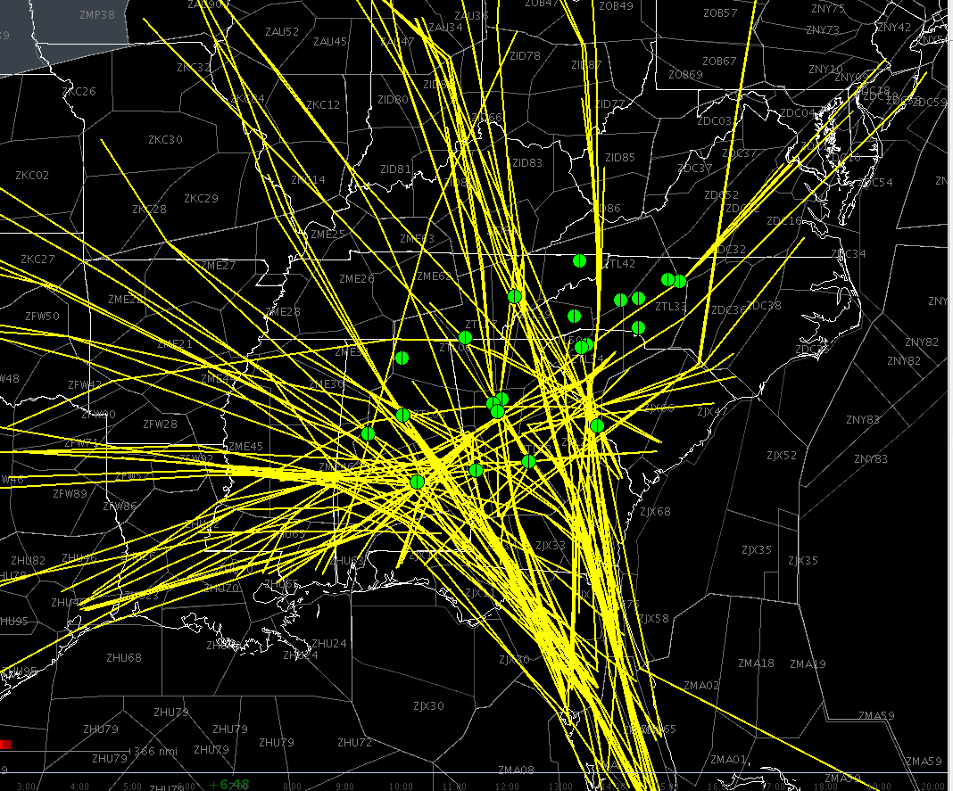
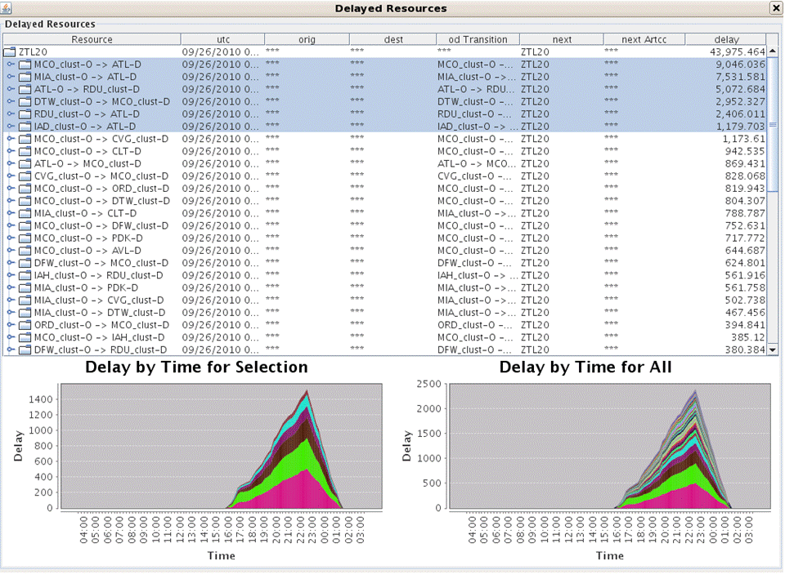
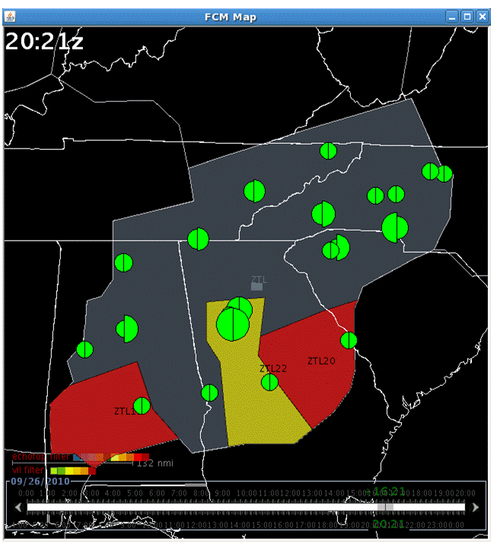
FCM Outcomes: Plan Evaluation Using the Simulation Interface

Slide 13
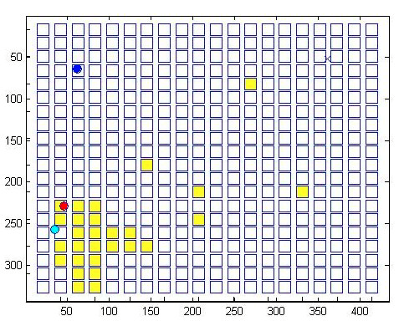
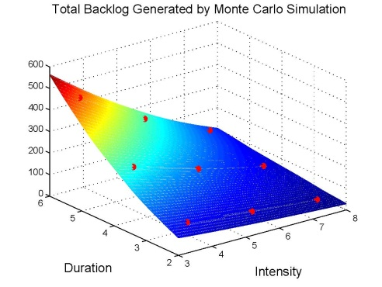
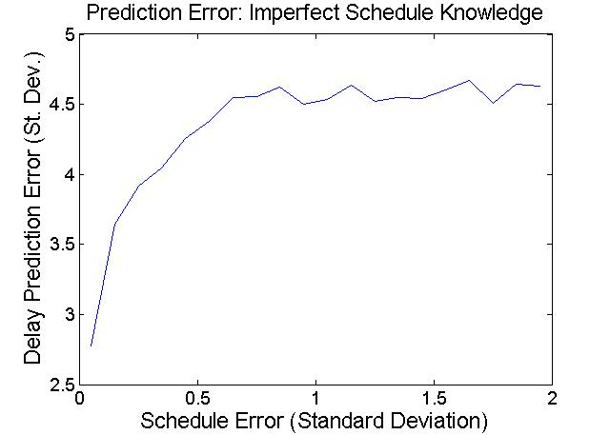
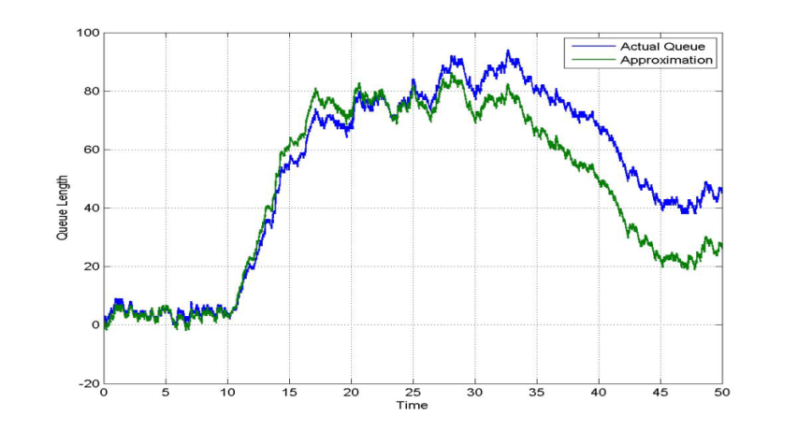
Further Outcomes: Toward Design and Implementation
Integrating UAS
Smart simulation approaches
Role of schedule knowledge
Meshed weather/traffic analysis: moment-linear approximations
(Wan et al; Xue et al; Landowski et al.)

Slide 14
A Diverse Underlying Science…
Decision-support solutions for STFM require cutting-edge techniques at the interface of computing, engineering, and science.
We have needed:
  Core domain expertise in air transportation
  Stochastic automata and queueing models
  Network science (and specifically network design) concepts
  Control Theory
  Operations-research ideas
  Sleep and fatigue science
  Jump-linear models
  Smart simulation techniques
This diversity of techniques is a perhaps a hallmark of a CPS.

Slide 15
Birds with Many-Colored Feathers?
Similar strategic decision-making problems arise in e.g. power-grid control, disease management, data-center design, etc.
These systems are vastly different, and domain expertise is critical to obtaining useful decision-support tools.
Yet, perhaps we will learn something fundamental by understanding commonalities – I believe that CPS can permit this cross-fertilization.

Slide 16
Acknowledgements
The Flow Contingency Management Team: effort led by Christine Taylor (Mitre Corporation), Yan Wan (University of North Texas), and Craig Wanke (Mitre); many others involved.
Our CPS Team: Yan Wan (UNT), Dengfeng Sun (Purdue).
Collaborators at NASA: Banavar Sridhar, Shon Grabbe, and others.
My amazing students: Mengran Xue, Rahul Dhal, William Landowski
We are grateful for financial support from NSF (CNS 1035369), FAA/Mitre, and NASA (NNA06CN26A).

