Slide 1





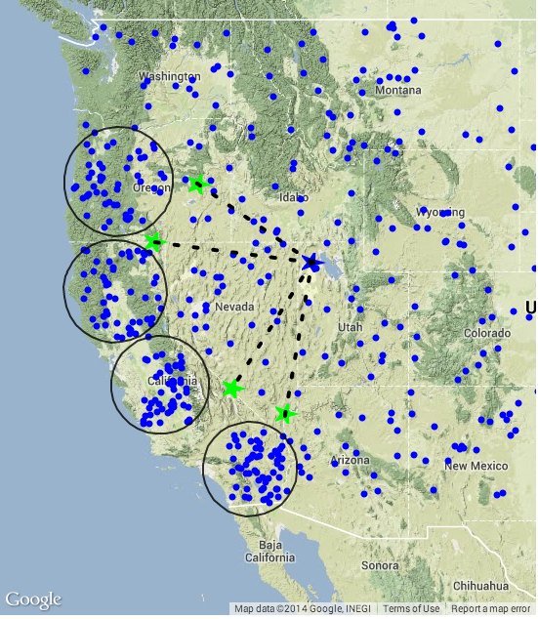
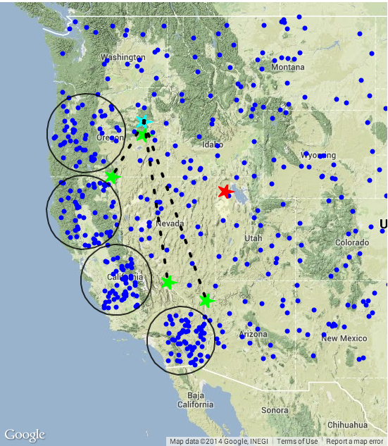
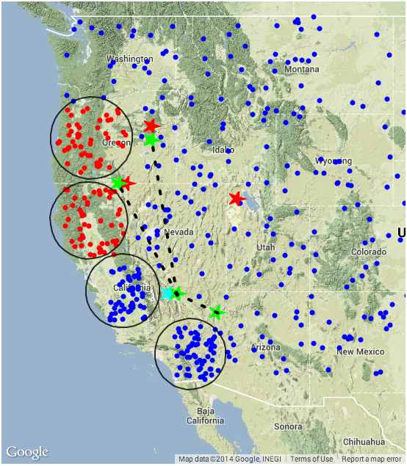
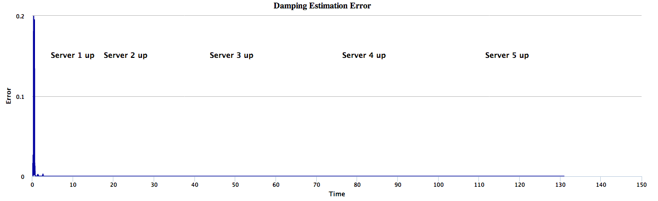
Distributed Asynchronous Algorithms & Software Systems For Wide-Area Monitoring of Power Systems
Aranya Chakrabortty*, Frank Mueller*, Rakesh Bobba⁺, Nitin Vaidya⁺ and Yufeng Xin⁺⁺
* North Carolina State University, ⁺University of Illinois Urbana Champaign, and ⁺⁺RENCI, University of North Carolina
Project Goal
Distributed Oscillation Monitoring
Distributed Middleware
To translate current state-of-art centralized processing algorithms for wide-area monitoring of large power grids using large volumes of Synchrophasor data to a completely distributed cyber-physical architecture.
Problem statement: Compute power flow oscillation frequencies (eigenvalues), mode shapes (eigenvectors), damping, and residue from PMU measurements using distributed algorithms implemented via DRCP and DLAP.
Power System Dynamic Model
Problem statement: Develop distributed middleware to support DRCP and DLAP algorithms for oscillation monitoring and transient stability.
Store recent PMU data
Supply PMU data with predictable delays
Idea: Real-time distributed storage (RT-DHT) utilizes
- Fault-tolerant network overlays
- Chord-like ring + finger pointers
- Multiple replicas of data → faults OK
- Prioritized requests→ urgent algorithm served first
- Deterministic wide-area networks
Infrastructure
- Cloud computing
- Software Defined Networks (SDN)
Experiments: BEN, Exo-GENI, and GENI
PMU
PMU
Intellectual Merits:
Distributed oscillation monitoring
Distributed voltage
monitoring
3. Distributed middleware
4. Fault-tolerance
Experimental verification using
Exo-GENI network
6. Real-time testing of QoS
and cyber-security
PMU
PMU
Distributed LS problem
PMU
PMU
Fault-Tolerance & Cyber-Security
Two types of consensus algorithms in the presence of faults. These algorithms are useful for coordinating agents in a distributed manner:
- Iterative approximate consensus under
Byzantine link faults
- Iterative convex hull consensus under crash and
Byzantine node faults
Evaluation of the impact of Byzantine failures
on ADMM, and exploration of potential
mitigation mechanisms
Technical Approach
New Algorithms and Results using ADMM
Area 1
Area 3
Proposed Distributed Cyber-Physical Architecture for PMU-PDC Communication:
1: Update both primal and dual estimation variables at every local control center:
2: Gather the values of at the central ISO
3: Take the average of at the central ISO
4: Broadcast the average to local control centers and iterate to Step 1
θ₁₁(t)
PMU
θ₁₂(t)
θ₃₁(t)
PMU
θ₃₂(t)
Area 1
Area 3
PDC 1
Central PDC
at ISO
PDC 3
θ₁₁(t)
PMU
θ₁₂(t)
θ₃₁(t)
PMU
θ₃₂(t)
Dynamic Rate Control Problem (DRCP):
- Find optimal PMU data exporting rates, and frequency of information exchange between local PDCs and inter-regional PDCs to minimize computation error between centralized and distributed estimation
PDC 2
PDC 4
PDC 1
Central PDC
at ISO
PDC 3
θ₂₁(t)
PMU
θ₂₂(t)
θ₄₁(t)
PMU
θ₄₂(t)
PDC 2
PDC 4
Area 2
Area 4
θ₂₁(t)
θ₂₂(t)
θ₄₁(t)
θ₄₂(t)
Hacked
PMU
PMU
Experimental Testbed
Area 2
Area 4
Area 1
Area 3
PMU
θ₁₂(t)
PMU
Participated in Smart America Challenge 2014 Initiative of NIST and US White House
Federated BEN-WAMS: Multi-vendor PMU-based hardware-in-loop simulation testbed at NCSU and DETERLab at Uniiv. of Southern California to showcase resiliency of ADMM based wide-area oscillation monitoring
θ₁₁(t)
PDC 1
θ₃₁(t)
PDC 3
θ₃₂(t)
PDC 2
Communication
Graph G
PDC 4
Dynamic Link Assignment Problem (DLAP):
- Find optimal communication topologies in real-time connecting local and inter-regional PDCs to maximize computational speed for the overall global estimation/monitoring/control problem.
θ₂₁(t)
PMU
θ₂₂(t)
θ₄₁(t)
PMU
θ₄₂(t)
Area 2
Area 1
Area 4
PMU
PMU
PMU
Area 3
PMU
θ_{11a}(t)
PDC 1a
θ_{21a}(t)
θ_{11b}(t)
PDC 1b
θ_{21b}(t)
θ_{13a} (t)
PDC 3a
θ_{23a} (t)
θ_{13b} (t)
PDC 3b
θ_{23b} (t)
Broader Impacts
θ_{11c}(t)
PDC 1c
PDC 3c
θ_{13c}(t)
Smart America Challenge 2014 and US Ignite 2014 demos
Undergraduate, K-12 and minority education via Science House and FREEDM ERC programs at NC State
Undergraduate summer internship at Information Trust Institute at UIUC
Industry collaborations with power utilities and vendors such as SCE
θ_{21c}(t)
Central PDC
at ISO
θ_{23c} (t)
θ_{22b}(t)
PMU
θ_{12c}(t)
PMU
PDC 4c
θ_{14c}(t)
θ_{22c}(t)
θ_{22a}(t)
θ_{12a}(t)
θ_{24c}(t)
PDC 2b
θ_{12b}(t)
PDC 2a
PDC 4a
PDC 4b
PDC 2c
θ_{24a} (t)
PMU
θ_{14a}(t)
θ_{14b} (t)
PMU
θ_{24b} (t)
Area 2
Area 4

