Slide 1


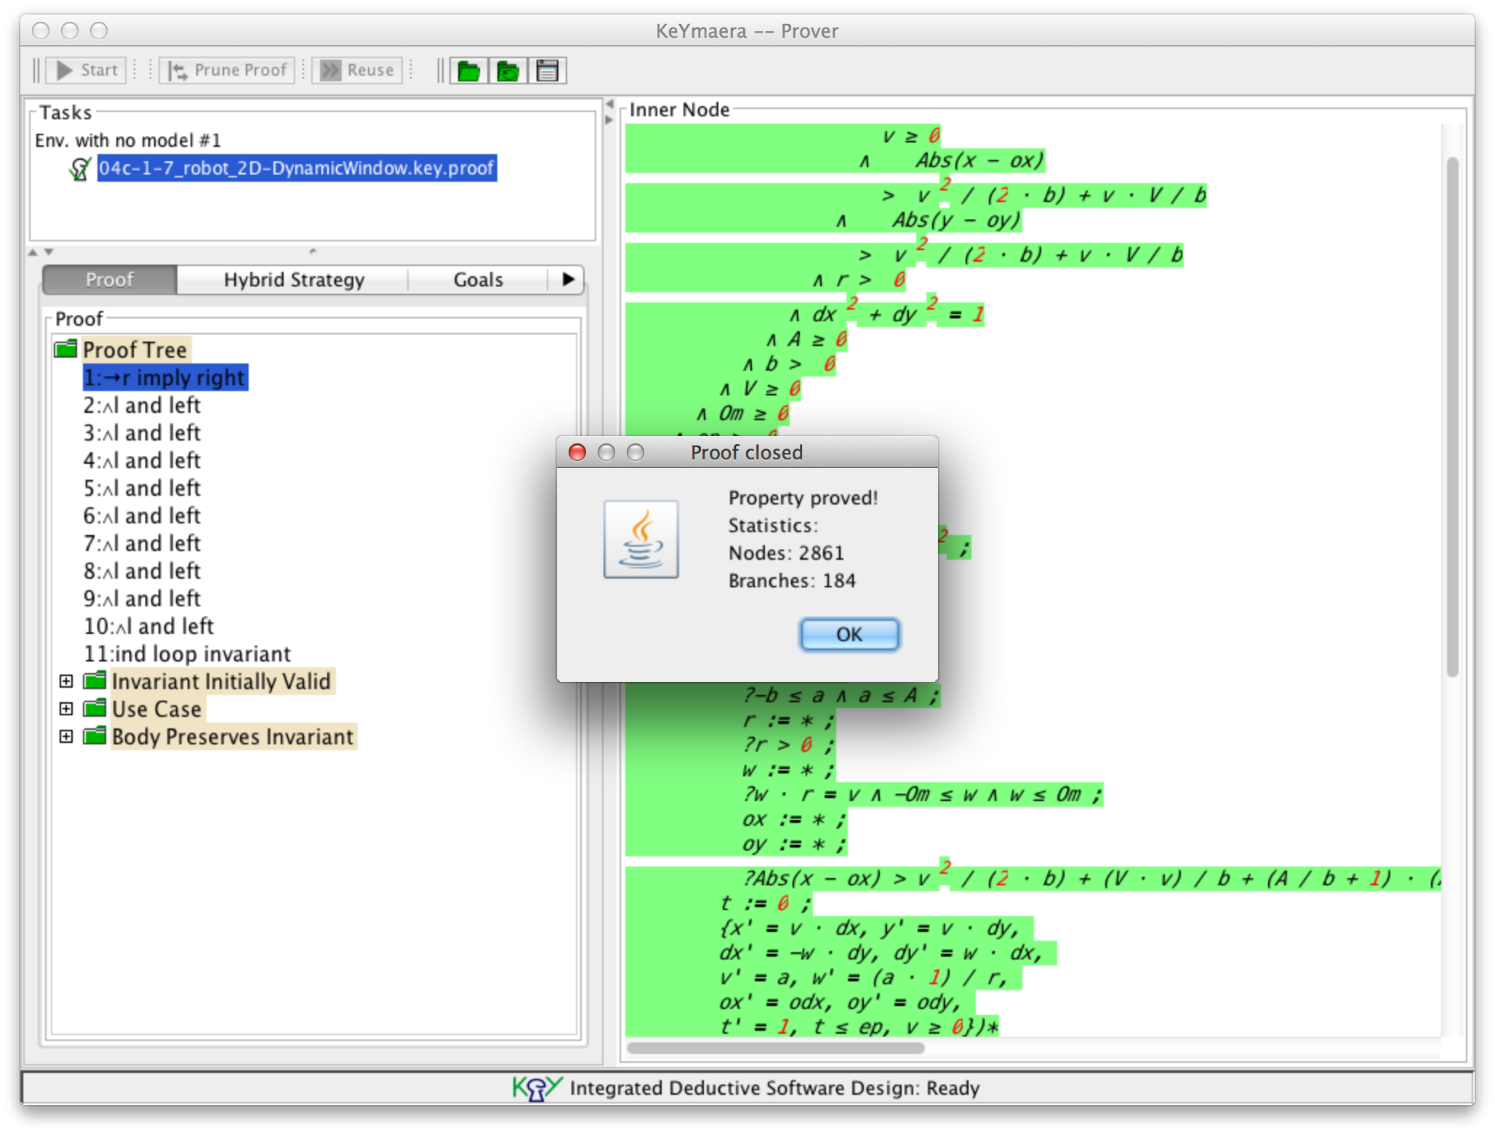
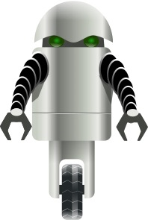


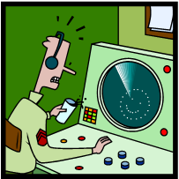
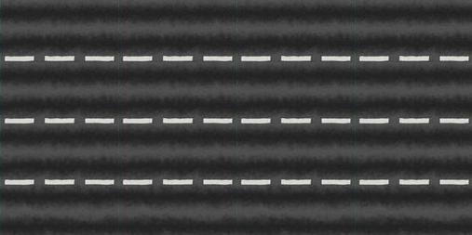


Distributed Hybrid Systems
Compositionality and Reconfiguration for Distributed Hybrid Systems
André Platzer, Edmund Clarke, Khalil Ghorbal, Stefan Mitsch, Sarah Loos, and Jan-David Quesel
Computer Science Department, Carnegie Mellon University
CASE STUDIES
Factory Automation
Adaptive Cruise Control, Road Traffic Control [6,7]: Car safety measures can be most effective when the cars on a street coordinate their control actions to minimize the risk of safety hazards and collisions. We verify that the control models guarantee collision freedom for arbitrarily many cars on a street, even if new cars enter from on-ramps or multi-lane streets.
KeYmaera implements proof strategies that decompose hybrid systems symbolically and prove the full system by proving properties of its parts.
Aircraft Controllers [1]: As airspace becomes ever more crowded, air traffic management must reduce both space and time between aircraft to increase throughput, making on-board collision avoidance systems ever more important. We prove the collision avoidance systems never allow
Aircraft Big Disc Protocol
METHOD
Automotive, aircraft, railway, and mobile and surgical robotics controllers are hybrid systems, which we model and verify using differential dynamic logic (dL) [8].
Factory Automation [4]: Modern factory grounds with many different autonomously operating agents are difficult to design. Already in the early design stages the question arises whether a single agent may operator safely given all the possible behavior of the other agents. We developed a methodology to formalize and deal with these questions and considered a factory automation scenario where a robot has to meet certain requirements while avoiding crashes.
Hybrid Programs
aircraft to get too close to one another, even when new planes approach an in-progress avoidance maneuver.
Sφnx [10] is our model-based design tool for hybrid systems. It provides a graphical and textual editor for differential dynamic logic. Sφnx links to KeYmaera, exchanges models and full or partial proofs, and supports C code generation.
Aircraft Small Discs Protocol
HOW CAN I APPLY THE METHODS?
Robot Obstacle Avoidance: Passive Safety
Some rules of our Gentzen-style proof calculus are shown below.
The systems are modeled in a program notation called hybrid programs. Properties are specified as differential dynamic logic formulas.
KeYmaera provides:
Automatic proof search strategy
Heuristics for automatic invariant generation
Can be guided by the user for complex cases
KeYmaera can deal with
Hybrid systems and hybrid games
Non-linear dynamics
Differential inequalities
Distributed Hybrid Systems
Train Control [2]: We prove that the European Train Control System protocol remains correct even in the presence of perturbation by disturbances and when a PI controlled speed supervision is used.
Robot Obstacle Avoidance [5]: Nowadays, robots interact frequently with a dynamic environment outside limited manufacturing sites and in close proximity with humans. Thus, safety of motion and obstacle avoidance are vital safety features of such robots. We formally verify that our controller avoids both stationary and moving obstacles.
Hybrid Dynamics
REFERENCES
[1] Sarah M. Loos, David W. Renshaw and André Platzer. Formal Verification of Distributed Aircraft Controllers. In Calin Belta and Franjo Ivancic, editors, HSCC 2013.
[2] André Platzer and Jan-David Quesel. European Train Control System: A case study in formal verification. In Karin Breitman and Ana Cavalcanti, editors, ICFEM 2009.
[3] Yanni Kouskoulas, David W. Renshaw, André Platzer and Peter Kazanzides. Certifying the safe design of a virtual fixture control algorithm for a surgical robot. In Calin Belta and Franjo Ivancic, editors, HSCC 2013.
[4] Jan-David Quesel and André Platzer. Playing hybrid games with KeYmaera. In Bernhard Gramlich, Dale Miller, and Ulrike Sattler, editors, IJCAR 2012.
[5] Stefan Mitsch, Khalil Ghorbal and André Platzer. On Provably Safe Obstacle Avoidance for Autonomus Robotic Ground Vehicles. In RSS 2013.
[6] Sarah M. Loos, André Platzer and Ligia Nistor. Adaptive cruise control: Hybrid, distributed, and now formally verified. In Michael Butler and Wolfram Schulte, editors, FM 2011.
[7] Stefan Mitsch, Sarah M. Loos and André Platzer. Towards formal verification of freeway traffic control. In Chenyang Lu, ICCPS 2012.
[8] André Platzer. Differential dynamic logic. J. Autom. Reasoning 41(2), 2008.
[9] André Platzer and Jan-David Quesel. KeYmaera: A hybrid theorem prover for hybrid systems. In Alessandro Armando, Peter Baumgartner and Gilles Dowek, IJCAR 2008.
[10] Stefan Mitsch, Grant O. Passmore and André Platzer. A Vision of Collaborative Verification-Driven Engineering of Hybrid Systems. In Manfred Kerber, Christoph Lange and Colin Rowat, Do-Form 2013.
Adaptive Cruise Control
and Road Traffic Control
TOOLS
KeYmaera [9] is our automated theorem-prover for differential dynamic logic. KeYmaera supports hybrid systems with nonlinear discrete jumps, non-linear differential equations, differential-algebraic equations, differential inequalities, and systems with nondeter-ministic discrete or continuous input.
Robotic Surgery [3]: Analyzing a control algorithm that provides directional force feedback for surgical robots we found two bugs. We then developed a new algorithm that provides safe operation along with directional force feedback. We then proved that this algorithm is correct.

