Slide 1
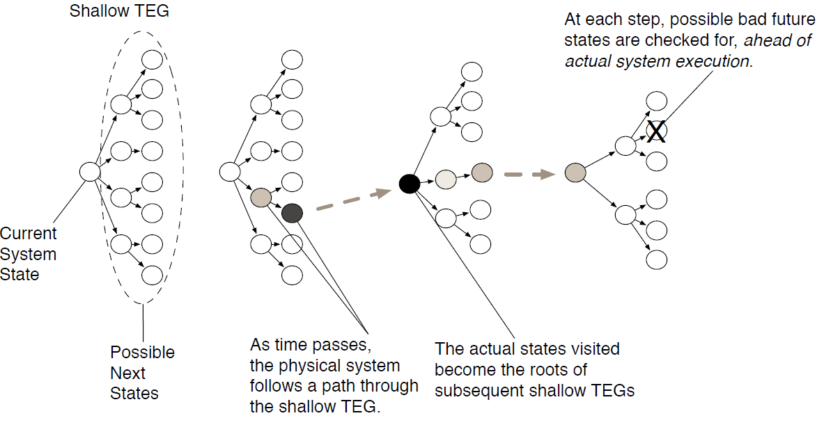
Distributed Just-Ahead-Of-Time Verification of Cyber-Physical Critical Infrastructures
Rutgers University, University of Illinois
Core Project Objectives and Benefits
Cyber-Physical Verifier (CPV)
Intercept binary executable of microcontroller machine codes
Translate to intermediate level language
Goal: Analyze controller code and system state on a near-minimal trusted computing base (TCB) to prevent controllers from taking actions that lead to safety or reliability violations in power grid infrastructures
Use the current controller execution and physical state to explore security threats against CP infrastructures
Combine formal verification with predictive situational awareness
Verify whether controllers will allow any unsafe operation
Analyze device-level code and criteria about what constitutes “safe” operation
Project Overview
Create a formal model of minimal size and complexity
Prune model based on execution state
Temporal Execution Graph (TEG) model
NP-View
Model Estimation, State Estimation, and Impact Analysis
How does knowledge of the power system improve enforcement of safety and security?
Make power model a part of the security model
Use distributed sensor data to construct a model
Computations using a minimal TCB
Improve CP situational awareness
Use run-time data from sensors to help prune the TEG
“X just happened”
Reduce complexity based on state
Determine what constitutes safe operation and integrate into controller analysis
“Do not allow any PLC to take an action that would overload lines 1 through 30”
Check properties using reduced system
Developing the foundations of theoretical modeling, synthesis and real-world deployment of a formal and scalable controller code verifier for programmable logic controllers (PLCs) in cyber-physical settings.
Protecting infrastructures against malicious control injection attacks on PLCs, such as Stuxnet, that inject malicious code on the device to drive the underlying physical platform to an unsafe state.
Using distributed just-ahead-of-time analysis of controller code and power systems analysis to verify safety and security properties.
Tie line
V,θ
V,θ
Tie line
V,θ
Power system study area reduced model
Rutgers University • University of Illinois
Award Number: CNS-1446229
Notes:
Add picture of full system before the model estimation picture
Edit source of figure on top right to crop out the black lines

