Slide 1
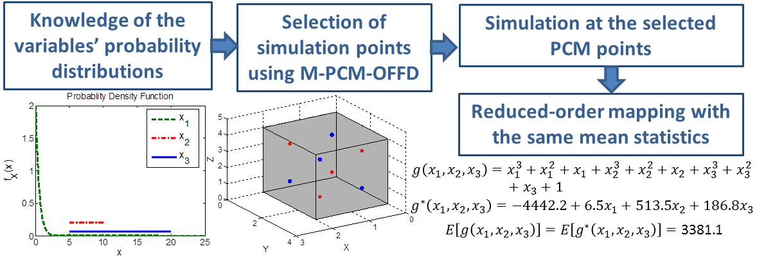
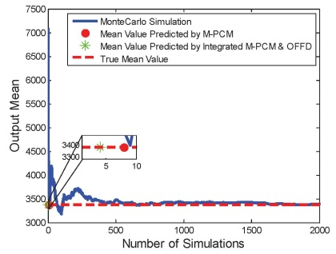
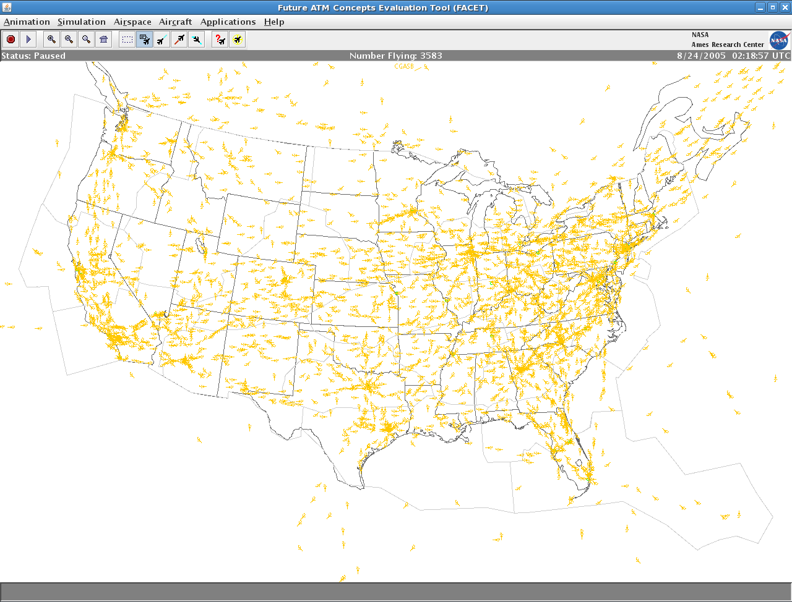
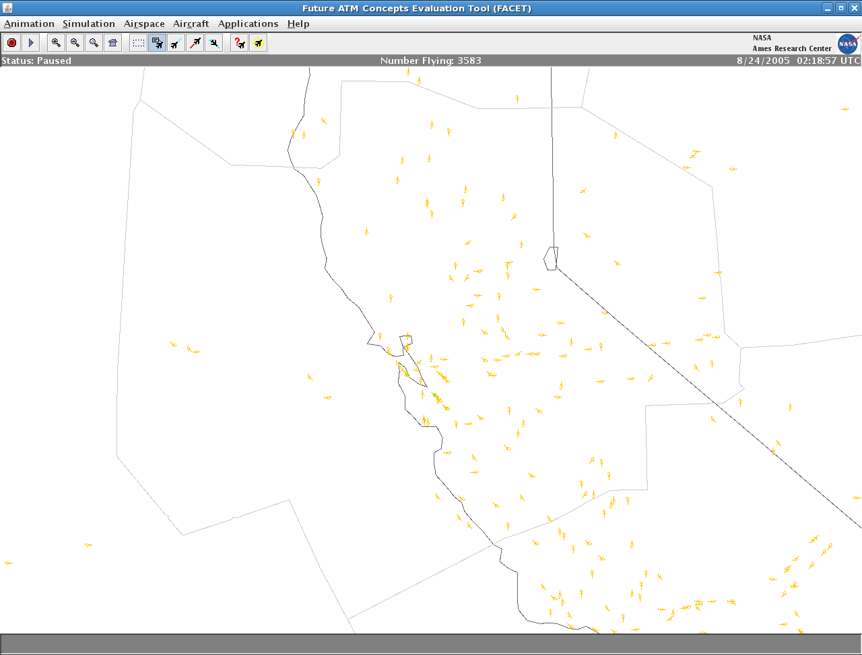
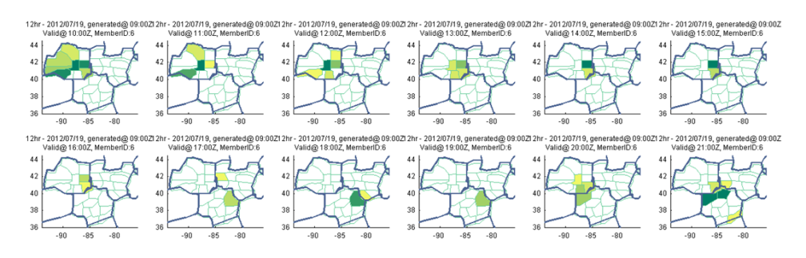
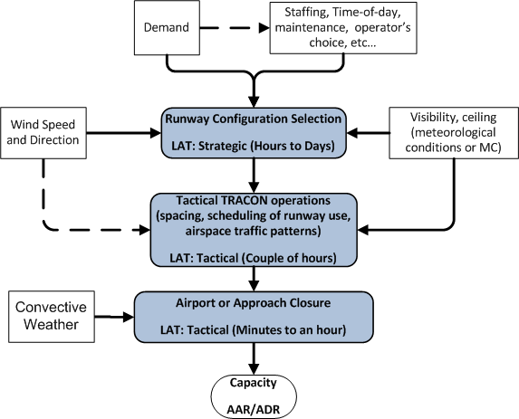
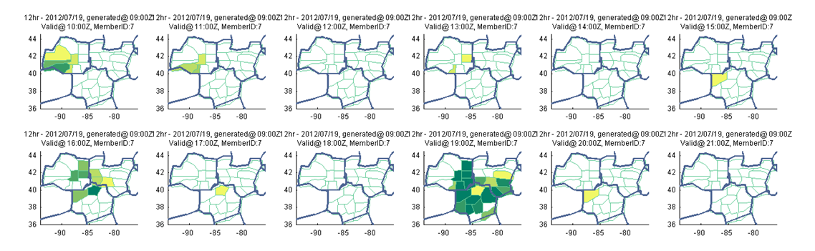
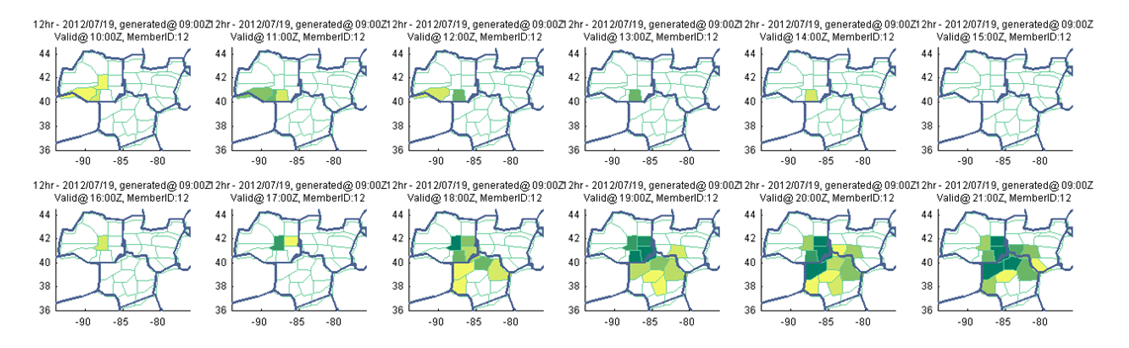
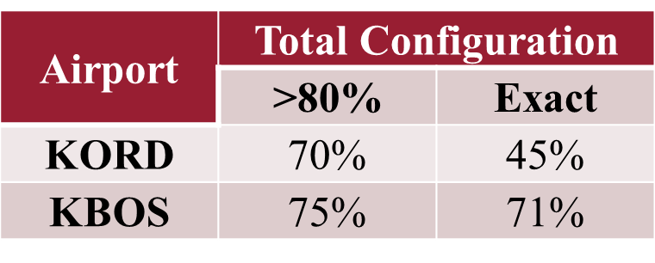
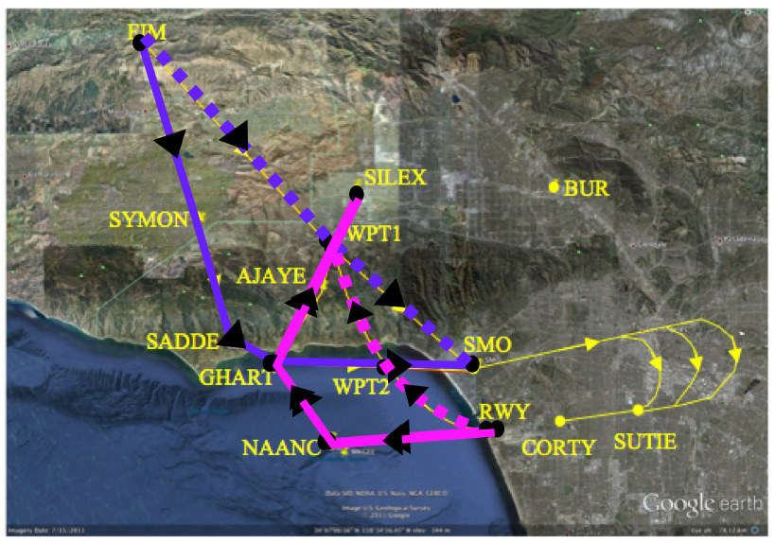
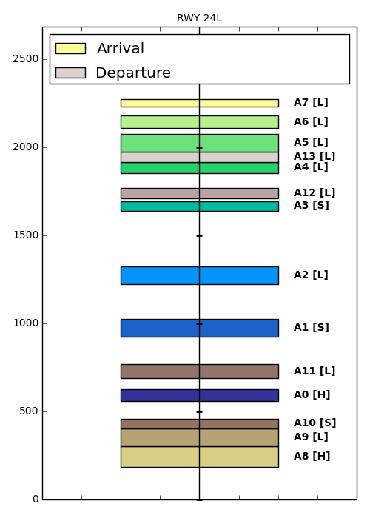
Dynamical-Network Evaluation and Design Tools for
Strategic-to-Tactical Air Traffic Flow Management
Yan Wan (PI), Electrical Engineering, University of North Texas
Sandip Roy (PI), Electrical Engineering, Washington State University
Dengfeng Sun (PI), Aeronautics and Astronautics Engineering, Purdue University
  Objective
  Develop tools for comprehensive design and optimization of air traffic flow management capabilities at multiple spatial and temporal resolutions: at a national airspace-wide scale and one-day time horizon (strategic time-frame); and at a regional scale (of one or a few Centers) and a two-hour time horizon (tactical time-frame).
  Approach
  Develop a suite of tools for designing complex multi-scale dynamical networks, and in turn to use these tools to comprehensively address the strategic-to-tactical traffic flow management problem. The two directions of intellectual merit in tool development include 1) the meshed modeling/design of flow- and queueing-networks under network topology variation for cyber- and physical- resource allocation, and 2) large-scale network simulation and numerical analysis. This research will yield aggregate modeling, management design, and validation tools for multi-scale dynamical infrastructure networks, and comprehensive solutions for nation-wide strategic-to-tactical traffic flow management using these tools.
  Contributions to NSF CPS Themes
  This research effort is providing both mathematical foundations, and concrete methods and tools, for tractably modeling environmental and physical-world uncertainties using cyber- capabilities. In this scope, the project can broadly permit the tight conjoining of cyber- and physical- resources in designing decision-support capabilities for infrastructure networks. Specifically, multiple core challenges in the study of cyber-physical systems are addressed:
  Our efforts permit the design of cyber- decision-support capabilities that can account for uncertainties in infrastructure-network dynamics
  Our efforts facilitate robust, adaptive decision-making by increasing the cyber-system’s awareness of infrastructure-network dynamics, at a resolution and time-horizon that is apt for decision-making.
  Year 4 Results
Focus and Core Outcomes at Washington State University: In Year 4, the Washington State University group continued research on developing airport capacity and runway configuration models that reflect weather impact. In particular, an operationally-structured model for predicting runway configurations and airport arrival/departure rates over a 24 hour horizon was developed and tested for seven major airports. We also have focused on the underlying network control theory, focusing particularly on characterizing the influence of highly-localized actuation and sensing capabilities. Some outcomes of the airport-capacity modeling work are shown.
Operationally-Structured Airport Weather-Impact Modeling
  Effective and Scalable Uncertainty Evaluation M-PCM-OFFD
  Dynamic Data-driven Approach to Representative Scenario Selection
Strategic TFM: 2-15 hours, NAS wide
Tactical TFM: <2 hours, a semi-standalone partition of the NAS
Smooth
Strategic-to-tactical Transition
1) Stochastic weather modeling
2) Resource allocation plan
3) Partitioning plan
1) Integration of 2 aggregate models
2) Tactical re-rerouting
3) Delay control
Actual Configuration | Predicted, midnight TAF | Predicted, 5:00 AM TAF | Predicted, ASPM Weather
4R|4R,9 | 4R|4R,9 | 4R|4R,9 | 4R|4R,9
4R|4R,9 | 4R|4R,9 | 4R|4R,9 | 4R|4R,9
4R|4R,9 | 4R|4R,9 | 4R|4R,9 | 4R|4R,9
4R|4R,9 | 4R|4R,9 | 4R|4R,9 | 4R|4R,9
4R|4R,9 | 4R|4R,9 | 4R|4R,9 | 4R|4R,9
4R|4R,9 | 4R|4R,9 | 4R|4R,9 | 4R|4R,9
4R|4R,9 | 4R|4R,9 | 4R|4R,9 | 4R|4R,9
4R|4R,9 | 4R|4R,9 | 4R|4R,9 | 4R|4R,9
4R|4R,9 | 4R|4R,9 | 4R|4R,9 | 4R|4R,9
4R|4R,9 | 4L,4R|4L,4R,9 | 4R|4R,9 | 4R|4R,9
4R|4R,9 | 4L,4R|4L,4R,9 | 4R|4R,9 | 4R|4R,9
4R|4R,9 | 4L,4R|4L,4R,9 | 4R|4R,9 | 4R|4R,9
4R|4R,9 | 4L,4R|4L,4R,9 | 4R|4R,9 | 4R|4R,9
4R|4R,9 | 4L,4R|4L,4R,9 | 4R|4R,9 | 4R|4R,9
4R|4R,9 | 4L,4R|4L,4R,9 | 4R|4R,9 | 4R|4R,9
4R|4R,9 | 4L,4R|4L,4R,9 | 4R|4R,9 | 4R|4R,9
4R|4R,9 | 4L,4R|4L,4R,9 | 4R|4R,9 | 4R|4R,9
4R|4R,9 | 4R|4R,9 | 4R|4R,9 | 4R|4R,9
4R|4R,9 | 4R|4R,9 | 4R|4R,9 | 4R|4R,9
4R|4R,9 | 4R|4R,9 | 4R|4R,9 | 4R|4R,9
4R|4R,9 | 4R|4R,9 | 4R|4R,9 | 4R|4R,9
4R|4R,9 | 4R|4R,9 | 4R|4R,9 | 4R|4R,9
4R|4R,9 | 4R|4R,9 | 4R|4R,9 | 4R|4R,9
4R|4R,9 | 4R|4R,9 | 4R|4R,9 | 4R|4R,9
Focus and Core Outcome at Purdue University: At Purdue, a fast decision support algorithm was developed to integrate terminal airspace operations under uncertainty. A multistage stochastic programming approach was chosen to formulate the problem and candidate solutions were obtained by solving sample average approximation problems with finite sample size. A multithreading technique was introduced to handle extensive computations. A proof-of-concept study was performed and evaluated on a model of the northern-western flows of the Los Angeles terminal airspace considering a fleet mix of 14 aircraft. The application of the algorithm shows that flight time savings can be obtained when an hybrid separation method that combines altitude separation rules and temporal controls is used to separated traffic even in the presence of uncertainty. To characterize the results, an uncertainty study was conducted and shows that a compromise between time and computation time can be found with 100 scenarios per stage.
  Focus and Core Outcome at University of North Texas: The UNT group continued to explore optimal management strategy design in the presence of weather uncertainties. Results include:
  An innovative uncertainty evaluation method M-PCM-OFFD that is effective and scalable to address large-scale system applications that typically involve a large number of uncertain parameters. The method breaks the curse of dimensionality for multi-dimensional uncertainty.
  The jump-linear approach toward tractable design of multiple management strategies under uncertainty. Optimization constructs were smartly integrated.
  A dynamic data-driven approach to select representative uncertain weather events for contingency planning. The selection captures the spatiotemporal correlation of data drawn from spatiotemporally evolving dynamic processes.
Model of the Los Angeles terminal airspace
Optimal Schedule Timeline at Runway 24L

