Slide 1


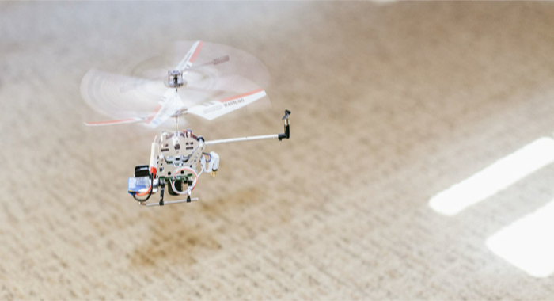
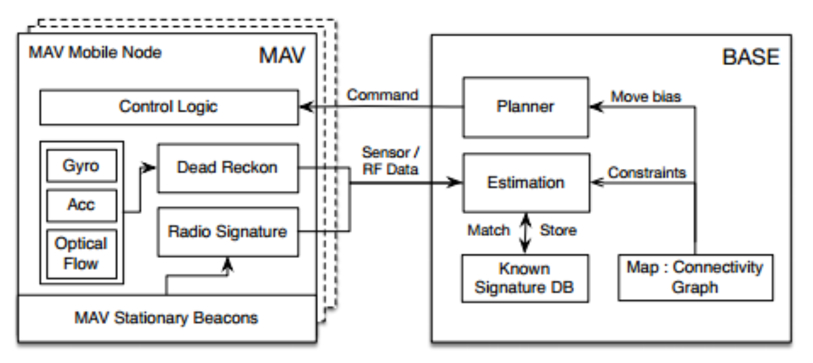
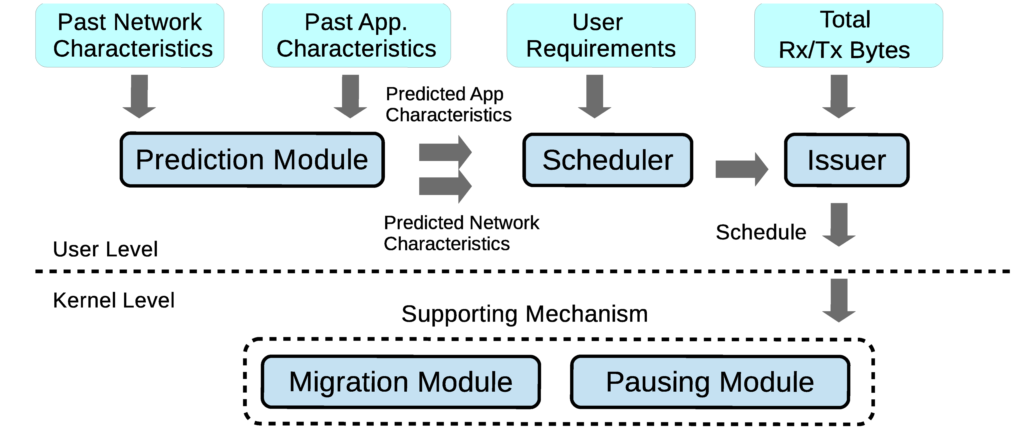
Efficient Mapping and Management of
Applications onto Cyber-Physical Systems
Prof. Margaret Martonosi, Princeton University and Prof. Pei Zhang, Carnegie Mellon University
Motivation
Testbed: Minimalistic Controlled Mobile Sensor
Predictive scheduling for Low-Energy Comms.
Cyber-Physical Systems: Richly heterogeneous devices (mobile devices, home electronics, taxis, robotic drones, etc.) that together gather sensor data, analyze it, and coordinate large-scale actions in response to it.
Challenge: How to program CP Systems?
Test Nodes Adapt to changing environment, reassign task base on node capabilities and localized failures
Hardware testbed for indoor Micro Aerial Vehicles (MAV)
Dynamic coverage estimation: by obtaining in-network relative path signatures, then assign task to multiple nodes to compute signature paths
WiFi
WiFi
  Approaches vary in reliance on workload and environmental predictions, and in degree of delay tolerance.
Greedy:
3G
Data Ready
WiFi
WiFi
Delay-Tolerant Non-Chunking:
Data Ready
WiFi
3G
WiFi
Deadline
Delay-Tolerant Chunking:
Data Ready
Data Ready
3G
Deadline
Delay-Tolerant
MILP-based:
WiFi
WiFi
Prior Approaches
Adaptive Motion Planning and Deployment
Data Ready
Data Ready
3G
Deadline
Simplifications to reduce complexity.
  Assume homogeneous systems
  Program for one particular deployment
Current approach leads to “brittle” systems.
  Deployments with multi-generation devices
  Multiple scenarios with different mobility capabilities
How to meet performance and accuracy goals while managing power and other scarce resources?
How to select which devices to use? From a static or dynamic pool of resources.
How to support dynamic adaptivity within a single deployment? How to support portable operation across different deployments?
Comms Optimization: Android Implementation
Determine deployment/coverage/location status using macro and micro changes in environmental signatures in the system.
Macro: Utilizing landed nodes to determine if the sensor is in new or old areas, to incrementally increase deployment coverage of a building.
Micro: Sensing coverage estimation by obtaining
  1) relative motion path signatures
  2) dead resigning signatures,
  3) similarity between prior signatures.
Dynamic allocate task allocation allow nodes to more efficiently coordinate and predict the current sensing coverage of an area.
  Bias motion to areas of lower coverage (application needs) and higher demand (system needs).
Our Project
Perfect
Prediction
Abstraction layer to allow CPS applications to express application needs
  Coverage and sensing requirements
Device attribute catalog to summarize local nodes and their capabilities
  Sensing capabilities, probability of success, accuracy, etc.
Model, Prediction and Control mobility of nodes
  Different types of motion (people, fixed sensors, robot, etc.)
Effect of
Prediction
Errors
Project Future Work
Select Publications
Integrate motion bias with availability and certainty of location at different areas
Improve co-mapping of the location certainty and physical space.
Simplify testbed deployment setup and use.
A. Purohit, S. Carpin, P. Zhang. Adaptive Planning for Deployment of Micro-Aerial Sensor Swarms. Intl. Workshop on Robotic Sensor Networks, CPSWeek, 2014.
O. B. Yetim and M. Martonosi. Adaptive Delay-Tolerant Scheduling for Efficient Cellular and WiFi Usage. IEEE Intl. Symp. on a World of Wireless Mobile and Multimedia Networks. June, 2014.
A. Purohit, Z. Sun, S. Pan, P. Zhang, “SugarTrail: Indoor Navigation in Retail Environments without Surveys and Maps”, IEEE SECON 2013.
D. Mir, S. Isaacman, R. Caceres, M. Martonosi, and R. Wright. DP-WHERE: Differentially Private Modeling of Human Mobility IEEE BigData, Oct. 2013
Acknowledgments
This work was supported by the National Science Foundation under collaborative grants CPS-1135874 and CPS-1135953.

