Slide 1
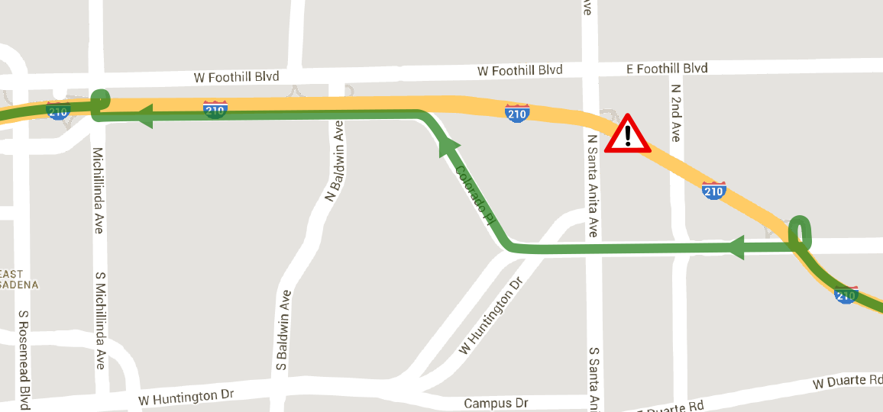
Efficient Traffic Management: A Formal Methods Approach
CPS: Synergy: Collaborative Research:
Murat Arcak (UC Berkeley), Calin Belta (Boston U.), Roberto Horowitz (UC Berkeley)
Overview
Abstraction
Linear Temporal Logic (LTL) for Traffic Management
This project will bring powerful tools from formal methods to traffic management to meet rich control objectives expressed using temporal logic. This approach will be first applied to signal timing and ramp metering strategies for signalized intersections and freeway traffic control. It will then be advanced to integrated control of freeways and arterials with a hierarchical control architecture that is compatible with the infrastructure.
Mixed Monotonicity leads to efficient abstraction:
The one-step reachable set from a box of initial conditions is tightly over-approximated by computing the decomposition function at only two points
Additional structure leads to efficient abstraction:
  Piecewise affine model of freeway flow
  Sparsely interconnected subnetworks
LTL formulae are expressive enough to capture a wide range of control specifications. For example, the following are typical control objectives of traffic networks that are expressible succinctly as LTL formulae:
It is never the case that an onramp exceeds capacity and “spills over” onto adjacent arterial roads.
Coordinated onramp metering eliminates congestion on the freeway whenever congestion occurs.
The freeway throughput remains above a minimum threshold until all onramps are emptied.
At signalized junctions, each queue is actuated at least once per time period T.
Queues are always eventually emptied (no persistent queues).
Traffic Network Model
Traffic network consists of Links and Intersections
For each link , the state
represents the number of vehicles on the link
Each link has:
  Demand
  to move downstream
  Supply
  to accept upstream flow
Dynamics:
Turn ratios divide demand among downstream links and supply ratios divide supply among upstream links
Signal variable indicates if link is actuated
Preliminary Results
Coordinated Arterial/Freeway Control
LTL Specification:
Each signal actuates cross street traffic infinitely often
Eventually, links 1, 2, 3, and 4 have fewer than 30 vehicles on each link and this remains true for all time
The signal at junction 4 must actuate corridor traffic and cross street traffic for at least two sequential time-steps
Naïve Policy Correct-by-Construction Policy
The most common opportunity for freeway/arterial coordination occurs whenever there is an accident on the freeway
Temporal logic specifications will specify the desired response of the adjacent arterial corridor to the diverted traffic
Hierarchical formal methods approach will adjust the signal timing and ramp metering rates to facilitate the diversion of traffic to upstream re-entry points along the freeway
Mixed Monotonicity
Traffic networks are mixed monotone systems:
Increasing and decreasing components
Decomposition function
Congestion causes nonmonotone behavior

