Slide 1


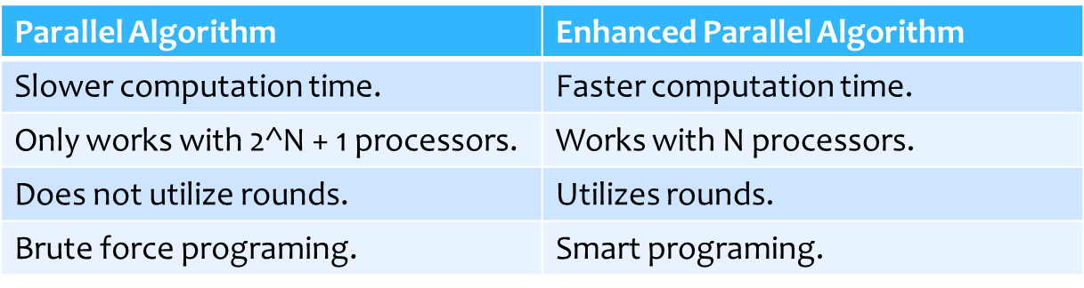
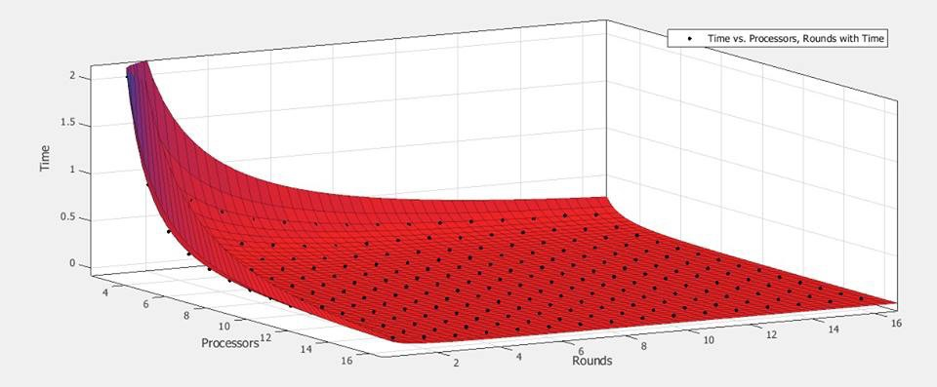
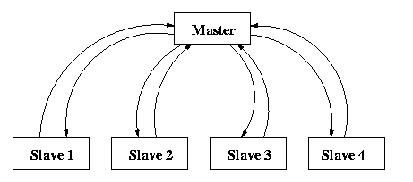
Energy-efficient techniques to allocate power to computer resources on demand
Alejandro Sánchez Fernández. Josue Ruiz Rodriguez Mentor Dr. Luis F. De La Torre Quintana
Caribbean Computing Center for Excellence, Universidad Metropolitana, Cupey
Introduction
Procedure
Managing and processing big amounts of data typically consumes large amounts of energy and computing time. These type of problems frequently occur in modern data centers. To solve this problem we can utilize parallel computing which is the most used way to carry out, manage and proces data faster. It is necessary to locate techiniques for energy efficient computation.
1. Created two algorithms for managing data in C.
Receive agglomerated data from parent If level<lastlevel
For i = 1, 2
“Retrieve data chunk from child i” “Send data chunk to child I”
Else
For j = 1, nRounds If Master process
For i = 1, nWorkers
“Retrieve data chunk for worker i” “Send data chunk to worker i”
Else
“Receive agglomerated data chunk” “Compute core task on data chunk”
Purpose of Study
“Compute core task on data chunk”
Figure 4. Algorithm Comparison (Parralel Algorithm vs Enhanced Parallel Algorithm)
Reduce energy consumption in parallel computing
Find the amount of processors used for energy-efficient processing (computing time vs energy consumption).
data
Figure 2. Parallel Algorithm Pseudo code (left) and Enhanced Parallel Algorithm Pseudo Code (Right)
Find the amount of processors and rounds that compute data in the fastest way possible while reducing energy consumption, utilizing master-slace paralle scheduling.
Created a 2x2 matrix using Excel
Ran the algorithm using 10,000 data (aleatory numbers from 0-99, 16 CPU and 16 rounds alternatively.
Fill the matrix with the results obtained
Identify which algorithm manages data faster
Identify the least amount of processors and rounds.
Key Concepts
Figure 5. Surface graph, Time vs. Processors, Rounds with Time.
Process: A computation carried out in a processor.
Rounds: N repetitions of the distribution and sorting process
CPU: Often called the processor, it is the brain of the computer where most of the calculations are carried out.
Parallel Computing: A form of computing in which a big problem is divide dinto smaller sub-problems that are then carried out by various processors simultaneosly
Master-Slave Scheduling:
Results
Conclusion
We chose the second method because it’s a more energy efficient way to manage data.
The amount of processors and rounds needed to be more energy efficient are
9 processors and 14 rounds. This amount calculates data faster while at the same time consumes less energy. Amounts greater than this waste more time and more energy.
Master
References
Send
Link
Compute
Longxiang Chen, Panruo Wu, Zizhong Chen, Rong Ge, Ziliang Zong, "Energy Efficient Parallel Matrix-Matrix Multiplication for DVFS-enabled Clusters," icppw, pp.239-245, 2012 41st International Conference on Parallel Processing Workshops, 2012
Figure 1. Diagram demonstrating Master-Slave Scheduling
Master
Important Information
David Culler, Richard Karp, David Patterson, Abhijit Sahay, Klaus Erik Schauser, Eunice Santos, Rames Subramonian, and Thorsten von Eicken, “LogP: Towards a Realistic Model of Parallel Computation”. Computer Science Division, University of California, Berkeley, 1993
The number of data that we used was 50,000 Processors ranged from 3 to 16
Rounds ranged from 1 to 16
Processor: Inter® Core™ i3 CPU 5530 @ 2.93GHz Connection Speed: 100 Mb/s
Yang Yang, Henri Casanova, “UMR: A Multi-Round Algorithm for Scheduling Divisible Workloads”, Department of Computer Science and Engineering, San Diego Supercomputer Center, Univesity of California at San Diego, 2003
Send Link Compute
Figure 3. Gantt Chart demonstrating the computation time of a Parallel Distribution Algorithm vs of the Enhanced Parallel Algorithm
Luis de la Torre, Jaime Seguel, “Scheduling Master-worker Divisible Tasks”,Electrical and Computer Engineering Department, University of Puerto Rico at Mayaguez, 2008

