Slide 1
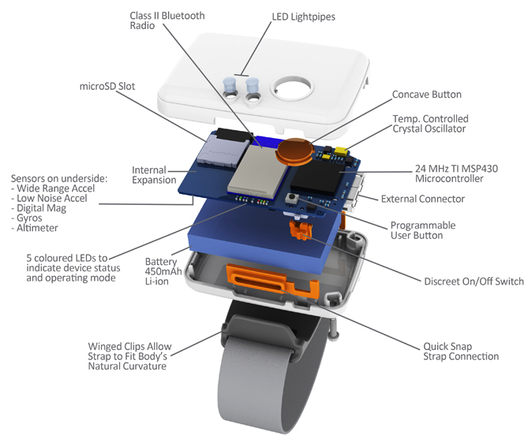
CPS-1446901 Energy & Delay:
Network Optimization in Cyber Physical Human Sensing Systems
Ming Hsieh Department of
Electrical Engineering
Urbashi Mitra & Ashutosh Nayyar
Wireless Body Area Networks
Research Directions-II
  Cyber-Physical system coupling bio-sensors on people and wireless networks
  Goals: provide real-time monitoring health and behavior, enable feedback via adaptive and personalized interventions
Joint Optimization Of Sensing & Communication
Control of sensing channel & communication channel:
  asymptotic rate-distortion tradeoff under cost constraints
Real-time encoding and decoding strategies for noisy/noiseless channels under active sensing of the source
Incorporating sensing costs in communication resource sharing games
Joint optimization of active sensing and event based communication under different decision architectures
Leverage results in decentralized control for joint optimization of sensing, communication and remote estimation
New decision-making problems:
  Sensing, communication, control
Challenges: sensor & data heterogeneity; sensor & coordinator energy constraints; sensing & communication are state dependent
Research Directions-I
Prior Work, New Results and Experiments
Active Sensing | Strategic utilization of sensing modalities. Observation quality depends on individual’s state. Analytical/numerical solutions to stochastic control formulations. Information theoretic characterizations of Rate-distortion-cost tradeoff.
Information Adaptive Communication | Adaptive resource allocation for communication as a function of “information quality.” E.g., Transmission power inversely related to distance from expected value of the source. Identifying tractable strategies and quantifying optimality loss. Possibility of signaling/implicit communication where the resource allocation decision conveys information.
Delay Constrained Communication | Joint source channel coding for multi-terminal problems with noisy observation and feedback. Incorporating energy constraints and channel state variability. A decentralized stochastic control framework
Prior Work: (a) Optimization of communication scheduling and remote estimation under varying energy budgets. [IEEE TAC, 2013] (b) Optimization of sensing and communication for robotic path planning. [IEEE JSAC, 2012] (c) Resource allocation for heterogeneous WBANs [IEEE TSP 2013 &2014]
New results: (a) Global optimization of active sensing and event based communication for point-to-point noiseless communication under average and strict energy constraints. [Allerton Conference, 2014] (b) Incorporating sensing costs and
implicit communication in decentralized detection with a group of sensors. [IEEE TCNS, 2014] (c) structural properties of discrete Kalman-filters [IEEE TSP 2nd review]
Experiments: Validation using data from a real-world WBAN (USC KNOWME 2.0) sensors from Shimmer Technologies
User interfaces via mobile on-board surveys
Ongoing statistical modeling of real-world data to drive algorithm design and large scale simulations

