Slide 1




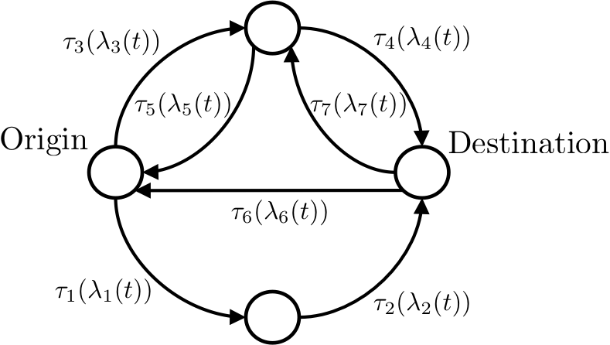
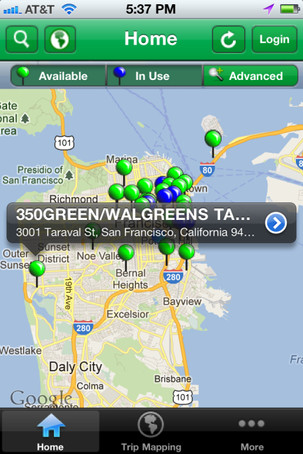
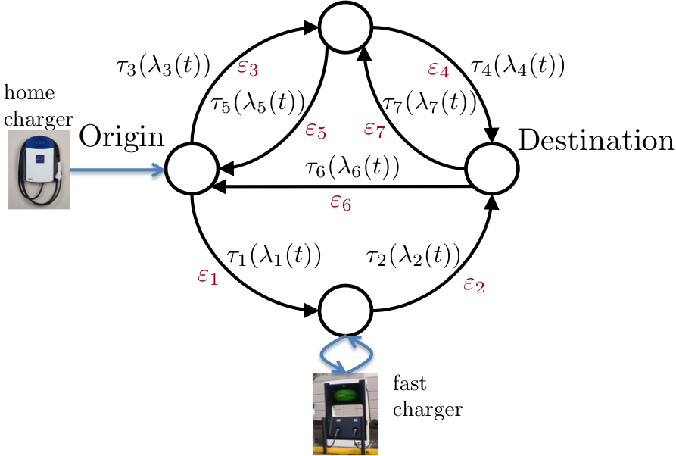
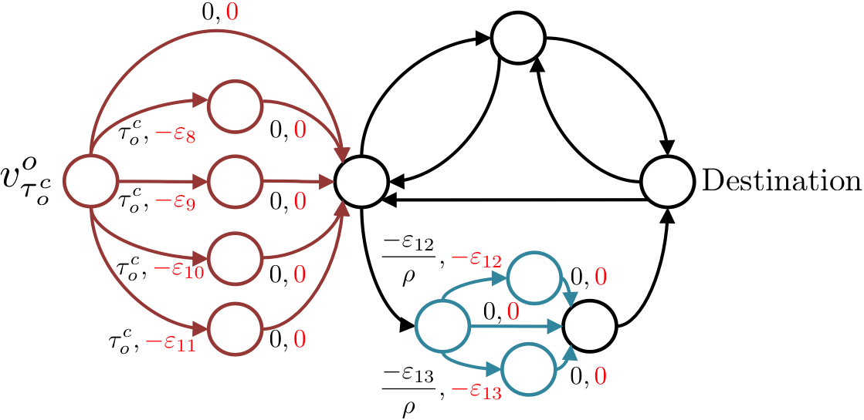
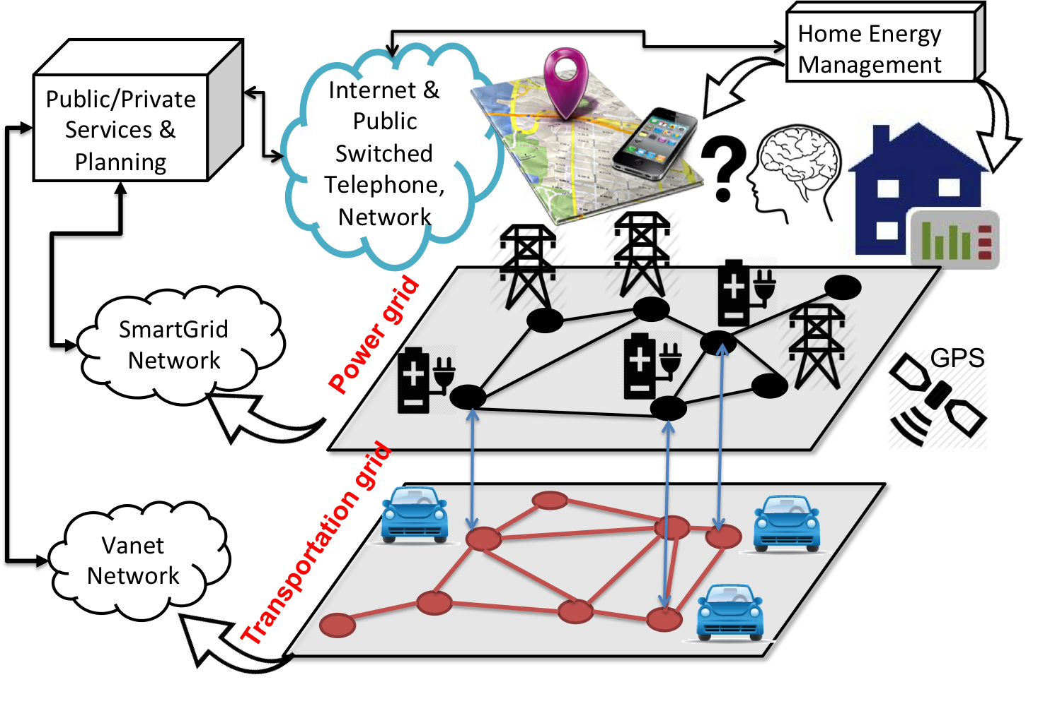
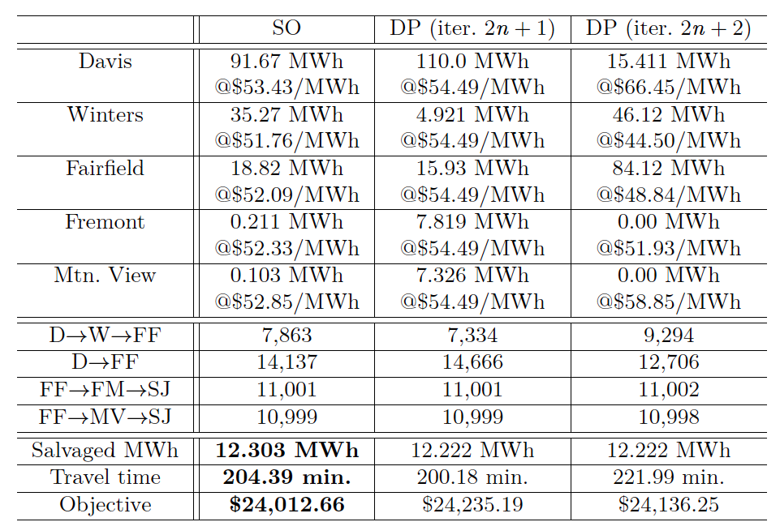
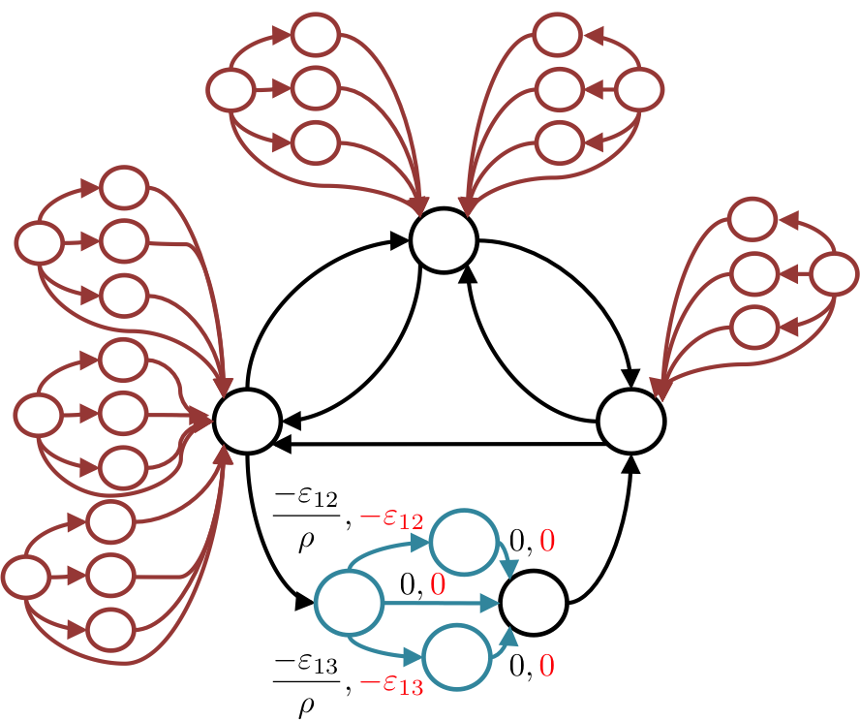

Event-Based Information Acquisition, Learning, and Control
in High-Dimensional Cyber-Physical Systems
Andrea Goldsmith (Stanford University) Tara Javidi (University of California San Diego) Bruno Sinopoli (CMU)
andrea@stanford.edu, tjavidi@ucsd.edu, brunos@ece.cmu.edu
Project Objectives
Individual driver decision model
Implications
Develop a theoretical framework for stochastic learning, decision-making, and control in high-dimension CPS
In our model, decision makers dynamically refine their estimates of the time-varying physical system
These parameter estimates are then used to control the physical system efficiently and robustly.
Both centralized and distributed control methodologies will be explored
Applications: smart buildings, intelligent transportation, energy-efficient data centers, and the future smart-grid
Original problem: dynamic shortest path
Travel time of each link → function of link flow → given (exogenous)
Question: what happens if transportation and power systems are disjointedly managed (under optimal pricing)? → effect of one system on the other taken as exogenous
Prices (LMPs and tolls) updated iteratively
New problem: jointly decision best path and best charge amount to receive at nodes that are visited
Solution strategy: Extended Transportation Graph with virtual charging links → find shortest path on resource-feasible paths (never run out of charge or plan to charge battery above capacity)
IEEE 9 bus test case overlaid on a simple transportation network from Davis to San Jose. The value next to each link is minimum travel time (in minutes) and the base (other than EV) load at each node is in italic. Each intermediate node equipped with (infinite number of) fast chargers.
Example Application: Joint path and charge planning
Simulation setting: static
    All EVs consumes 1 kWh each 25 miles
    Cost of unit time spent en route ( ) = 0.1 cent per 5 min
    Flow to travel time mapping:
    Rate of travel: 2000, 10000, 10000 EVs, initial charge of 2,3, and 4 kWh respectively
    Fast charge rate: 1 kWh to each EV every 5 mins
Target CPS: power systems + transportation systems
Specific Problem: Joint Path & Charge Decision for EV drivers
User costs:
Electricity costs
Time spent en route
Traffic tolls
Notice significant oscillation
in LMPs
Across
iterations
under disjoint model
System-level: centralized and decentralized model
Prior Work:
Dynamic pricing to shift/flatten load
Ignores demand elasticity of drivers
Ignores joint optimization of path and charging
Heterogeneous trip demand → different O-D+ trip start times + initial charge level
Two types of control studied:
  Decentralized user interactions lead to an equilibrium (may be inefficient), e.g., everyone selfishly using Google map
  A social planner maximizes welfare
State variable: network flow
Steps for system-level study:
  Map path and charge decision of drivers under each control strategy to network flow
  Map flow variables to aggregate cost
System-level feedback loop not modeled by route guidance apps → inefficient traffic distribution
Feedback not modeled for power grid dynamic price design → harder to balance system → danger to system reliability
Our
scheme
Next Steps:
- Optimal clustering of demand and of routes to reduce complexity
Stochastic modeling of prices
Profit-maximizing retail price design for aggregators
Low-Complexity Modeling
Optimal decentralized control: joint marginal pricing
Low-complexity model of true EV demand elasticity for reliable price design → trade-off between accuracy and model order
Can we design prices for electricity and transportation such that selfish user equilibrium results in an efficient (welfare-maximizing) solution? Yes!
How? Design prices that effectively relay system costs to individual users
overcharge = marginal social cost - marginal private cost
LMPs should be calculated using our demand elasticity model
Future Work
  Reduced-order models of network topology and origin-destination demand statistics
  Effect of selfish route and charge decisions on system load
  Aggregate response of population to posted prices
Complexity-performance tradeoffs in reduced-dimension information acquisition and state estimation
Remote state estimation and control in Networked Control Systems with a constrained shared bandwidth
Joint estimation and control jointly over event-based information acquisition policies.
Optimal price design for joint power and traffic management
Optimal placement of resources based on data analytics
Grant Information
Supported by NSF CPS synergy grant #1330081.

