Slide 1
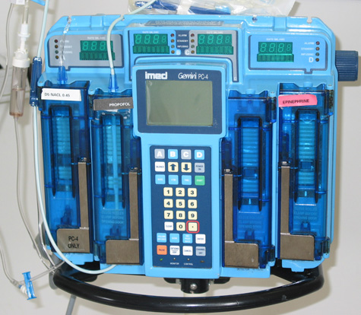
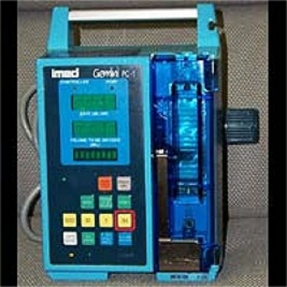
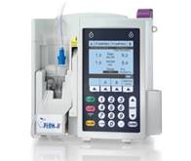
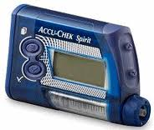
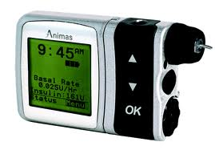
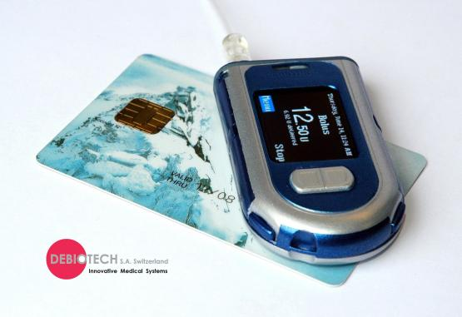
Analyzing Human User Interactions with Cyber-Physical Systems
Sriram Sankaranarayanan (PI) and Clayton Lewis (co-PI)
University of Colorado, Boulder, CO, USA.
Human users are integral to the operation of safety-critical CPS. The goal of this project is to model and analyze the actions of human users along with possible mistakes that may appear in these interactions. We seek to develop approaches that will help us understand the effect of human operator mistakes on the overall system correctness. Our focus is on medical infusion pumps used to deliver drugs to patients. We are studying drug infusion pumps used to deliver anesthesia to patients and insulin infusion pumps used by diabetic patients to self-regulate their post-meal blood glucose levels.
Mistakes
Physical Faults
Results: Modeling Operator Strategies + Mistakes
Our modeling framework can reveal the connection between combinations of machine faults and the resulting ill-effects to patients.
Modeling drug infusion pump mistakes and analysis using discretization and bounded-model checking [4]. Scenarios causing overdosage/underdosage of the drug.
Modeling insulin infusion pump usage and analysis using S-Taliro tool [for robustness-guided model checking [4]. Scenarios causing hyperglycemia / hypoglycemia were revealed by various fault combinations [3].
Optimizing insulin infusion pump usage based on modeling and verification tools to help users avoid mistakes and achieve good glycemic control [2].
Results: User-Interface Analysis
Automated discovery of interface internal states using systematic exploration of interface mockups using computer vision techniques (Sikuli script) and automata learning for learning internal interface state [1].
Recent Work
Modeling usage patterns for insulin pump usage based on patient data that includes meals, boluses and physical activity patterns.
Correlating hypo/hyperglycemia outcomes with specific usage patterns.
Acknowledgments
Aleks Chakarov, Paul Givens, Hadjar Homaei, Sidartha Gracias and Chris Miller (CU Boulder).
Prof. Tom Yeh (CU Boulder).
Prof. Georgios Fainekos (Arizona State University).
User Model
Device Model
Physiological Model
(Patient)
Drug Infusion Pumps: Linear PK/PD models of drug diffusion.
Insulin Infusion Pumps: Non-linear insulin-glucose regulatory models
(eg., Bergman model, Hovorka model, Dalla-Man model)
Original Prescription
Mode: PCA
Vial Conc: 10 mg/ml
Continuous: 50 mcg/min
Bolus Request: 10 mcg
Lockout: 15 minutes.
Mode Selection
Error
PCA Data
Error
Actual Prescription
Mode: CONTINUOUS
Vial Conc: 10 mg/ml
Continuous: 50 mcg/min
….
Vial Conc.
Error
Actual Prescription
Mode: PCA
Vial Conc: 10 mg/ml
Bolus Request: 25 mg/ml
…
Figure 1. Commercial Drug Infusion Pump Models.
Actual Prescription
Mode: PCA
Vial Conc: 50 mg/ml
Continuous: 50 mcg/min
….
Figure 3. Infusion pump operator mistakes as a transformation from intended to actual prescription [4].
Figure 2. Commercial Insulin Infusion Pump Models.
Bolus
Infusion Time
Modeling User Interactions
User interactions can be modeled at two distinct levels:
Higher level usage plan: model a sequence of high level tasks that the users needs to carry out to achieve their eventual goals.
Interface-level usage: The high level usage plans are translated into actions involving the user interface (key-presses and display reads).
Modeling Mistakes
Mistakes transform interactions. We model many different types of mistakes based on how they transform the interactions. Common types of mistakes include the mis-timing, mis-sequencing of high level usage plans , omitting ``redundant’’ checks and the wrong sequence of low level key-presses in the interface.
Time
Actual
Meal Time
Planned
Meal Time
References
[1] Givens et al. Exploring the internal state of interfaces using computer vision and grammatical inference. ICSE 2013.
[2] Sankaranarayanan et al. Synthesis of insulin pump usage parameters. Allerton Conference 2012 (Invited).
[3] Sankaranarayanan et al. Simulating Insulin Infusion Pump Risks by In-Silico Modeling of the Insulin-Glucose Regulatory System. Computational Methods in Systems Biology (CMSB) 2012.
[4] Sankaranarayanan et al. Model-based analysis of real-time medical devices, Formal Modeling and Analysis of Timed Systems (FORMATS) 2011 .
[5] Annapureddy et al. S-Taliro: tool for temporal falsification of hybrid systems. TACAS 2011.
Planned Meal
Carbs: 150 gm
Time: 6 p.m.
Insulin bolus amt: 5 U
Bolus time: 5:45 p.m.
Bolus shape: sine-wave
Actual Meal
Carbs: 250 gm
Time: 6:30 p.m.
Insulin bolus amt: 5 U
Bolus time: 5:45 p.m.
Bolus shape: sine-wave
Figure 4. Meal bolus programming mistakes in insulin infusion pump usage [3].
.

