Slide 1
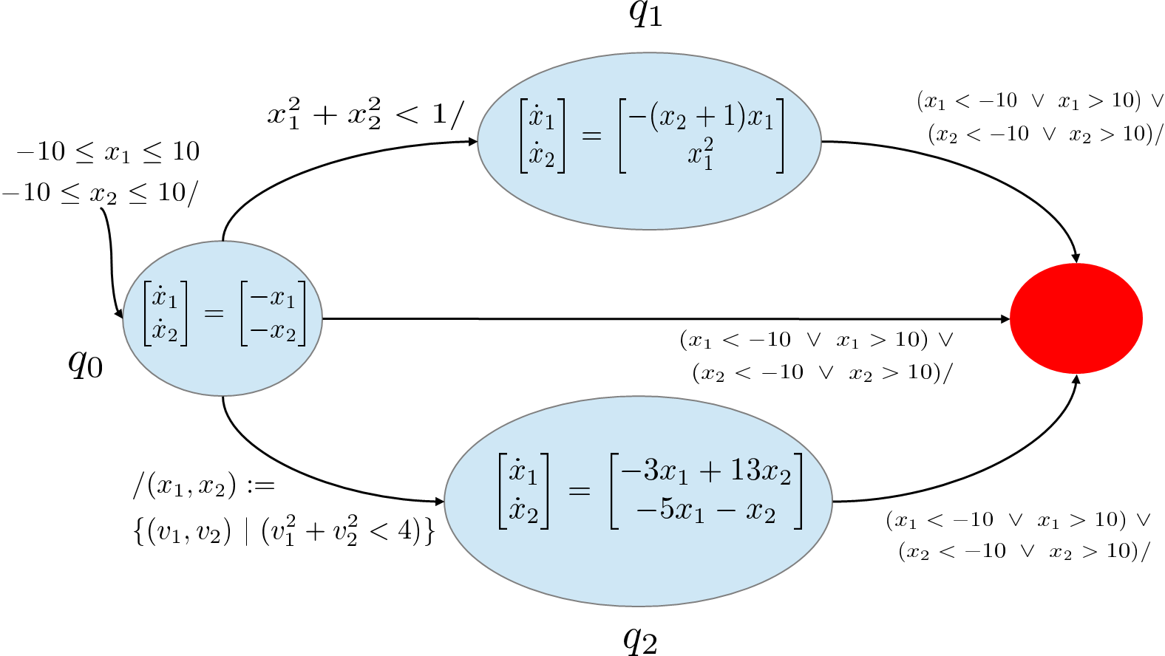
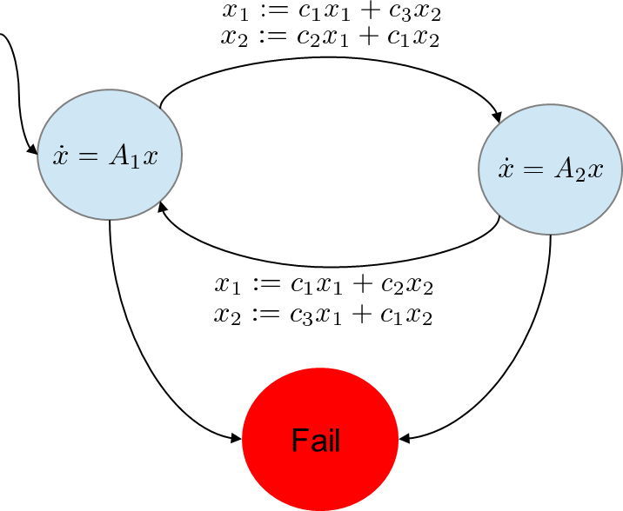
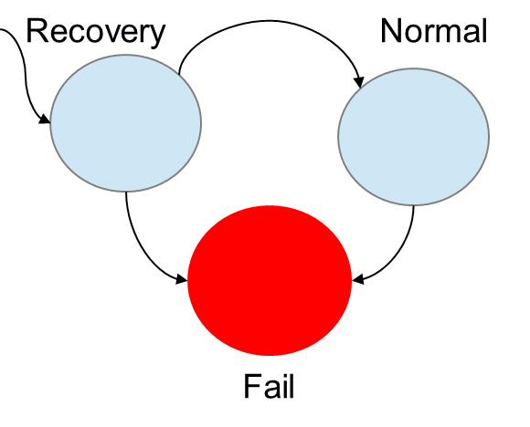
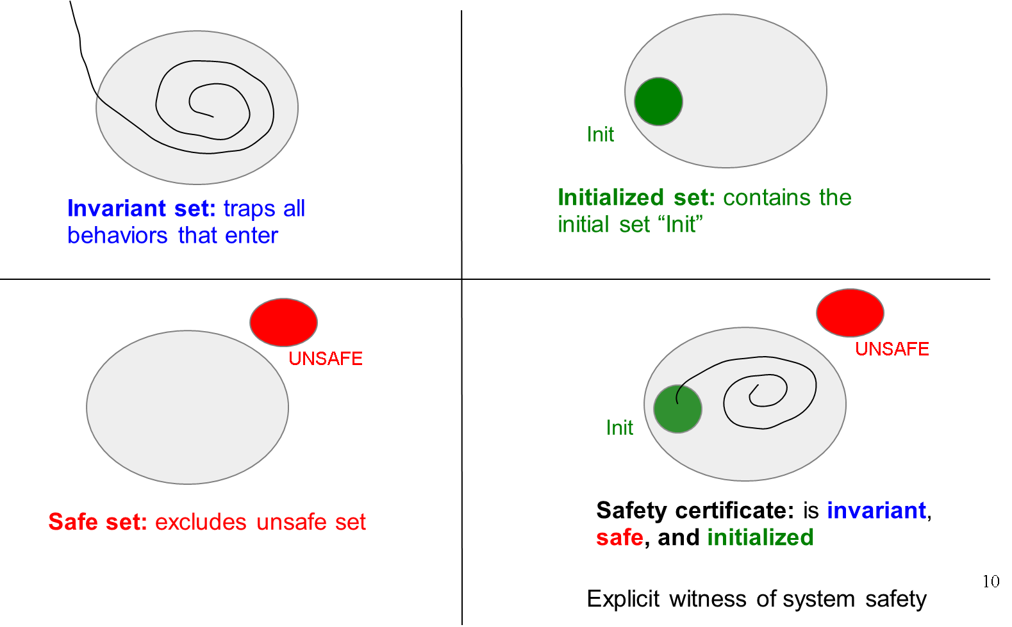
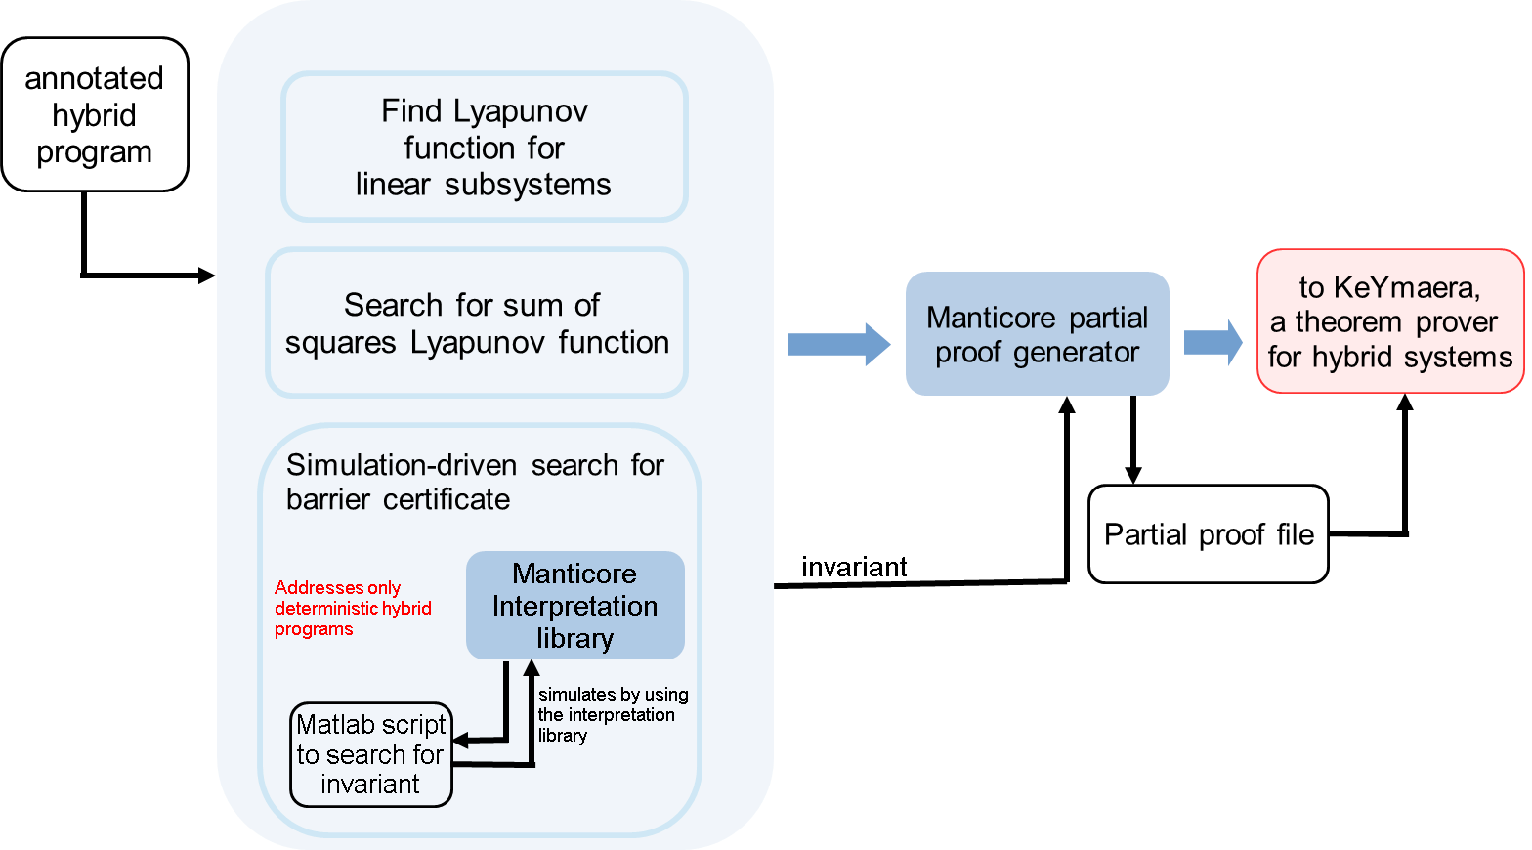

Forward Invariant Cuts to Simplify Safety Proofs
N. Arechiga¹, J. Kapinski³, J. Deshmukh³, B. Krogh¹, A. Platzer²
{¹ECE, ²CS} Department, Carnegie Mellon University, Pittsburgh, PA. ³Toyota Technical Center, Gardena, CA.
Award # 1035800
MEDIUM GOALI
Motivation
Case study: system with four stable modes
Case study: Non-autonomous switched system
Safety critical applications require formal guarantees
Medical devices [1]
Automotive powertrain control [3]
Air traffic controllers [2]
One approach: theorem proving
Can handle nonlinear dynamics without approximation
Support mathematical reasoning
Drawback: have low automation
Unintuitive for inexperienced users
Background
$$?x_{1}^{2}+x_{2}^{2}≥10$$
An external user may switch between system modes
Fails if state leaves ball of radius $√10$
To maintain stability, designer imposes a minimum dwell time before switching
Dwell time is abstracted as decay in the reset
$S_{1}$ is a sublevel set for the Lyapunov function of mode 1. It is invariant because reset maps it to ${\hat{S}}_{1}$, which is contained in $S_{2}^{∗}$, a sublevel set of the Lyapunov function of mode 2 which is contained in $S_{1}$. Symmetric argument holds for $S_{2}$
Use forward invariant cut to leverage knowledge that S1 and S2 are invariant, preserved across modes because of the decay imposed by the resets
Proof can be completed with these designer insights
Mechanical theorem provers
Software tools used to construct formal proofs
Usually require human intervention
Helping the theorem prover can be difficult for complex proof tasks
KeYmaera is a mechanical theorem prover for correctness properties of hybrid systems
This system cannot be verified automatically by KeYmaera
Modes 1 and 2 are stable and have known Lyapunov functions
After applying two forward invariant cuts to leverage the Lyapunov functions, KeYmaera can prove the rest automatically
System has been verified using insight about stability
Project goal
Case study: Fuel controller recovery routine
Want to
Reduce need for human intervention
Use insights from control engineers and designers to simplify proof tasks
$$\dot{x}=f_{r}(x)$$
$$\dot{x}=f_{n}(x)$$
Tool Support: Manticore
{Invariant, initialized, safe} sets
$$x= \left[\begin{matrix}\begin{matrix}p \\ r\end{matrix} \\ \begin{matrix}p_{est} \\ i\end{matrix}\end{matrix}\right]$$
Manifold pressure
Air/fuel ratio
Observation of p
Controller integrator
Simplified model of a powertrain control recovery routine
System spends 8ms in recovery mode, during which the engine must be controlled in open-loop, without feedback
Goal is to ensure that air-fuel ratio remains within 10%
Continuous dynamics are complex, containing radicals and rational functions [4]
Use a barrier certificate computed via simulation driven techniques as a forward invariant [5]
Use an overapproximation of the reachable set during the recovery phase, use the theorem prover to show that it lands in the forward invariant after recovery
Use of safety certificates requires proving that set is invariant, safe, and initialized
Existing numerical techniques can be used to find safe invariant sets to formalize designer intuition about invariant or stable modes of operation.
We extend the KeYmaera tool to support using sets that are invariant and safe, but not initialized. In this way, a proof can be constructed incrementally by removing regions of state space. This also allows identifying problematic initial conditions
Uses an array of heuristics to generate invariants, guided by user annotations about regions of hybrid state space that are believed to contain invariants
Once invariants are found, uses forward invariant cut rule to generate a partial proof file for KeYmaera
References
Z. Daw, R. Cleaveland, M. Vetter. Formal verification of software-based medical devices considering medical guidelines.
Sarah M. Loos, David W. Renshaw and André Platzer. Formal verification of distributed aircraft controllers.
N. Aŕechiga, J. Kapinski, J. V. Deshmukh, B. H. Krogh, A. Platzer. Forward invariant cuts to simplify safety proofs
X. Jin, J. V. Deshmukh, J. Kapinski, K. Ueda, K. Butts. Benchmarks for Model Transformations and Conformance Checking
J. Kapinski, J. V. Deshmukh, S. Sankaranarayanan, N. Aŕechiga. Simulation-guided Lyapunov Analysis for Hybrid Dynamical Systems

