Slide 1
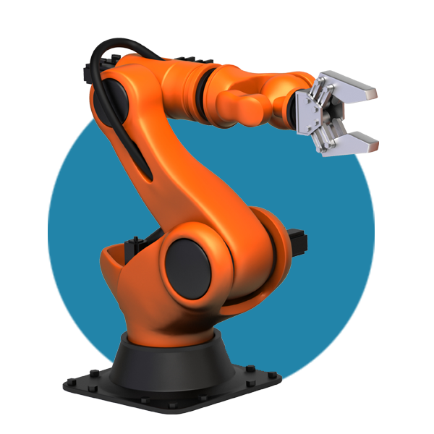
Foundations for Innovation in Cyber-Physical Systems
October 4, 2012
NSF workshop
on CPS
Dr. S. Shyam Sunder
Director, Engineering Laboratory
National Institute of Standards and Technology
U.S. Department of Commerce

Slide 2
Major Points
CPS are critical to the nation’s future
Significant fundamental research is needed
Serious measurements & standards barriers exist
NIST has programmatic efforts underway

Slide 3
What are Cyber-Physical Systems?
Integrated, hybrid networks of cyber and engineered physical elements
Co-designed and co-engineered to create adaptive and predictive systems
Enhance performance including safety and security, reliability, agility and stability, efficiency and sustainability, privacy

Slide 4
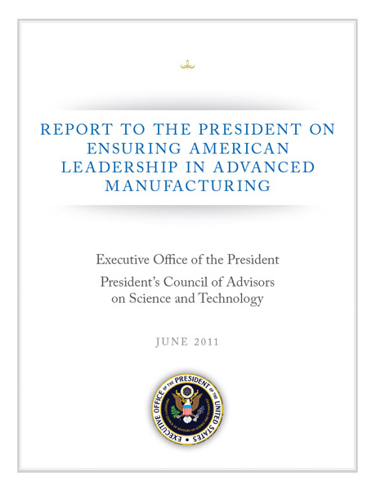
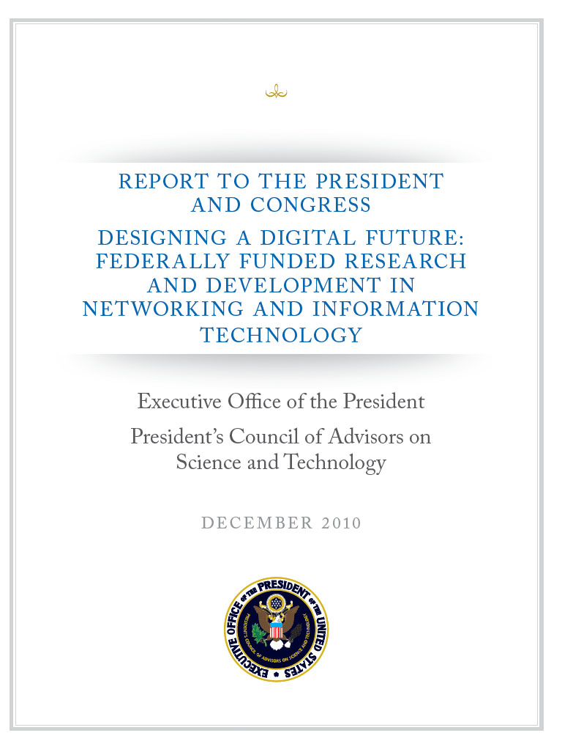
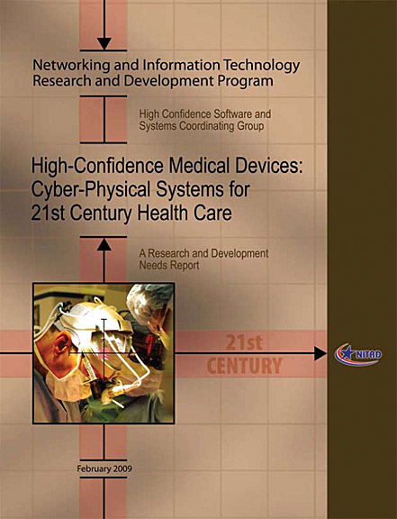
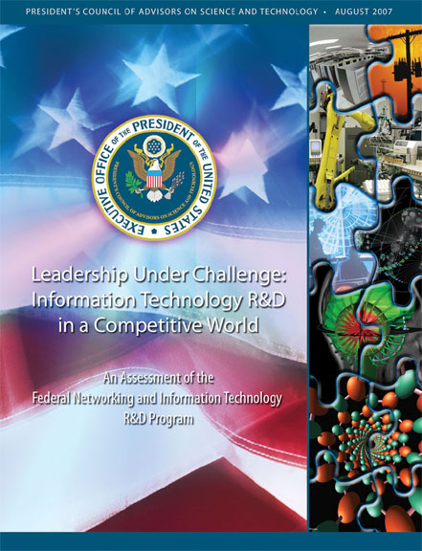
Reports Highlight CPS Significance
2011 PCAST Report Ensuring American Leadership in Advanced Manufacturing: New methods and tools for engineering, testing and integrating CPS components
2010 PCAST Report Designing a Digital Future: Increased research in areas that enhance interactions of networked cyber technologies with the physical world
2009 NITRD High-Confidence Medical Devices Report: R&D focus on architectures, compositional modeling, and model-based design for advanced CPS medical devices
2007 PCAST Report Leadership Under Challenge: New methods and tools to assure high levels of reliability, safety, security, and usability of CPS
2007 NRC Report Software for Dependable Systems: Sufficient Evidence?: Agencies give high priority to IT R&D to enhance software-enabled system dependability

Slide 5
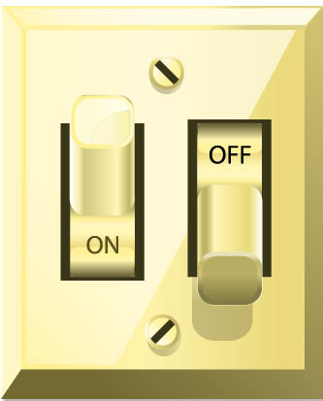
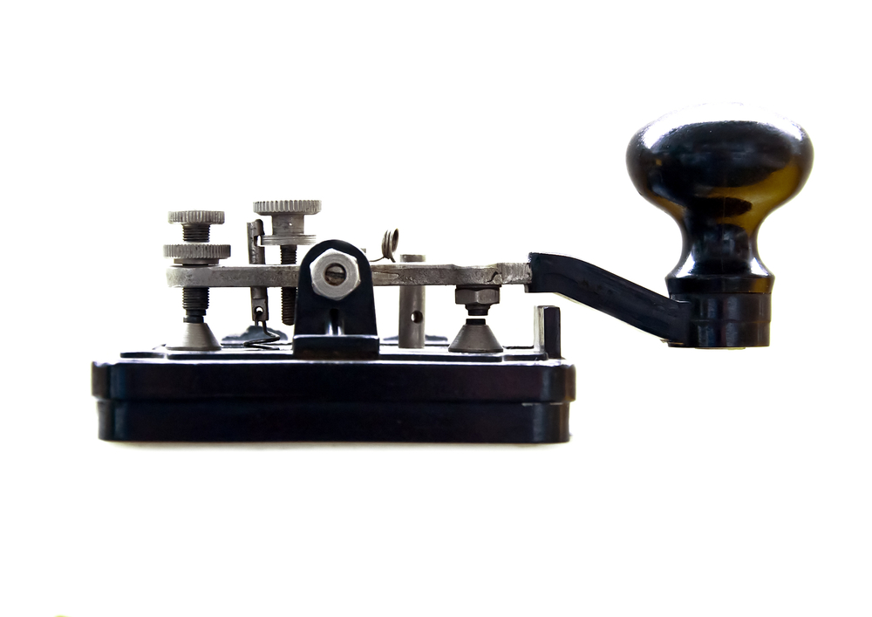
Cyber-Physical Systems - Enabling a new generation of “smart” systems
Through the convergence of networking and information technology with manufactured products, engineered systems of products, and associated services
Images©Shutterstock.com

Slide 6
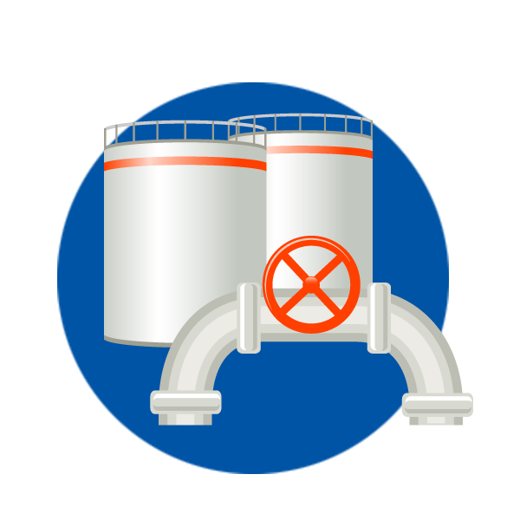
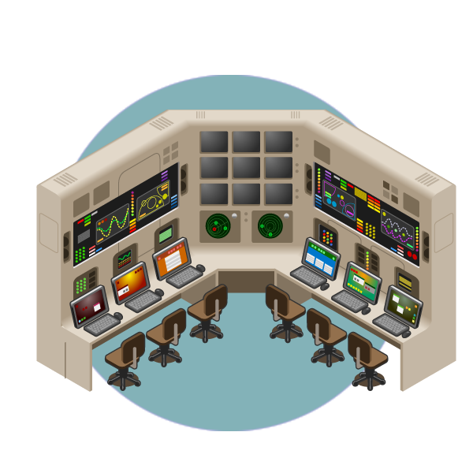
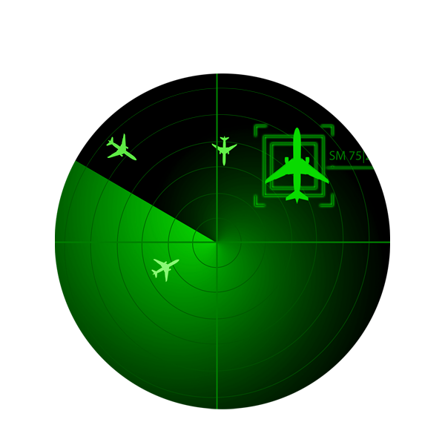
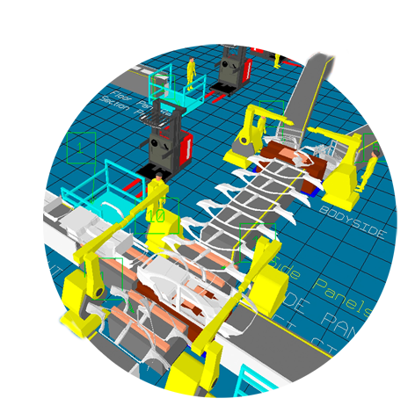
Infrastructure
Emergency Response
Buildings & Structures
Cyber-Physical Systems
Warfighting
Transportation
Healthcare
Smart Production
Images©Shutterstock.com

Slide 7
Many Federal Agencies Have a Common Stake in CPS R&D
CPS linked to mission success
CPS linked to innovation and economic growth
Federal NITRD (Networking and IT R&D) program coordinates interagency CPS R&D
Notes:
Things to consider mentioning here:
Feb 21 interagency coordination meeting
NITRD High Confidence Software and Systems Coordinating Group; workshop participants may have participated in other workshops sponsored by HCSS
Formation of CPS Senior Steering Group within NITRD being actively explored – may want to only mention this in informal conversations

Slide 8
Potential Impacts
Potential Economic Impact
Widespread disruptive technology
Innovative new products and services
Creation/retention of U.S. jobs
Potential National Impacts
Strengthen U.S. security
Enhance U.S. competitiveness
Improve quality of life for Americans
Baloncici/Shutterstock.com
Santiago Cornejo /Shutterstock.com
Dusit/Shutterstock.com

Slide 9
Significant fundamental research is needed

Slide 10
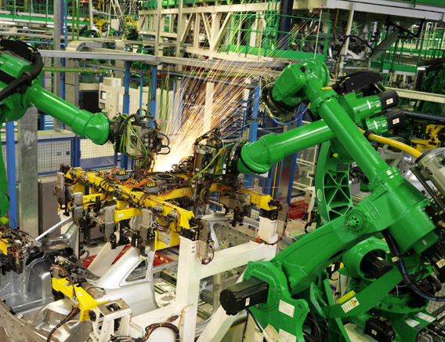
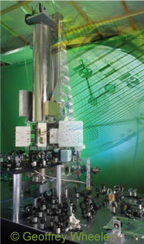
Cyber-Physical Systems Concept Map
Wireless Sensing and Actuation
Hybrid Models
Validation and Verification
Cyber- Physical Systems
Control
Systems
Applications of CPS
Concurrency, Communication, and Interoperability
Scalability and Complexity Management
Cyber Security
Source: Edward Lee, UC Berkeley http://cyberphysicalsystems.org
Images©Shutterstock.com

Slide 11
Key R&D Challenges
Co-designing hybrid secure networked systems
Diagnostics & prognostics for evolving complex, dynamic systems
Anticipating emergent behaviors arising from interactions
Multi-scale, multi-physics, multi-temporal modeling
Including uncertainty and risk into reasoning and decision-making
Modeling levels of autonomy and optimizing the roles of humans
Wireless Sensing and Actuation
Hybrid Models
Validation and Verification
Cyber- Physical Systems
Control
Systems
Applications of CPS
Concurrency, Communication, and Interoperability
Scalability and Complexity Management
Cyber Security
Source: Edward Lee, UC Berkeley http://cyberphysicalsystems.org

Slide 12
CPS Platform Technologies: Concept Map
Stochastic Models
Assurance
Continuous and Discrete
Wireless Sensing and Actuation
Certification
Hybrid Models
Validation and Verification
Human in the Loop
Simulation
Multiform Time
Adaptive and Predictive
Cyber- Physical Systems
Transportation
Warfighting
Control
Systems
Applications of CPS
Infrastructure
Networked Control
Healthcare
Manufacturing
Intelligent Systems
Emergency Response
Concurrency, Communication, and Interoperability
Scalability and Complexity Management
Cyber Security
Models of Computation
Real-Time Systems
Legacy Systems
Design Methodology
Resilience
Privacy
Heterogeneity
Networking
Modularity and Composability
Tools
Malicious Attacks
Intrusion Detection
Time Synchronization
Source: Edward Lee, UC Berkeley http://cyberphysicalsystems.org

Slide 13
Serious measurement & standards barriers

Slide 14
What is NIST’s CPS R&D portfolio?
Architectures: Protocols for communications, control, cybersecurity, and interoperability
Models: Validation, verification, uncertainty and integration
Sensors: Calibration, uncertainties, wireless networks, robustness, interference
Cybersecurity: Security of components and systems, protocol testing, graceful degradation

Slide 15
What is NIST’s CPS R&D Strategy?
Address cross-cutting measurements and standards challenges
Enable self-consistent solutions across diverse applications
Establish strong interagency and public-private partnerships

Slide 16
What has NIST done to date?
NIST CPS Working Group (January 2011)
Cooperative Agreement with University of Maryland for CPS R&D (Kick-off December 2011)
Short Course for NIST Executives and Senor Staff delivered by world class industry and research leaders (January 19-20, 2012)
Idea Submission Opportunity (crowdsourcing)
R&D Needs Assessment Workshop: Foundations for Innovation in CPS (March 13-14, 2012)
Performance Metrics for Intelligent Systems (PerMIS) Workshop – CPS Theme (March 20-22, 2012)
Cyber-Security for CPS Workshop (April 23-24, 2012)
CTO Roundtable (June 18, 2012): Strategic Vision and Drivers
CPS Testbed @ NIST

Slide 17
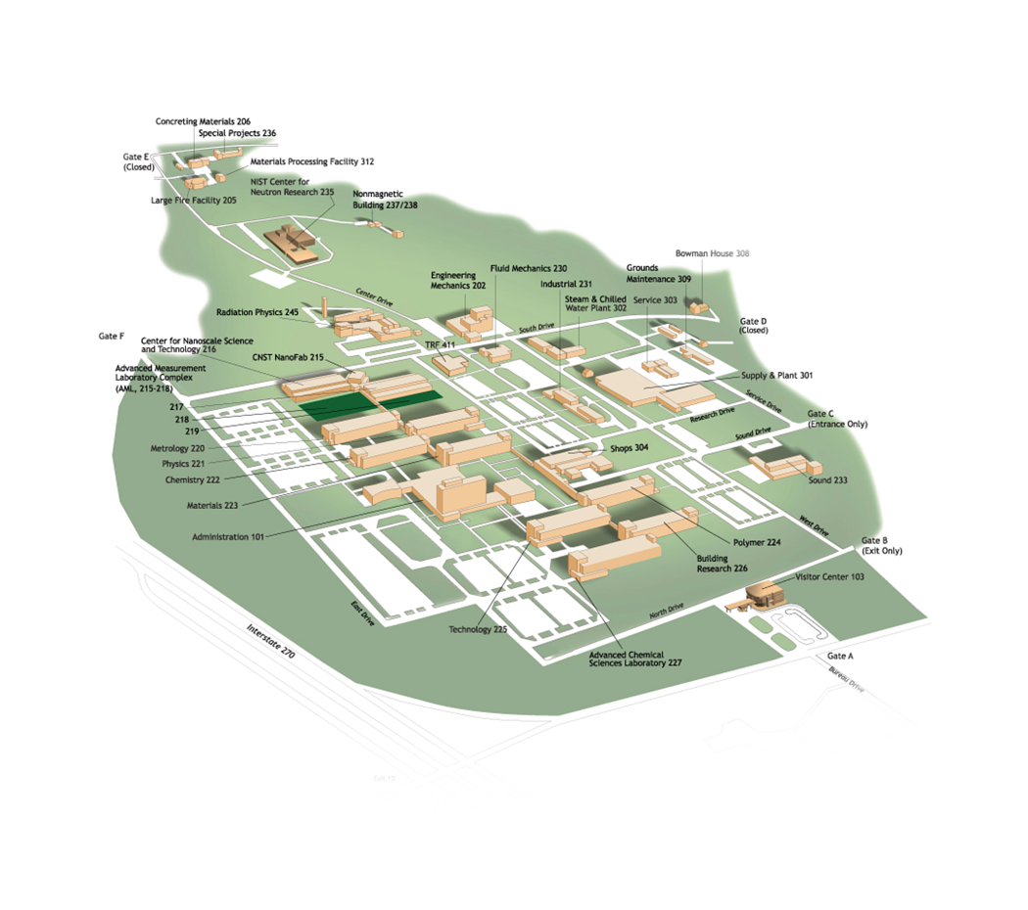
NIST has established a CPS Testbed
Showcase NIST’s measurement and standards research results
Vehicle for implementing NIST’s R&D strategy
Integrate multiple application domains into a smart community
Smart Community

Slide 18
Summary
CPS is critical for our future
Significant fundamental research issues remain
Serious measurements & standards barriers exist
NIST has programmatic efforts underway

Slide 19
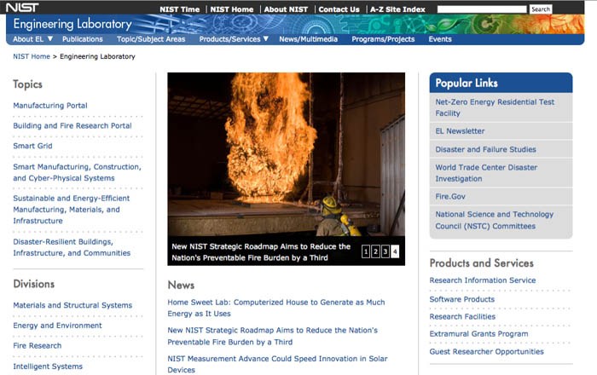
Contact Info
Shyam Sunder
Director
301 975 5900
sunder@nist.gov
Engineering Laboratory
National Institute of Standards and Technology
100 Bureau Drive
Gaithersburg, MD 20899-8600
www.nist.gov/el

