Slide 1


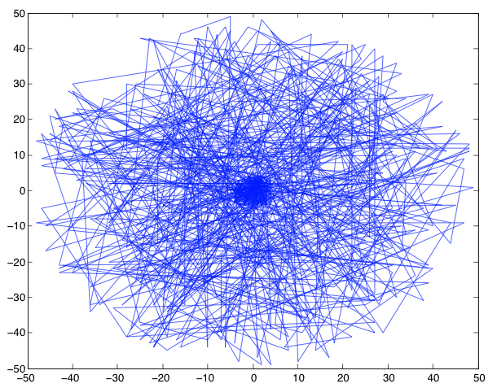







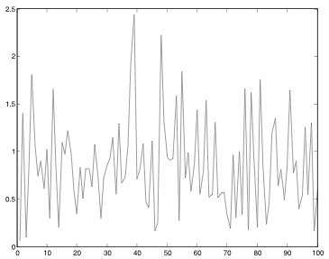
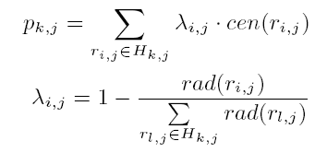
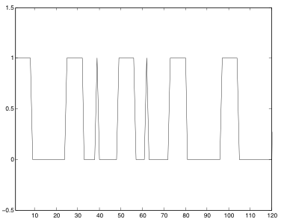
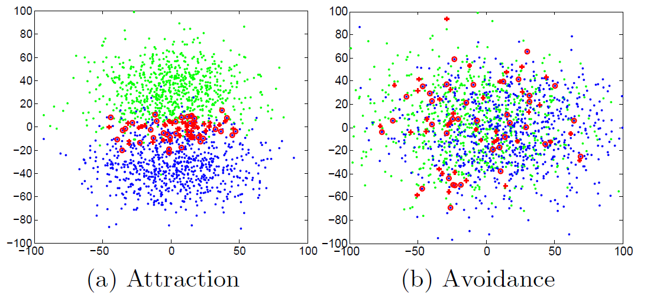
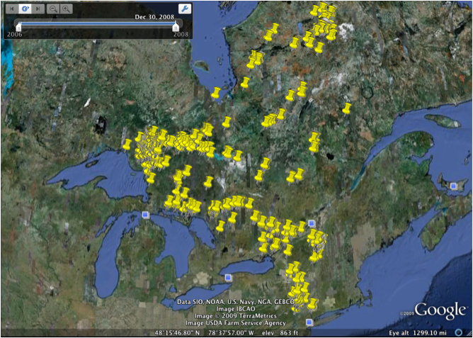
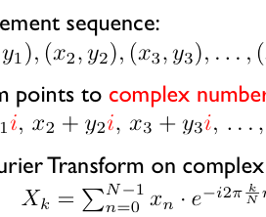
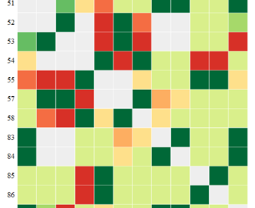

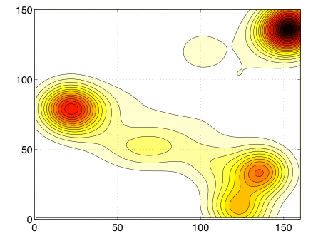
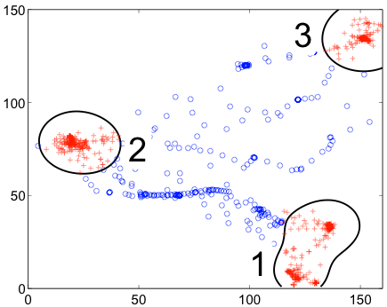
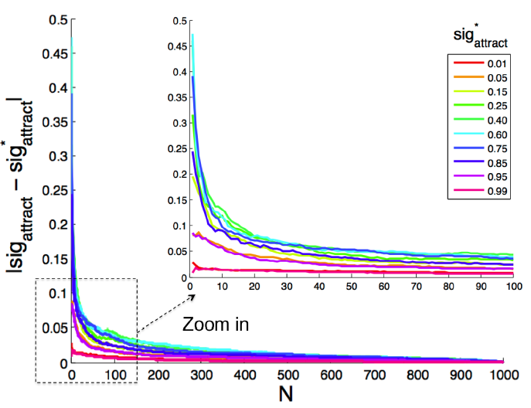
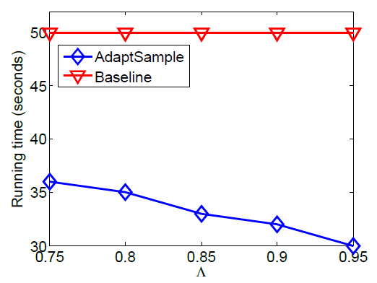
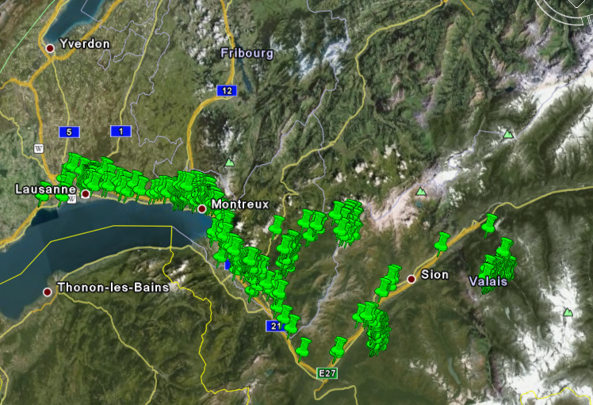
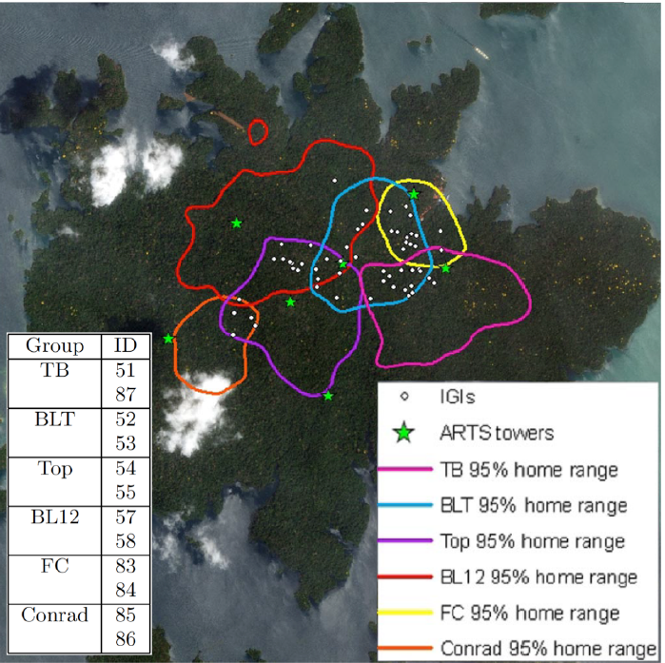
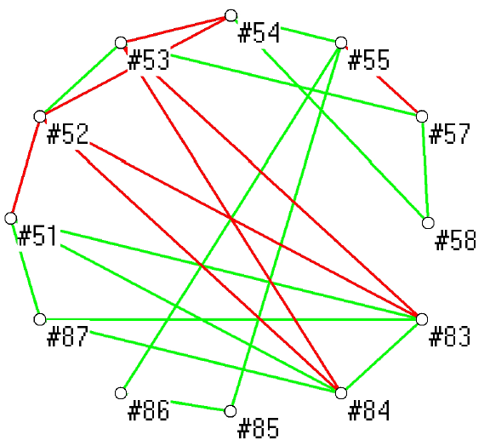
NSF CPS: Small: Collaborative Research: Foundations of Cyber-Physical Networks
Jiawei Han¹ Tobias Kin Hou Lei¹ Zhenhui Jessie Li² Lu An Tang¹ Jingjing Wang¹ Chao Zhang¹
University of Illinois at Urbana-Champaign¹
Pennsylvania State University²
Overview
Trajectory Discovery From Untrustworthy Sensor Data
Cyber Physical Systems(CPS) integrate physical devices (e.g., sensors, cameras) with cyber components to form a situation-aware analytical system. The rich information within CPS proliferates the research community in the study and application of CPS innovations.
Here we provide an overview of our recent research achievements addressing the following issues:
Rare event detection and analysis in cyber-physical data streams, including trajectory discovery from untrustworthy sensor data[KDD’13], attraction and avoidance detection[VLDB’14], periodic event detection [KDD’12], reliable and trusted data analysis [VLDB’12]
MoveMine system and Movebank system integration
Motivation: Mining Lines in the Sand
Challenges:
Massive and streaming data
Untrustworthy data
Tracking multiple intruders
Battlefield CPS: monitoring designated region and detect intruders
  Igloo White
  Ground Tactical System
  REMBASS
  (REmotely Monitored BAttlefield Sensor System)
1. Deploy larger number of sensors
2. Collect seismic, acoustic
and magnetic signals from the field
Problem Statement: Mining Lines in the Sand
Input: sensor network S; sensor data arriving by time, R ={R₁, R₂, …, R_{m}}.
Output: a set of intruder trajectories {L₁, L₂, … L_{k}}
Two sub-problems: (1). Mining dots in the sand; (2). Connecting dots as lines
Mining Event Periodicity from Incomplete Observations
1. Mining Periodicity in Movements
2. Sparse and Incomplete Observations
3. Discover intruder trajectories from the sensor data
The Cone Model
Retrieve the ω-most recent points from the candidate trajectory
Calculate the mean and deviation values of the intruder’s moving speed and direction
Assumption: the moving speed
and direction are in the normal distribution
Construct a cone area to predict next move of L_{k}
1.1. Motivation
A fundamental problem. Useful for prediction, summarization, and abnormal event detection.
2.1. Motivation
A big challenge: Sparse and incomplete observations
Birds movement data: 2~3 recorded locations in 3~5 days
Human movement data: only report locations when making calls or using location-based services
Mining dots in the sand:
Input: sensor network S; sensor data in time t_{j}, R_{j} = {r_{1,j}, r_{2,j}, …, r_{n,j}}, sensor’s reliability scores
Output: intruder appearances in time t_{j}
Bee example:
8 hours in hive
16 hours fly nearby
2009-05-02 01:03 in
2009-05-03 11:30 out
2009-05-05 03:12 in
2009-05-09 12:03 in
2009-05-10 11:14 out
2009-05-11 02:15 in
…
1. Constructing the watching network:
Select the watching sensors for each record
Responding sensor: also has a detection near-by
Non-responding sensor: no detection or the detection is far away
Hard to detect periodicity when observations are sparse
← Observations are incomplete and sparse
Raw movement sequence:
Transform points to complex numbers:
Apply Fourier Transform on complex numbers
2. Detecting the intruder appearances
Cluster the detection records
Calculate the position of the intruder appearances for each cluster.
The position is a weighted average of the detection centers,
the weights are
determined by
the detection radius
Validation and Feedback
Observation: The real intruder moves in a continuous manner and the trajectory grows longer over time, the false positive appearances are unlikely to be connected
Filtering out the false positives by time
2.2. Method
Overlay the segments with a potential period T, and measure the skewness of distribution
← Fail to detect the period of one day because the raw movement is not periodic
Update sensor reliability scores when a candidate is removed as false positive or selected as the mining results
Compare Intruder Mining (IM) to Maximum Likelihood detecting (ML) and TruAlarm (TA)
1.2. Method
Observe the movement from reference spots
Transform the movement into binary sequence
ground truth: real traj. Pts
result: detection result
valid detection: dist(p_{g}, p_{d}) < δ_{d}
precision = |valid |/|result|
recall = |valid |/|ground|
in hive
Use Hive as the reference spot to observe the movement. Easy to see the periodicity.
outside hive
Attraction and Avoidance Detection from Movements
Motivation
40 co-locating (red) points on both moving object but two objects could be in own territories or same the same territories. We see that co-locating frequency is not a good measure for attraction and avoidance relationships.
1.3. Experiment
No existing method addresses the problem of mining significant attraction and avoidance relationships in a well-defined and unified framework.
Bald Eagle
Tracking time: Jan, 2006 to Dec., 2008
Number of locations: 2204
The green points and blue points show the locations of two moving objects. The red points indicate the locations at which the two objects are spatially close at the same time.
Density Map
Reference Spots
skewed distribution → true period
even distribution→ false period
New Measure
Method
Experiment
2.3. Experiment
Detect the relationships through the comparison between how two objects are expected to meet and the actual meeting frequency they have.
The degree of a relationship using significance value of the relationship
  The exact significance value is a #P-hard problem
Design two pruning rules to speed up the permutation test
  Eliminating nonoverlapping locations
  Early termination conditions
Efficiently retrieve all the objects with significance values above certain threshold Λ
← Our method is more robust than Fourier Transform and Auto-correlation when the observations are very sparse
Periods detected using Fourier transform and autocorrelation:
ref. spot | period
1 | 363
2 | 363
3 | 364
3. Nokia Location Prediction Competition
Sampling rate
Estimated significance
value converges fast to its true value.
Our method is much faster with the pruning rules for different threshold Λ
Problem: given historical movement and current time and location, predict next location.
Model intuition: human movements are strongly determined by periodic behaviors.
Periodicity-based features: day of week, hour of day, hour of week, weekend, weekday, morning, noon, afternoon, evening, midnight.
Classification model: Support Vector Machine.
Result: Our method gets 52.83% accuracy, ranked 2nd place in the competition. This demonstrates the importance of periodicity in movement prediction.
MoveMine + MoveBank Integration
Motivation: Animal scientists want advanced data mining methods on moving object data.
Movebank: Free online database of animal tracking data.
MoveMine: A rich set of spatial and temporal algorithms.
Benefits: A general framework to integrate more spatial and temporal mining algorithms together; Solve real problems using real datasets.
Home range of the six monkey study groups and the mined results for mining significant relationships for the monkey data (green line: attraction, red line: avoidance).
A human trajectory near Lake Geneva
National Science Foundation Award Number: NSF CNS 0931975 (09-01-2009—08-31-2014)

