Slide 1
Foundations of Implicit and Explicit Communication
Anant Sahai
Wireless Foundations
Berkeley Wireless Research Center

Slide 2
Some Key Students/Postdocs Supported
Pulkit Grover
Got the first real positive result on the Witsenhausen Counterexample in 40+ years --- by characterizing it as implicit communication.
Will take tenure-track position at CMU in 2013
Se Yong Park (graduating soon)
Fundamental results on Intermittent Kalman Filtering, connecting decentralized LTI control to network coding, and approximately optimal nonlinear decentralized LQG control.
Kristen Ann Woyach (graduating soon, F, +NSF Fellow)
Radical new approach to lighthanded regulation of interacting CPS ecosystems involving evolving technologies, certification and enforcement: the cognitive radio case.
Kate Harrison (F, +NSF Fellow)
Exploring the potential the TV Whitespaces as a resource and how they might be the gateway to cloud-based spectrum-as-a-service approaches to decentralized spectrum use.
Gireeja Ranade (F, +NSF Fellow)
Further exploring ideas of implicit communication in control, linear deterministic models, and crowdsourcing.

Slide 3
Two Basic Problems
Plant
Plant
Information
Flows?
Observer
Actuator
Information
Flow
Controller
Controller
Communication
Channel
Controller
Controller
Explicit Information Flow
Plant as Source
Implicit Information Flow
Plant as Channel???

Slide 4
The plant as “source”
Observer
Noiseless Channel with rate R
Actuator
Q: How much information is being generated?
A: How much information do we need to communicate to stabilize the system?

Slide 5
A deterministic perspective
At each time step, bits

Slide 6
Focus on reliability: real erasure channels
Observer
Actuator
Real Erasure Channel has infinite rate but finite delay error exponent.

Slide 7
Intermittent Kalman Filtering: need enough rank
P_{e}=1
Stability
Intermittent Kalman Filtering
P_{e}=0
Observability
Sinopoli et al. [2004]
Lyapunov Stability :
Bound on
Our result (extending Mo&Sinopoli)
Intermittent Observability :
Exact Characterization of
\
Theorem [Park and S., 2011]
where …

Slide 8
Nonuniform sampling = each observation adds rank
Uniform Sampling
Nonuniform Sampling
timing jitter

Slide 9
Network coding and decentralized linear systems?
a
S
b
R₁
R₂
a
b
?
R₃
a
a+b
b
R₄
a+b
a+b
D₁
D₂
a, b
a, b

Slide 10
LTI Stabilizability of decentralized linear systems

Slide 11
Conceptual Example
Plant
Controller 1
K1
Controller 2
K2
State-space representation of Decentralized Control System
Notes:
Then, how can we stabilize the system?
The answer is communication. The first controller can relay its observation to the second controller, and the second controller stabilize it.

Slide 12
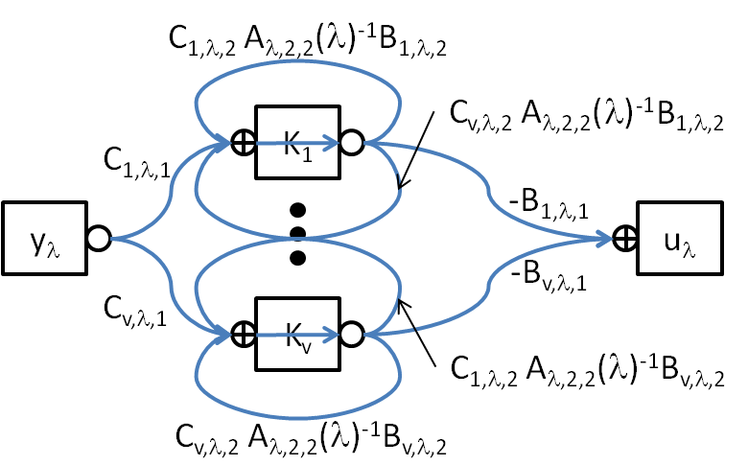
The general case
Decentralized Linear Systems | Relay Communication Networks
Unstable States associated with eigenvalue λ | Source
Unstable States associated with eigenvalue λ | Destination
Controllers | Relays
Remaining States and Bi, Ci | Channels
Unstable Subspace associated with eigenvalue λ | Message
Number of Jordan blocks associated with eigenvalue λ | Rate of Message
Stabilizability (Enough implicit communication for unstable subspace) | Capacity

Slide 13
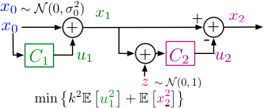
Bit-level picture of Witsenhausen’s counterexample
floating
point
Can we extend understanding to infinite-horizon?

Slide 14
Simplest decentralized LQG problem
C₁[0]
C₁[1]
C₁[2]
C₁[n]
C₂[0]
C₂[1]
C₂[2]
C₂[n]
Radner’s Problem
Witsenhausen’s
Counterexample

Slide 15
Linear controllers: a deterministic perspective
Input
constraint for
controller 1
Time 1
Time 2
Time 3
Time 4
Noise
level for
controller 2
floating point

Slide 16
Nonlinear controller
Input
constraint for
controller 1
Time 1
Time 2
Time 3
Time 4
Noise
level for
controller 2
floating point

