Slide 1
2015 Workshop on Big Data Analytics in CPS:
Enabling the Move From IoT to Real-Time Control
Framework for Scheduling of “Intelligent” Jobs in
Flexible Job-shop Environment
Ashutosh Nayak
Prof. Seokcheon Lee

Slide 2
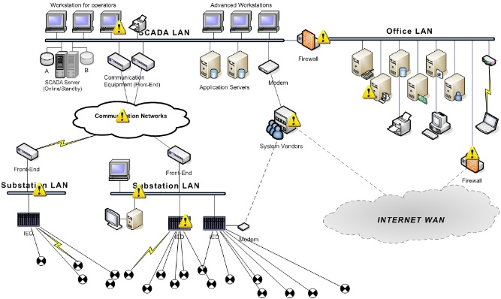
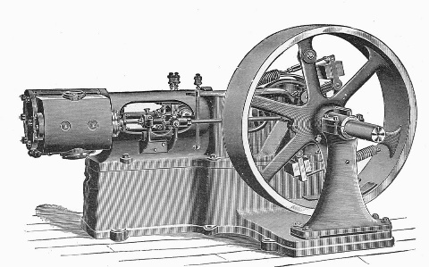
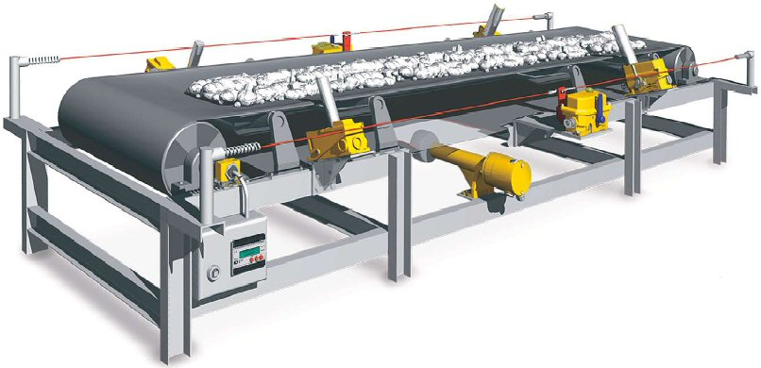
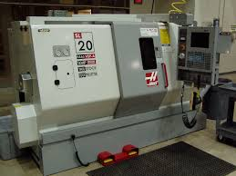
Motivation: Industrial Evolution led by IoT and CPS
………………………....................…………………
1st
2nd
3rd
4th
Steam engine
Industrialization
Computer CNC
Cyber physical systems
Power generation
Manual automation
Fast production
Electronic automation
Smart automation

Slide 3
Agenda
………………………....................…………………
Introduction to intelligent jobs
Vision : IoT and CPS
Flow Shop and Peak Energy
Mathematical Formulation
Agent Based Framework
Scheduling
Negotiation Protocol
Conclusion
Future Research

Slide 4
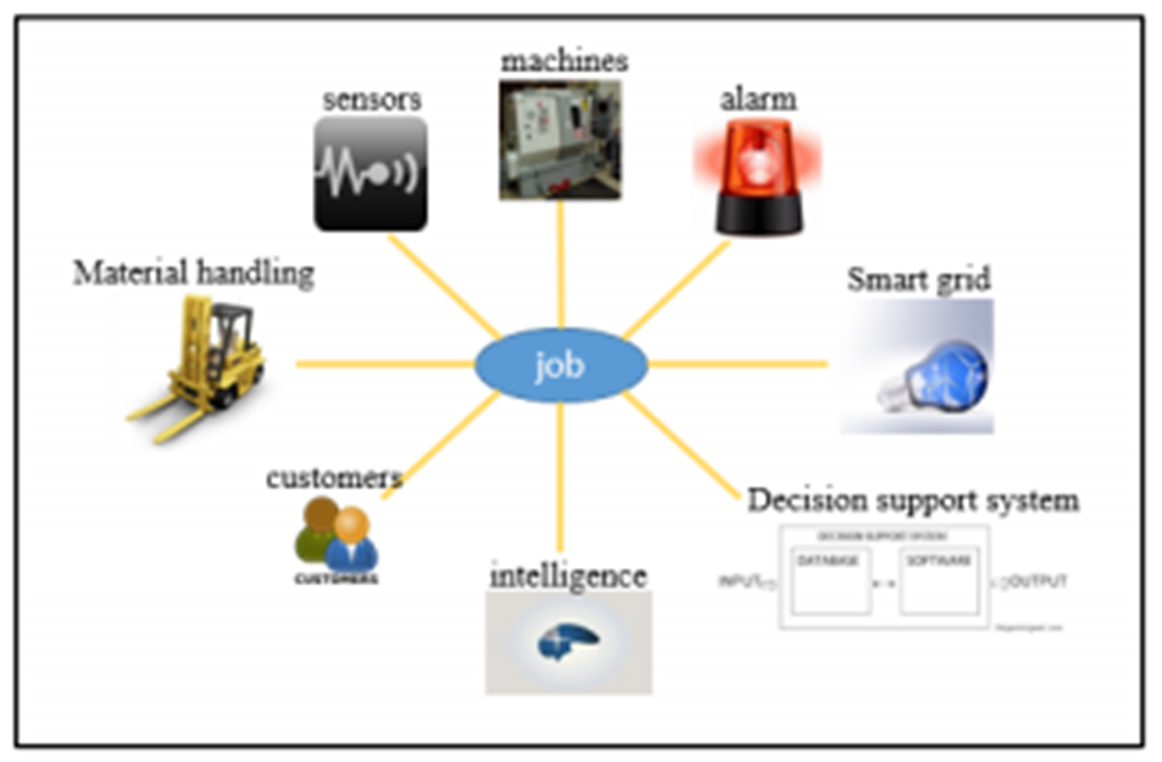
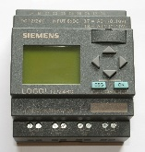
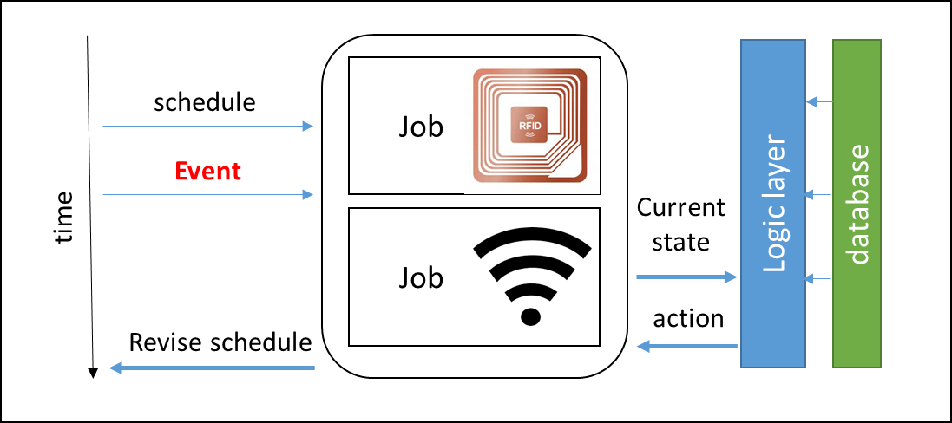
Intelligent jobs
………………………....................…………………
Large database
Storage – raw materials
Product
information
Indexing machine
Send
information
on what next
Raw
material
Mark raw material / start with a mark with the product information

Slide 5
Vision for IoT in manufacturing
………………………....................…………………
‘’Highly flexible, individualized and resource friendly mass production’’
How will it affect -
customers
manufacturers
Taylor – made products
Affordable prices
New products / options
Flexible mass production
Highly adaptable to market changes
Cope up with short product lifecycle
Energy Efficient Manufacturing

Slide 6
Flow Shop Environment
………………………....................…………………
J = {1,2,…n} | Set of Jobs
M = {1,2,…m} | Set of Machines
S = {1,2,…d} | Set of Speeds
x_{ijs} | = 1 if job j runs in machine i at speed s
P_{ijs} | Processing time when job j runs in machine i at speed s
Q_{ijs} | Energy consumed/ time when job j runs in machine i at speed s
Manufacturing set up : Permutation Flow shop
Let the sequence is J₍₁₎, J₍₂₎ ,J₍₃₎ ,………J_{(n)}
The jobs are processed in the same sequence across all the machines in order m₁, m_{2……} m_{m}
Each job can be processed at only one of the possible speeds of machines

Slide 7
Peak Energy
………………………....................…………………
Energy profile
Energy profile
M1
M2
M1
M2
Machine 2
Machine 2
Machine 1
Machine 1
time
time
(a) Case 1
(a) Case 2

Slide 8
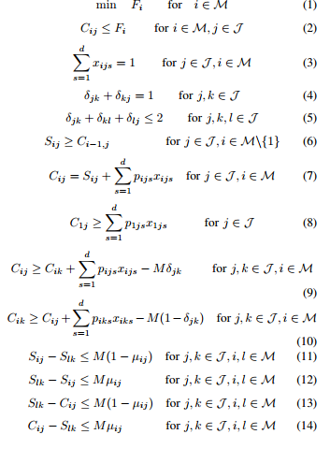
Mathematical Formulation
………………………....................…………………
Objective
Finishing time of a job
Assigning one speed to a job in a machine
Ordering any two jobs
Transitivity of two jobs
Constraints for one job
Constraints for two jobs

Slide 9
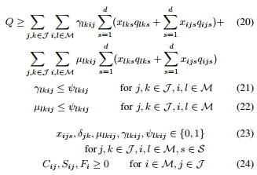
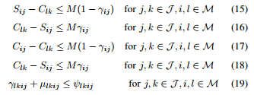
Mathematical Formulation
………………………....................…………………
Finishing time of a job
Machine l
Assigning one speed to a job in a machine
Machine l
Machine i
Ordering any two jobs
Machine i
Transitivity of two jobs
(a) Case 1
(a) Case 2
Constraints case 1
Peak energy constraint
Constraints case 2

Slide 10
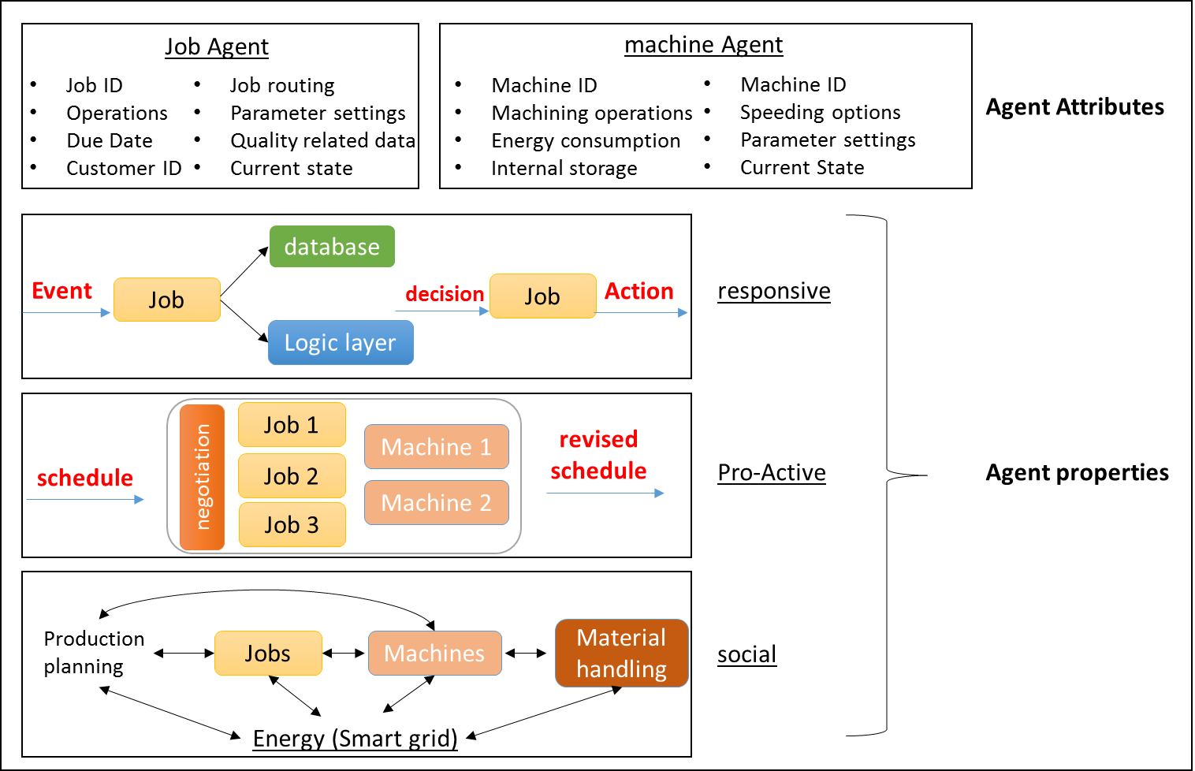
Agent Based Framework
………………………....................…………………
Why ?
The Agent based modelling is good fit because:
The job agents are autonomous
The agents can make decisions on their own
The properties of agent based modelling are shown

Slide 11
Agent Based Framework
………………………....................…………………
New job
Peak Energy violation
Removing a job
New events
Job agent actions
Evaluate actions in action set of jobs with objectives of machines as constraints
Evaluate actions in action set of machines with objectives of job as constraints
Decision to reschedule
Machine agent actions
Evaluate the actions
Reschedule
Select the action based on the negotiation protocol
negotiation protocol between job and machine agent

Slide 12
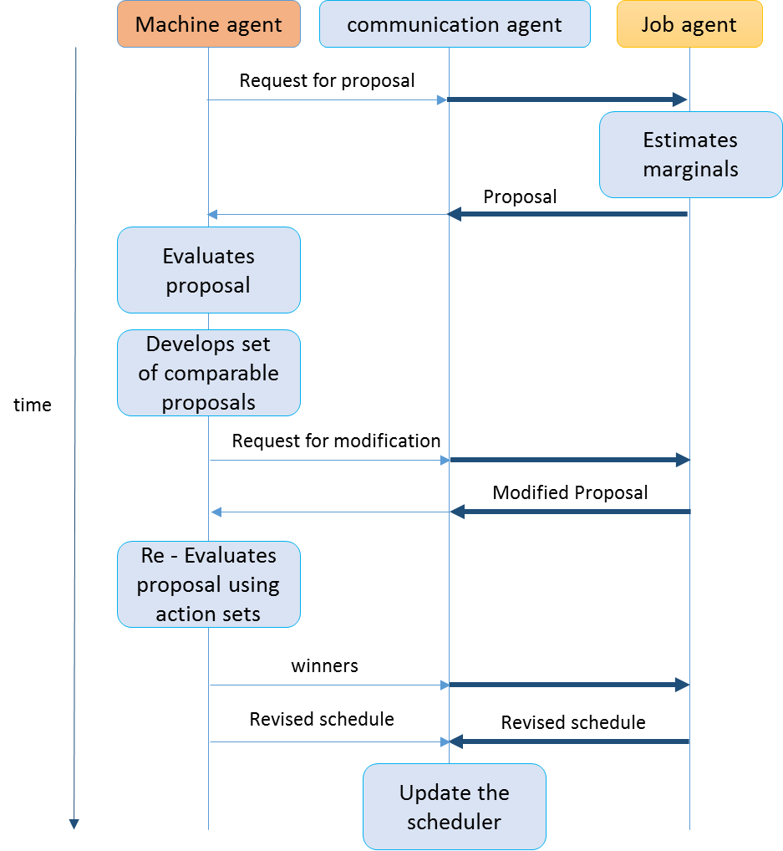
UML for Scheduling
………………………....................…………………

Slide 13
Action Set
………………………....................…………………
Jobs
Objectives
minimize completion time
minimize overall energy consumption
Action set
If two jobs are scheduled to be processed at the same time in two machines parallely, keep one job with higher processing time(averaged over different speeds) in waiting while processing the other job.
Reshuffle the order of the jobs to be processed in different machines
Machines
Objectives
Minimize makespan
Maximize utilization
Action set
Insert idle time in the scheduling plan of machines if peak energy constraint is expected to be violated.
Change the speed at which the jobs are scheduled to be processed in machine. It is assumed that the energy consumption decreases as the processing time increases

Slide 14
Negotiation Protocol
………………………....................…………………
Rule based Negotiation
Peak energy violation is never allowed
Global objective of minimizing makespan is preferred over local objectives in case of conflict between the different agents
To break the ties between the different actions with equal marginal, the action with overall minimum energy consumption is selected
if machine agent changes speed such that it cannot be used for a particular job agent, that processing speed cannot be used
Re-schuffling and selection of different speed is preferred over adding idle time in the machine as idle time increases the makespan and is it assumed that the machines consume energy even when they are idle

Slide 15
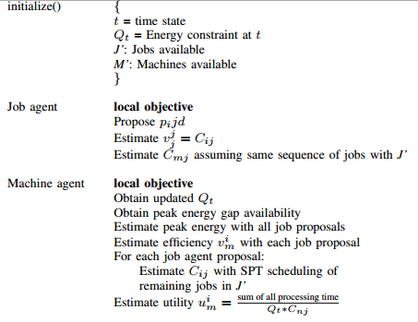
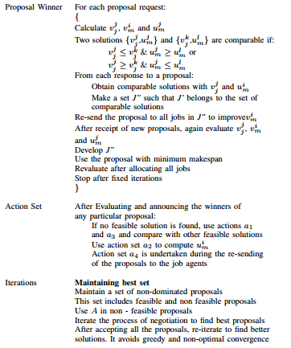
Negotiation Process
………………………....................…………………

Slide 16
Conclusion
………………………....................…………………
With the evolution of information technology and internet services, a huge potential has been created for developing IoT
IoT has created opportunity for involving customers directly in the manufacturing process and manufacturing lifecycle
Increasing energy costs is a growing concern for manufacturing industries. With changing energy charges pattern, controlling energy consumption has become significant
This paper introduces a concept of “intelligent jobs” and shows an application of intelligent job in scheduling manufacturing operations and restricting the peak energy consumption
An Agent Based modelling framework is proposed to handle the scheduling problem with peak energy constraint

Slide 17
Future research Directions
………………………....................…………………
The model can be extended to include various different entities in the manufacturing network like unloaders, warehouse storage devices, material handling devices, building energy controllers etc.
The framework presented in this paper can be extended to different manufacturing set-ups like flexible job-shop or assembly lines.
The action set of agents can be developed based on the environment and requirements. In this paper only jobs and machines are connected.
Concepts of Complex networks could be used in better understanding of the connected networks, their behavior and reaction to external and internal perturbations
As we all talk of scope, its enormous and growing enormously.

Slide 18
Literature Review
………………………....................…………………
F.S. Hsieh and C.Y. Chiang (2011) Collaborative composition of processes in holonic manufacturing systems, Computers in Industry, 62:51-64
G. Mouzon and M.B. Yildirim (2008) A framework to minimise total energy consumption and total tardiness on a single machine, International Journal of Sustainable Engineering, 1(2):105116.
Internet of Things (IoT): A vision, architectural elements, and future directions (2013) Future Generation Computer Systems, 29
K. Bunse, M. Vodicka, P. Schonsleben and F.O. Ernst (2011) Integrating energy efficiency performance in production management - gap analysis between industrial needs and scientific literature, Journal of Cleaner Production, 19(6-7):667 – 679
N. Bessis and C. Dobre (2014) Big Data and internet of Things: Roadmap for Smart Environments, Studies in Computational intelligence,546
K. Fang, N.A. Uhan, F. Zhao, and J.W. Sutherland (2013) Flow shop scheduling with peak power consumption constraints, Annals of Operations Research, 206(1):115-145.
S. Gaglio and G. Lo Re (2013) Advances onto the Internet of things, Advances in Intelligent Systems and Computing, 260
P. Anussornnitisarn, S. Y. Nof and O. Etzion (2008) Decentralized control of cooperative and autonomous agents for solving the distributed resource allocation problem, International Journal of Production Economics,98:114-128

Slide 19
Questions
Suggestions

