Slide 1
Collaborative Research: NRI: Ocean-Powered Robots for Autonomous Offshore Aquaculture
Tomonari Furukawa
Professor and Zinn Faculty Fellow
Department of Mechanical and Aerospace Engineering
University of Virginia

Slide 2
Schedule
7:00pm-7:15pm: Introduction
7:15pm-7:25pm: Project Overview (Tomo Furukawa)
7:25pm-7:40pm: Aquaculture (Yan Jiao, Iman Pakzad)
7:40pm-7:55pm: Energy Harvesting (Lei Zuo, Yaling Yang)
7:55pm-8:10pm: Autonomous ROV navigation (Brendan Englot, Ivana Collado)
8:10pm-8:25pm: Autonomous ROV manipulation (Long Wang, Justin Sitler)
8:25pm-8:35pm: Autonomous USV (Tomo Furukawa, Tyler Haden)
8:35pm-9:00pm: Discussion

Slide 3
Attendees / Invitees
University of Virginia
Tomo Furukawa (PI)
Tyler Haden (MS student)
Virginia Tech
Lei Zuo (PI)
Yaling Yang (SP)
Jin Hyuk Yu (PhD student)
Yan Jiao (Co-PI)
Iman Pakzad (PhD student)
Stevens Institute of Technology
Brendan Englot (PI)
Ivana Collado (PhD student)
Long Wang (Co-PI)
Justin Sitler (PhD student)
Industry Advisory Board (IAB)
InnovaSea
Rafi Cordero (SP)
Blue Ocean Mariculture
Dick Jones
OpenBlue
Derik Foster
Ocean Era
Neil Sims
E-Wave Technologies
Junhui Lou
NEC Corporation
Yasuyuki Nasu
Ikuko Fujikawa
Jun Kobayashi

Slide 4
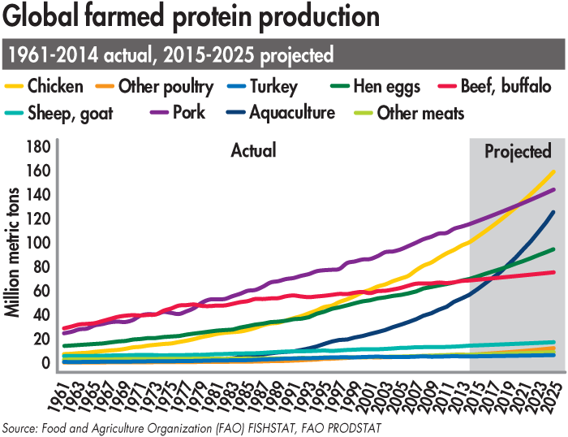
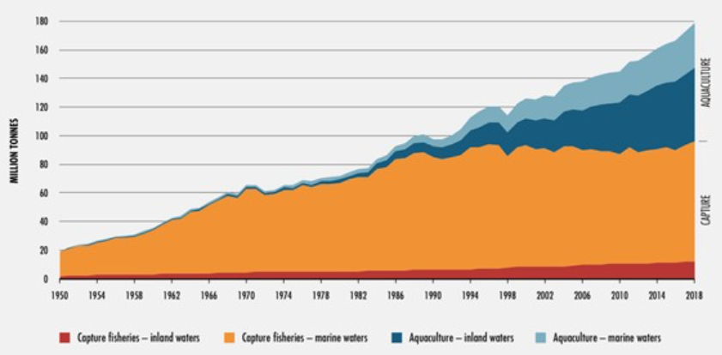
Offshore Aquaculture
Aquaculture has been the fastest-growing source of animal protein since 1990.
Offshore aquaculture may yield 10-100 times the fish production, compared with inshore aquaculture.
United States remains a relatively minor aquaculture producer (ranked 16th in 2018).
There is huge potential for offshore aquaculture.

Slide 5
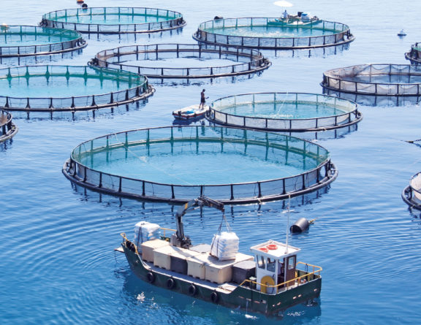
Issues Identified in Offshore Aquaculture
Labor-intensive and high-risk tasks
Cleaning;
Dead fish removal
Facts
Human divers are sent to fish pens to remove dead fish every day.
Monthly cleaning work to mitigate biofouling.
Offshore environment is subject to high waves and aggressive sea creatures.

Slide 6
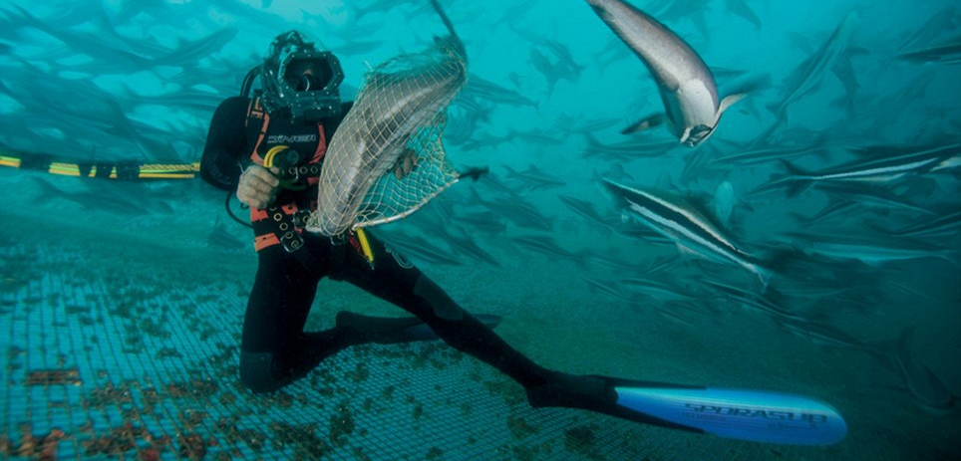
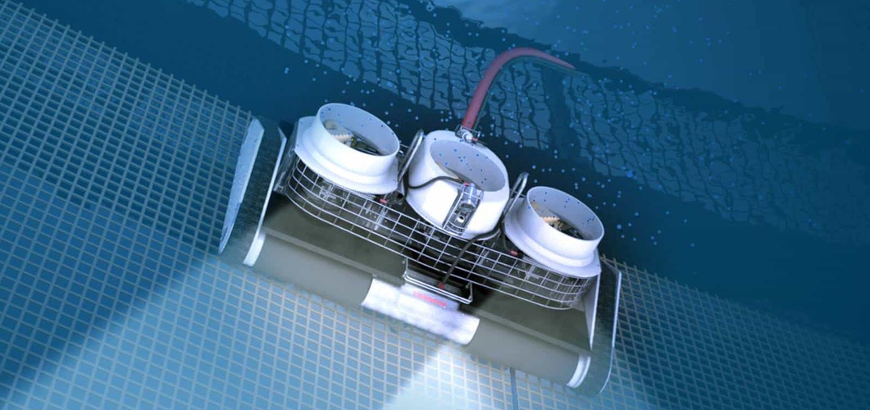
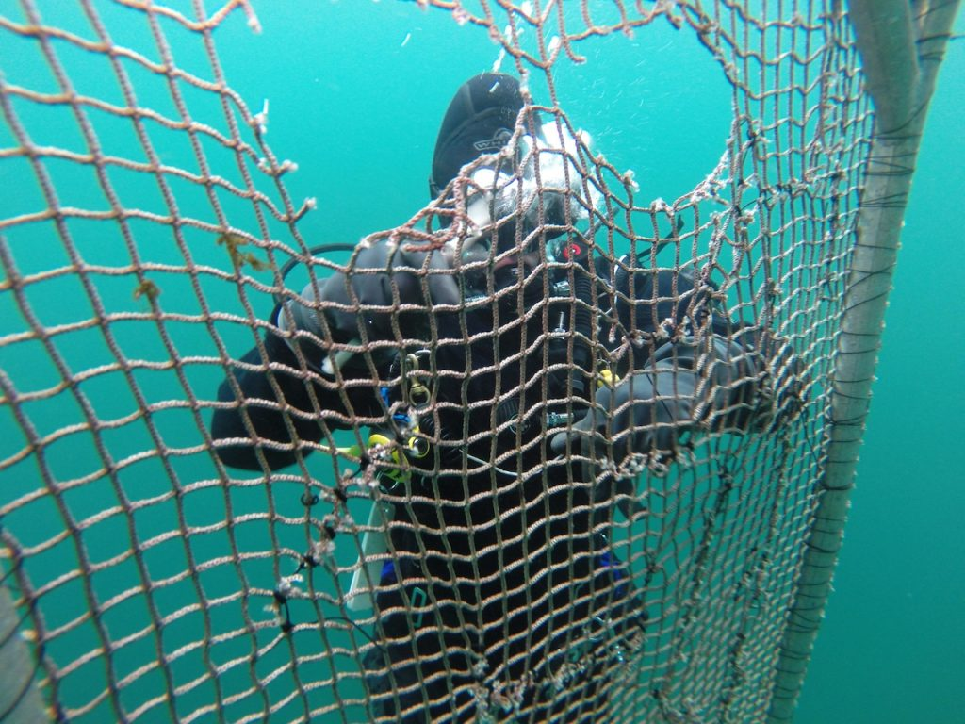
Limitations of Existing Technologies
Power Supply: Battery self-powered or Diesel-powered at surface, which has limited electricity production.
Cleaning Performance: Predominant high-pressure water blasting of algae introduces problematic waste into pens and surrounding environment.
Dead Fish Removal by Divers: Daily cleaning by human divers expose them to unnecessary danger.
Lack of Autonomy: Skilled operation and careful monitoring are necessary.

Slide 7
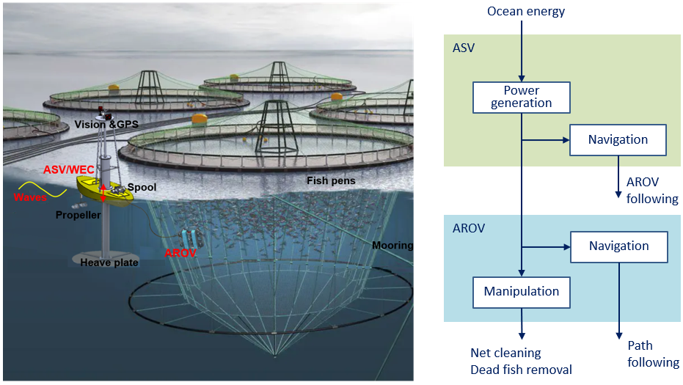
Our Solution
System modules
Autonomous Surface Vehicle (ASV) with Wave Energy Converter (WEC) – Harvest energy
Autonomous Remotely Operated Vehicle (AROV) – Consume energy and complete cleaning / dead fish removal.

Slide 8
Our Contribution
Conventional
Battery self-powered or diesel powered
Heavy-duty
Heavy
Joystick control
Proposed
Ocean energy harvesting
Light-duty
Light
Autonomous (24/7)
Expensive equipment
Expensive maintenance
Skilled operation
Limited use
Low-cost equipment
Low-cost maintenance
Unskilled operation
Extensive use

Slide 9
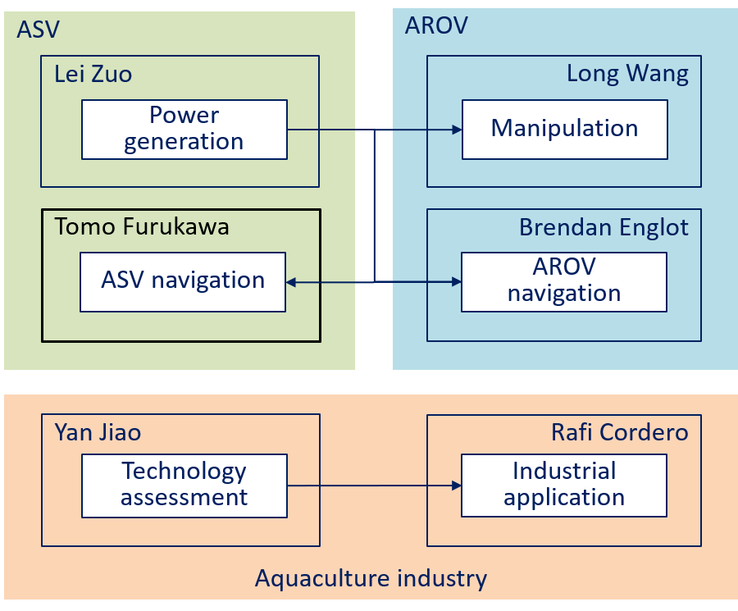
Research Team and Collaboration Plan
Local community education
Diverse community education
Robotics
Energy harvesting
UVA
VT
Management
Grad students
Tomo Furukawa
Lei Zuo
Grad students
SIT
Brendan Englot
Long Wang
Fisheries
Grad students
Yan Jiao
Aquaculture industry
IAB
Research team
Supervision
Collaboration
Interaction
Collaboration plan

Slide 10
IAB
InnovaSea
Rafi Cordero (SP)
Blue Ocean Mariculture
Dick Jones
OpenBlue
Derik Foster
Ocean Era
Neil Sims
E-Wave Technologies
Junhui Lou
NEC Corporation
Yasuyuki Nasu
Ikuko Fujikawa
Jun Kobayashi
Benefits and possible follow-on activities
Leading offshore aquaculture business
Leading offshore aquaculture technology
Commercialization
Implementation
Project
University team
Seed transfer
Development
Need transfer
Research
Technology transfer
IAB
New technology
Industry-University Collaboration

Slide 11
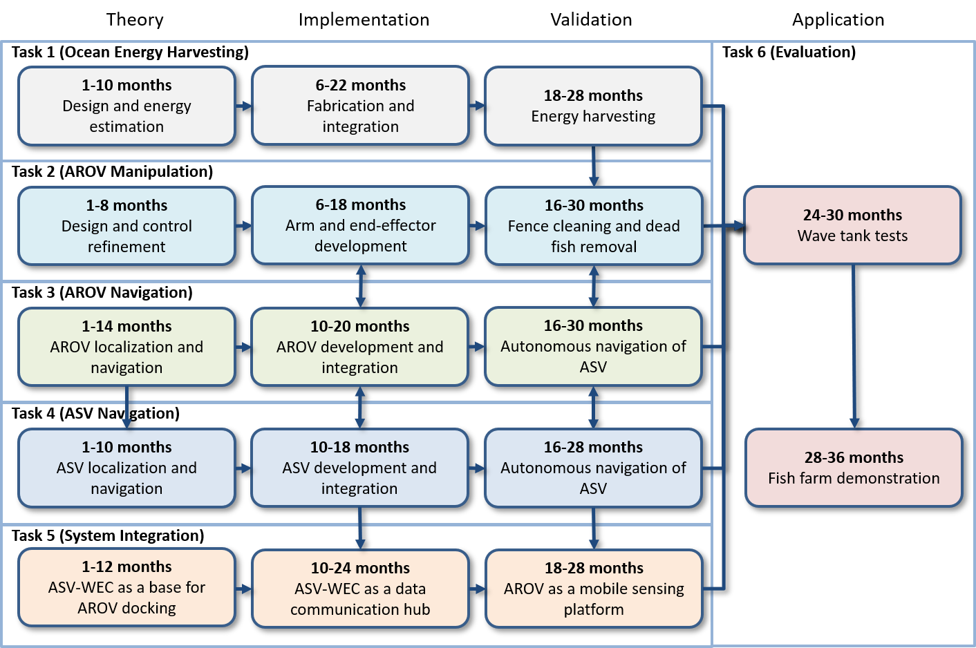
Research Plan

