Slide 1
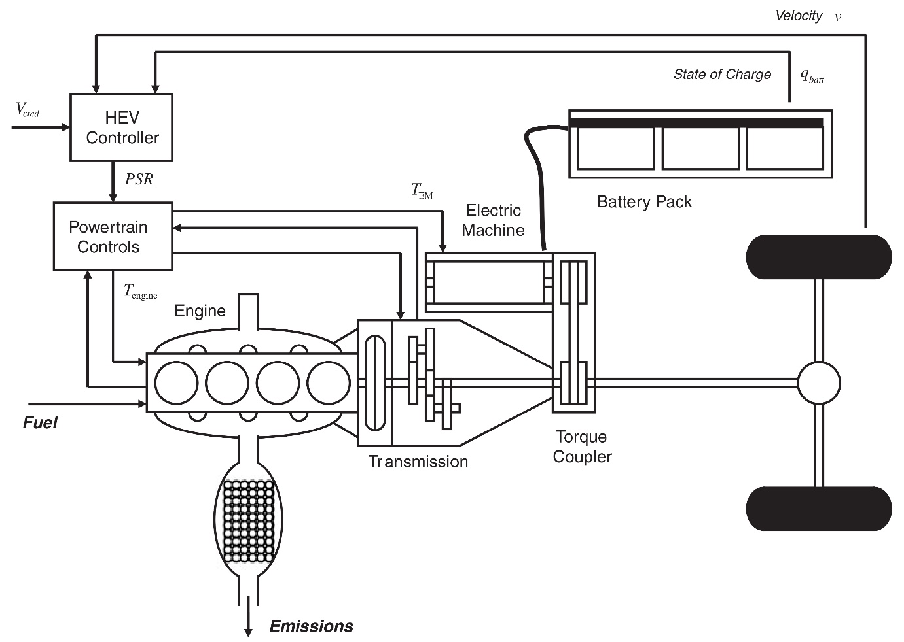
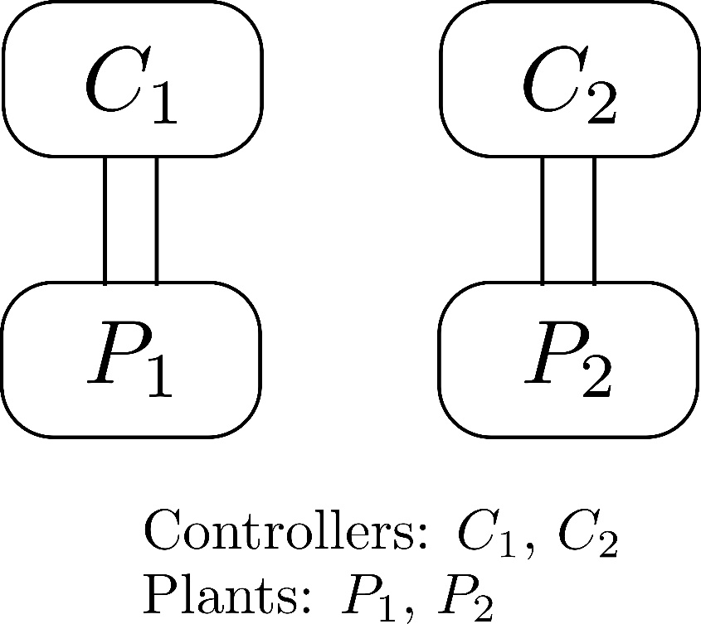
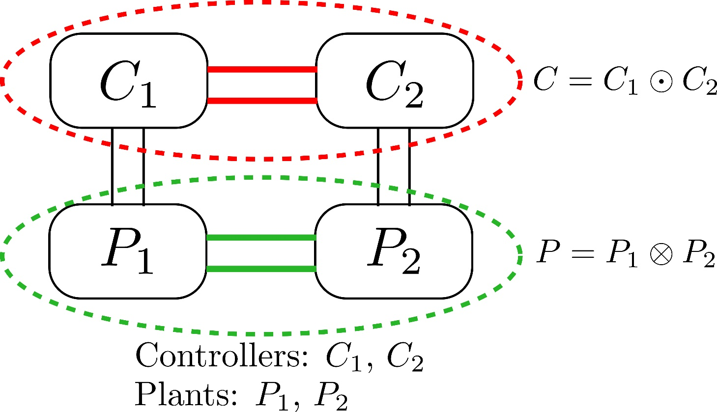
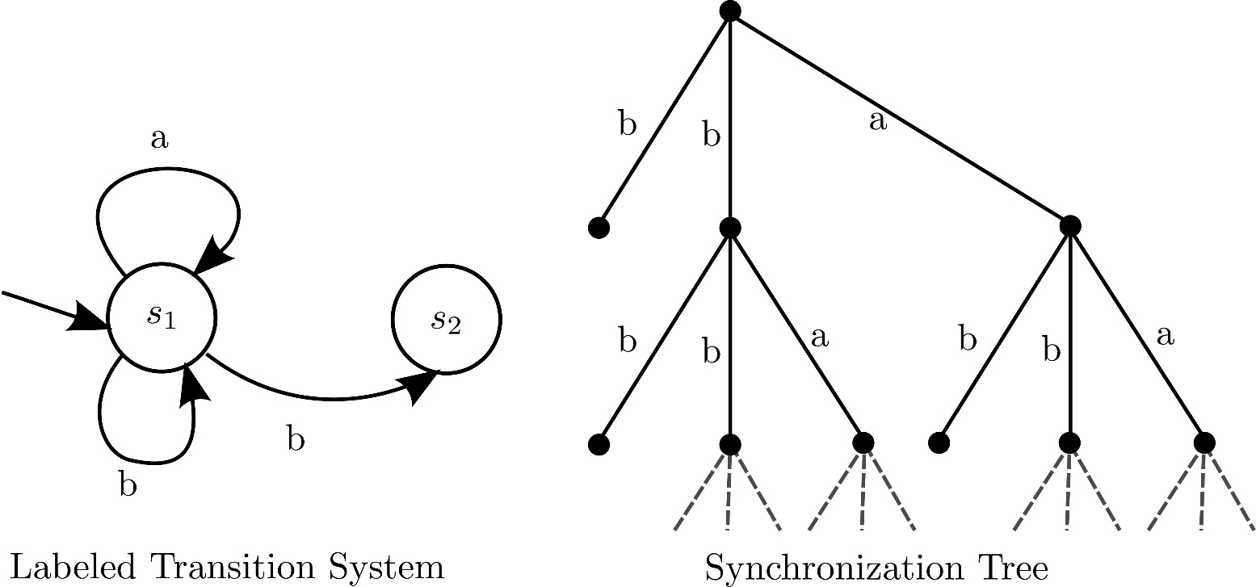
Generalized Synchronization Trees James Ferlez†, Rance Cleaveland§ and Steve Marcus† §Department of Computer Science & †Department of Electrical and Computer Engineering
CPS Program Information
Generalizing Trees
Research: Composition and Congruence
CPS Breakthrough: Compositional Modeling of Cyber-Physical Systems (NSF Grant: CNS-1446665)
PIs: Rance Cleaveland and Steve Marcus
Definition:
A tree [3] is a partially ordered set $(P,≤)$ with the following two properties:
There is a $p_{0}∈P$ such that $p_{0}≤p$ for all $p∈P$. $p_{0}$ is the root of the tree.
For each $p∈P$, the set $\left\{p^{′}∈P | p^{′}≤p\right\}$ is linearly ordered by $≤$.
In a synchronization tree there is a natural partial order for the nodes. This partial order labels each node with the list of its predecessors (on the path connecting it to the root); then the nodes are partially ordered according to sequence prefixes.
Goal: an algebraic theory of composition for CPSs.
Composition Operators and constructions on GSTs
CSP parallel composition has already been exhibited for GSTs
Substitutivity with respect to strong and weak bisimulation
For which operators does strong-bisimulation equivalence allow substitution of GSTs? For which operators does weak-bisimulation allow substitution?
Frameworks for operator definitions
Structural Operational Semantic (SOS) style rules [5] for GSTs
Cyber-Physical Systems are Compositional
For example, hybrid powertrains (see e.g. [6]):
p₀
p₀
p
p
Research: Timed GSTs
Adding Time to GSTs
What structure should time lines have?
How can a timed GST be defined?
How can a timed GST be retimed?
Bisimulation and Timed GSTs
Time rigidity and time fluidity
Multi-time-line equivalences
Composition of Timed GSTs
(Diagram taken from [6])
Compositional Reasoning for CPSs
We need to reason about a complicated system based on models/behaviors of components:
Can the composed system be analyzed in a rigorous way?
Generalized Synchronization Trees (GSTs)
Definition:
A Generalized Synchronization Tree [1] over a set of labels $L$ is a tree $(P,≤)$ along with a labeling function $ℒ:P\backslash \left\{p_{0}\right\}→L$.
In a synchronization tree, the nodes form a discrete GST tree with the canonical partial order.
Research: Assessment
Validate GST models against real-world examples, e.g. hybrid powertrain.
Research: Model Encodings
References
Algebraic Composition of Transitions Systems
Native semantics of CPS models
Encode relevant CPS models: Hybrid Process Algebra, hybrid automata and behavioral models.
Prove correctness: GST encoding should preserve native semantics.
Non-native semantics and heterogeneous models
A single category of CPS model may admit multiple encodings: consider refinements and/or abstractions of native encodings.
Identifying the least refined common encoding for two different models allows the meaningful composition of heterogeneous CPS models.
Such encodings imply a taxonomy of CPS models.
Famously, Milner [4] devised synchronization trees for labeled transition systems (subsequently known as Process Algebra):
Definition:
A Synchronization Tree over a set of labels $L$ is a tuple $(V,E,ℒ)$ where:
$(V,E)$ is an undirected, connected, acyclic graph $(V,E)$ with a specially identified root node $r$ and
$ℒ$ is a function $ℒ:E→L∪\left\{ε\right\}$
Each path in the tree is an execution of the transition system.
Nondeterminism: multiple children with the same label.
Composition: algebraic operations on synchronization trees
[1] J. Ferlez, R. Cleaveland, and S. Marcus. Generalized synchronization trees. In Foundations of Software Science and Computation Structures - 17th International Conference, FOSSACS 2014, volume 8412 of Lecture Notes in Computer Science, pages 304–319, Grenoble, France, 2014. Springer- Verlag.
[2] Matthew Hennessy and Robin Milner. Algebraic laws for nondeterminism and concurrency. J. ACM, 32(1):137–161, January 1985.
[3] Thomas Jech. Set Theory. Academic Press, 1978.
[4] Robin Milner. A Calculus of Communicating Systems. Number 92 in Lecture Notes in Computer Science. Springer-Verlag, 1980.
[5] G.D. Plotkin. A structural approach to operational semantics. Technical Report DAIMI- FN-19, Computer Science Department, Aarhus University, Aarhus, Denmark, 3700 citations 1981.
[6] Edward Dean Tate Jr, Jessy W. Grizzle, and Huei Peng. Shortest path stochastic control for hybrid electric vehicles. Int. J. Robust Nonlinear Control, 18(14):1409-1429, December 2007.
Research: Bisimulation and Logic
Characteristic modal logics
Hennessy-Milner Logic (HML) [2] as a starting point to characterize existing notions of bisimulation for GSTs.
Different notions of bisimulation will have different characteristic logics.
CTL-like logics on GSTs
Path quantification operators for GSTs

