Slide 1
Smart Cities
Glenn Ricart
November 7, 2014

Slide 2
What is US Ignite?

Slide 3
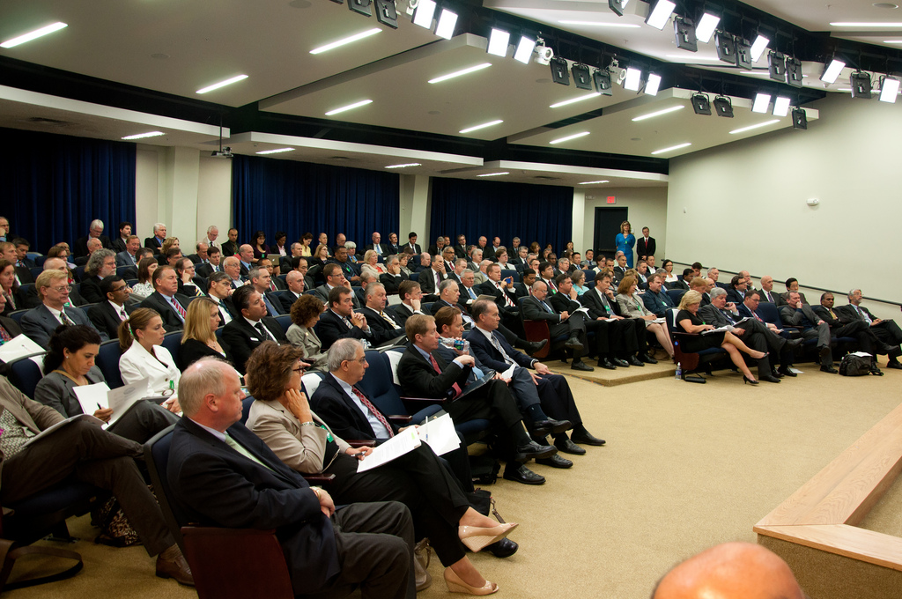

Slide 4
Public-private partnership
501(c)(3)
Notes:
We’re at a time in our country’s history when we need to build the interstate system all over again. But if we truly built the internet’s ultrafast interstate now, it would be like having an auto interstate for a population that only drives horses and buggies or Tin Lizzies. We aim to “ignite” and connect the various parties in building truly compelling, next-gen applications that can run on top of the ultra-fast networks.
To do this, US Ignite is the “+”s in this equation. We are the conveners of the communities and their needs with the providers of new technologies that address those needs – and we coordinate to help match the right resources to create the applications
US Ignite’s priority areas are healthcare, education, advanced manufacturing, energy, and

Slide 5
OUR GOALS
1
60 next-generation applications
Infrastructure
2
200 community test beds
Next-Gen Applications
Economic Leadership
3
Coordinate best practices

Slide 6
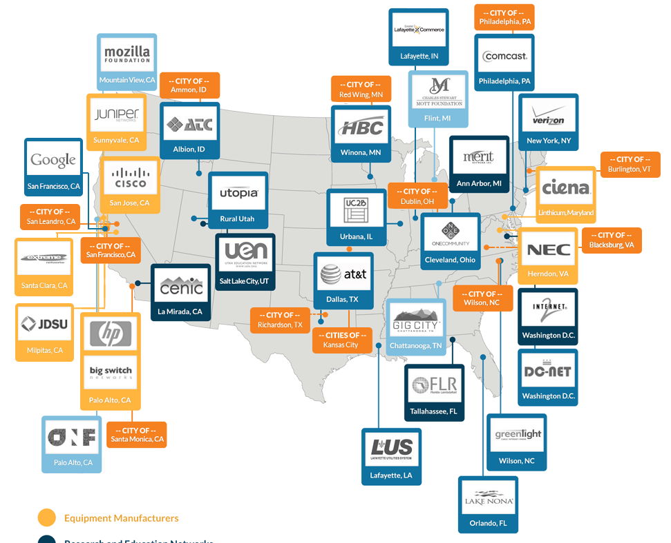
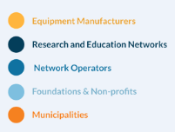
Current Partners

Slide 7
Application Characteristics
Very low latency
Reliable (no hiccups)
Support cyberphysical interactions
Big data to the end user / anchor institution
Visual data exploration (“fly-through”)
Collaborative (in the moment)
Distributed

Slide 8
CPS Connections
“Network is an important part of the system”
Virtual networks via SDN can provide:
Reduced latency
Reduced jitter
Privacy
Layer of security
City-wide gigabit can provide:
Lower latency
Capacity for overlaying virtual networks

Slide 9
Smart City
US Ignite
Real-time
Closed-loop control
Wireless gigabit
Immersive education
Smart Building (not connected)
Connected Smart Buildings
Smart grid
Rural Telemedicine
Advanced manufacturing
Personal health
Secure medical info
Emergency response
Pollution management
Real-time analysis

Slide 10
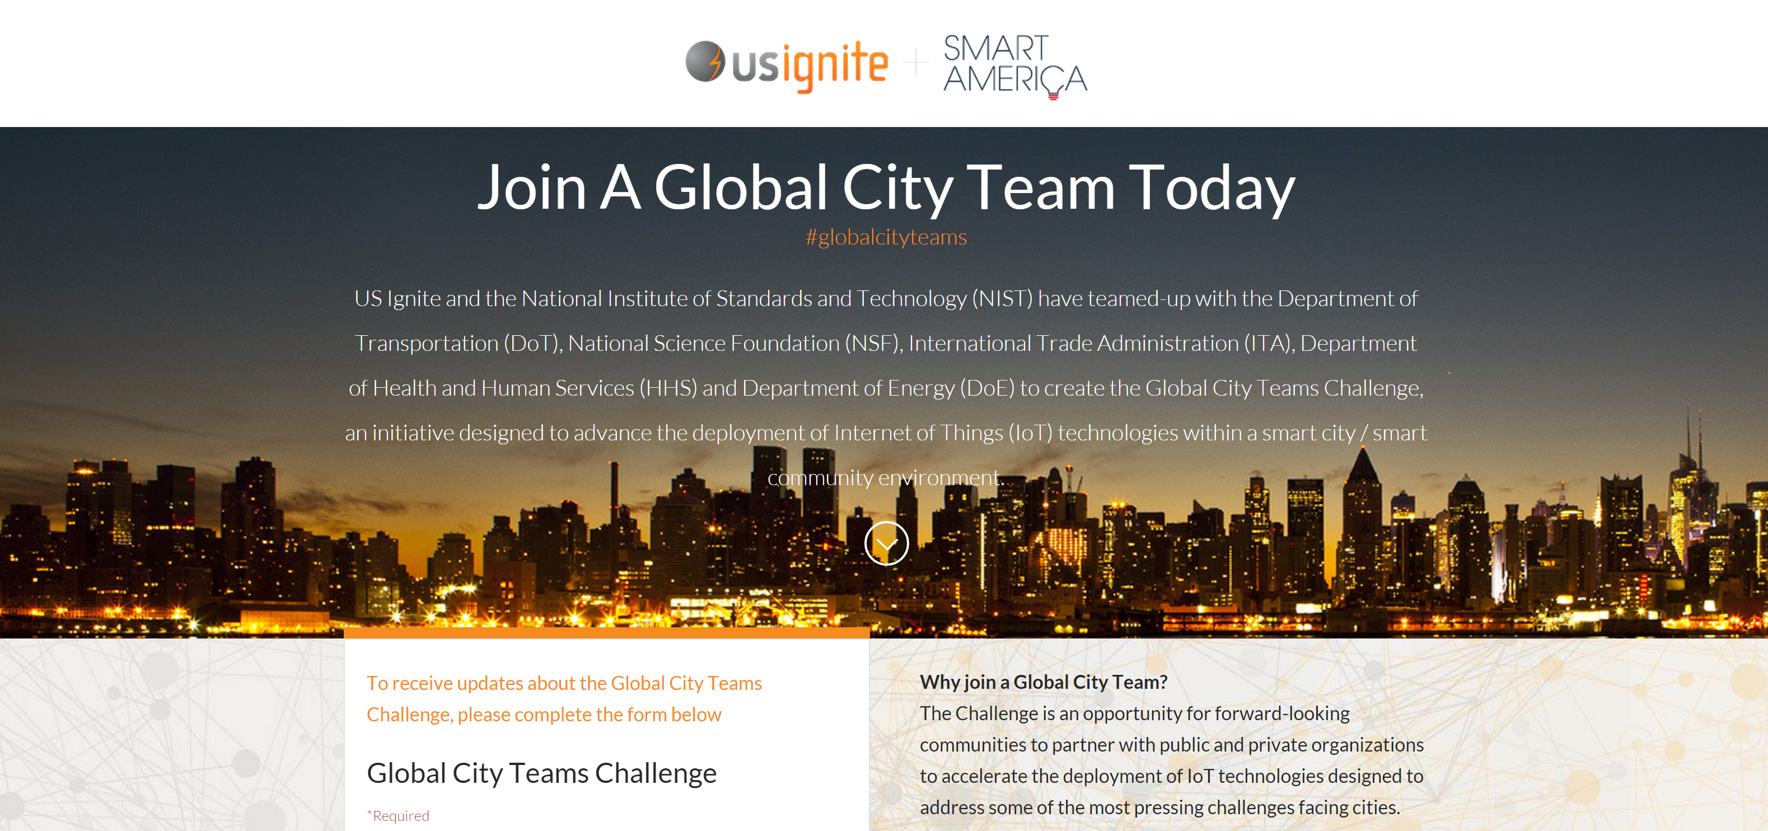

Slide 11
KEY ISSUES

Slide 12
Glenn’s Definition
A Smart City
leverages information
and adapts dynamically
to the benefit of its
citizens, government, organizations, & visitors

Slide 13
Key Challenges
Technology supporting analysis and control loops. Examples:
Low latency and reliable networks
Software-orchestrated infrastructure (SOI)
Dynamically adaptive operations research
Appropriate economic models (not just $s)
Balancing privacy with leveraging data

Slide 14
Tools
Information theory
Game theory
Team theory
Operations research
Dynamic systems modeling
Distributed decision theory

Slide 16
IoT, CPS, Global Cities
Small, inexpensive sensors (common)
Local, capable storage and compute (less common)
Low latency, reliable network (critical)
Smart, adaptive, responsive systems

Slide 17
US Ignite and Cities
Convene
Convince
Connect
Corporate Partners
Community Organizations
Cook up new projects
Collaborate
Copy the success in other cities

Slide 18
What can you measure?
Utilization (water,
What can you impact?
Price

Slide 19
Case Study: Chattanooga
Leveraging largest city-wide network in the Western Hemisphere, with Gig speeds available to 150,000
Connected with Dept. of Energy Pacific Northwest National Labs and corporate sponsors
GigTank accelerator driving development of entrepreneurial ecosystem and dozens of startups
Hackanooga” and other events driving new apps (e.g., Smart Grid, Engage3D, SimCenter)
Established businesses choosing GigCity (e.g., Amazon, VW, Access America, HomeServe USA
Over 6,000 new jobs created within past five years

Slide 20
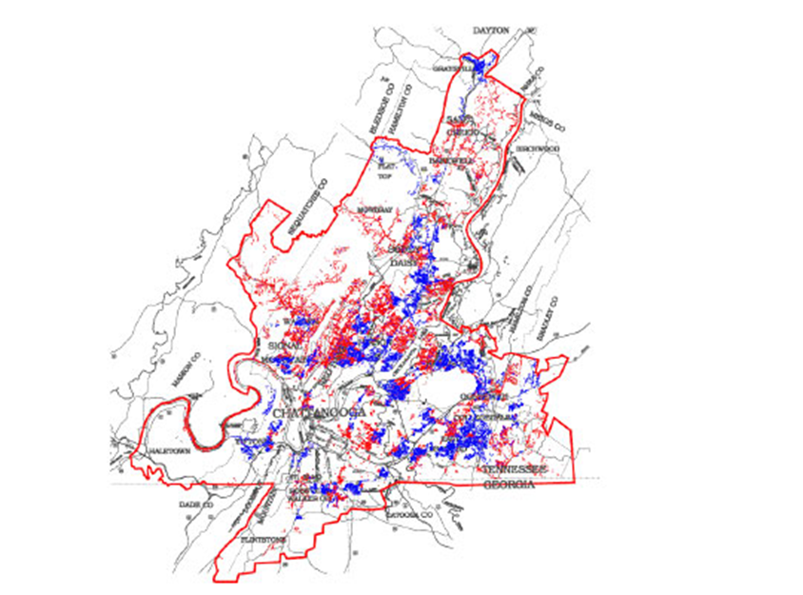
Courtesy EPB

Slide 21
Chattanooga Smart Grid
60% reduction in duration of power outages, estimated at $60M in savings to community
Replaces manual search for outage and manual re-routing
Replaces 350,000 miles of wasted vehicle travel and up to 18,000 gallons of wasted fuel
All made possible by a network with less than 7ms latency

Slide 22
CCX

Slide 23
Current US Ignite Cities
Ammon, ID
Austin, TX
Blacksburg, VA
Burlington, VT
Chattanooga, TN
Cleveland, OH
Dublin, OH
Kansas City, MO and KS
Lafayette, LA
Lake Nona, FL
North Carolina (incl. Raleigh, Durham, Chapel Hill)
Orem, UT
Philadelphia, PA
Provo, UT
Redwing, MN
Richardson, TX
Salt Lake City, UT
San Francisco, CA
San Leandro, CA
Santa Monica, CA
Utah Education Network (state-wide schools and museums)
UC2B
Washington, DC
Wilson, NC

Slide 24
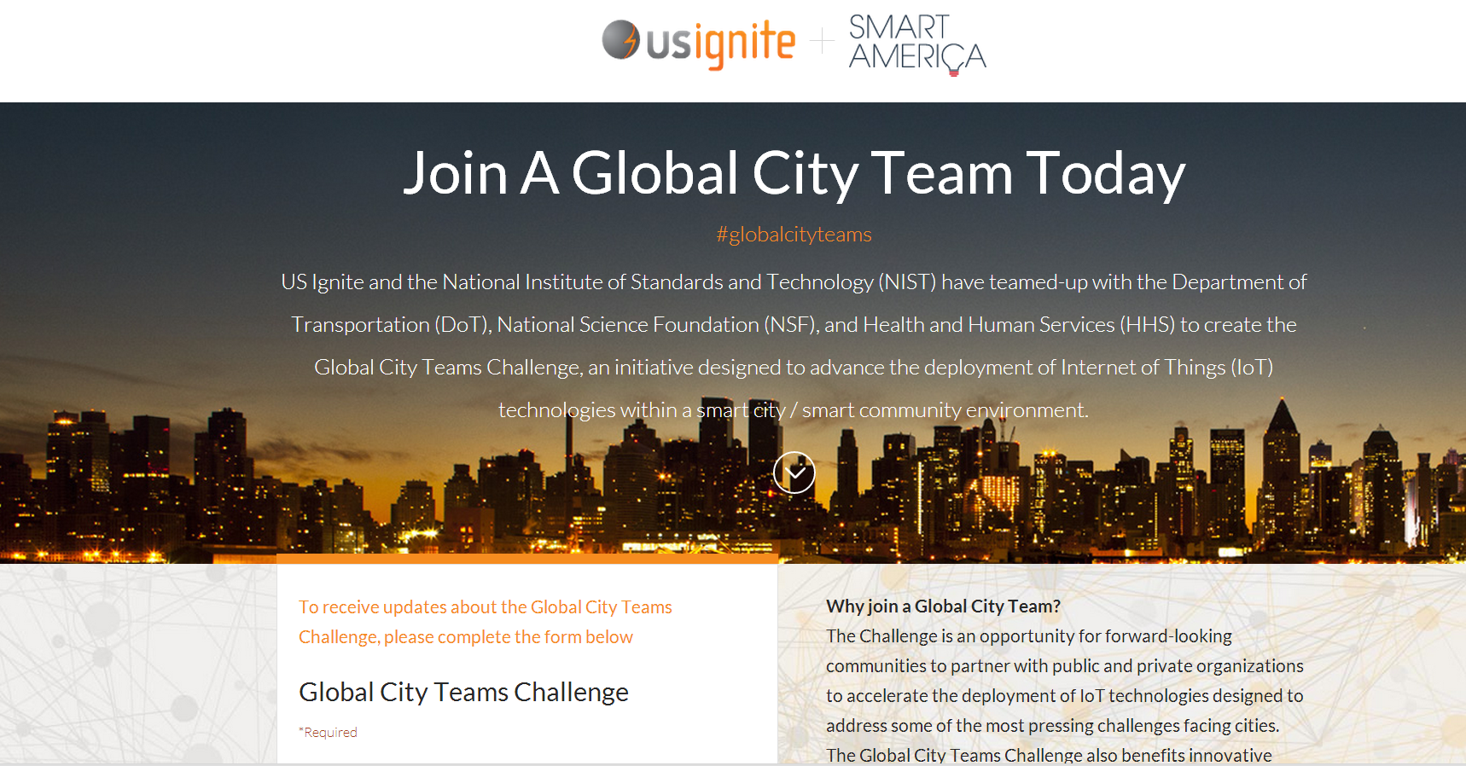

Slide 25
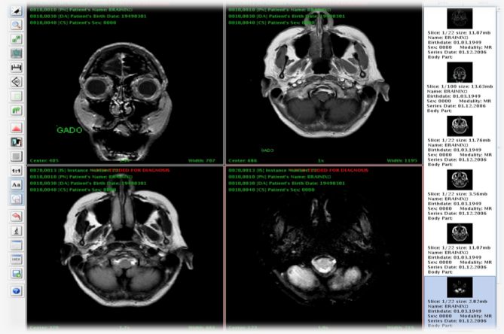
Remote Radiology

Slide 26
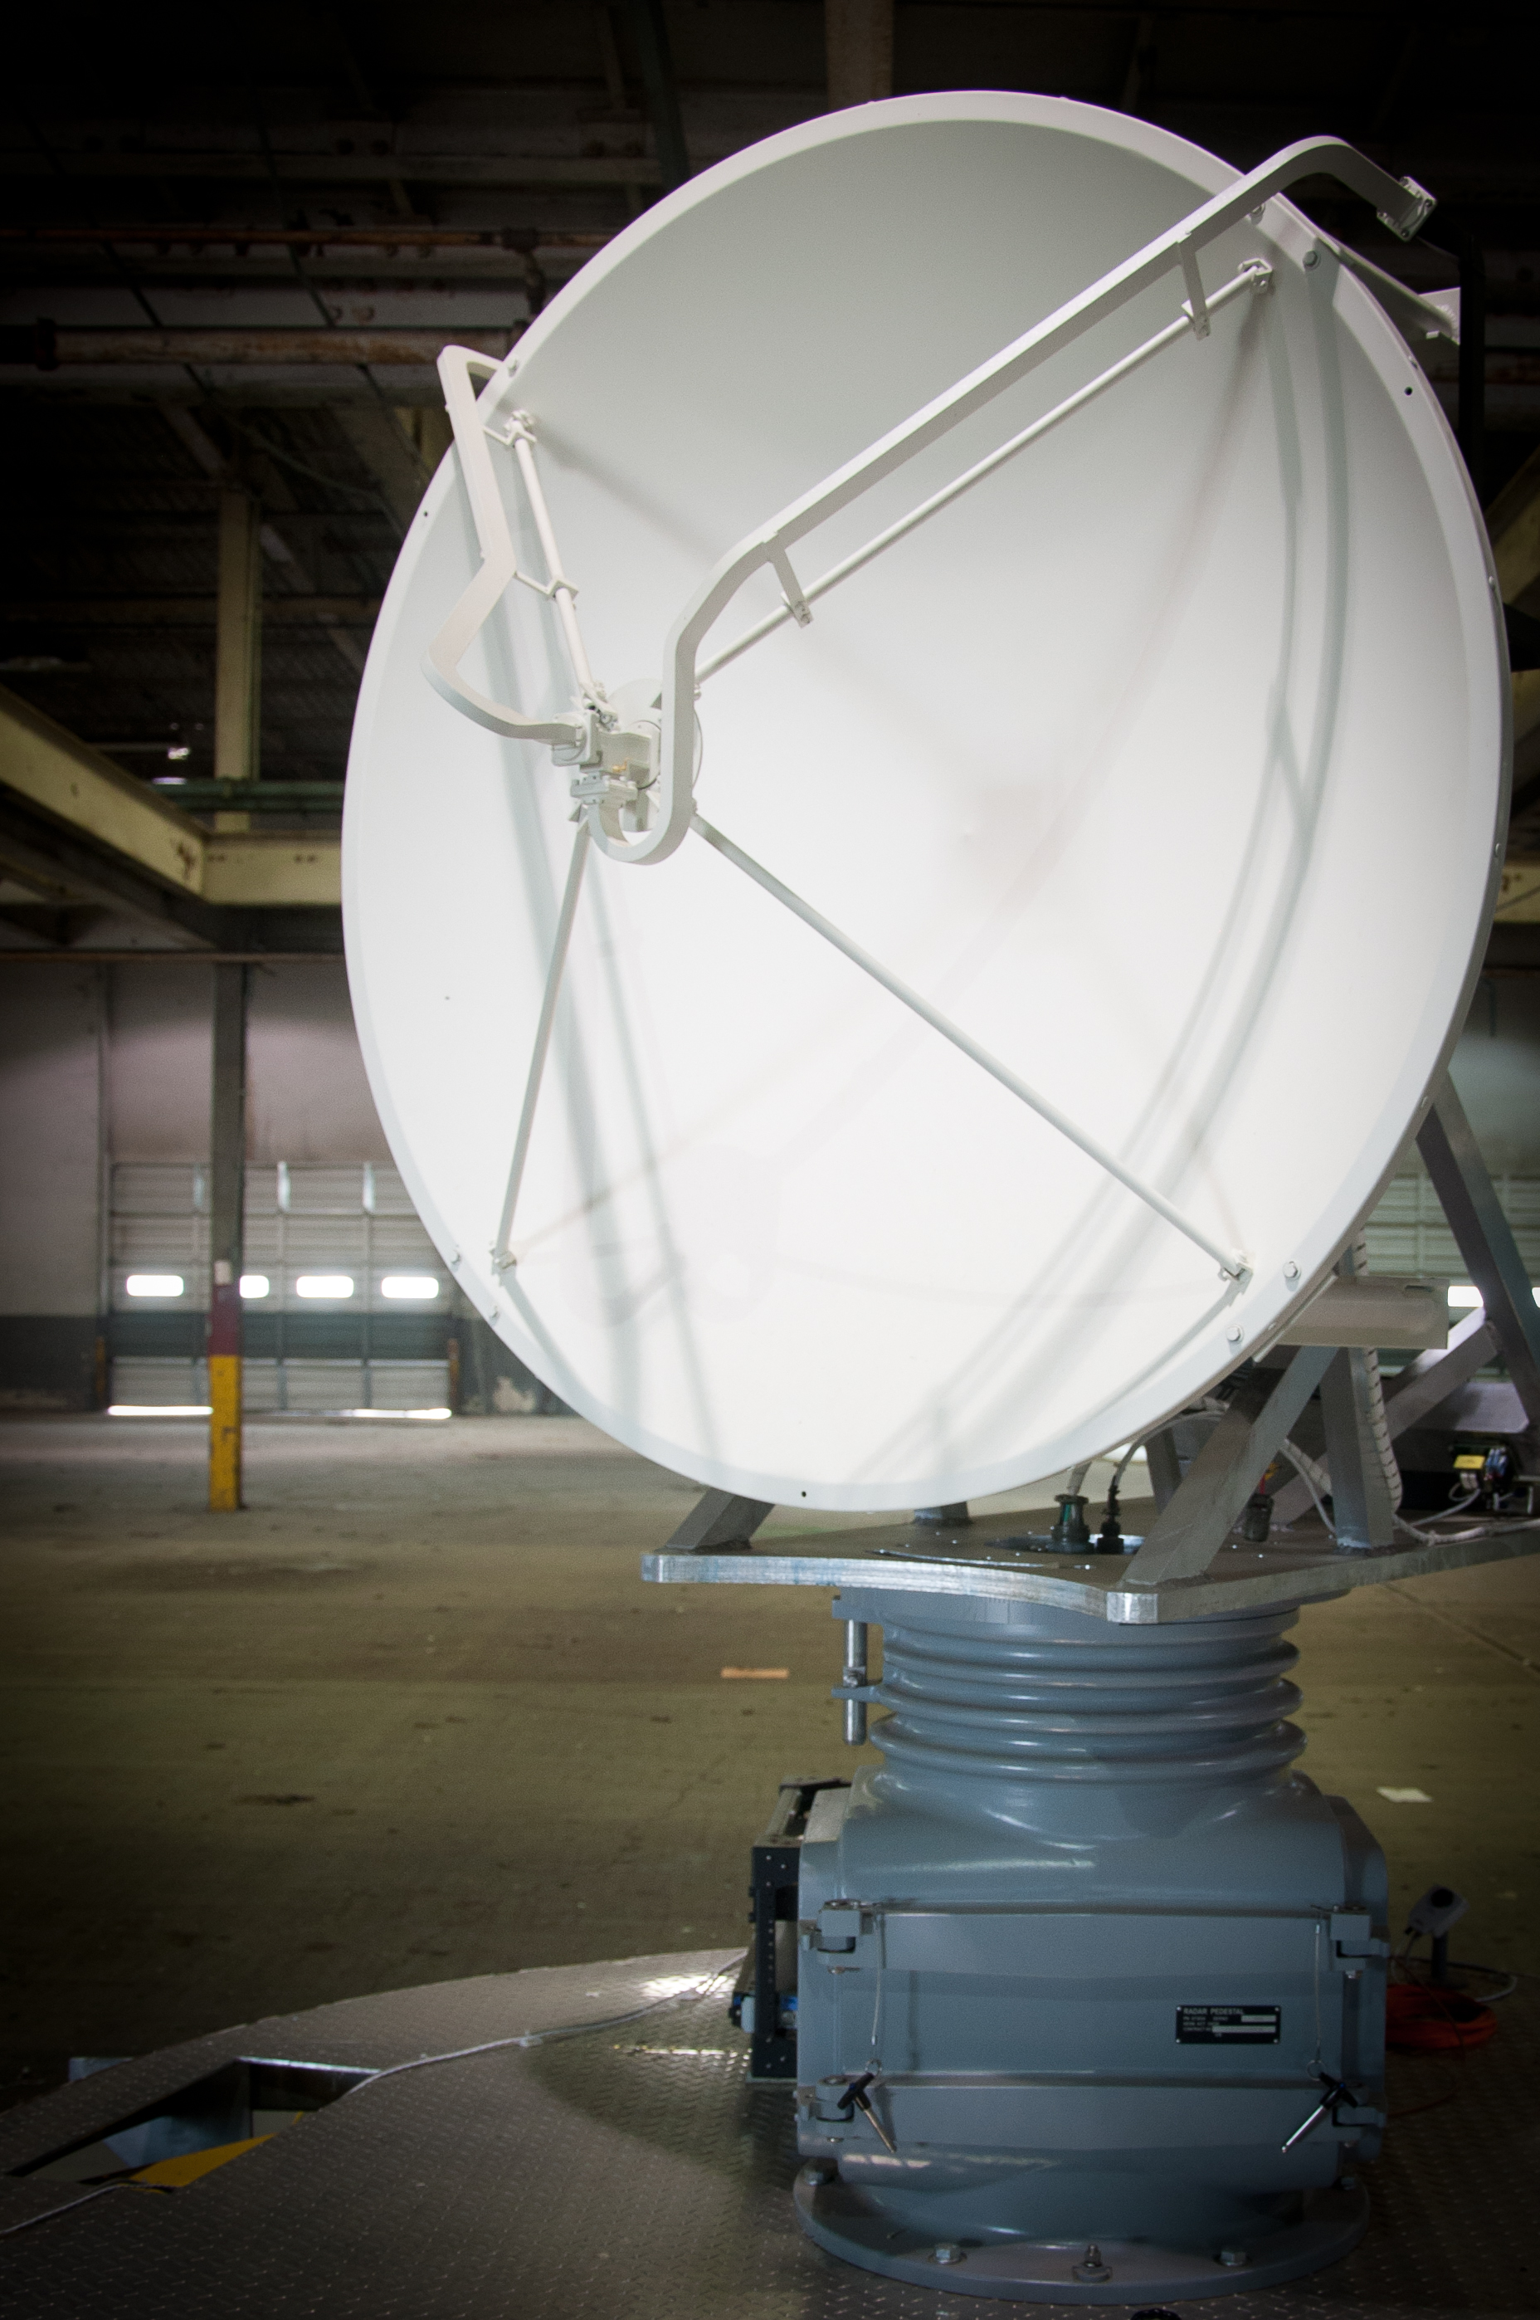
CASA Radar

Slide 27
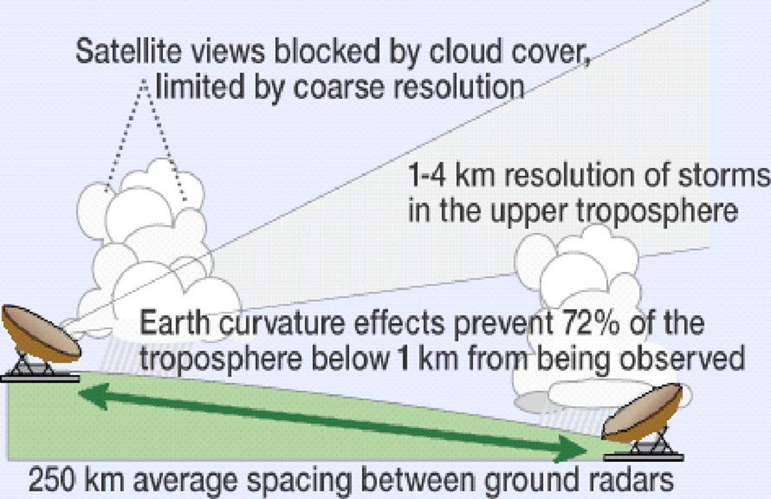
Courtesy Mike Zink

Slide 28
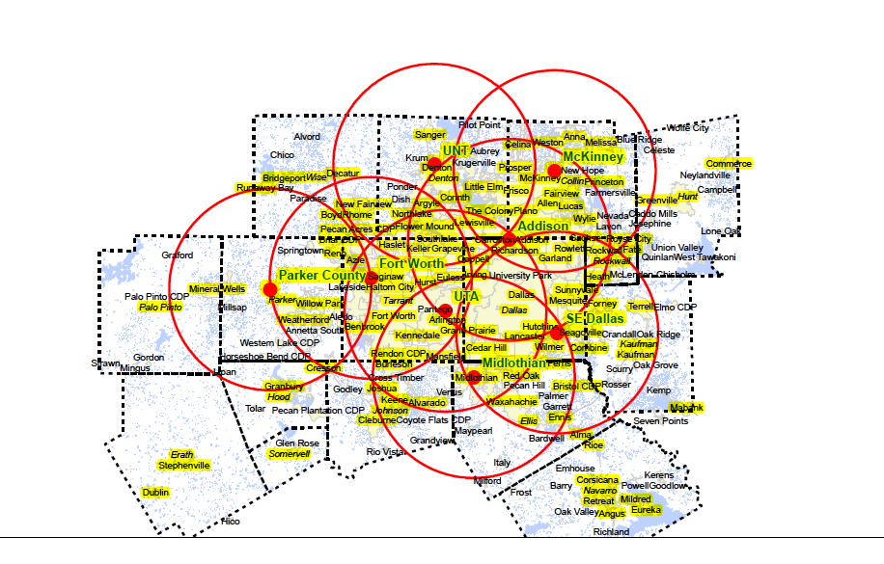
Courtesy Mike Zink

Slide 29
Courtesy Mike Zink

Slide 30
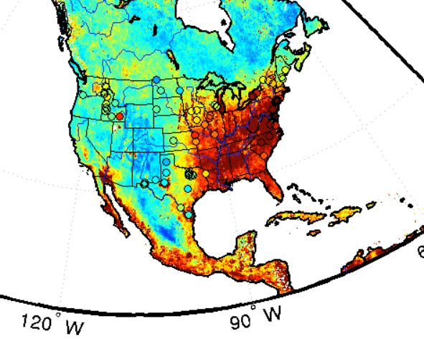
PM_{2.5} Modeling
Courtesy David Lary

