Slide 1
Historical Context for USDA
1862 Morrill Act established land-grant universities as colleges of agriculture and mechanic arts
U.S. Department of Agriculture established the same year to serve as the federal partner to the LGU system (NIFA mission today)
Now, 17 agencies in USDA: land management, regulation, marketing, inspection, and R&D

Slide 2
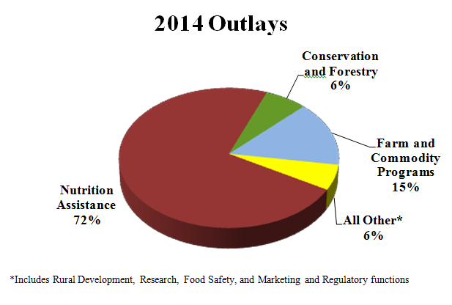
USDA

Slide 4
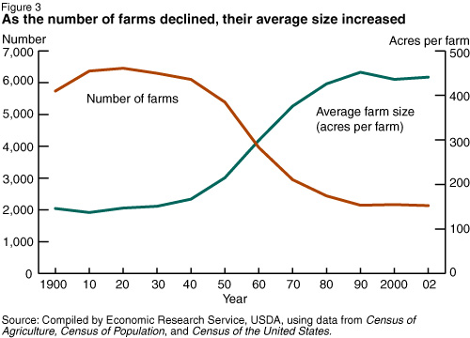
U.S. Agriculture
2.2 million “farms”
Average age = 57
55% of farms less than 100 acres
55% of farms are operated by retirees or persons with primary occupations elsewhere
Approx. 90-10 rule
Net exporter
Accounts for 1% of GDP (12% for food & fiber system)

Slide 5
Agricultural Resource Use
50% of U.S. land devoted to ag production
Ag uses 10% of the U.S. energy budget
70-80% of all fresh water used in U.S.
20 million tons of fertilizer (plus herbicides, fungicides, and pesticides)
Globally, we are rapidly approaching the limit for arable land
And yet, 40-50% of U.S. food is lost/wasted

Slide 6
Projections
9 billion inhabitants by 2050
Shrinking land base for agriculture
Food production must double in the next 40 years
Recent drought period in the Western U.S. has depleted the Ogalala aquifer, raising concerns for future irrigated agriculture
Climate change—with its extreme weather events, new pest pressures, and regional shifts in productivity—will increase risk and make food shortages more likely
Number of people globally that are food insecure continues to increase

Slide 7
Strategic Vision
Mission: Develop the science, engineering, and technology that will enable precise (in time and space) practices and decision making that require fewer inputs, while increasing productivity and efficiency.
Vision: Through the application of advanced technologies, leading to an efficient use of resources, food, feed, fiber, and biofuel systems will become more sustainable nationally and globally.

Slide 8
Precision Agriculture
Precision farming or site-specific crop management is a farming management concept based on observing, measuring and responding to inter- and intra-field variability in crops. Crop variability typically has both a spatial and temporal component. The holy grail of precision agriculture research will be the ability to define a Decision Support System for whole farm management with the goal of optimizing returns on inputs while preserving resources.

Slide 9
Expanded Precision Agriculture
Just-in-time-and-place agriculture relies on the application of tightly coupled and highly dense information, sensing, and actuation spaces representative of the physical environment in time and space—throughout our food, feed, fiber, and biofuel systems—that can be interrogated, manipulated, or controlled by humans or other intelligent agents.

Slide 10
Technology Constraints
Robust technologies that can be applied to a wide variety of crops and operations: e.g., varying fruit size, plant/animal size and arrangement, and cultural practices
Scale-neutral technologies: viable for both large and small operations
Crisis-driven industries: weather, regulation, insects and diseases

Slide 11
CPS and NIFA
CPS MOU signed July 1, 2014: NIFA and NSF Engineering and CISE
Includes intention for NIFA to participate in NSF’s 2016 CPS solicitation
Conference on CPS in Agriculture would be timely (conference grants available)

Slide 12

Contact Information
Daniel Schmoldt, PhD
National Program Leader
USDA National Institute of Food and Agriculture
800 9th Street SW
Washington DC 20024
dschmoldt@nifa.usda.gov
+1 202-720-4807

