Slide 1
CPS: Synergy: Collaborative Research: Hybrid Continuous-Discrete Computers for Cyber-Physical Systems
CNS-1239134 (Columbia University)
Y. Tsividis (lead PI), M. Seok, S. Sethumadhavan,
CNS-1239136 (University of Texas, Austin)
M. Bryant, B. Fernandez
CPS PI Meeting, Crystal City, VA, October 17-18, 2013

Slide 2
Goals
Develop hardware and software that merge discrete and continuous computing on a single chip
Use this to enable CPS with:
  Higher energy efficiency
  Higher speed
  Improved numerical convergence

Slide 3
Classical digital computers
Pluses:
Well-known
Minuses:
Computational convergence issues
High power for high speed
Expensive (latest) technology
Technology issues (leakage currents, variability…)

Slide 4
Classical analog computers
Pluses:
True parallel computing
Convergence virtually guaranteed
Minuses:
Limited accuracy
Limited programmability
Investigated in the 1940s-70s and then abandoned.

Slide 5
Analog computers in a CPS context
Limited accuracy is not an issue
  Sensors in CPS are often low-accuracy anyway
Programmability is not an issue
  Make analog part of a hybrid computer
VLSI can potentially change the game
Preliminary results are very encouraging [1]:
  80th-order DEs solved (incl. nonlinear PDEs)
  Problems: Chip size, accuracy, no digital on-chip

Slide 6
Digital computing in a CPS context
High resolution is not critical
  Signals often come from limited-accuracy sensors
  Small number of bits is adequate
Ideal for control flow tasks in hybrid computer
Ideal for memory functions
Ideal for analog calibration tasks
Can perform computational tasks when warranted.

Slide 7
Our approach
ANALOG
CORE
ADC
ARRAY
ANALOG
IN/OUT
INTER-
CONNECT
FABRIC
DIGITAL
IN/OUT
DIGITAL
CORE
DAC
ARRAY
DIGITAL
MEMORY
Hybrid continuous-time and discrete-time computing (HCDC) on the same chip [2]
Can benefit by not going to latest technology node (even for digital [3])

Slide 8
Instruction Set Architecture
Configurable: Analog data path topology and all chip parameters are fully accessible via ISA during runtime
Dynamic: ISA provides control over execution timing; multiple stopping conditions available
Adaptable: Simulation results accessible in real time via both serial and parallel digital interfaces
Fail-safe: Data-out-of-bound errors are communicated to digital hardware so new computational parameters can be generated.

Slide 9
Analog circuit design
Current-in, current-out blocks
  Ease of addition
  Noise immunity
A few basic blocks, extensively used
  Integrators
  Multipliers
  Fan-out elements
Digital calibration reduces analog imperfections

Slide 10
Digital circuit design
On-chip memory array and peripherals
  Custom memory to enable event-driven operation
  Low voltage operation with level conversion to reduce peak power and noise
Off-chip / testing interface
  Scan-chain for testing
  Serial peripheral interface (SPI) for off-chip interface

Slide 11
Hybrid circuit design
DIGITAL
MEMORY
ADC
DAC
Flexible, programmable nonlinearity implementation
Event-driven, continuous-time design [4] (no clock) for compatibility with other analog modules
  Continuous-time ADC/DAC
  Custom memory array

Slide 12
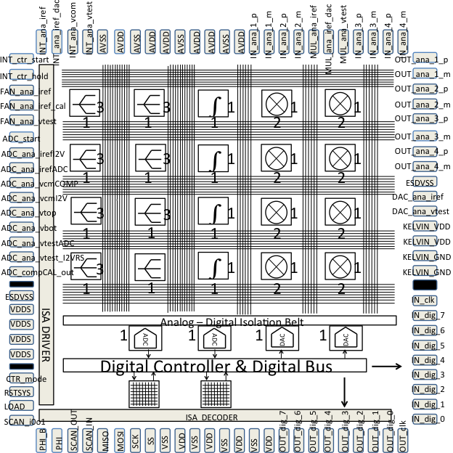
First test chip – floor plan

Slide 13
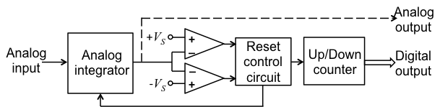
In progress:
High-precision, hybrid integrator [5]
Operation:
  Integrator accumulates to sub-rail threshold
  Comparator triggers capacitor reset + counter increment
So far, PCB prototypes via class projects

Slide 14
Hybrid integrator, cont’d
Integrating analog & digital
  True real number output with extended range
  Fully differential
Future:
  Taylor series in analog (using R2R ladders & DACs) for nonlinear functions
  Digitally programmable

Slide 15

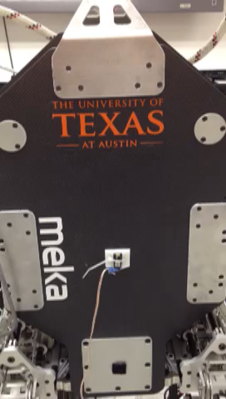
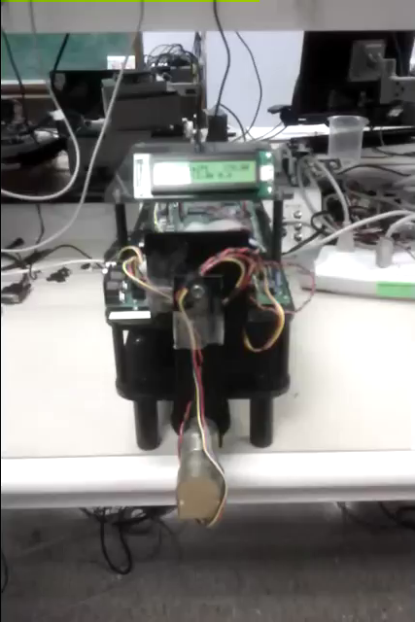
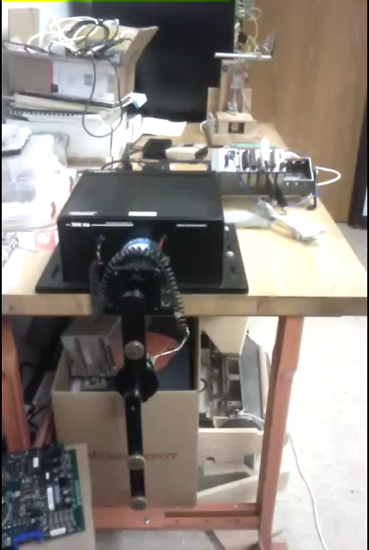
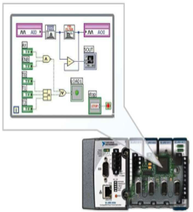
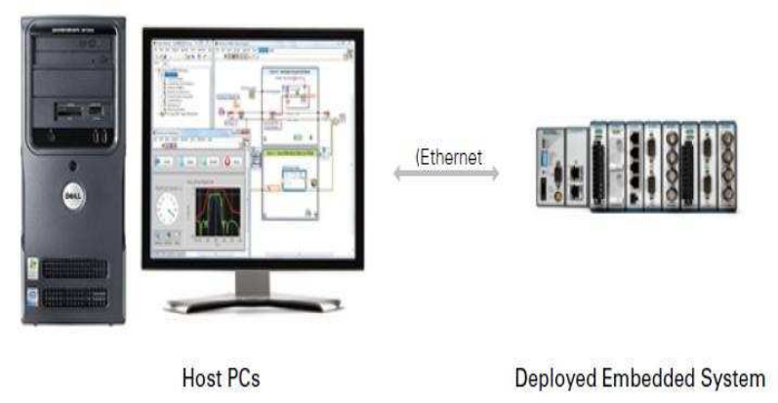
Demo apps
Fast, high bandwidth, hybrid continuous discrete computer (HCDC) to control nonlinear platforms @ Univ. Texas-Austin
  Robots
  Inverted pendulum
NI cRIO interface
  HCDC ⇒ cRIO insert
  Easy programming

Slide 16
References
[1] G. Cowan, R. Melville, and Y. Tsividis, “A VLSI analog computer / digital computer accelerator”, IEEE Journal of Solid-State Circuits, vol. 41, pp. 42-53, January 2006.
[2] S. Sethumadhavan, R. Roberts, and Y. Tsividis, “Hybrid discrete-continuous computer architectures”, IEEE Computer Architecture Letters, vol. 55, no. 99, Digital object identifier: 10.1109/L-CA.2011.22, September 2011.
[3] M. Seok, et al., “The Phoenix Processor: A 30pW Platform for Sensor Applications,” Digest, 2008 IEEE Symposium on VLSI Circuits, pp. 188-189.
[4] Y. Tsividis, "Event-driven data acquisition and digital signal processing – A tutorial", IEEE Transactions on Circuits and Systems II, Jump-start tutorial, vol. 57, no. 8, pp. 577-581, August 2010.
[5] ]M. D. Bryant, S. Yan, R. Tsang, B. Fernandez, and K. K. Kumar, “A mixed signal (analog-digital) integrator design”, IEEE Transactions on Circuits and Systems I, pp. 1409-1417, July 2012.

