Slide 1

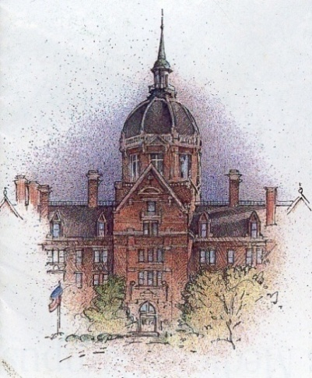
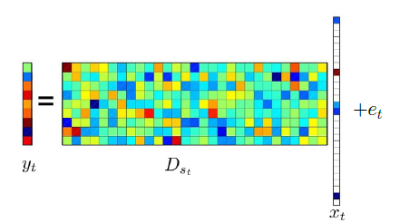
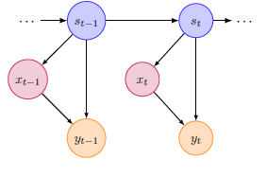
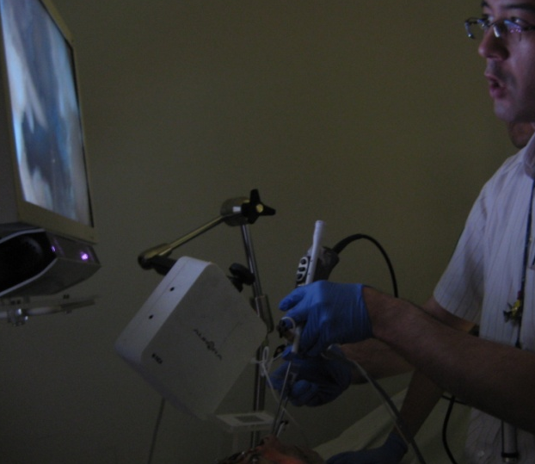
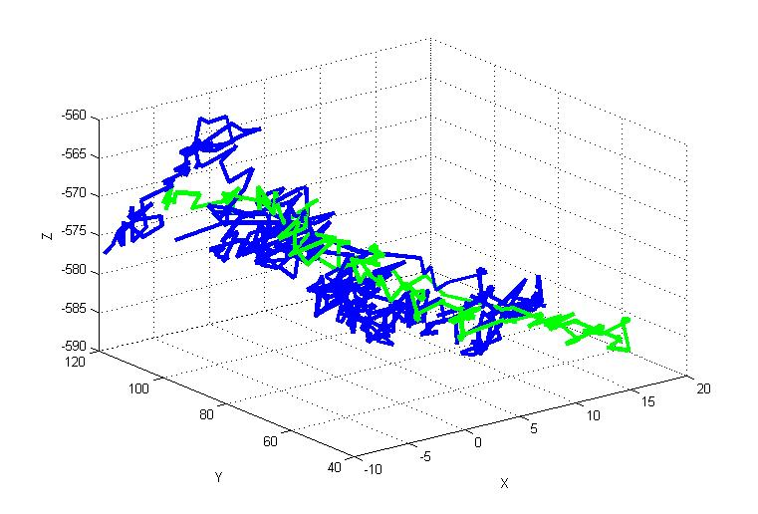
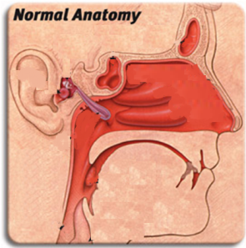
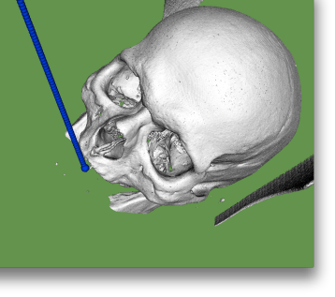
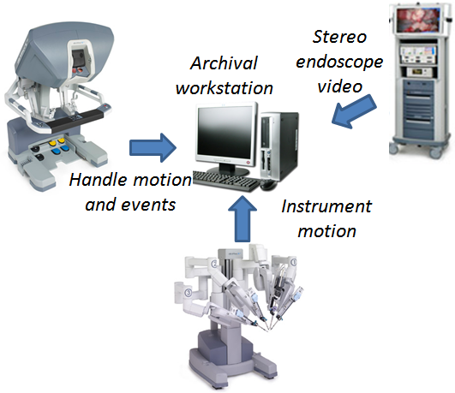
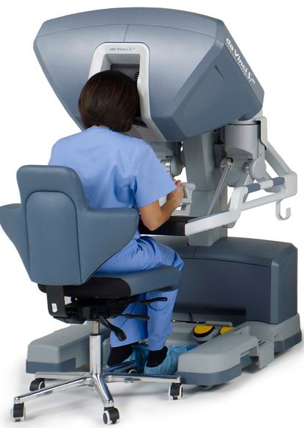
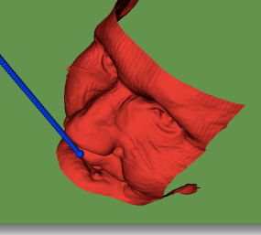
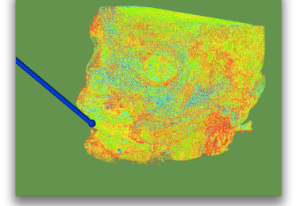
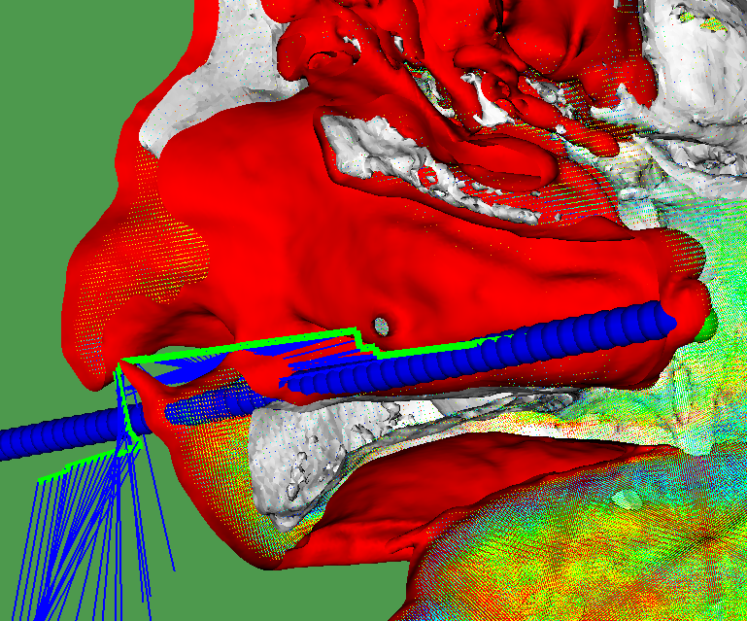
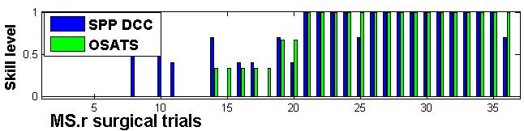
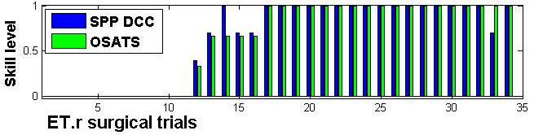
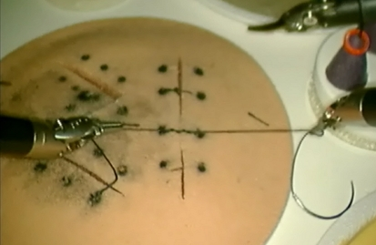
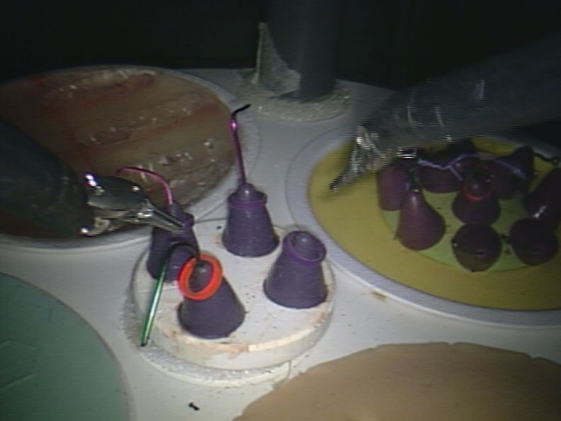
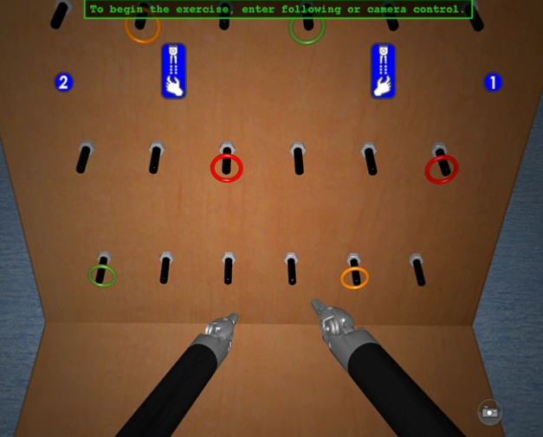
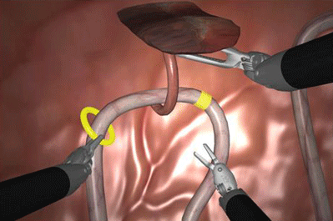
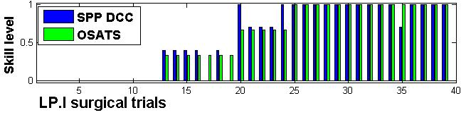
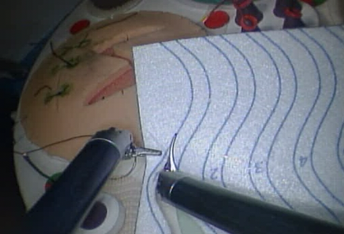
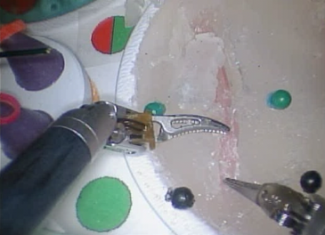
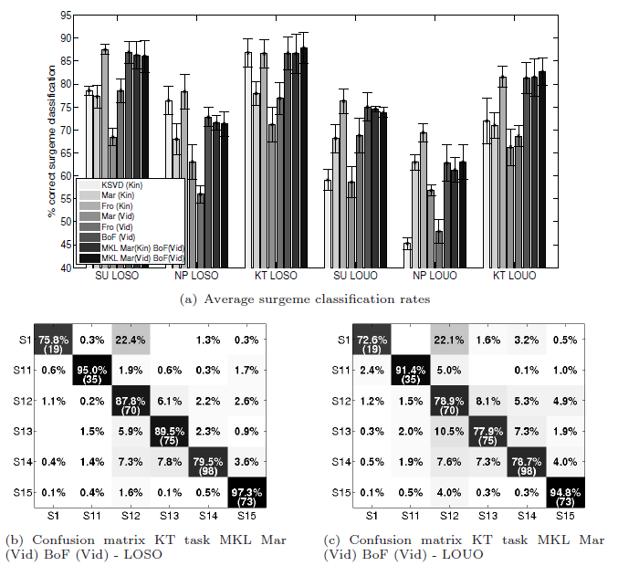
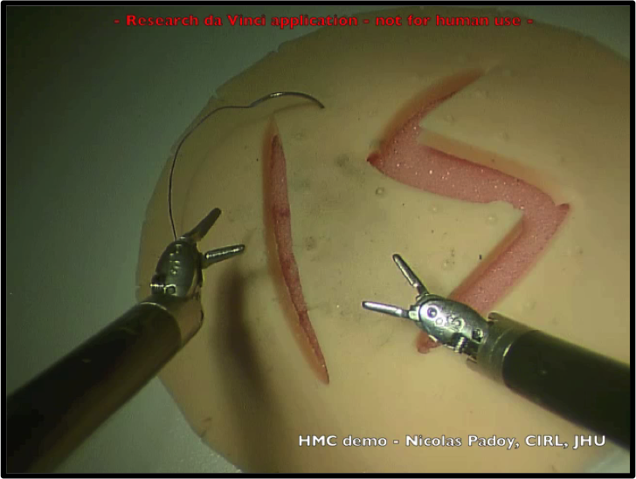
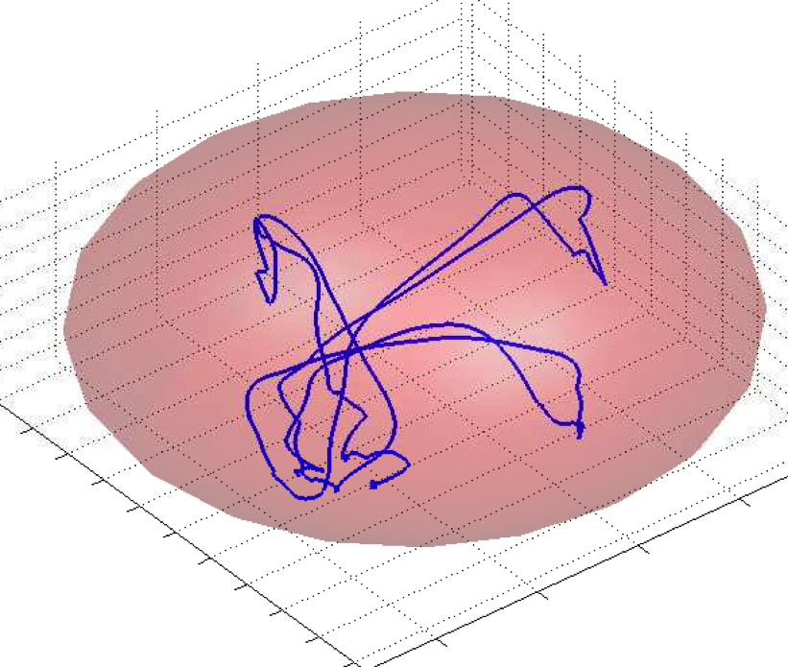
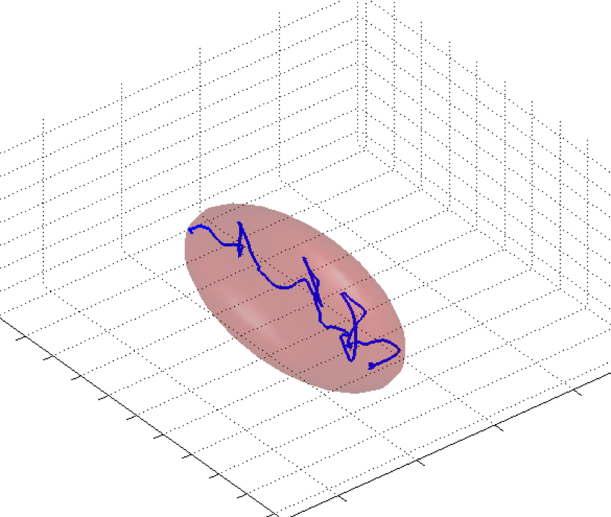
Hybrid Systems for Modeling, Performing and Teaching the Language of Surgery (CPS 0931805)
Sanjeev Khudanpur, Gregory Hager, Rene Vidal, Rajesh Kumar
Chi Chiung Grace Chen, MD², David Yuh, MD
INTRODUCTION
HYBRID DYNAMICAL SYSTEMS
AUTOMATED SKILL ASSESSMENT METRICS
The aim of this project is to investigate methods for modeling human expert surgeons performing robotic minimally invasive surgery, and to understand how to reflect this expertise back for training and augmentation of surgical skill. At a fundamental level, we view modeling the surgical “signal” as one of language modeling in a complex multivariate space, and the problem of augmentation and training as one of applying these models to new task instantiations. We have chosen robotic minimally invasive surgery (RMIS) as our domain of investigation.
One of our work is based on building dictionaries of surgical motions and using those dictionaries to classify new time series. We proposed a new class of models called Sparse Hidden Markov Models (S-HMMs)[5].
Combines sparse dictionary learning techniques such as K-SVD with classical HMMs.
Observations from a surgeme are generated as linear combinations from an over-complete dictionary of surgical motions associate with that surgeme.
Inference by sparse coding and dynamic programming
Parameter learning by using sparse dictionary learning techniques.
In Functional Endoscopic Sinus Surgeries (FESS), time and experience do not necessarily predict skill. Objective Structured Assessment of Technical Skills (OSATS) is an alternative. However, we have shown that OSATS grading is not consistent with the overall self-declared scores of the resident skills (primarily based on number of hours of experience) [8].
To this end, we have developed a Surgical Path Planning (SPP)-based automated metric which relies on the deviation from an optimal path for a FESS task to estimate skill level. Our results show that the surgeons with higher OSATS are closer to the SPP path than the ones with lower scores.
To improve this metric, we introduce the Descriptive Curve Coding (DCC) method which translates the Cartesian-space motions to a coded string which represents the “texture” of the motion and is independent of the path.
Experiments were run on data collected from a group of 20 subjects (self declared: 7 experts and 13 novices) performing a simulated nasal surgery.
In future, we would like to investigate the success rate of grammar-based DCC methods.
OBJECTIVES
The development of hybrid dynamical systems (HDS) models and related statistical classification and clustering methods for motion data acquired during surgical training tasks.
The development of language models for skilled movements based on HDS.
The development of teaching, training and assistance methods using dynamical systems and language models.
DATA COLLECTION FRAMEWORKS ^{[1]}
We applied S-HMMs to gesture segmentation one three surgical tasks. The results show that S-HMMs obtain results on a par with or better than models used in the past, such as Factor-Analyzed HMMs (FA-HMM) or Switched Linear Dynamical Systems (SLDS) [6]. For methods that model each surgeme as one state of the HMM (as we do), S-HMMs perform 5% to 10% better than state-of-the-art methods. On the other hand, S-HMMs with one state per surgeme performs on par with other methods that use three states per surgeme.
Expert
Novice
Electromagneic Tracker
 |  | 1-state models |  |  |  | 3-state models
 |  | MFA-HMM | FA-HMM | SLDS | S-HMM | FA-HMM | SLDS
Suturing | Setup 1 | 76.4 | 70.2 | 74.8 | 81.1 | 78.2 | 80.8
 | Setup 2 | 59.8 | N/A | N/A | 67.8 | 57.2 | 67.1
Needle Passing | Setup 1 | 74.2 | 64.3 | 72.3 | 76.1 | 65.0 | 77.6
 | Setup 2 | 46.6 | N/A | N/A | 59.3 | 42.7 | 60.0
Knot Tying | Setup 1 | 76.5 | 77.1 | 78.5 | 82.6 | 82.8 | 82.0
 | Setup 2 | 65.1 | N/A | N/A | 65.7 | 67.0 | 66.0
(Left) Experiment setup. (Middle) Sample of tool motion in the Cartesian-space (Right) Sinus anatomy the bones/skin/soft tissue extracted from CT (blue line is the endoscopic)
Ref. path
Tool
MS.r
Fully Automated Data Collection System
da Vinci Skills Simulator
ET.r
Performance of different methods with 1-state or 3-state models per surgeme
Deformed tissue
Goal
LP.l
Surgical Gesture Classification from Video Data
Surgical path planner
Surgical trials
We also extend our experiments on the video dataset[7]. We propose and evaluate the following three approaches to surgical gesture classification from video.
Model each video clip from each surgical gesture as the output of a linear dynamical system (LDS) and use Martin (Mar) and Frobenius (Fro) metrics to classify new video clips.
Use spatio-temporal features extracted from each video clip to learn a dictionary of spatio-temporal words and use a bag-of-features (BoF) approach to classify new video clips.
Use multiple kernel learning (MKL) to combine the LDS and BoF approaches.
Our experiments show that methods based on video data perform equally well as the state of-the-art approaches based on kinematic data.
(Left) Lateral clipped view of the sinus cavity. The tool follows the SPP reference path (green line) by opening its way toward the goal and putting minimum pressure on the soft tissue (blue lines). (Right) The resulting scores of SPP+DCC method (blue) and the corresponding OSATS score (green) for each trial (sorted by OSATS value, skill level of “zero” is novice and of “one” is expert on the y-axis).
Simulated Pegboard and Ring Walk tasks
 |  | Skill Evaluation Methods
 |  | HMM | SPP | DCC | SPP + DCC
Endoscopic Task | MS.r | 61.24% | 83.60% | 80.46% | 87.30%
 | ET.r | 79.35% | 95.19% | 92.15% | 97.64%
 | LP.l | 75.38% | 85.29% | 88.37% | 94.70%
Training tasks include, suturing, manipulation dissection, transection
We have now collected data from a large range of situations, ranging from simulation, robotic surgery training tasks and, most recently, we have begun data collection from live surgery.
Skill evaluation results (similarity between OSATS and our metric) for FESS tasks (MS.r, ET.r, and LP.l) from different methods (OSATS-based HMM, SPP, DCC, and their concatenation)
Human-Machine Collaborative Systems
REFERENCES
Kumar, R, Jog, A, Vagvolgyi,B, Tantillo, T and Chen, CCG, Nguyen, H, Hager,G, Yuh, D. Operational Skill Assessment for Robotic Surgery Training. 11th Society of American Gastrointestinal and Endoscopic Surgeons (SAGES), poster, San Antonio, TX , 2011.
N. Padoy, G.D. Hager, Human-Machine Collaborative Surgery Using Learned Models, Proceedings of IEEE International Conference on Robotics and Automation (ICRA), May 2011, pp 5285-5292.
B. Varadarajan, S. Khudanpur and T. Tran, "Stepwise Optimal Subspace Pursuit," in IEEE Signal Processing Letters, Vol 18, No 1, pp 27-30, 2011.
B. Varadarajan and S. Khudanpur, "Learning and Inference Algorithms for Partially observed Structured Switching Vector Autoregressive Models," in Proceedings of the IEEE International Conference on Acoustics, Speech and Signal Processing, pp1281-1284, Prague, Czech Republic, May 2011.
Tao, L., Elhamifar, E., Khudanpur, S., Hager, G., Vidal, R.,Sparse hidden Markov models for surgical gesture classification and skill evaluation. Conference on Information Processing in Computer-Assisted Interventions 2012
Varadarajan, B., Learning and Inference Algorithms for Dynamical System Models of Dextrous Motion. PhD thesis, Johns Hopkins University (2011)
B. Béjar, L. Zappella, and R. Vidal.,Surgical Gesture Classification from Video Data. Medical Image Computing and Computer-Assisted Intervention, October 2012.
N Ahmidi, GD Hager, M Ishii. Robotic Path Planning for Surgeon Skill Evaluation in Minimally-Invasive Sinus Surgery. Medical Image Computing and Computer-Assisted Intervention (MICCAI) , October 2012
A learned state model of a task is used to create both a recognition system for components of the task as well as an average trajectory during segments that are large transport motions
The system automatically recognizes when a segment of the task can be automated and carries out that motion with user interaction. As shown at the right, the result is a far more efficient use of master workspace.
DISCLOSURES
Manual task
Augmented task
Results of Kinematic- (Kin) and Video- (Vid) based techniques. SU, NP and KT corresponds to Suturing,
Needle Passing and Knot Tying tasks. LOSO and LOUO correponds to Setup1 and Setup 2 in previous section
Portions of this work were supported in part by NIH grant # 1R21EB009143-01A1, National Science Foundation grants #0941362, and #0931805, and Johns Hopkins University internal funds. A collaborative agreement with Intuitive Surgical, Inc with no financial support, provided access to the API data. The Skills Simulator data was collected at Intuitive Surgical.

