Slide 1
ISIS Summer Internship Computational Fluid Dynamics (CFD) Analysis
Kate Owens

Slide 2
Background
Objective:
Compute drag, lift, and moment coefficients for an underwater vehicle
Automate the drag, lift, and moment computation process

Slide 3
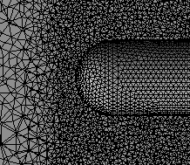
Process
Geometry Setup
Fluid Region
Refinement Zone
Mesh Generation
Fluid Region
Refinement Zone
CFD Analysis

Slide 4
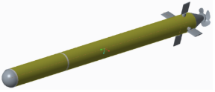
Automated Approach
OpenMeta (CyPhy)
Generates CAD assembly
Sets up and run CFD computations
Collects post processing results
1
2
3
Test Bench
Design
1
Creo Parametric
2
Ansys Fluent
3
Python Script
CAD Assembly Under Test

Slide 5
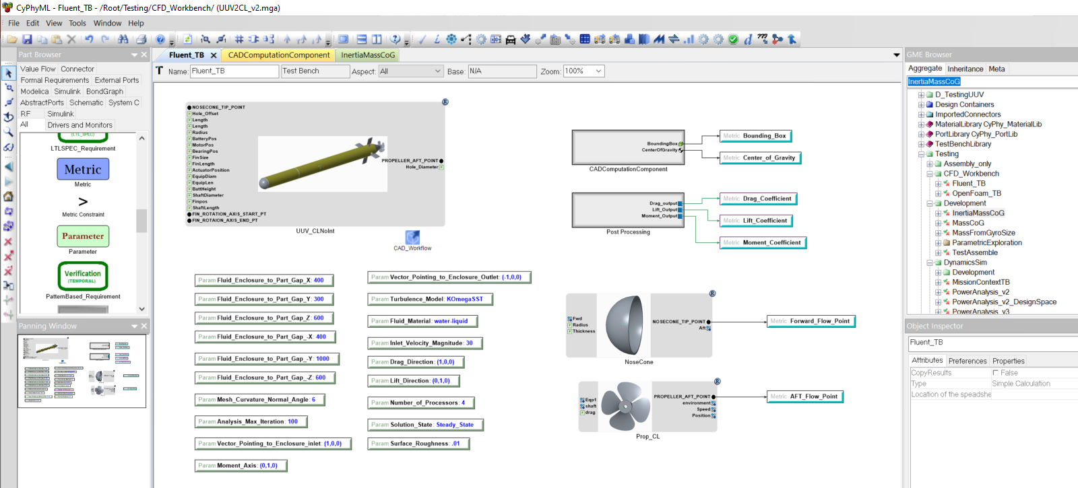
OpenMeta
System Under Test
CAD Properties
Simulation Results
Parameters
Reference Points

Slide 6
Reflection
Lessons Learned:
Automating CFD analysis can lead to optimized designs
CFD programs have limitations, which usually can be worked around
Challenges:
Learning Ansys Fluent software
Coding the meshing process

