Slide 1
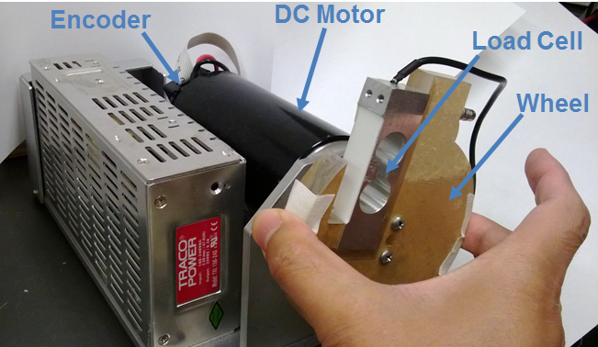
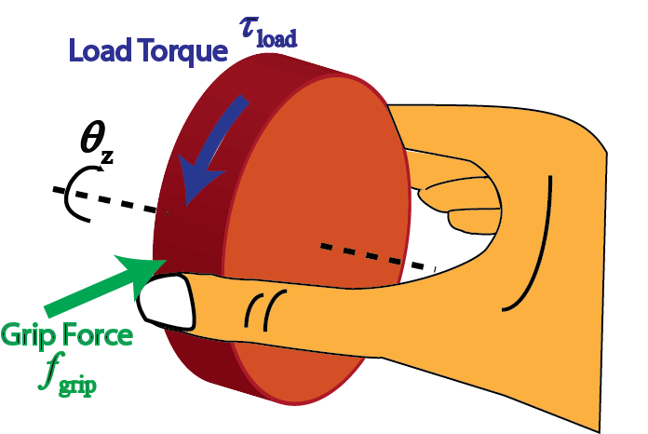
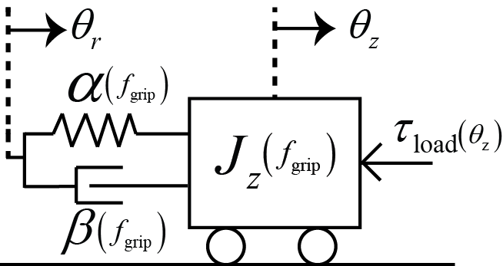
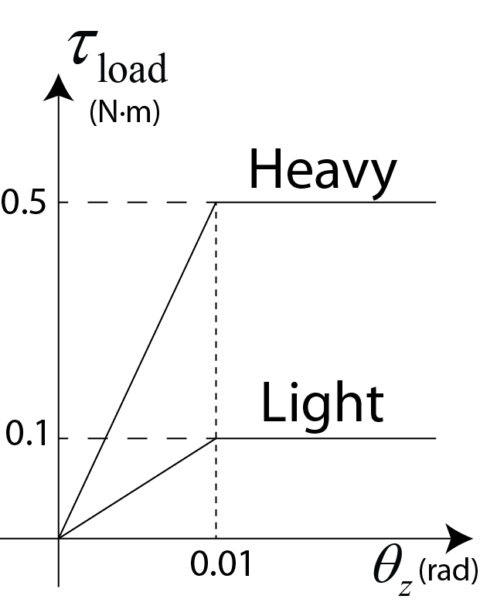
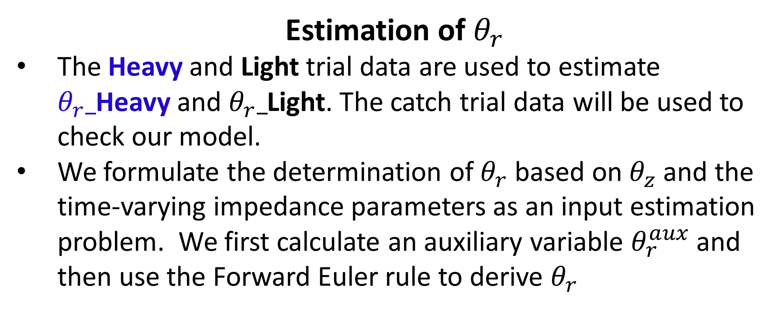
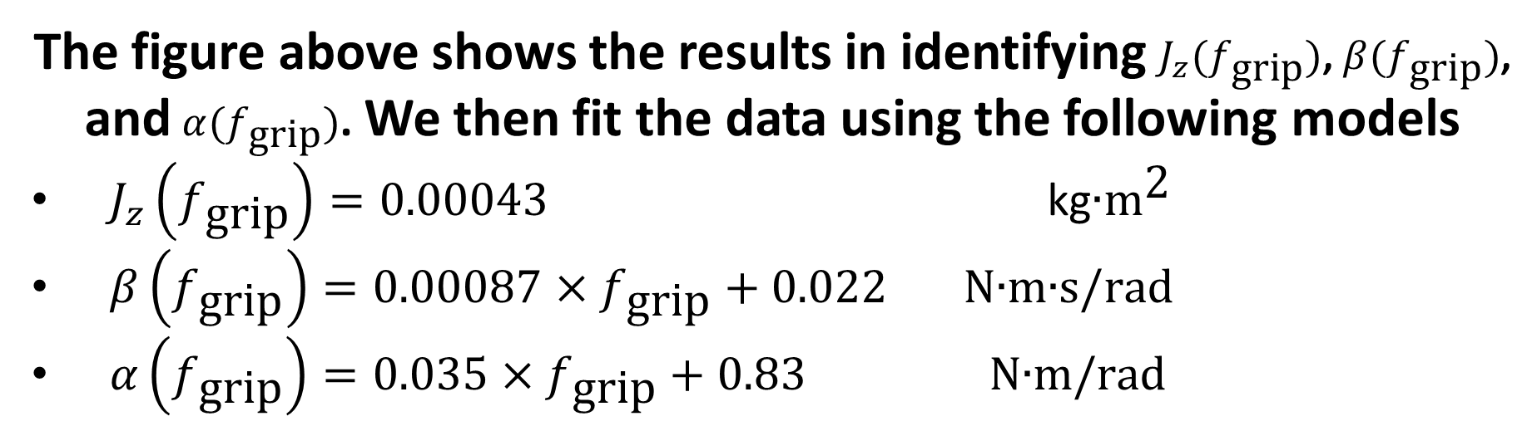
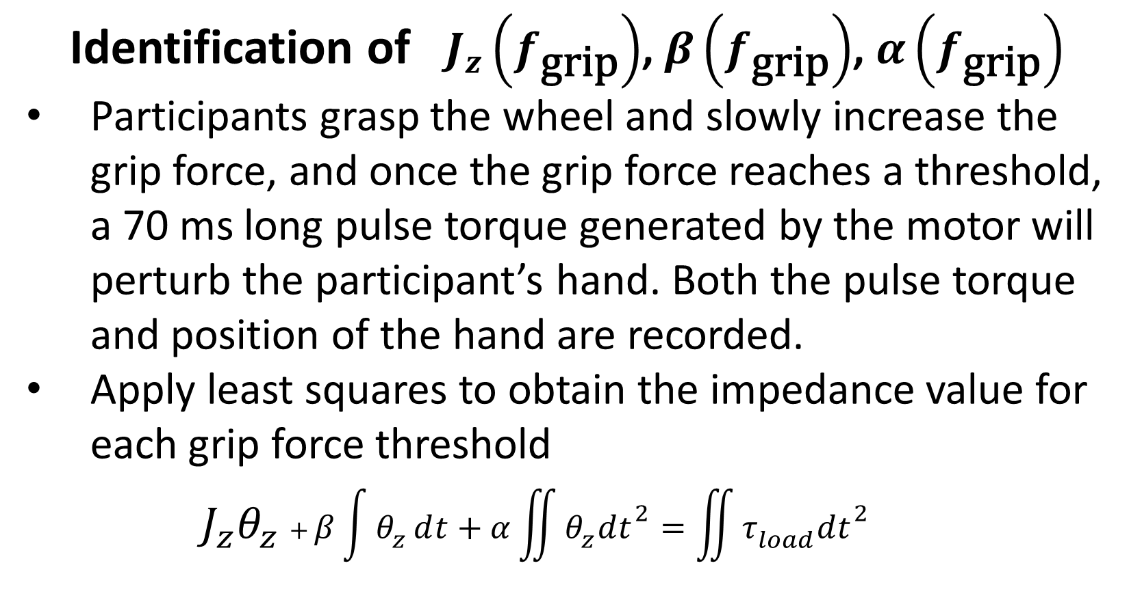




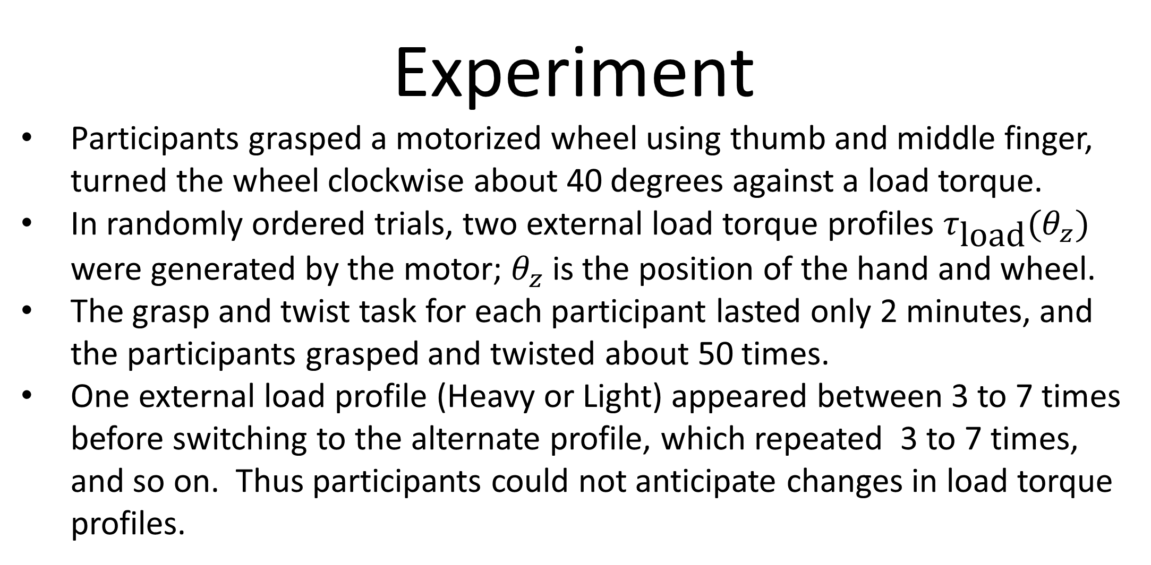
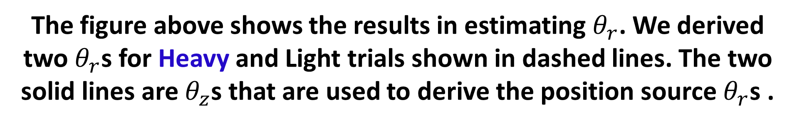

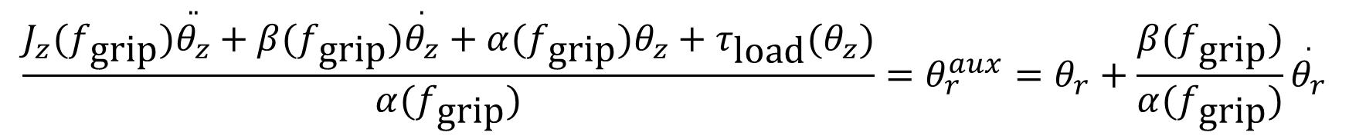
Identification of Human Feedforward Control in a Cyber Grasp and Twist Task
James Freudenberg (PI), Brent Gillespie (Co-PI), and Bo Yu
University of Michigan, Ann Arbor
Introduction
Tight coordination between grip force and load force during the first 110 ms of the grasp and lift task reveals the existence of feedfoward control in human motor behavior. We use system identification and input estimation methods to construct a simple model for describing this feedfoward control in human hand movement. A simple yet competent model of human motor behavior would enable the design of cyber-physical systems capable of sharing control and collaborating with humans. In particular, predicting human behavior during unexpected conditions is critical to engineer reliable active safety systems.
Model Verification
The data of catch trials Light-Heavy and Heavy-Light are used to check the model.
To calculate $θ_{z}_$Light-Heavy, we will use $θ_{r}$ for Light, grip force for Light torques, and the Heavy $τ_{\text{load}}$. Similarly, $θ_{z}$_Heavy-Light is calculated using $θ_{r}$ for Heavy, grip force for Heavy torques, and the Light $τ_{\text{load}}$. The comparison of experimental data and model prediction for one participant is shown below.
Experiment
Participants grasped a motorized wheel using thumb and middle finger, turned the wheel clockwise about 40 degrees against a load torque.
In randomly ordered trials, two external load torque profiles $τ_{\text{load}}(θ_{z})$ were generated by the motor; $θ_{z}$ is the position of the hand and wheel.
The grasp and twist task for each participant lasted only 2 minutes, and the participants grasped and twisted about 50 times.
One external load profile (Heavy or Light) appeared between 3 to 7 times before switching to the alternate profile, which repeated 3 to 7 times, and so on. Thus participants could not anticipate changes in load torque profiles.
Model and Methods
Our model consists of a position source and a spring-damper coupler that captures the driving-point impedance of the hand.
The position source is an embodiment of a human user’s volitional control, in this case control of the twisting movement. The dependency of the model parameters $J_{z}$, $α$, and $β$ on the grip force captures a modulation of driving point impedance that takes place during the twist. This modulation likely has to do with muscle activation mechanics.
$$J_{z}\left(f_{\text{grip}}\right)\ddot{θ_{z}}+β\left(f_{\text{grip}}\right)\dot{θ_{z}}+α\left(f_{\text{grip}}\right)θ_{z}=α\left(f_{\text{grip}}\right)θ_{r}+β\left(f_{\text{grip}}\right)\dot{θ_{r}}−τ_{\text{load}}(θ_{z})$$
$J_{z}$: Mass (inertia) of hand and wheel
$β$: Damping coefficient
$α$: Stiffness coefficient
$θ_{r}$: Position source
$θ_{z}$: Position of the hand and wheel
Impedance values ($J_{z}$, $β$, $α$) change with grip forces
We classify our data into four categories depending on the loads encountered in the current and previous trials
$$\overset{\text{Light}}{\overbrace{LLL }} \overset{\text{Light}\text{−}\text{Heavy}}{\overbrace{H}} \overset{\text{Heavy}}{\overbrace{HHHH} } \overset{\text{Heavy}\text{−}\text{Light}}{\overbrace{L}} \overset{\text{Light}}{\overbrace{LLL}}⋯$$
Light: Previous load is light and current load is light
Heavy: Previous load is heavy and current load is heavy
Light-Heavy: Previous load is light and current load is heavy
Heavy-Light: Previous load is heavy and current load is light
The predicted trajectory of catch trial $θ_{z}_$Light-Heavy matches the experimental data up to 0.11s, which is roughly the time when the participant uses feedback information to change grip force and position source. As we only consider feedforward control and do not consider the change of grip force and position source due to feedback, it is not surprising that the two trajectories are not similar after 0.11s. Similar excursions can be seen for the $θ_{z}$_Heavy-Light trajectory. The predicted trajectory matches the experimental result up to 0.18s and then these two traces separate.
The errors before 0.11s are due to the dynamics not captured by our model and the modeling errors.
Identification of $J_{z}\left(f_{\text{grip}}\right)$, $β\left(f_{\text{grip}}\right)$, $α\left(f_{\text{grip}}\right)$
Participants grasp the wheel and slowly increase the grip force, and once the grip force reaches a threshold, a 70 ms long pulse torque generated by the motor will perturb the participant’s hand. Both the pulse torque and position of the hand are recorded.
Apply least squares to obtain the impedance value for each grip force threshold
${J_{z}θ}_{z}+β\int{θ_{z}}ⅆt+α\iint{θ_{z}dt^{2}}=\iint{τ_{load}dt^{2}}$
Estimation of $θ_{r}$
The Heavy and Light trial data are used to estimate $θ_{r}_$Heavy and $θ_{r}_$Light. The catch trial data will be used to check our model.
We formulate the determination of $θ_{r}$ based on $θ_{z}$ and the time-varying impedance parameters as an input estimation problem. We first calculate an auxiliary variable $θ_{r}^{aux}$ and then use the Forward Euler rule to derive $θ_{r}$
In a Light trial, the participant adequately prepares for the light load as the current trial is based on the previous trial’s load. A Heavy trial is also prepared for adequately. In a Light-Heavy trial, the participant erroneously prepares for the light torque when in fact the load is heavy. Hence this is a “catch trial”. The other catch trial is Heavy-Light.
Future Work
We will extend our analysis to combine feedforward and feedback control using the grasp and twist task and tracking of sinusoidal and random-appearing signals.
$$\frac{J_{z}(f_{\text{grip}})\overset{..}{θ_{z}}+β(f_{\text{grip}})\overset{.}{θ_{z}}+α(f_{\text{grip}})θ_{z}+τ_{\text{load}}(θ_{z})}{α(f_{\text{grip}})}=θ_{r}^{aux}=θ_{r}+\frac{β(f_{\text{grip}})}{α(f_{\text{grip}})}\overset{.}{θ_{r}}$$
Results
The left figure shows the averaged data of four categories for one participant.
Grip Force: Two distinct grip force profiles for Heavy and Light; Heavy-Light follows Heavy in the beginning and then swaps to Light at about 0.12s due to sensory feedback; Similar trend for Light-Heavy.
This clearly shows participants use feedforward control to modulate grip force before 0.12s.
Position of Hand: four distinct hand position trajectories from top to bottom in the order of Heavy-Light, Light, Heavy, Light-Heavy.
Our Objective: Build model to identify the feedforward control in hand movement and explain the four distinct hand position trajectories.
The figure above shows the results in identifying $J_{z}(f_{\text{grip}})$, $β(f_{\text{grip}})$, and $α(f_{\text{grip}})$. We then fit the data using the following models
$J_{z}\left(f_{\text{grip}}\right)=0.00043 \text{kg}\text{∙}{\text{m}}^{\text{2}}$
$β\left(f_{\text{grip}}\right)=0.00087×f_{\text{grip}}+0.022 \text{N}\text{∙}\text{m}\text{∙}\text{s}\text{/}\text{rad}$
$α\left(f_{\text{grip}}\right)=0.035×f_{\text{grip}}+0.83 \text{N}\text{∙}\text{m}\text{/}\text{rad}$
The figure above shows the results in estimating $θ_{r}$. We derived two $θ_{r}$s for Heavy and Light trials shown in dashed lines. The two solid lines are $θ_{z}$s that are used to derive the position source $θ_{r}$s .
Notes:
We are going beyond characterization of the driving point impedance (alpha/beta/Jz), adding additional experiments and features to our model that capture volitional control (user intent). Theta_r is a simple motion source (doesn’t really exist) that enables a particularly simple (hopefully still competent) model of the user with intent.
Previous work in modeling the coupled dyanmics of human and haptic device has only contributed (driving point) impedance models. Missing is the simplest competent model that captures *volitional control*.

