Slide 1
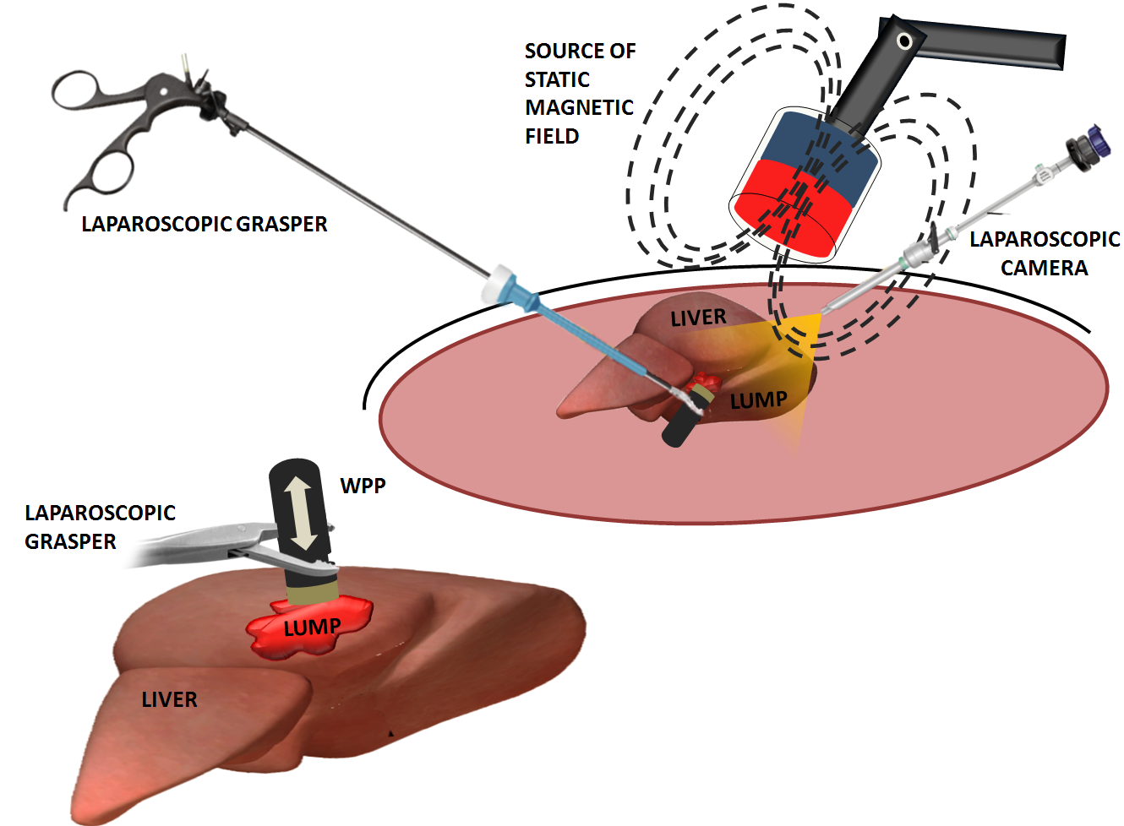
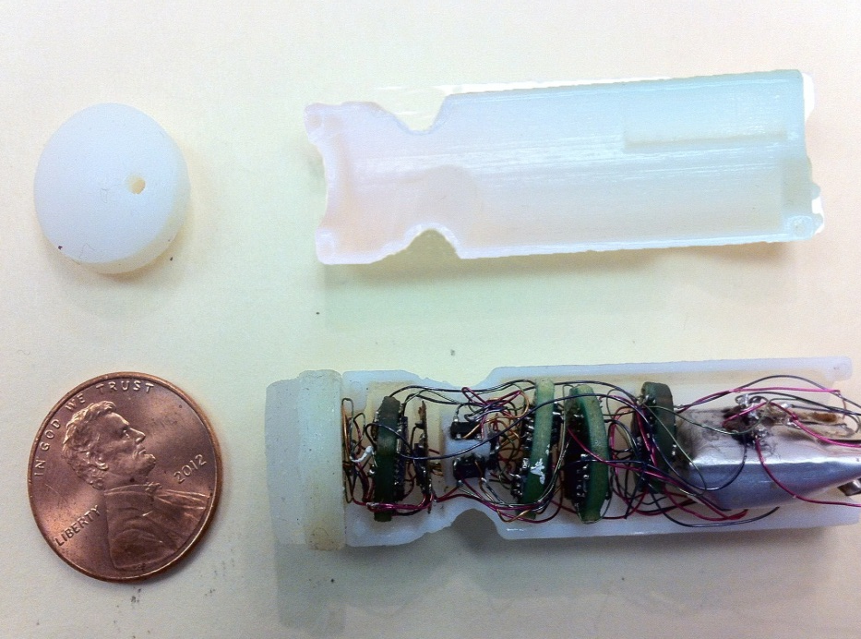
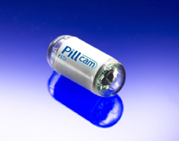
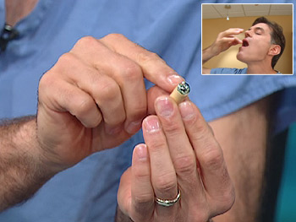
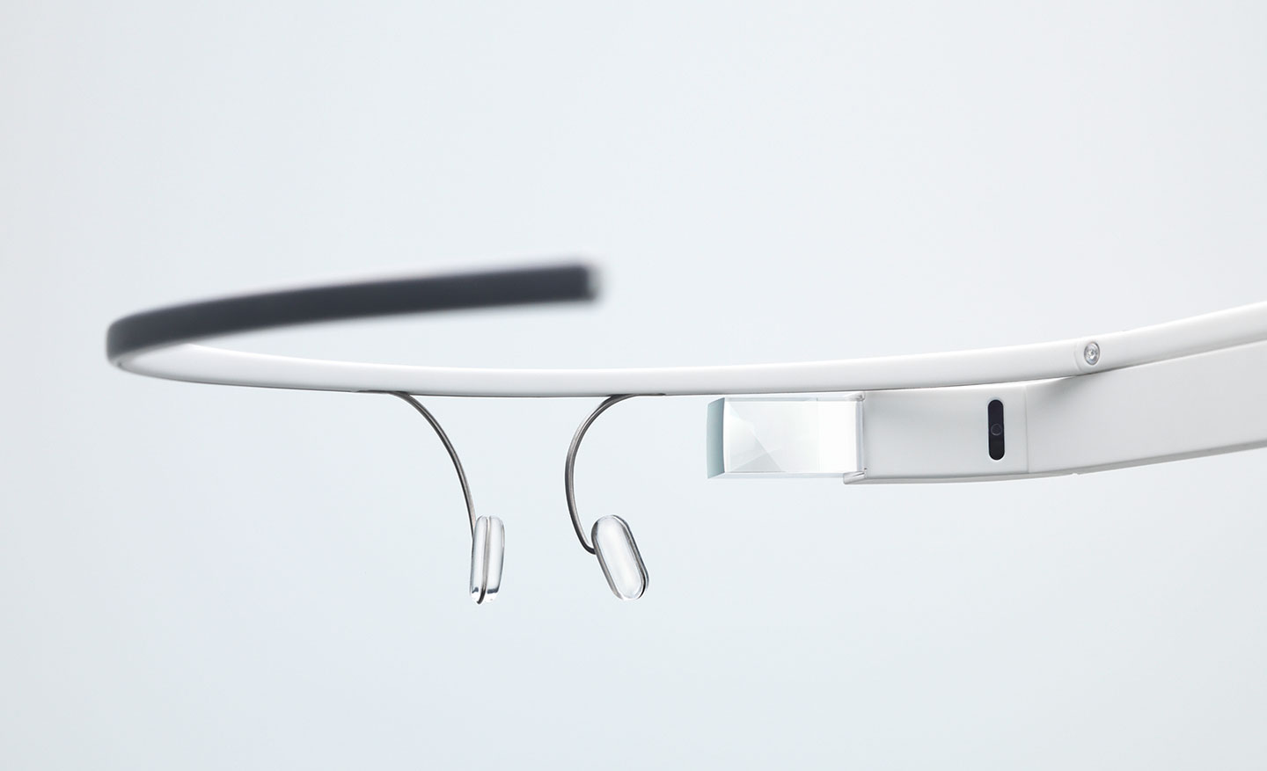
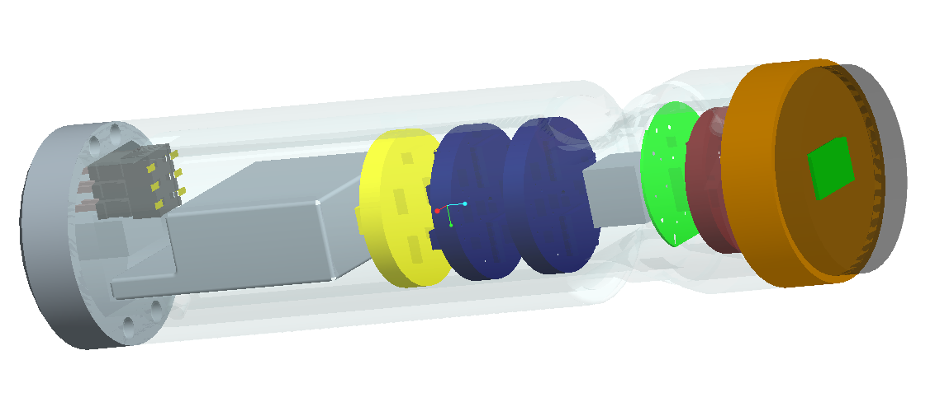
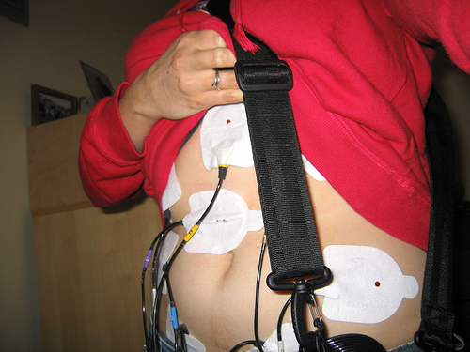
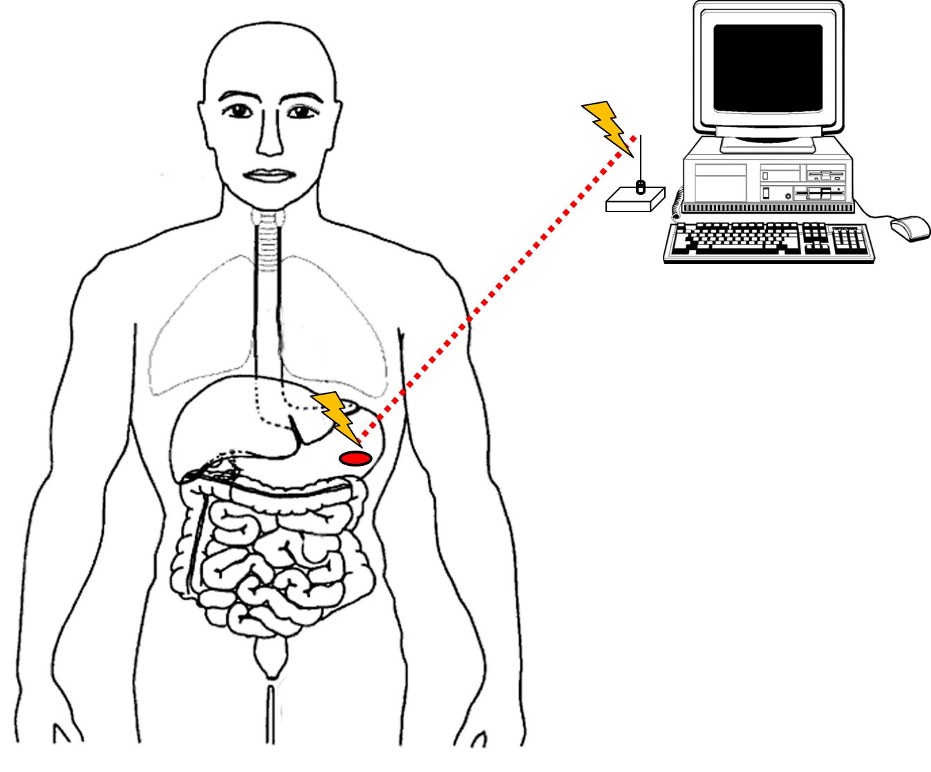
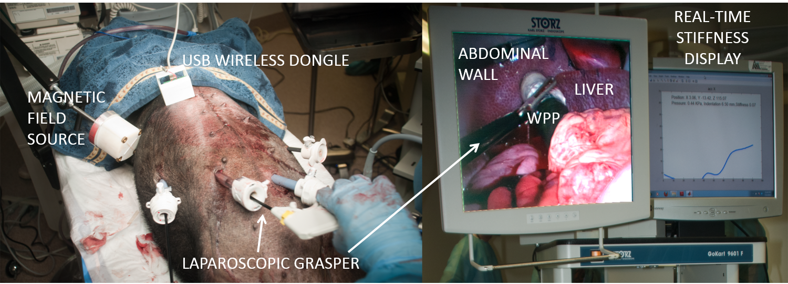
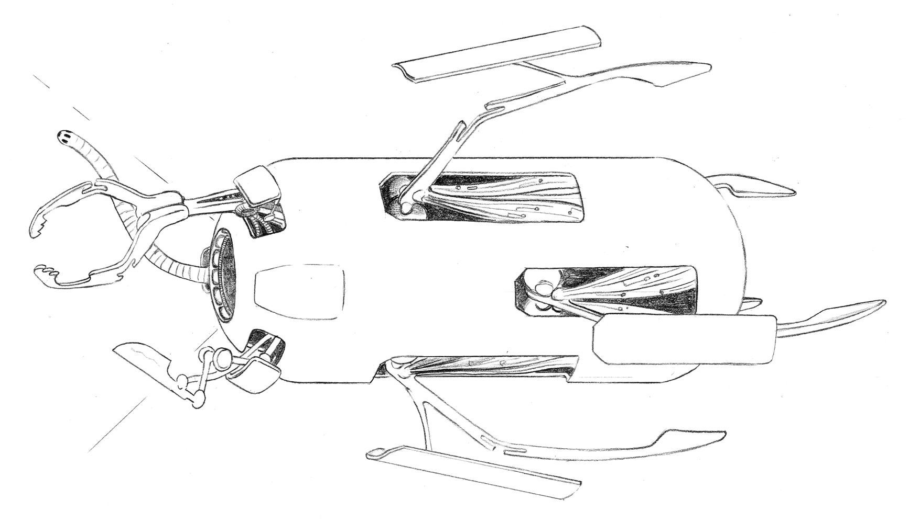
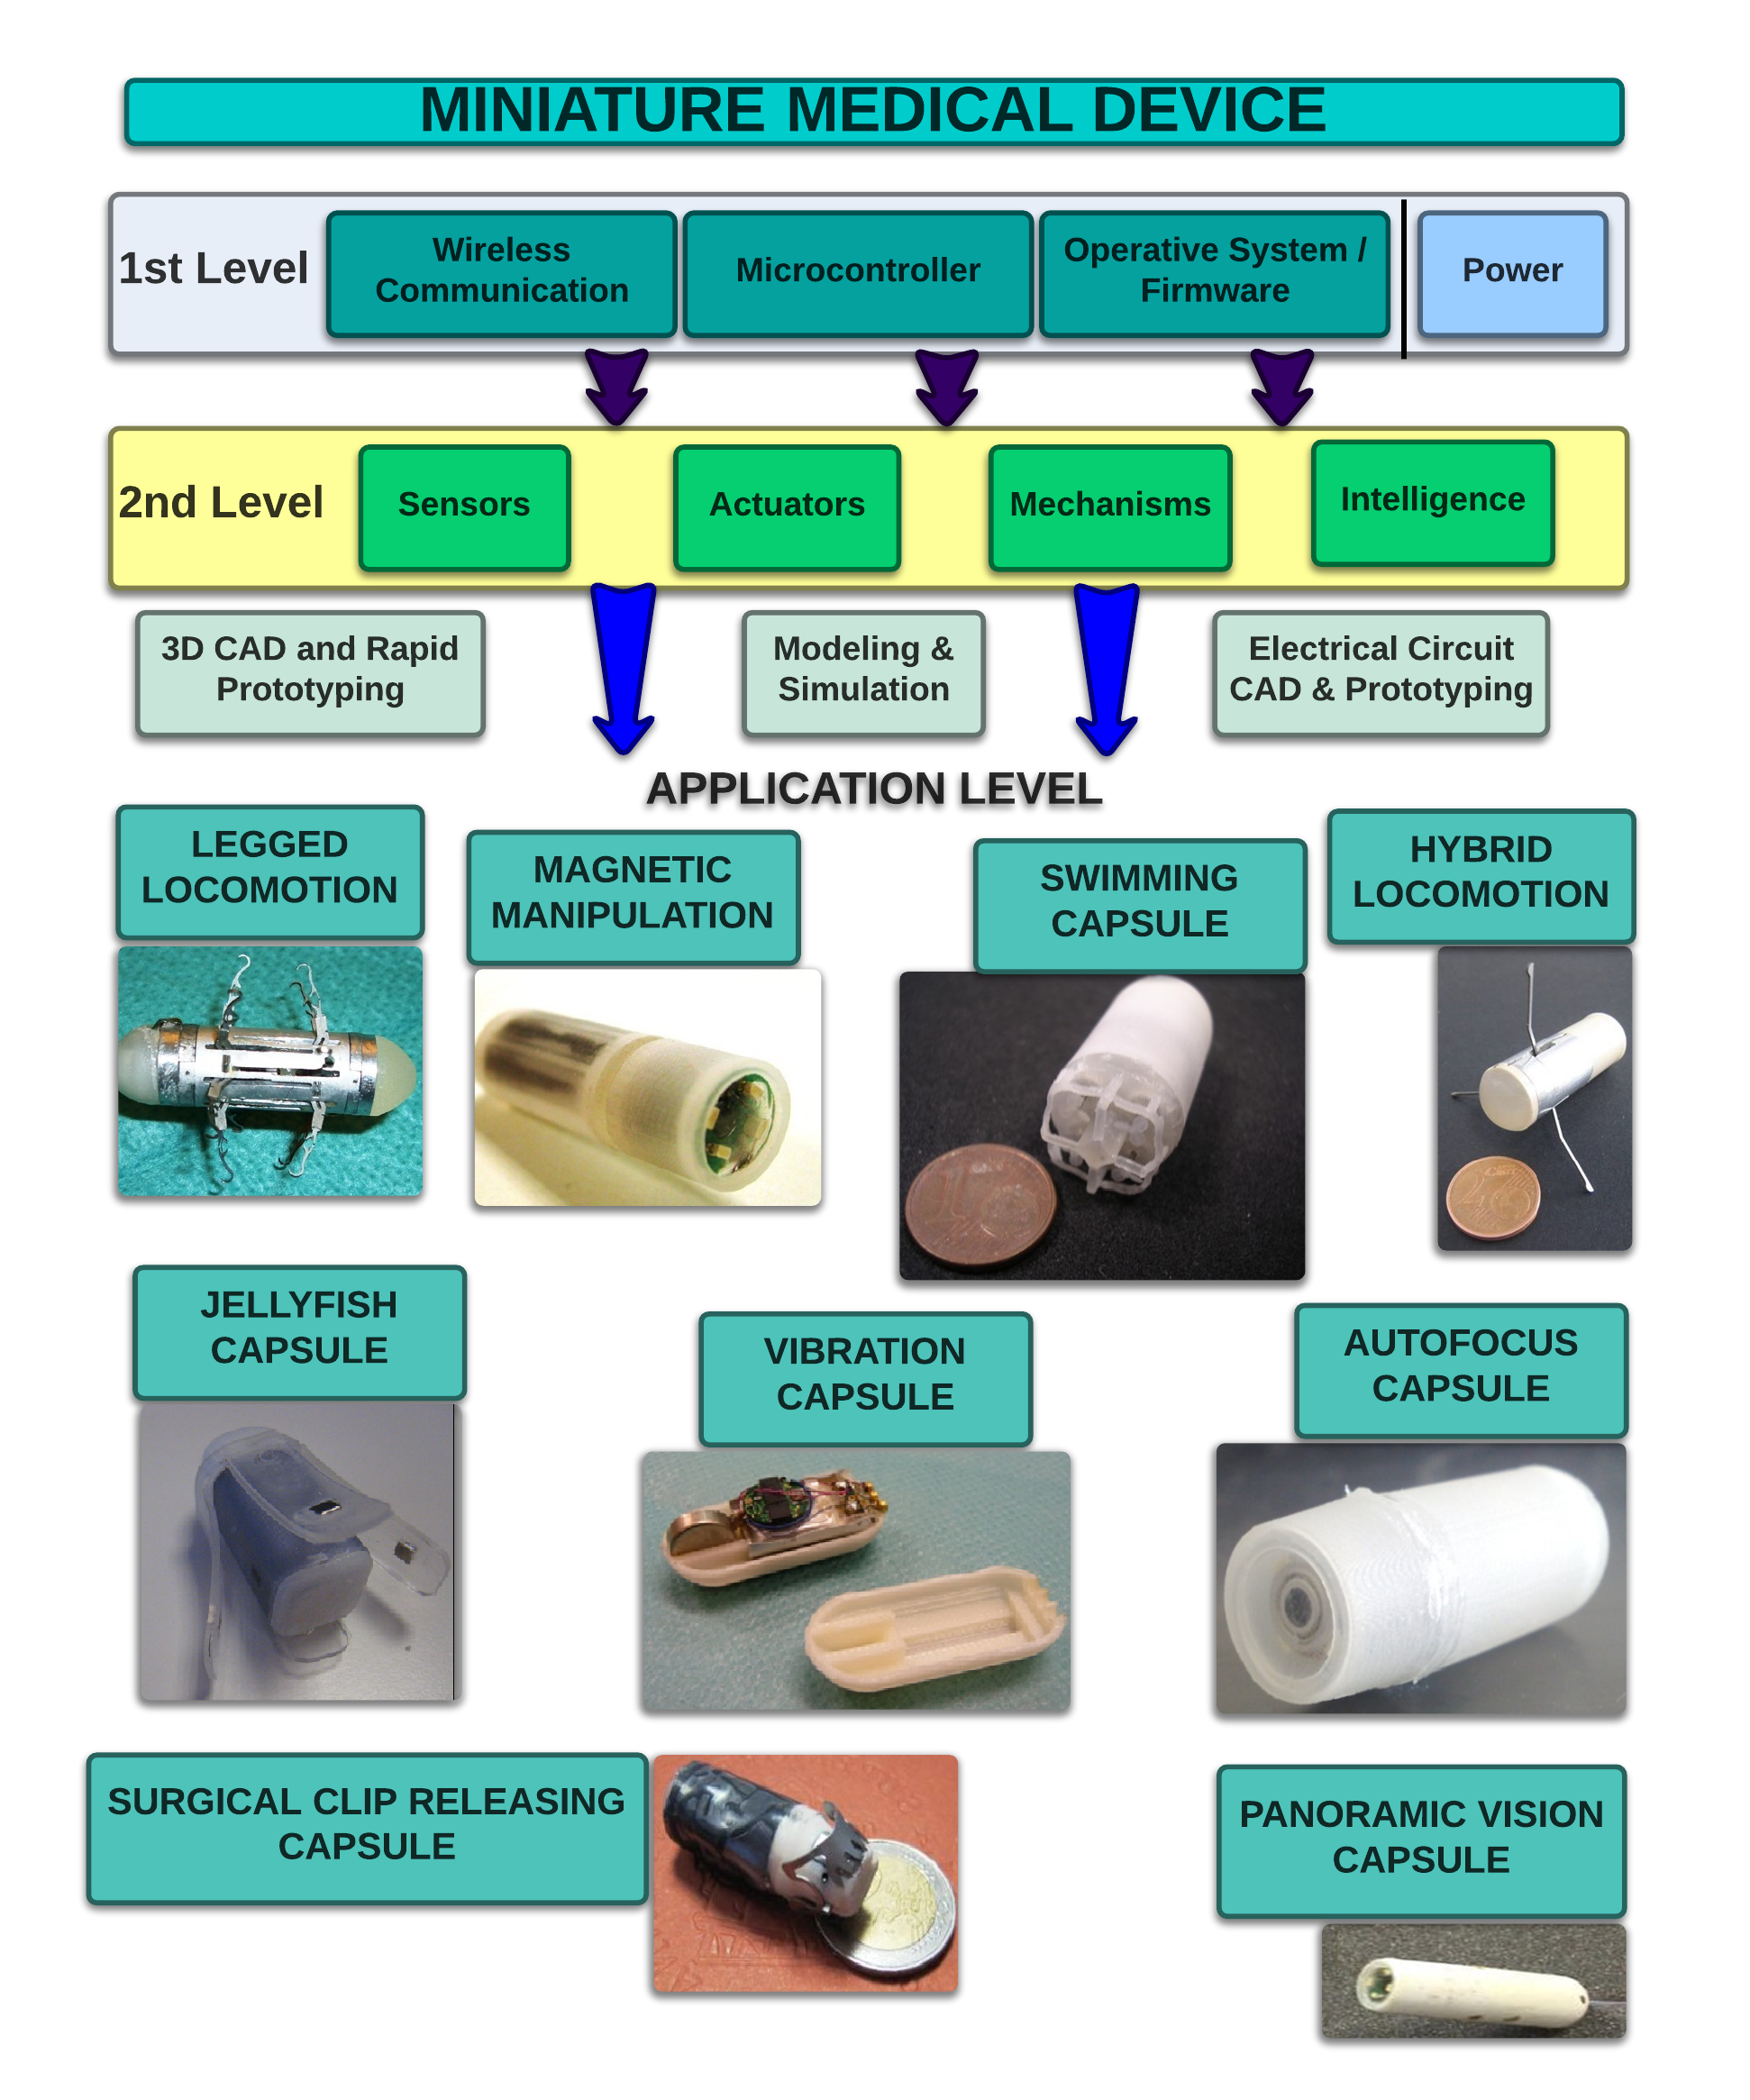
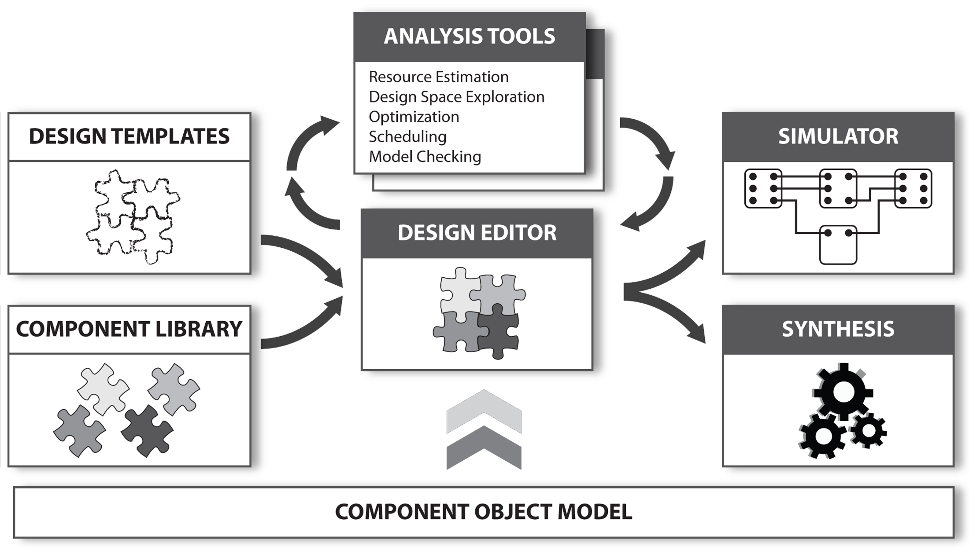
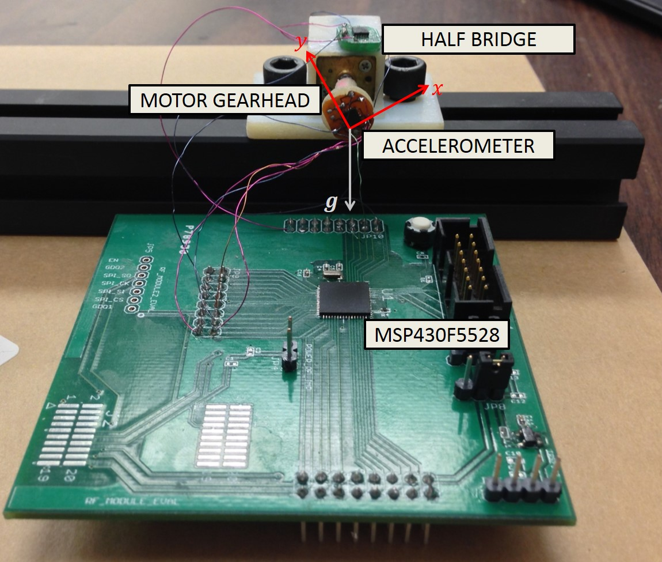
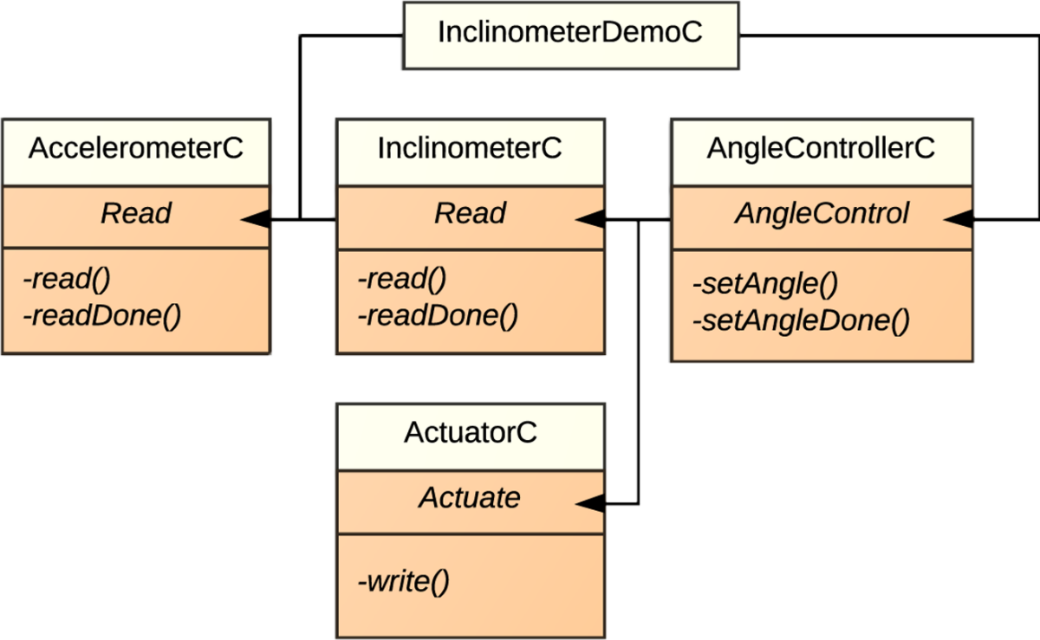
CPS: Synergy: Integrated modeling, analysis and synthesis of miniature medical devices
Pietro Valdastri ¹, Marco Beccani ¹, Addisu Taddese ², Robert J. Webster III¹, Peter Volgyesi ², Ákos Lédeczi ²
Vanderbilt University Nashville, TN
¹ The STORM Lab
Vanderbilt University
²
BACKGROUND
AN EXAMPLE OF A CUSTOM APPROACH: WIRELESS TISSUE PALPATION
Technology available today is enabling what yesterday was a dream
Wireless Microcontroller
Front End for the 3D Localization Unit
CAPSULE FEATURES
Weight 9.5 g
Battery Life Time ~ 90 minutes
15 mm ø, 60 mm H
Refresh rate: 5 ms
Workspace: 30 cm³
Pressure accuracy: 34 Pa
Indentation depth accuracy: 0.68 mm (d = 75 mm)
Localization accuracy: 10 mm
3D Accelerometer
Battery
Pressure Sensor
Power regulation
Silicon Rubber
Handle for the surgical tool
3D Localization Unit
TECHNICAL CHALLENGES
Provide ACTUATION for tissue indentation The probe is controlled by the surgeon with a laparoscopic grasper
Acquire INDE5NTATION DEPTH Onboard real-time 5DoF localization system measuring the magnetic field generated by an external permanent magnet [Di Natali et al., IEEE TMAG 2013]
Acquire INDENTATION PRESSURE Directly measured at the head by a pressure sensor inspired by www.takktile.com
WIRELESS transmission of data - CC2530, TI -- Carrier freq 2.4 GHz
IN VIVO TRIALS
Miniature Medical Device
Human machine interface
Other miniature devices
Energy Source
Environment
Sensors
CPU
Wireless Comm.
Actuators/ Mechanisms
DEVELOPMENT TIME 1 YR
DEVELOPMENT COSTS $ 200k
Beccani et al., IEEE Transactions on Biomedical Engineering, 2013
PRELIMINARY RESULTS
A versatile component model will provide the structural and semantic foundation for the entire model-based design flow
An integrated open source on line simulation framework would lower development time and costs to implement miniature medical devices
A pre-built component will provide the building blocks for design construction
Static analysis tools will provide performance and cost estimates
To synthesize application software, printed circuit board (PCB), computer aided design (CAD) models, and bill of materials with cost estimates with minimal manual guidance
MODULAR HARDWARE
MODULAR SOFTWARE ABSTRACTION
TinyOS
An integrated simulation framework would provide insight into the dynamic behavior of the design before manufacturing or physical prototyping
EXPERIMENTAL VALIDATION
GOAL: TinyOS application for a closed loop control of an actuator from sensor readings is compared with a custom implementation of the same task on a 8051 MCU programmed in barebone C.
Crosscutting Constraints
PID control algorithm of a brushed DC motor based on an accelerometer used as an inclinometer
Component based implementation of the closed loop experiment using TinyOS on the MSP430 MCU
FAIL-SAFE OPERATION
WIRELESS COMMUNICATION
POWER CONSUMPTION
SIZE
Valdastri et al., Annual Review of Biomedical Engineering, 2012
INTERACTION WITH ENVIRONMENT
CONTACT
Pietro Valdastri, PhD
Assistant Professor of Mechanical Engineering
Director of the STORM Lab
Email: p.valdastri@vanderbilt.edu
WEB: http://my.vanderbilt.edu/stormlab
Open source @ http://github.com/pillforge
Taddese et al., submitted to ICRA 2014

