Slide 1
Interactive Climate Education Application based on NetsBlox
-- Explore Impact of Important Climate Forces
Yutong Ouyang
Advisor: Prof. Akos Ledeczi

Slide 2
Overview
Goals
To develop curricular material for high schools to introduce climate change and computational thinking in a synergistic manner.
Have students explore the impact of some important climate forcings on temperatures here on Earth
NetsBlox
A visual programming environment for introducing distributed computing to secondary education.
Extension of Snap!
Distributed programming capabilities
Message passing
Remote Procedure Calls (RPC)
Students are able to create imaginative applications that utilize the wealth of information.

Slide 3
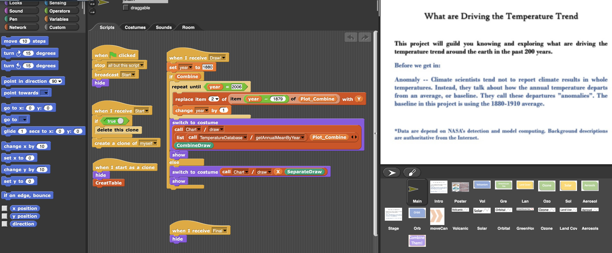
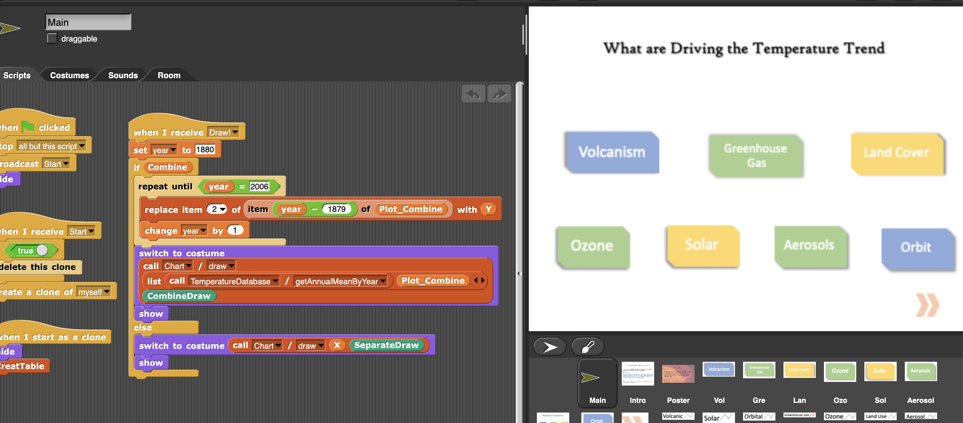
Application Flow
Intro slide
Introduce the objective and background knowledge.
Forces slide
Discuss the impact of these forces
Introduce how did these separate. data create and how scientists computed and stimulated these data.

Slide 4
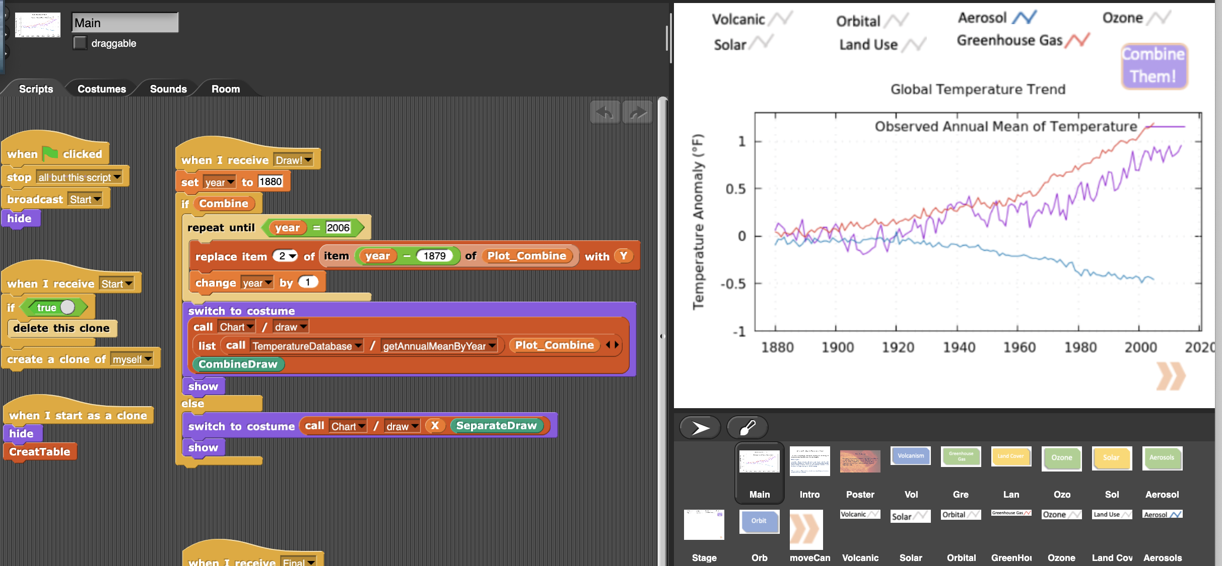
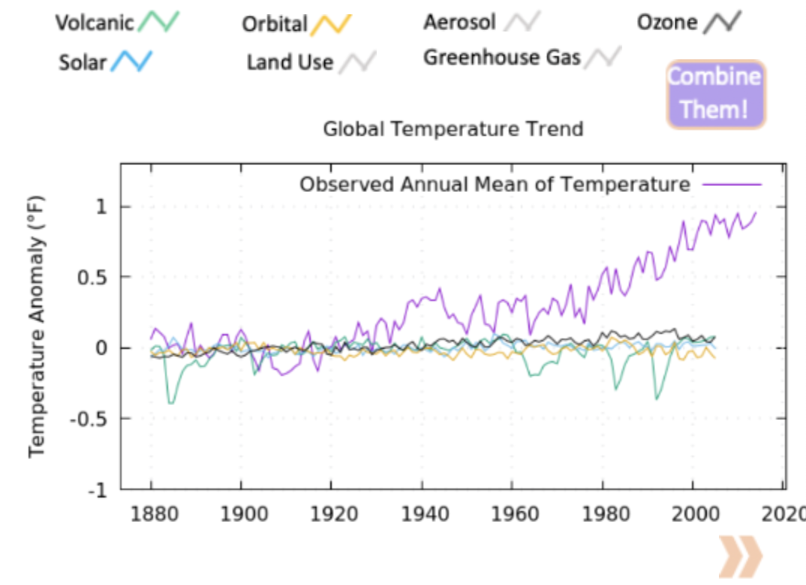
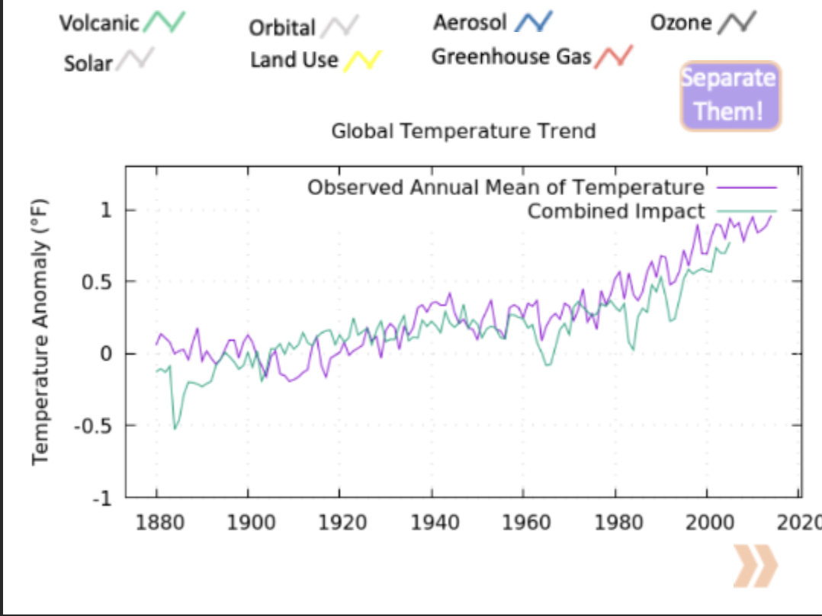
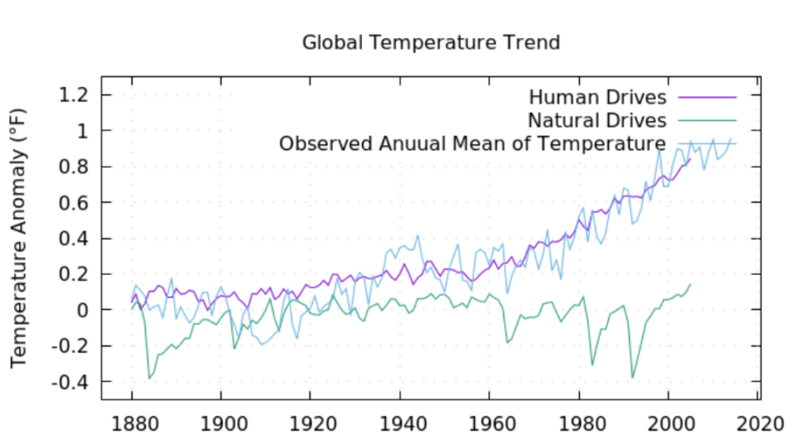
Application Flow
Plotting slide
Student could choose different forces and see the result either in separate lines or in an aggregate line.
Interact with instructor by plotting and finding the corresponding impact.
Last slide
Conclusive view about the human drives and nature drives compared with observed global temperature.

Slide 5
Conclusion
Challenges & What I learnt
Quickly get started with a new software development environment.
Explore in an interdisciplinary area of Computer Science, Peabody and Earth Science.
Combine technology with real-life education curricular.
Update and iterate a product/application based on requirements and feedback round by round.
Keep productive when working from home.
Get help remotely from advisors and teammates.
Great thank to everyone!

