Slide 1

Internet of Things Enables a Cyber-Physical
Systems Approach to Lighting
Abhishek Murthy*, Yong Yang, Dan Jiang, Talmai Oliveira, and Dave Cavalcanti
Philips Research North America
*abhishek.murthy@philips.com
NSF Workshop on Big Data Analytics in CPS: Enabling the Move from IoT to Real-Time Control
April 13, 2015
2
December 2014 Philips Research Confidential
Notes:
Please insert a characteristic picture for your topic and crop it to 140 mm x 240 mm to fit template
Check if topic title is appropriate
Insert a subtitle that inspires / triggers / hints the reader in the direction that you are aiming for, this can be visionary / high leve / long term oriented

Slide 2
Outline
Internet of Things (IoT): an Enabler for Smart Cities
Lighting has come a long way
Lighting-Enabled IoT Applications
Networking Issues
Applications: Light-on-Demand
Applications: Traffic-Adaptive Lighting
Conclusions

Slide 3
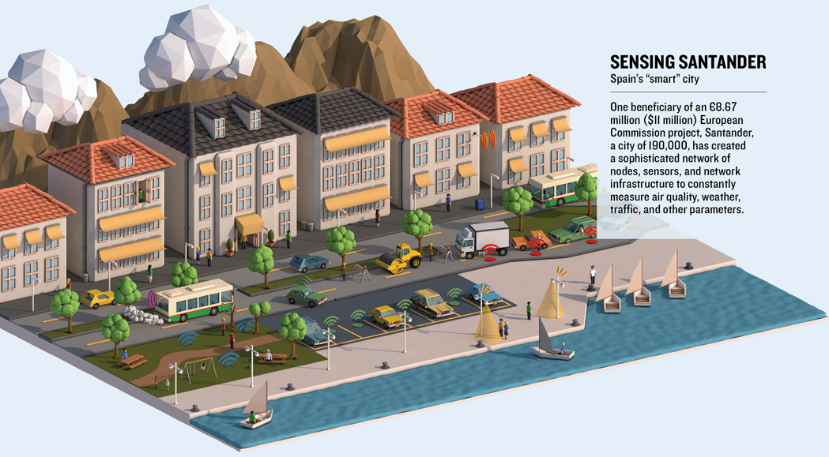
IoT: an Enabler for Smart Cities
Cities are already using IoT to solve various problems
Traffic congestion (NYC)
Crime prediction (Chicago)
Smart grids (Chattanooga)
Civic repairs (Boston)
Cities expected to spend around 12 Billion dollars over the next ten years
Incremental projects, not overly ambitious, tend to yield results faster
Source: Cities Get Smarter, MIT Technology Review, February 2015

Slide 4
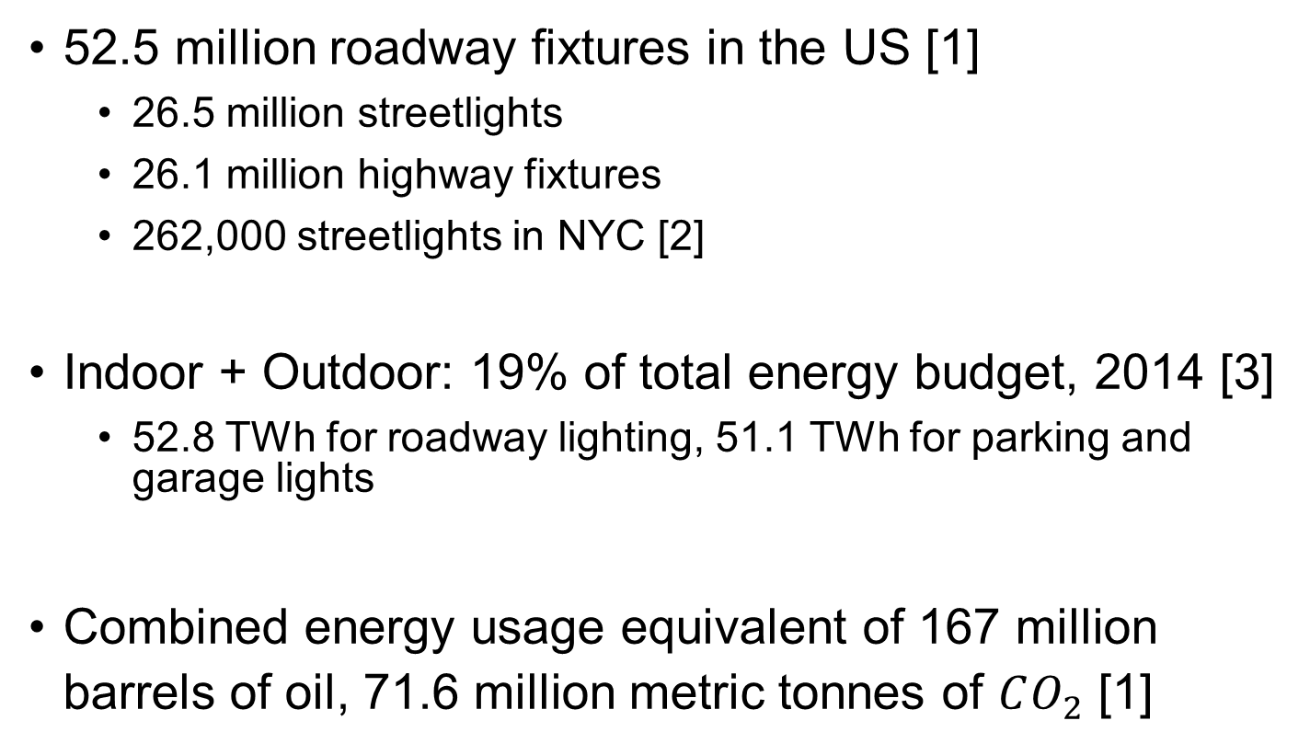
Lighting: a widespread and dense urban infrastructure
52.5 million roadway fixtures in the US [1]
  26.5 million streetlights
  26.1 million highway fixtures
  262,000 streetlights in NYC [2]
Indoor + Outdoor: 19% of total energy budget, 2014 [3]
  52.8 TWh for roadway lighting, 51.1 TWh for parking and garage lights
Combined energy usage equivalent of 167 million barrels of oil, 71.6 million metric tonnes of $CO_{2}$ [1]
Conventional streetlights in NYC

Slide 5

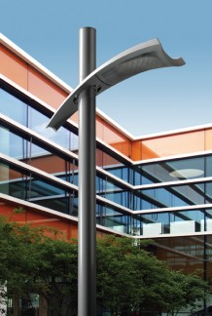
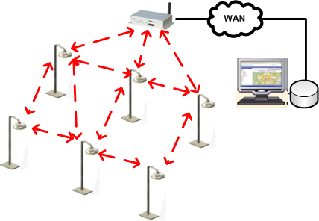
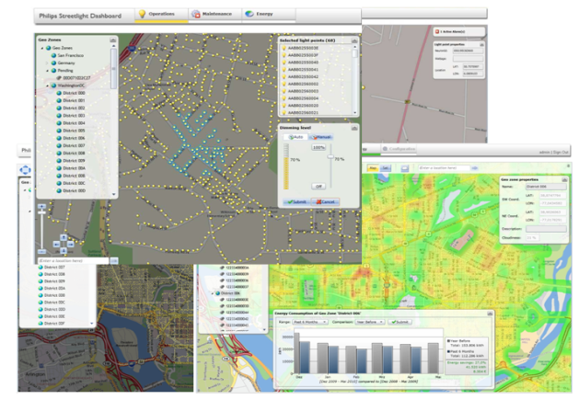

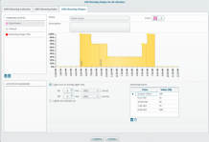
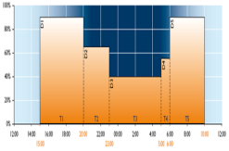
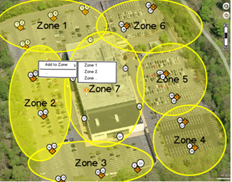
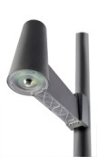


Lighting has come a long way …
Power-efficient Solid-State Technology
Connected
Remote monitoring & control
Adaptive
Aware (sensor-enabled)
Dimming Schedules
Existing Lighting-Related Technologies

Slide 6
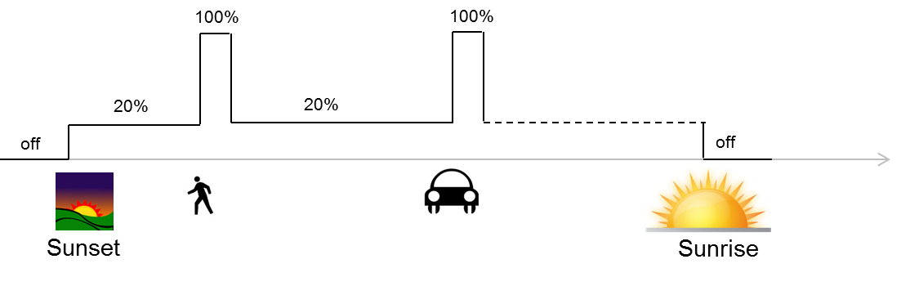
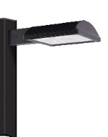


Lighting-Enabled IoT Applications
Value-Added Services
Analytics
Heterogeneous Spatio-Temporal Data
Adaptive Energy-Efficient Light-on-Demand
Traffic Monitoring
Road Surface Monitoring
Pollution Monitoring
Cloud-Based Data Acquisition, Processing & Actuation
IP Network
Gateway
Wireless Mesh-Based lighting network
Wireless Sensor Nodes
Intelligent Transportation Systems

Slide 7





Networking Issues
Central Mgmt. Systems
IP Network
Gateway
Mesh Networks
Unlicensed spectrum, cheaper
Locally managed
Cellular Networks
Highly reliable
Guaranteed quality of service
Heterogeneous Wireless Lighting Networks
Network capacity and quality-of-service crucial for value-added services beyond lighting

Slide 8
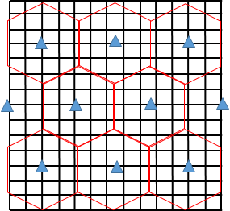
Networking Issues
Gateways with hexagonal coverage (sinks)
Capacity Analysis Simulations
Grid-based topology of light poles equipped with 802.15.4g radios
Multiple sources send data to sink, a gateway at the center of hexagonal regions
Grid-based topology for lighting networks
 |  | IEEE 802.15.4 |  | IEEE 802.15.4g
Data rates (Kbps) |  | 40 | 250 | 50 | 200 | 400 | 800
SNR |  | 0dB | 9dB | 6dB | 9dB | 15dB | 21dB
# light Poles | 1K | 38 | 15 | 32 | 8 | 4 | 2
 | 5K | 200 | 87 | 190 | 58 | 34 | 17
 | 10K | 403 | 177 | 389 | 122 | 89 | 46
Delay (Minutes) in delivering 5KB of load per light pole: only delay-tolerant applications can be supported.
Throughput (KB) per light pole per day: denser topologies give higher throughputs.

Slide 9
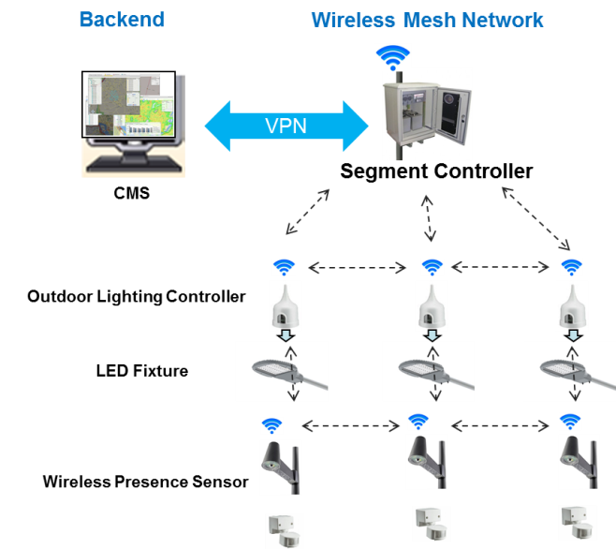
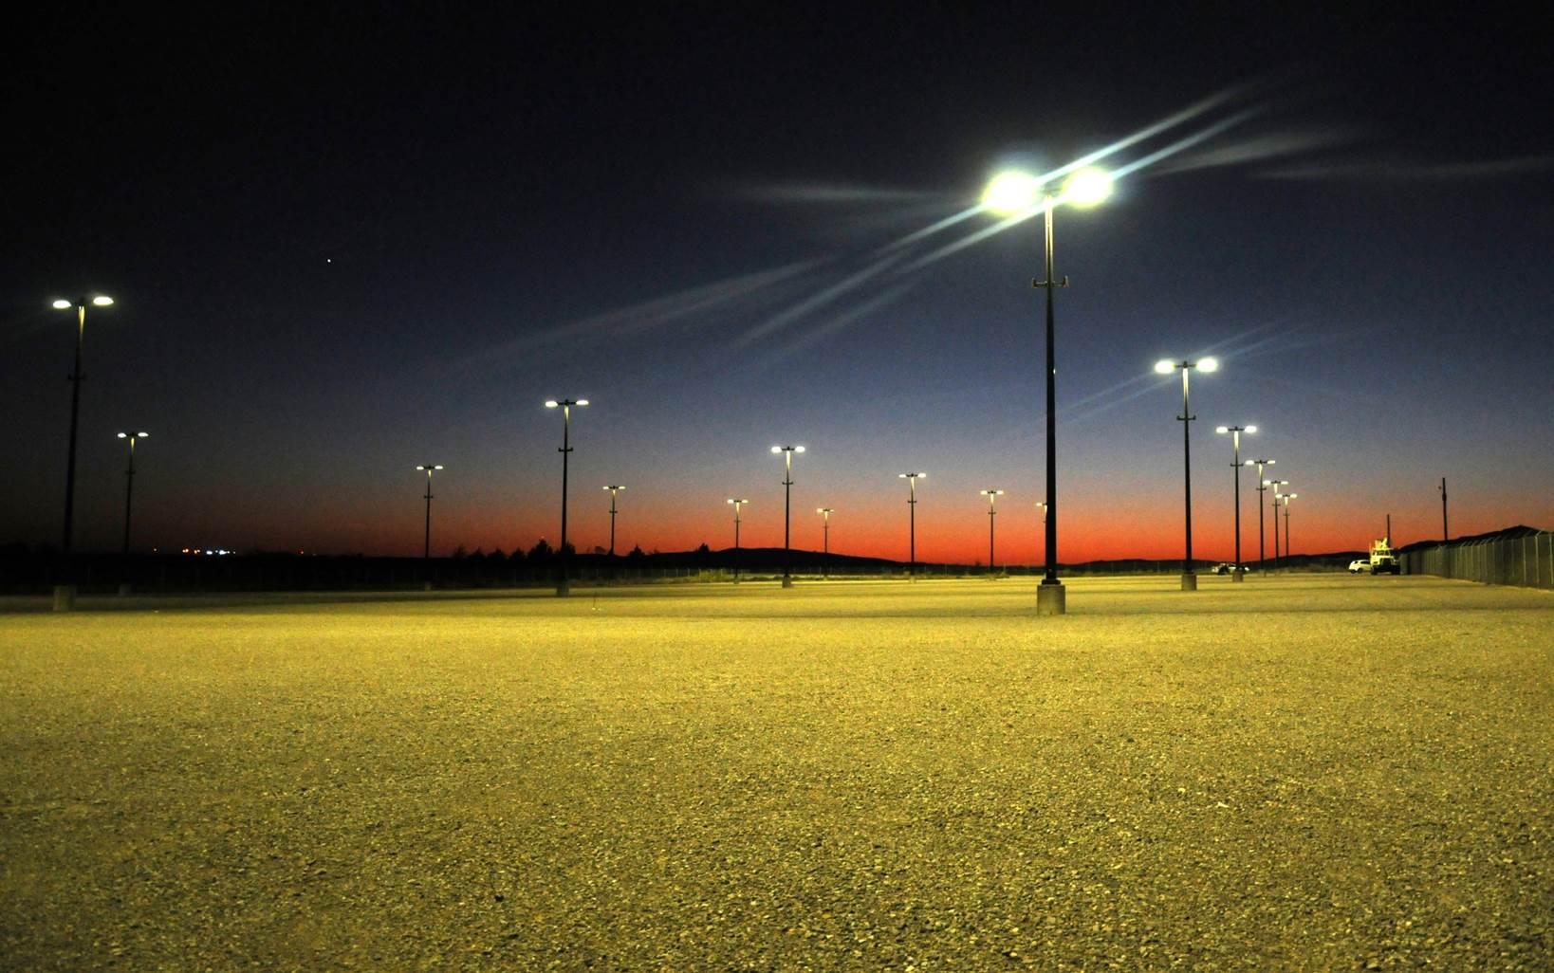
Applications: Light-on-Demand
Dim the LED-based lights by default, at say a parking lot
Camera-based sensors detect motion, trigger light controllers to maximize light levels
Triggers flooded over a mesh network to all the lights
Up to 87% energy savings over traditional lighting
Successful Dept. of Defense project at Fort Sill, OK (project # EW201141)

Slide 10

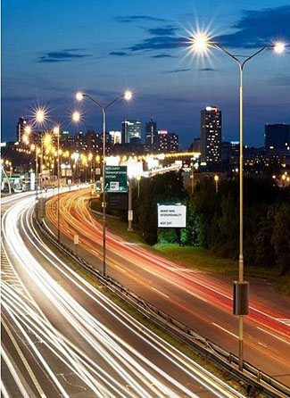
Applications: Traffic-Adaptive Lighting
Roadway lighting affects driving conditions
Federal Highway Administration: potential to decrease lighting levels by up to 50% safely [4]
Traffic profile: either updated in real time or use historical trends
The two approaches are not significantly different for most of the roadways
10% - 40% energy savings possible

Slide 11
Conclusions
Connected outdoor lighting can help save energy and reduce emissions
CPS approaches to lighting: Light-on-Demand, Traffic-Adaptive Lighting
The resulting mesh network can be used for data-enabled applications beyond lighting: environmental sensing, crowd monitoring, etc.
Networking issues: capacity analysis of mesh-based link layer technologies
Other issues
  Interoperability
  Systems approaches for scalability

Slide 12
References
NEEA Study: Technology and Market Assessment of Networked Outdoor Lighting Controls, Northwest Energy Efficiency Alliance, 2011.
Green Light, Sustainable Street Lighting for NYC, New York City Department of Transportation.
2010 U.S. Lighting Market Characterization, U.S. Department of Energy, 2012.
Design Criteria for Adaptive Roadway Lighting, U.S. Department of Transportation, Federal Highway Administration, 2014.

