Slide 1



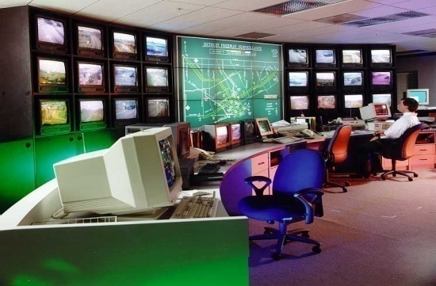
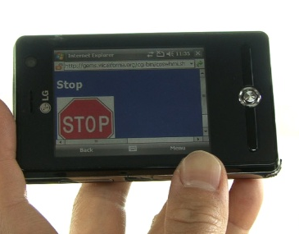

It’s All About Connectivity
“The Network”
Opportunity for Innovation
E-payment
Real Time Network Data
Signal Phase and Timing
Situation Relevant Information
Safety Messages
Probe Data
Instrumented Roadside
Notes:
Like the Internet, which provides information connectivity, IntelliDriveSM provides a starting point for transportation connectivity that ultimately will enable countless applications and spawn new industries. Today we can see only the tip of the iceberg.
IntelliDriveSM will deliver networked connectivity that will truly transform travel. IntelliDriveSM applications provide connectivity:
With and among vehicles;
Between vehicles and the roadway infrastructure;
Among vehicles, infrastructure, and wireless devices (consumer electronics, such as cell phones and PDAs) that are carried by drivers, pedestrians, and bicyclists.
Connectivity is already providing real-time traffic and travel information to inform travel decisions and help transportation managers mitigate congestion and the environmental impacts of transportation. Greatly enhanced capabilities will be available in the future – including the potential of preventing the majority of vehicle crashes. Researchers are already testing these possibilities.

