Slide 1
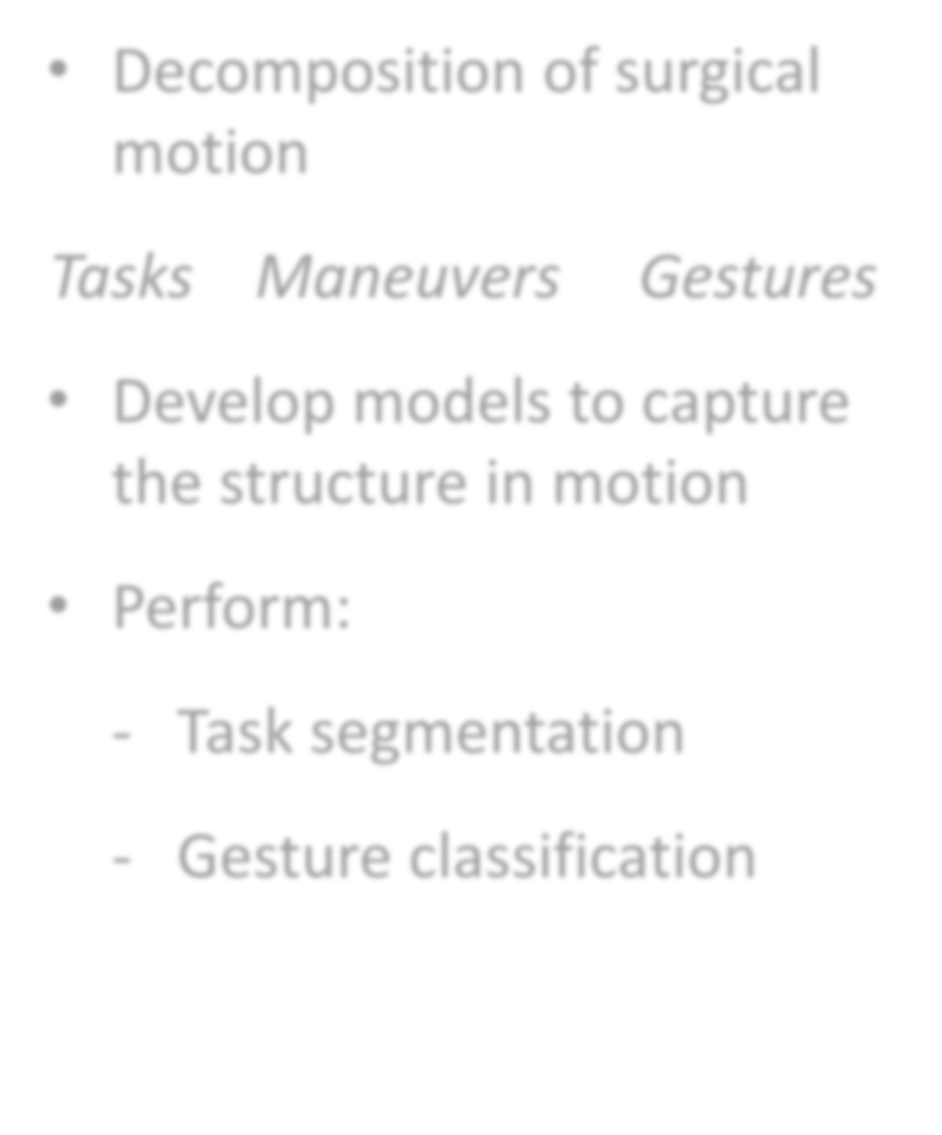
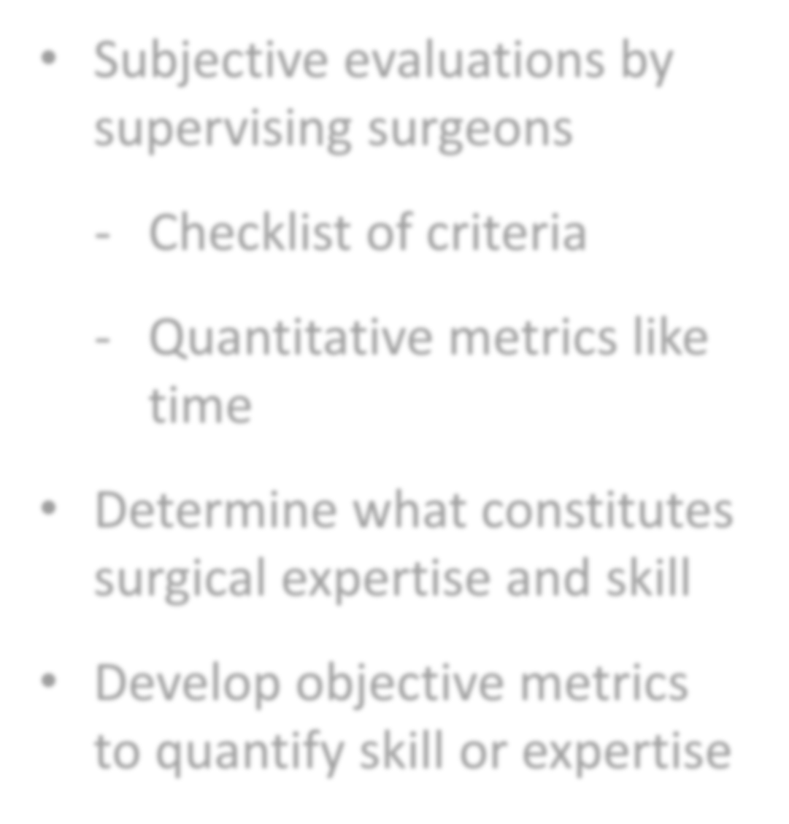
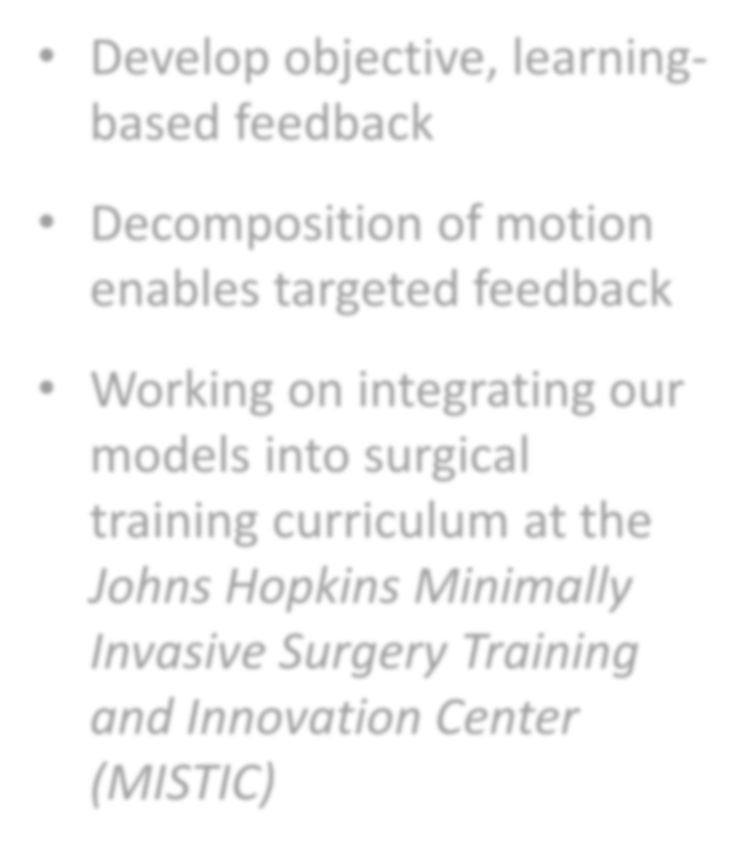
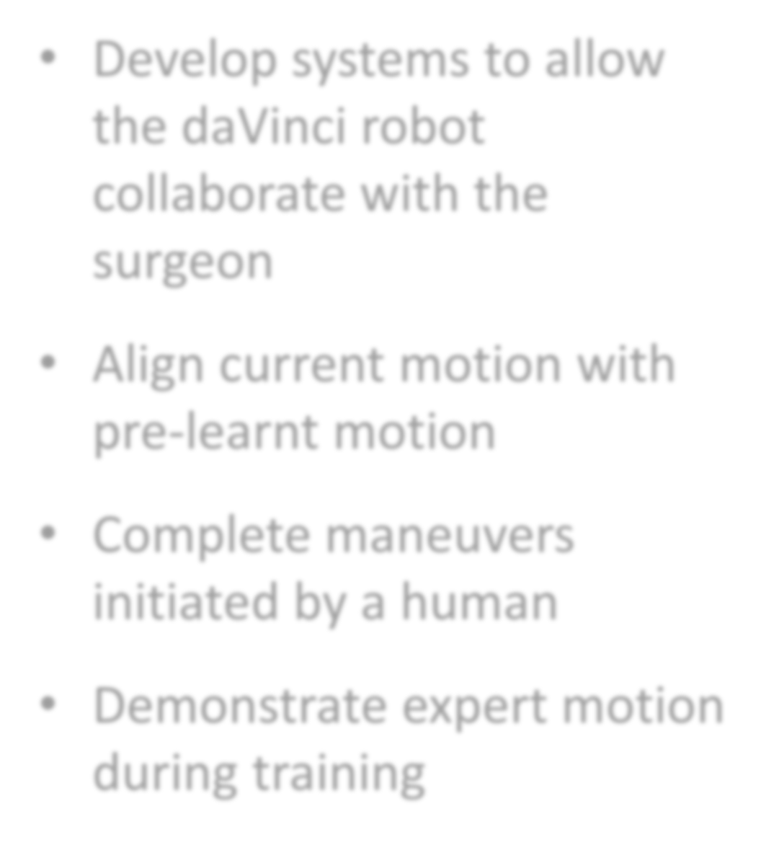


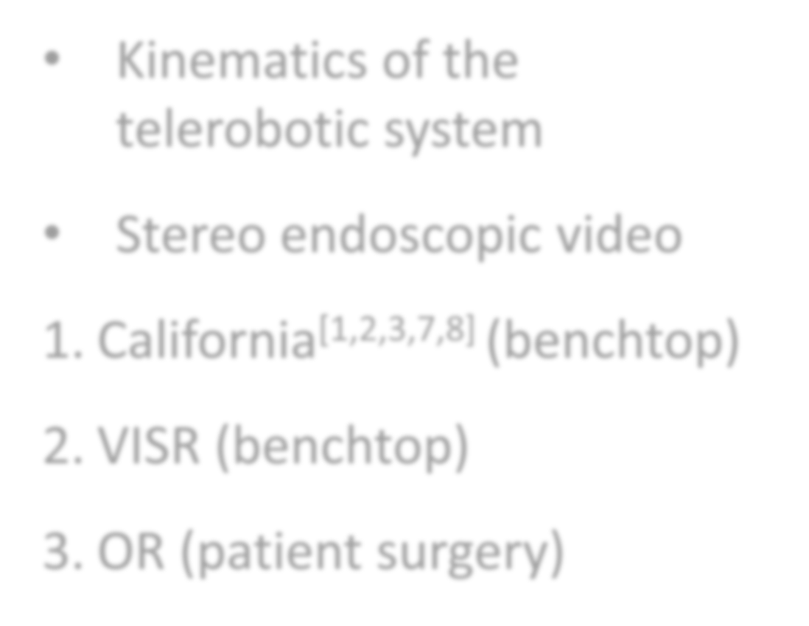
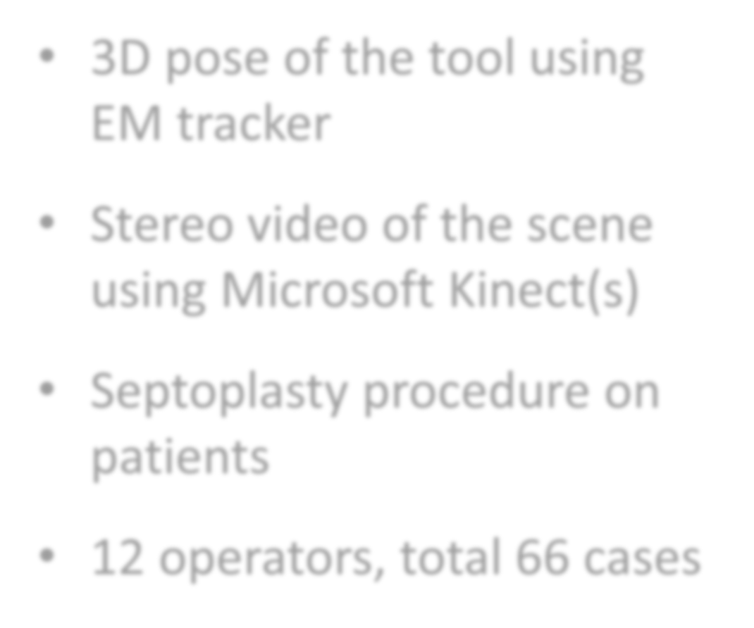
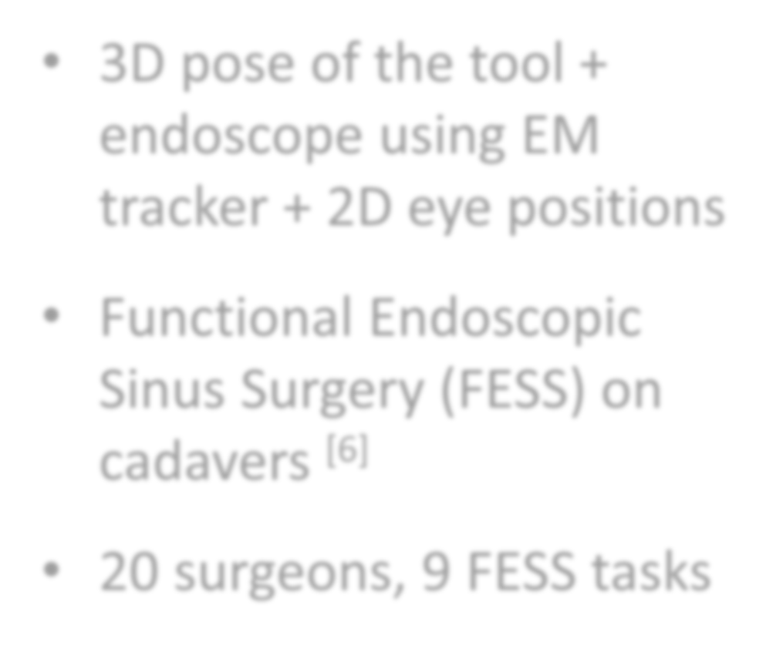
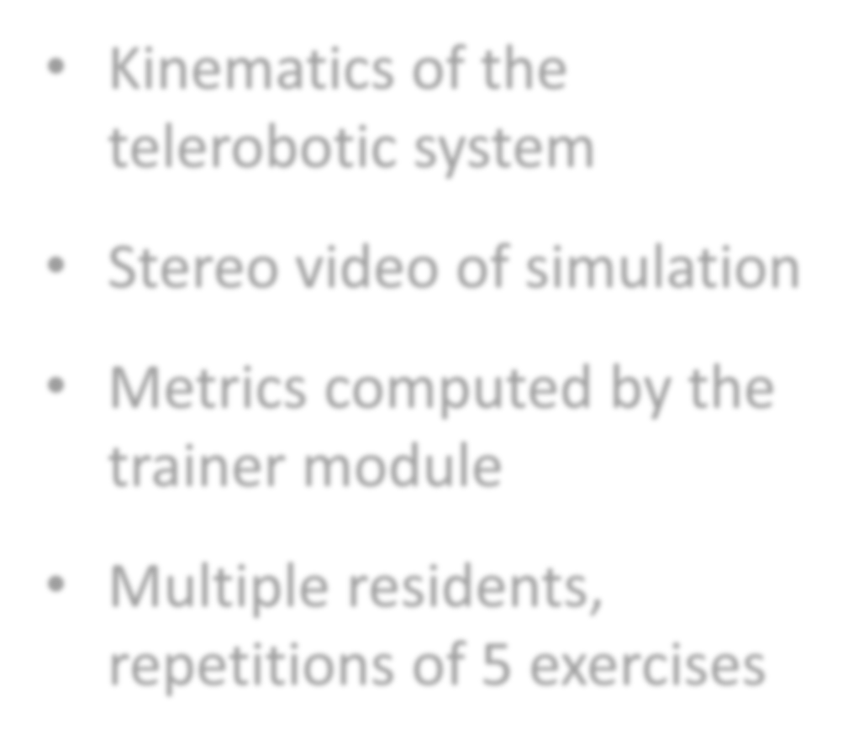






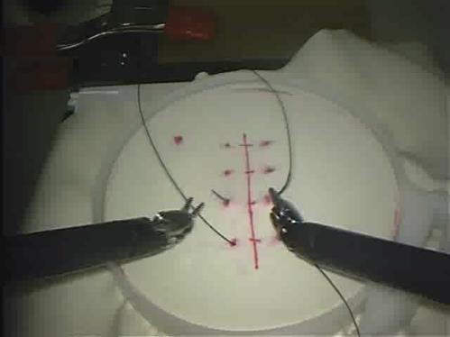
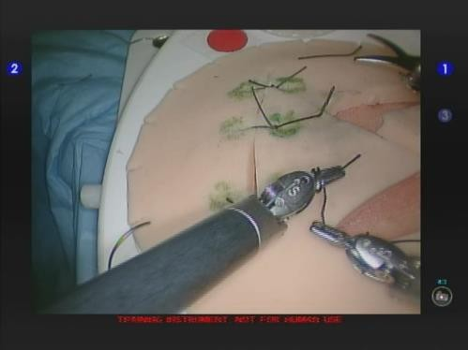
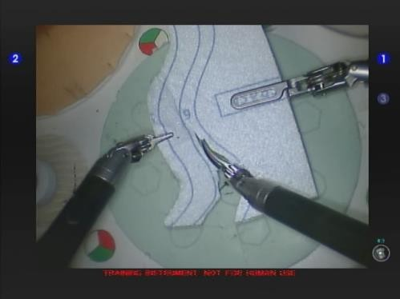
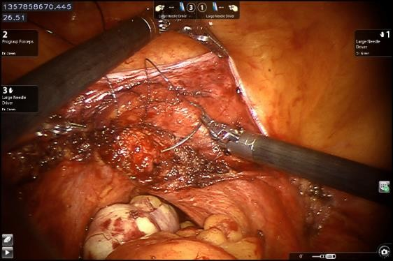
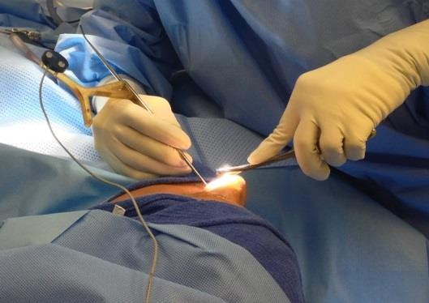
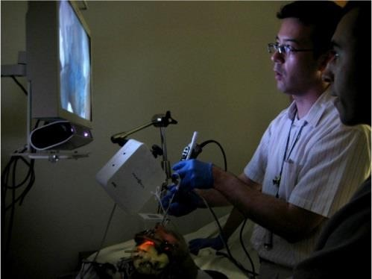
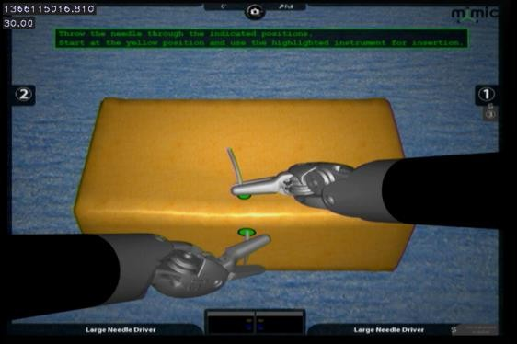
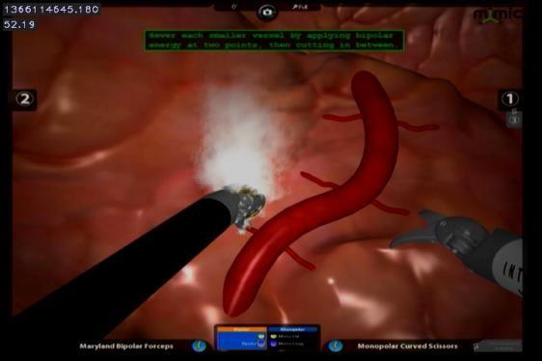
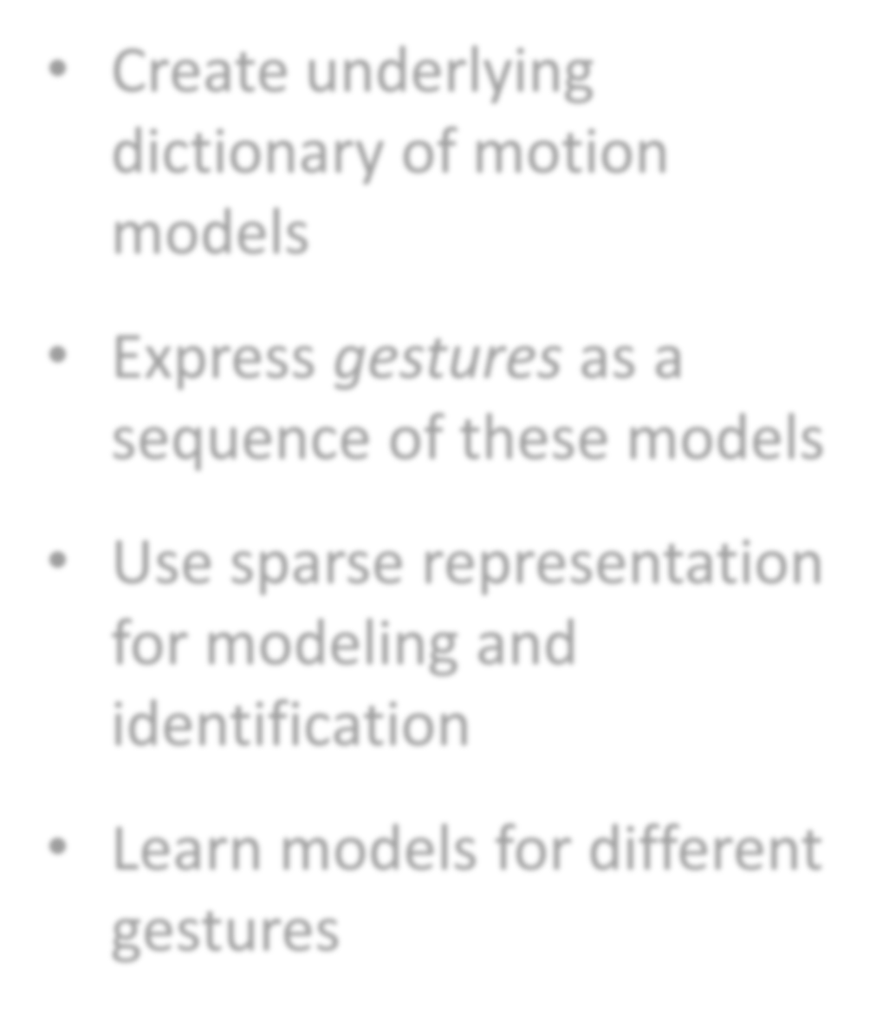
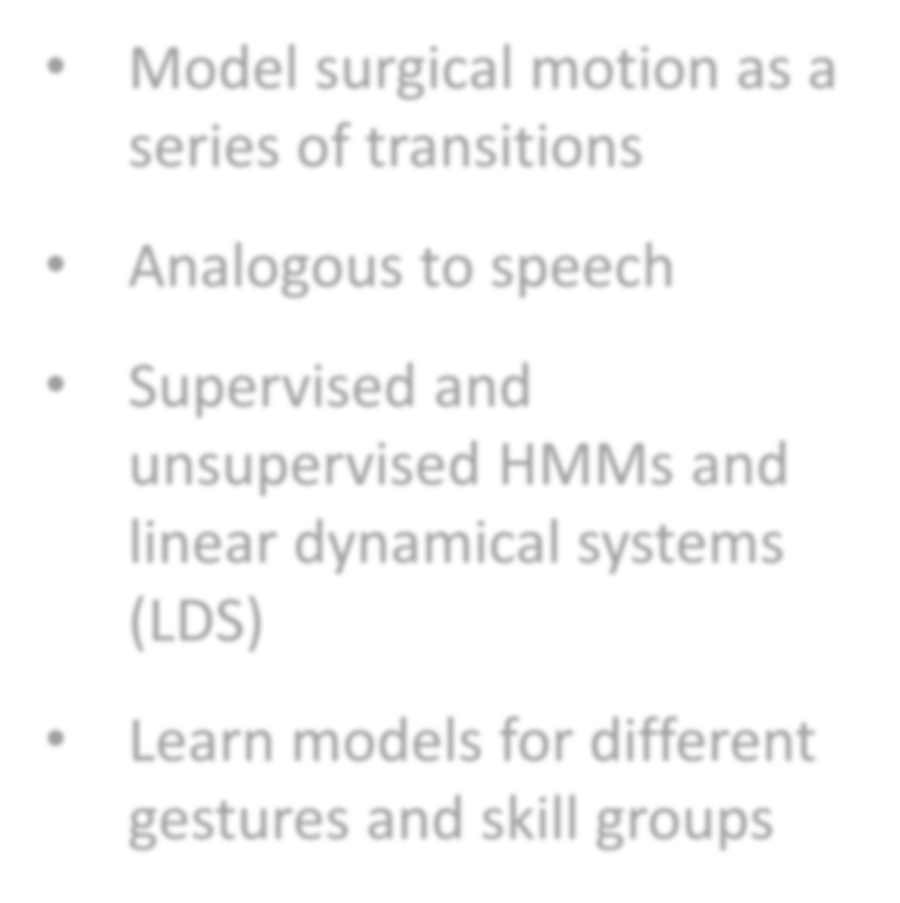
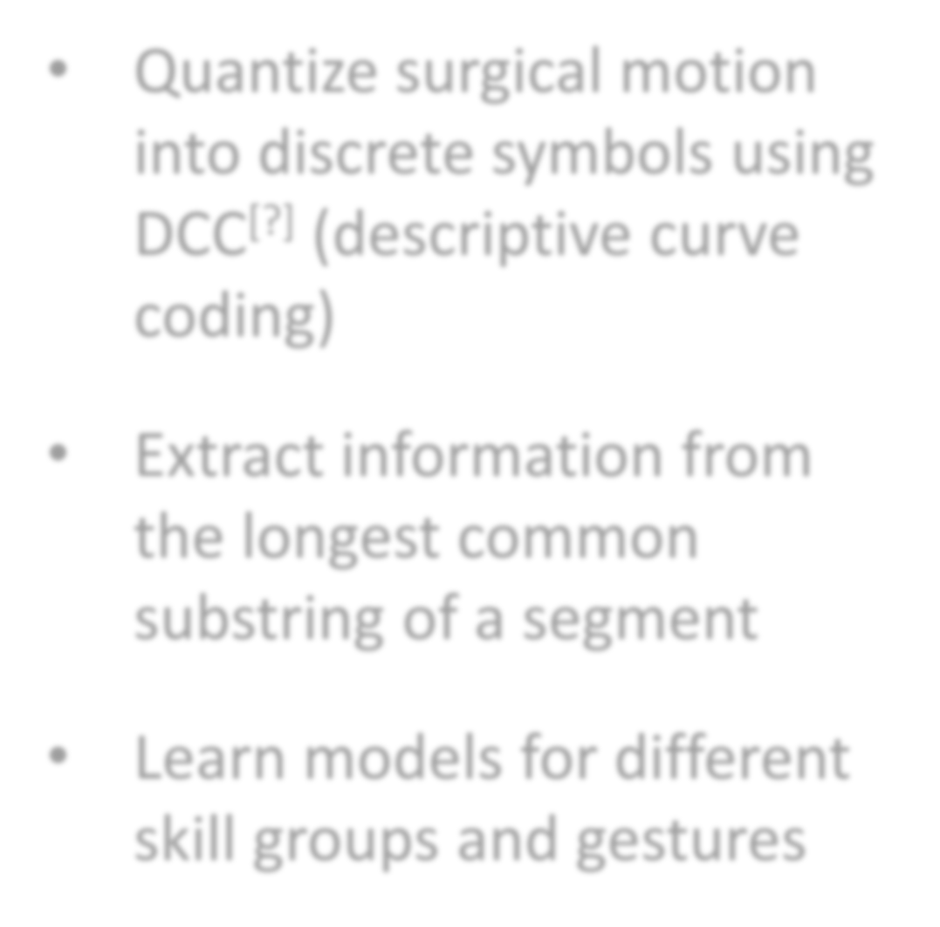
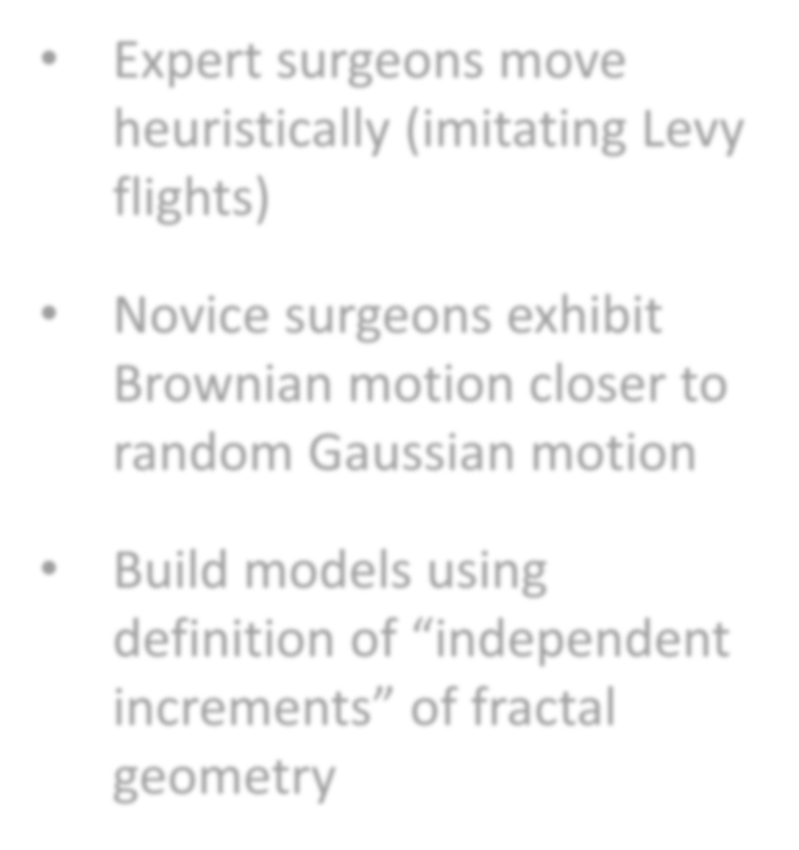

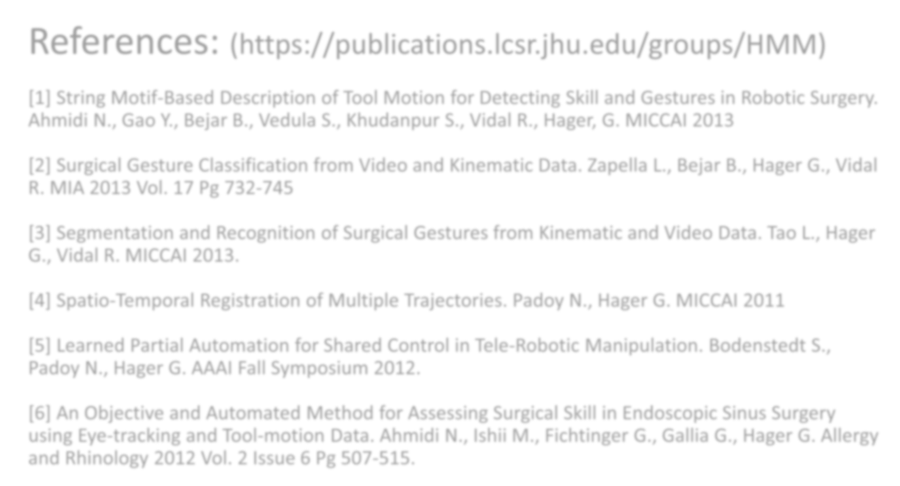
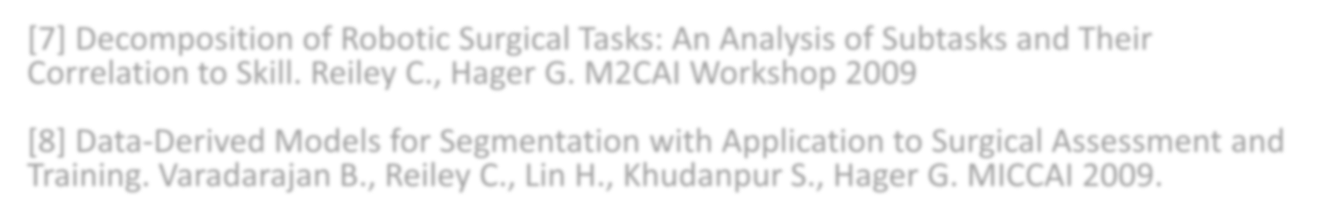












Language Of Surgery – Human Motion Modeling
Malpani A., Ahmidi N., Tao L., Vedula S., Gao Y., Zapella L., Bejar B., Padoy N.,Vardarajan B., Reiley C., Elhamifar E., Lin H., Lee G., Ishii M., Ishii L., Chen G., Vidal R., Khudanpur S., Hager G.
Research Objectives
Surgical Activity Recognition
[1,2,3,7,8]
Objective Skill Assessment
[1,6,7,8]
Automated Feedback & Individualized Training
Human Machine Collaboration ^{[4,5]}
Decomposition of surgical motion
Tasks Maneuvers Gestures
Subjective evaluations by supervising surgeons
Develop objective, learning- based feedback
Decomposition of motion enables targeted feedback
Working on integrating our models into surgical training curriculum at the Johns Hopkins Minimally Invasive Surgery Training and Innovation Center (MISTIC)
Develop systems to allow the daVinci robot collaborate with the surgeon
Align current motion with pre-learnt motion
Complete maneuvers initiated by a human
Demonstrate expert motion during training
Develop models to capture the structure in motion
Perform:
  Task segmentation
  Gesture classification
Checklist of criteria
Quantitative metrics like time
Determine what constitutes surgical expertise and skill
Develop objective metrics to quantify skill or expertise
Robotic Surgery (daVinci)
Open Surgery
Endoscopic Surgery
Simulation in Surgery (daVinci Skills Simulator)
Kinematics of the telerobotic system
Stereo endoscopic video
3D pose of the tool using EM tracker
Stereo video of the scene using Microsoft Kinect(s)
Septoplasty procedure on patients
12 operators, total 66 cases
3D pose of the tool + endoscope using EM tracker + 2D eye positions
Functional Endoscopic Sinus Surgery (FESS) on
Kinematics of the telerobotic system
Stereo video of simulation
Metrics computed by the trainer module
Multiple residents, repetitions of 5 exercises
Data Sets
California^{[1,2,3,7,8]} (benchtop)
VISR (benchtop)
OR (patient surgery)
cadavers
[6]
20 surgeons, 9 FESS tasks
Hybrid Dynamical Systems
Language Models
String Motif based Models ^{[1]}
Fractal Geometry based Models ^{[6]}
Create underlying dictionary of motion models
Express gestures as a sequence of these models
Use sparse representation for modeling and identification
Learn models for different gestures
Model surgical motion as a series of transitions
Analogous to speech
Supervised and unsupervised HMMs and linear dynamical systems (LDS)
Learn models for different gestures and skill groups
Quantize surgical motion into discrete symbols using DCC (descriptive curve coding)
Expert surgeons move heuristically (imitating Levy flights)
Methods
[?]
Extract information from the longest common substring of a segment
Novice surgeons exhibit Brownian motion closer to random Gaussian motion
Learn models for different skill groups and gestures
Build models using definition of “independent increments” of fractal geometry
References: (https://publications.lcsr.jhu.edu/groups/HMM)
[1] String Motif-Based Description of Tool Motion for Detecting Skill and Gestures in Robotic Surgery. Ahmidi N., Gao Y., Bejar B., Vedula S., Khudanpur S., Vidal R., Hager, G. MICCAI 2013
[7] Decomposition of Robotic Surgical Tasks: An Analysis of Subtasks and Their Correlation to Skill. Reiley C., Hager G. M2CAI Workshop 2009
[8] Data-Derived Models for Segmentation with Application to Surgical Assessment and Training. Varadarajan B., Reiley C., Lin H., Khudanpur S., Hager G. MICCAI 2009.
[2] Surgical Gesture Classification from Video and Kinematic Data. Zapella L., Bejar B., Hager G., Vidal R. MIA 2013 Vol. 17 Pg 732-745
Acknowledgements:
[3] Segmentation and Recognition of Surgical Gestures from Kinematic and Video Data. Tao L., Hager G., Vidal R. MICCAI 2013.
Funding: NSF NRI 1227277, NSF CPS 0931805, NSF CDI-II 0941362, NIH
1R21EB009143-01A1, Intuitive Surgical Inc.
[4] Spatio-Temporal Registration of Multiple Trajectories. Padoy N., Hager G. MICCAI 2011
[5] Learned Partial Automation for Shared Control in Tele-Robotic Manipulation. Bodenstedt S., Padoy N., Hager G. AAAI Fall Symposium 2012.
Students: Poddar P., Chen G., Paxton C., Bodenstedt S., Jog A., Tantillo T.
[6] An Objective and Automated Method for Assessing Surgical Skill in Endoscopic Sinus Surgery using Eye-tracking and Tool-motion Data. Ahmidi N., Ishii M., Fichtinger G., Gallia G., Hager G. Allergy and Rhinology 2012 Vol. 2 Issue 6 Pg 507-515.
Collaborators: Intuitive Surgical Inc., Johns Hopkins Medical Institutions
https://cirl.lcsr.jhu.edu/Research/HMM

