Slide 1
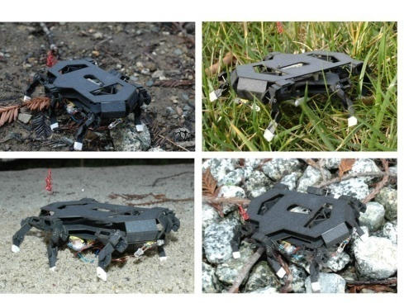
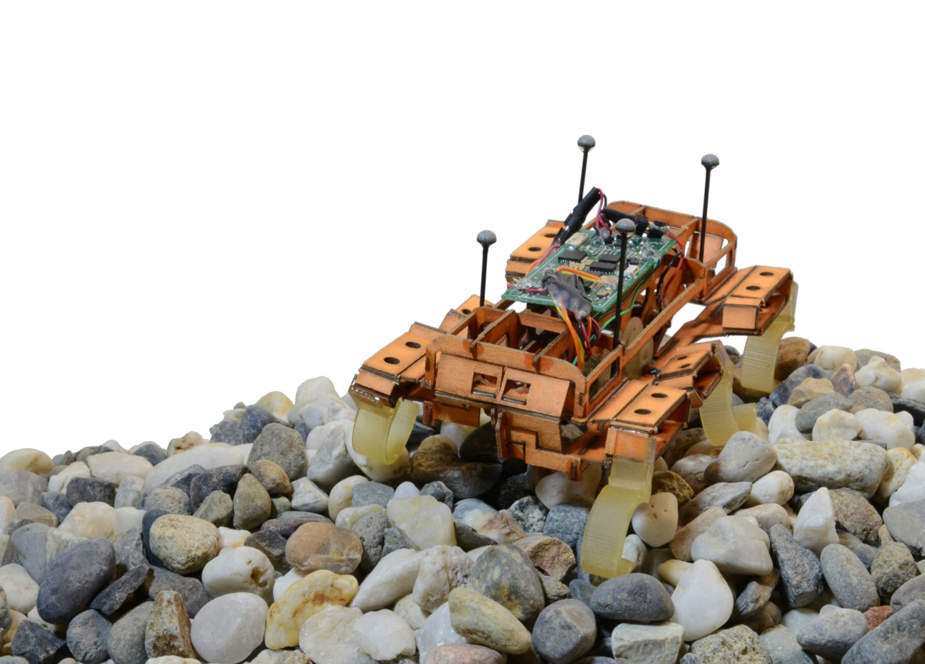
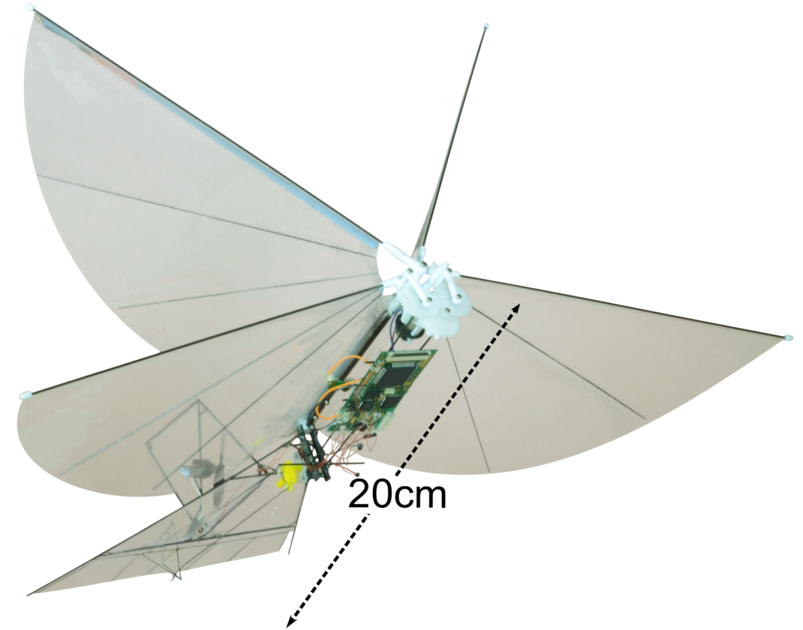
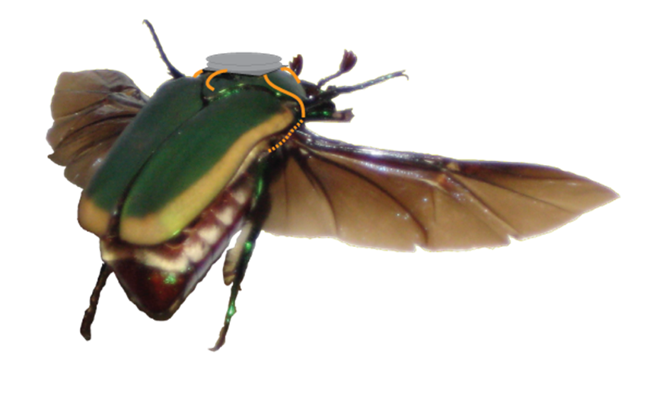
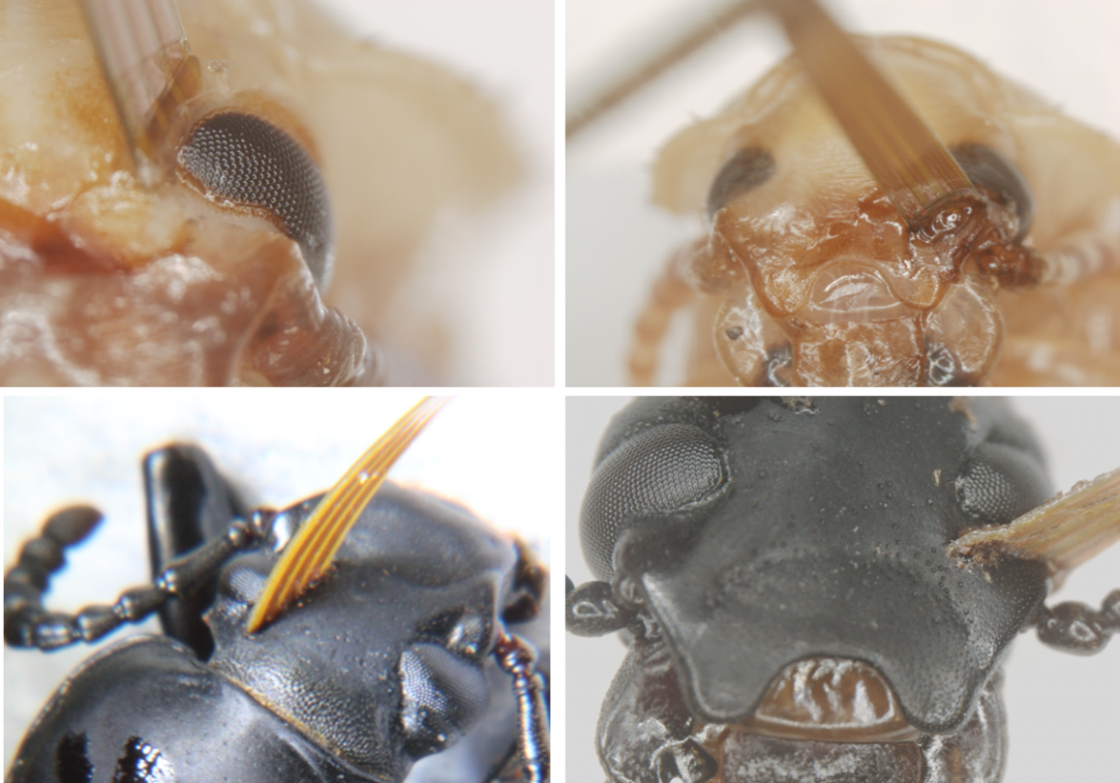
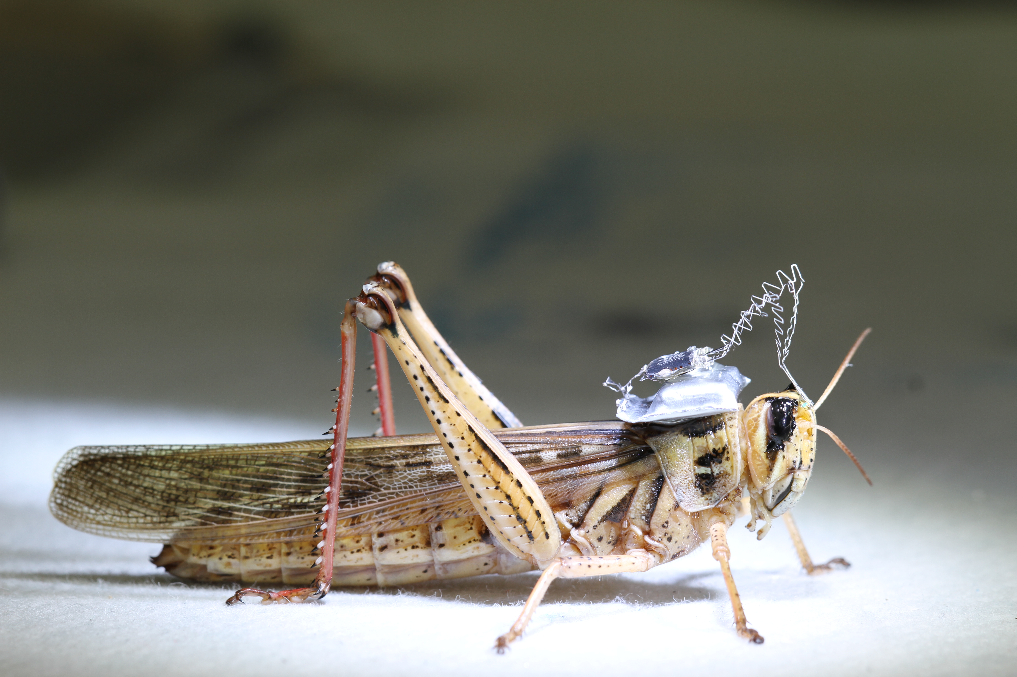
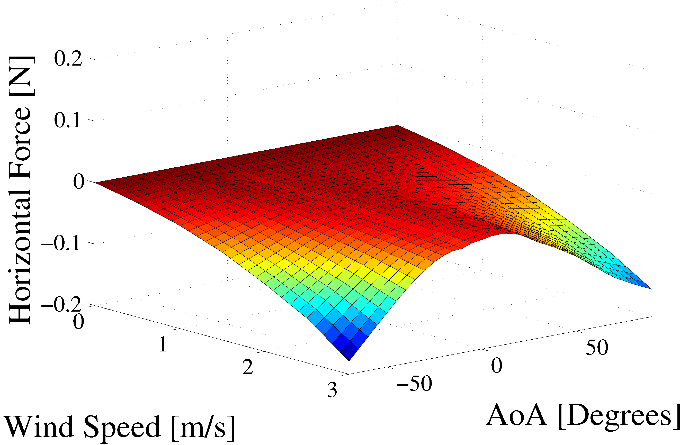
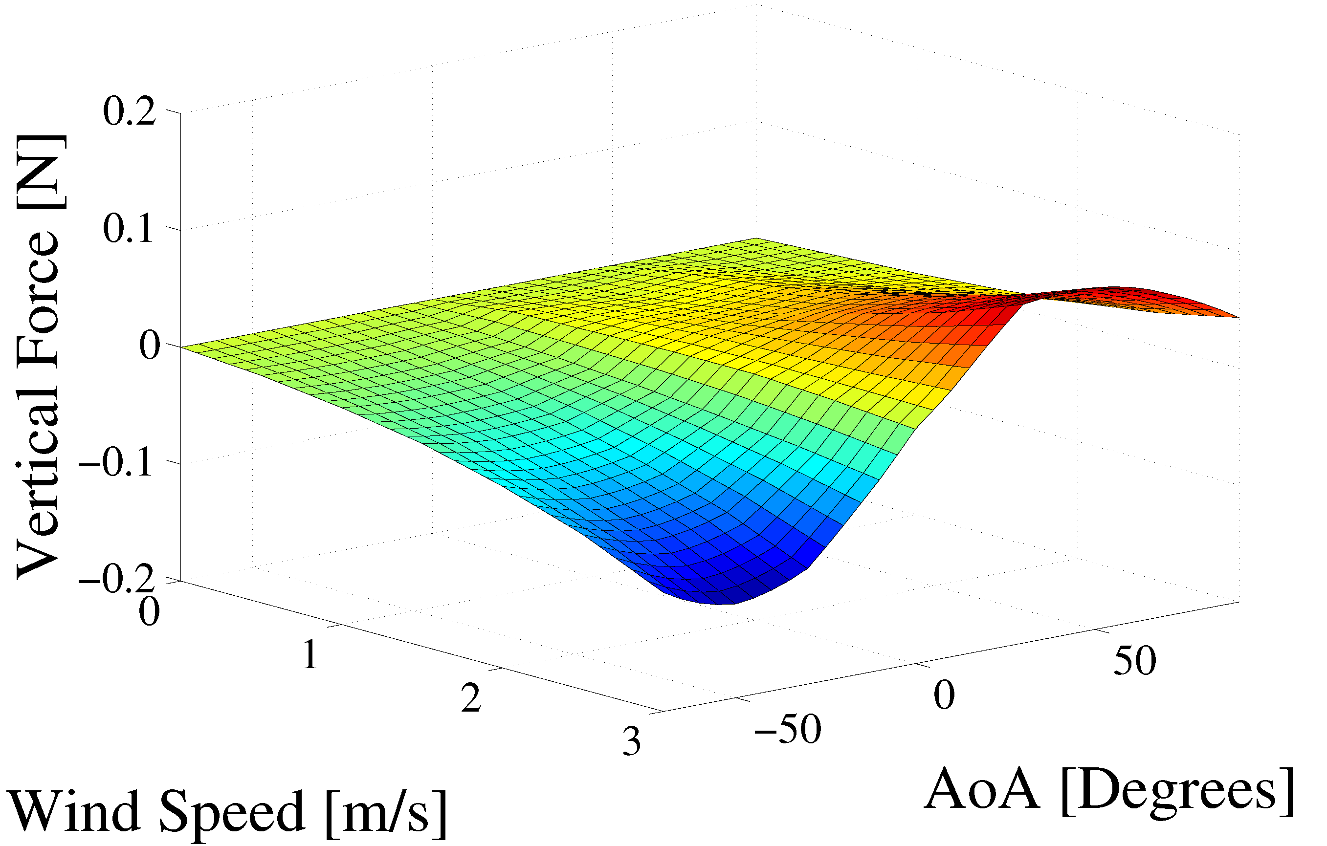
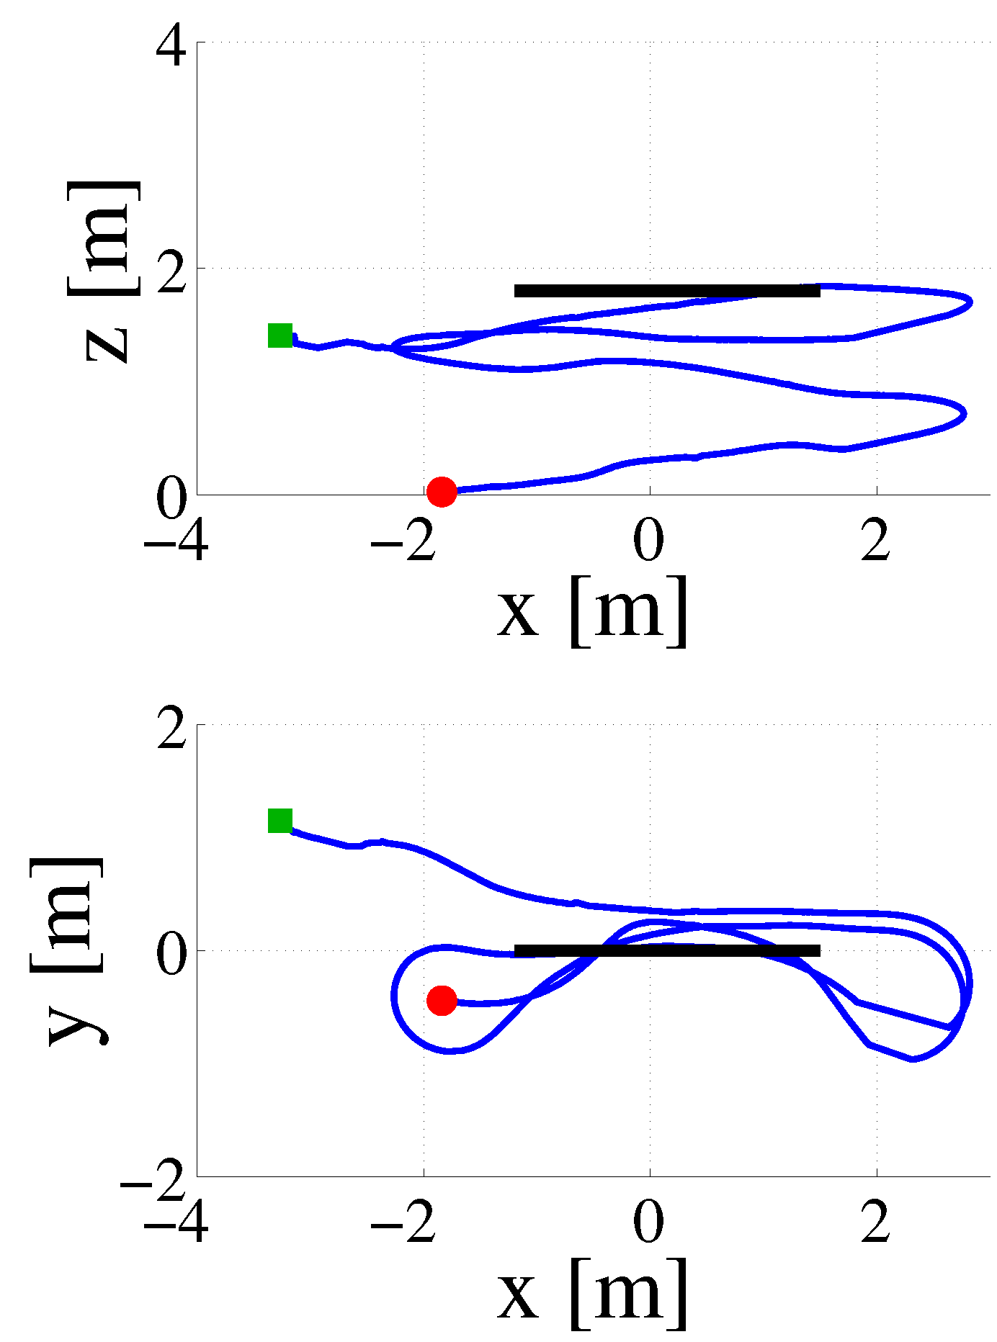
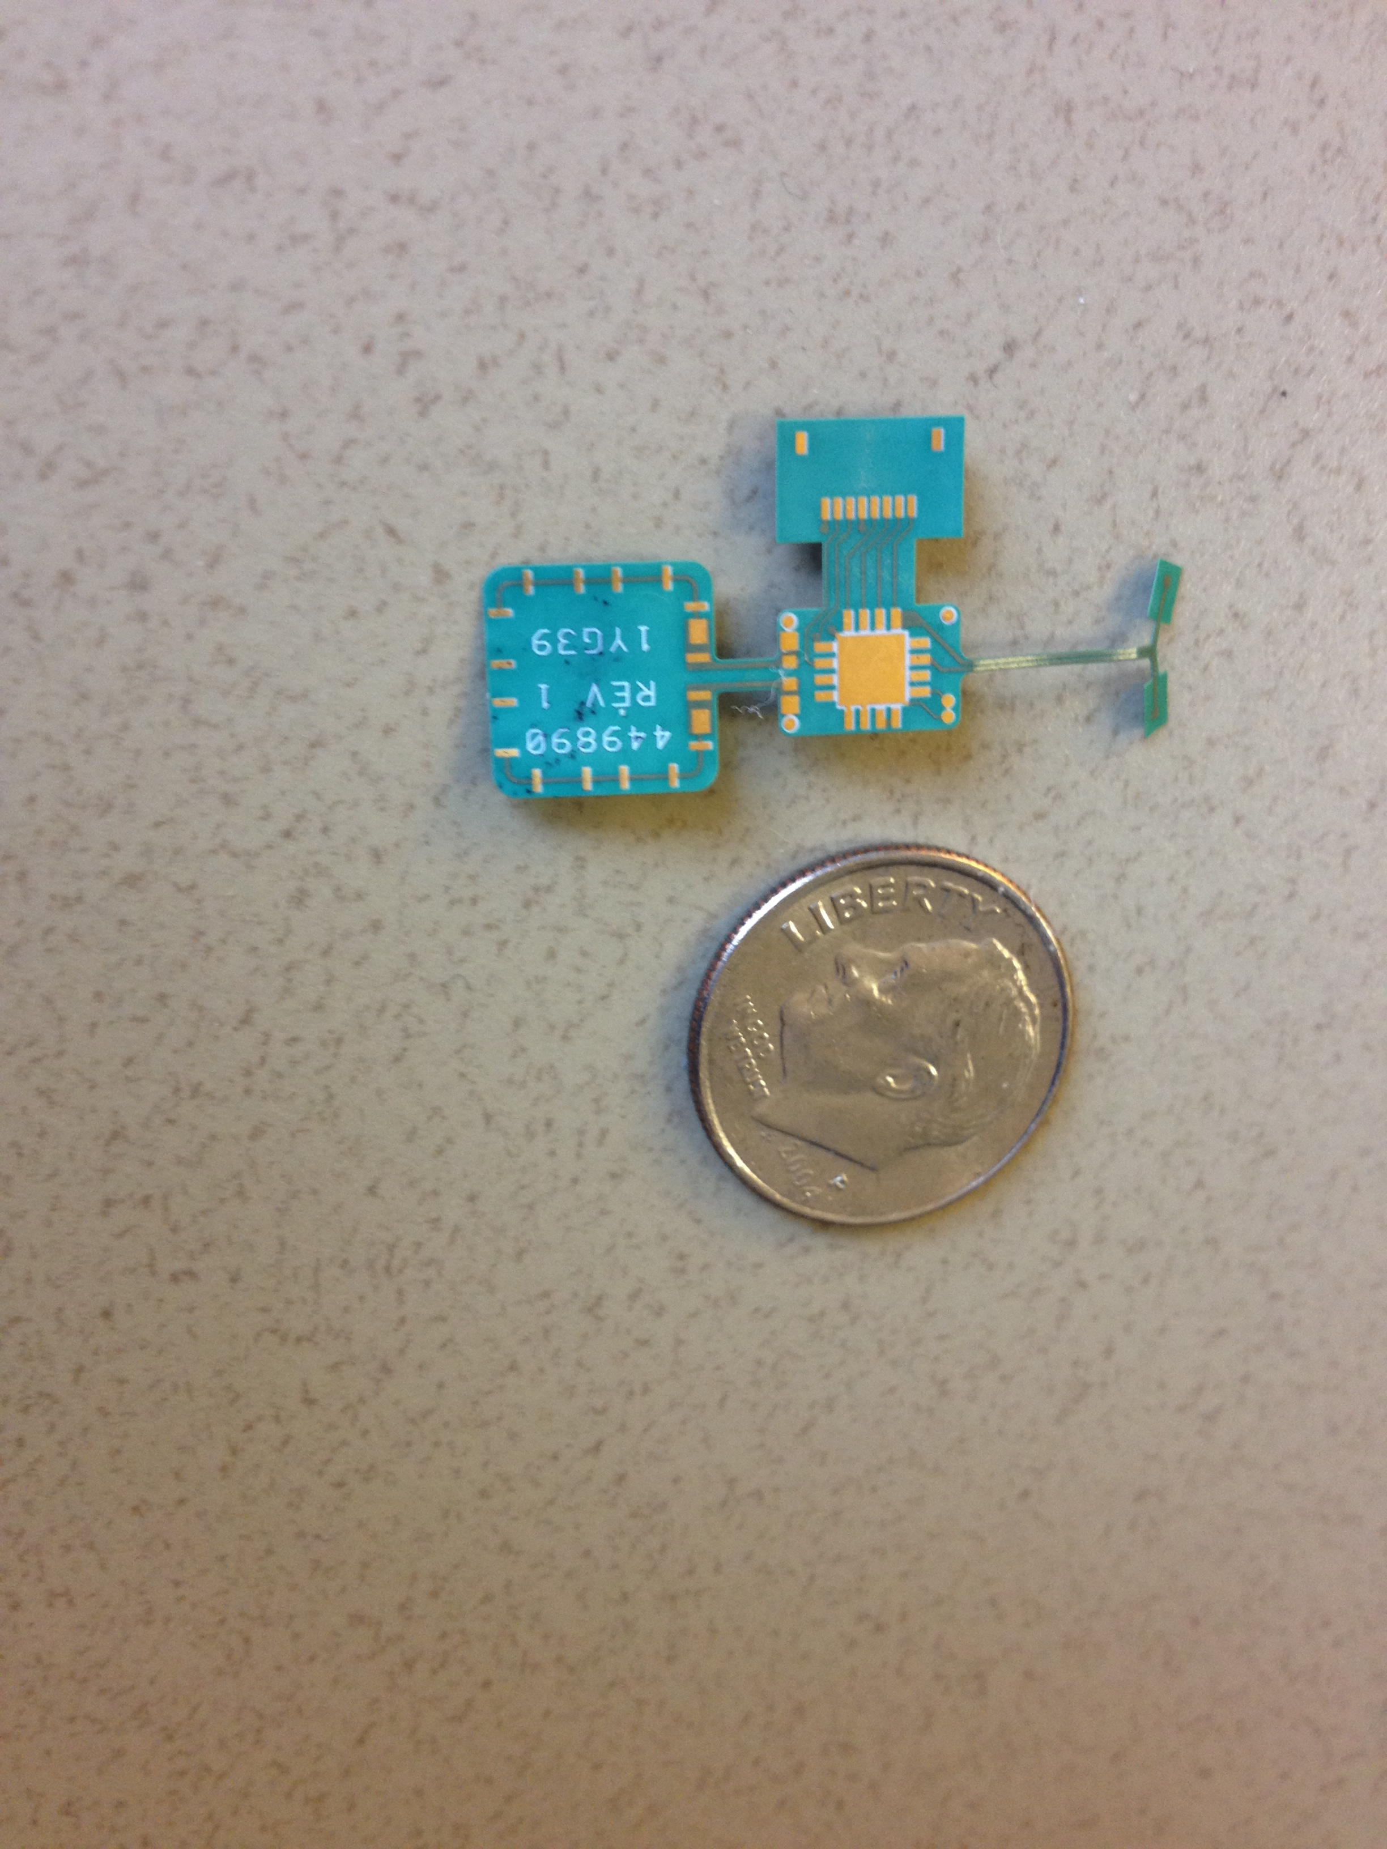
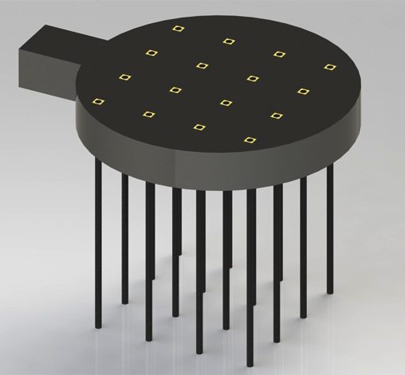
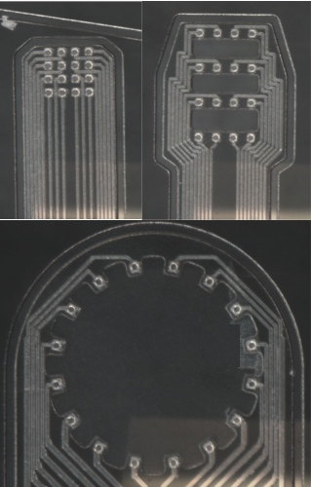
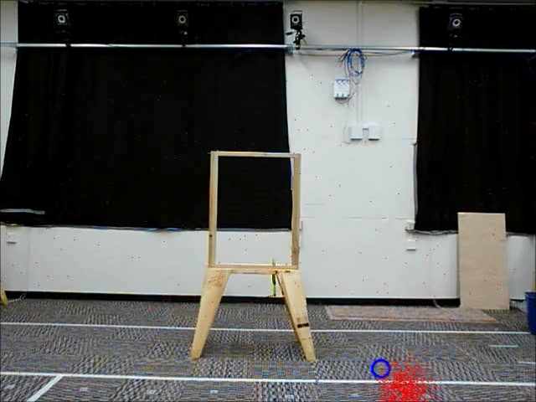
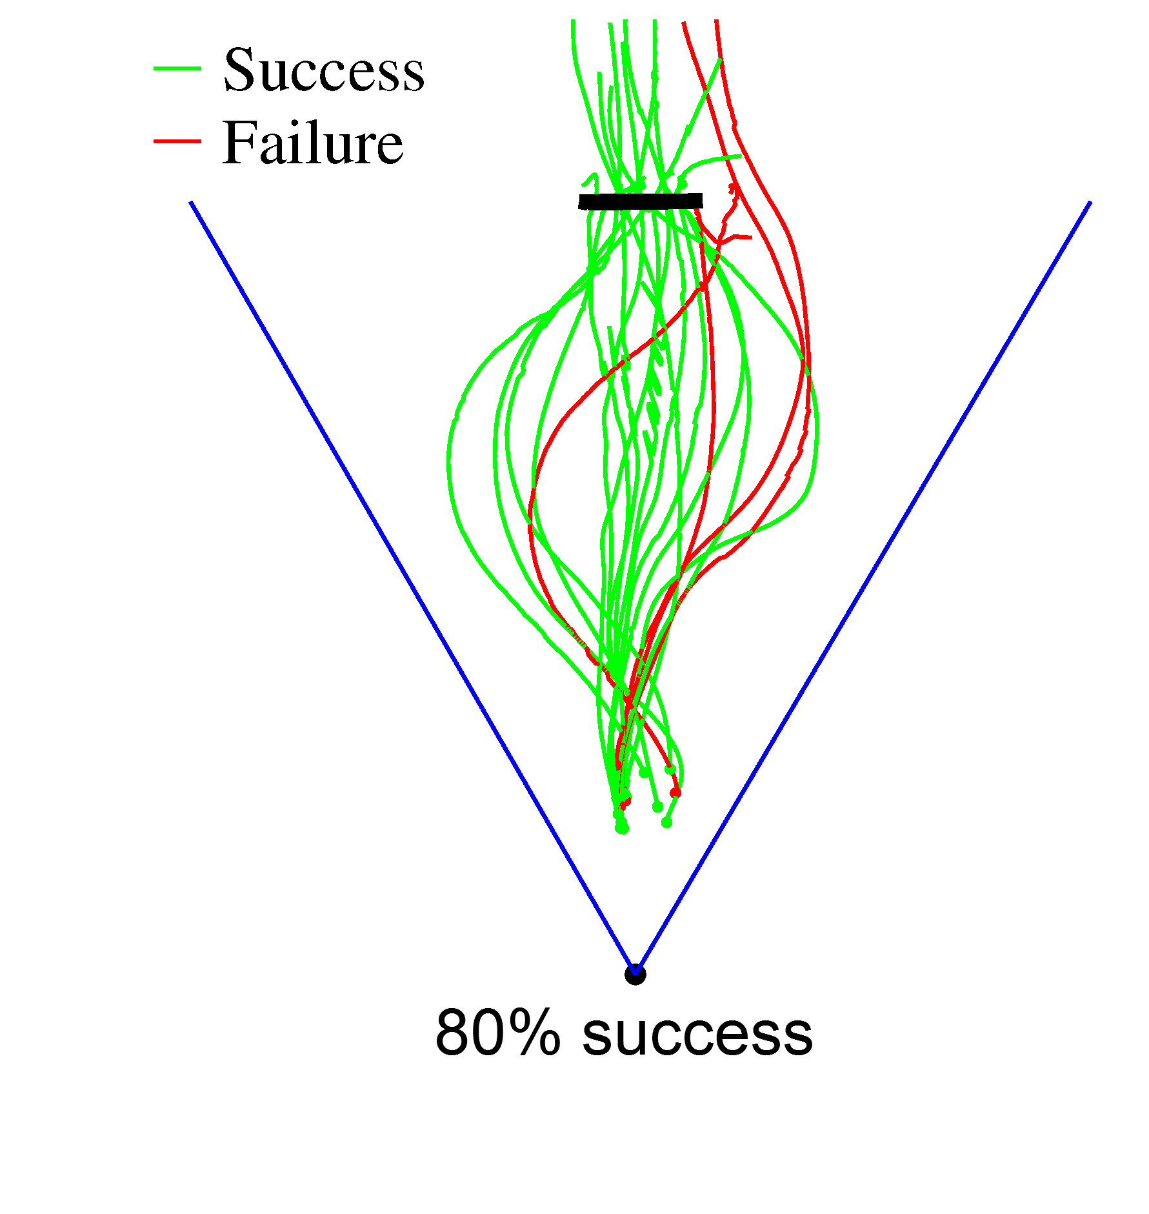
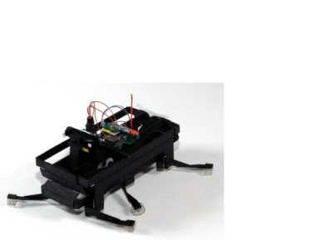
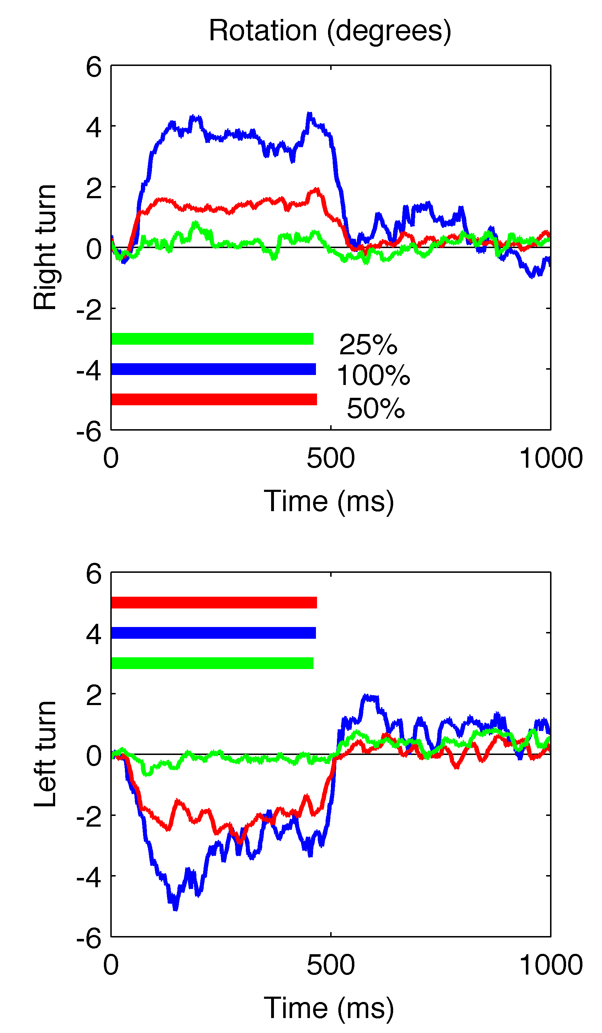
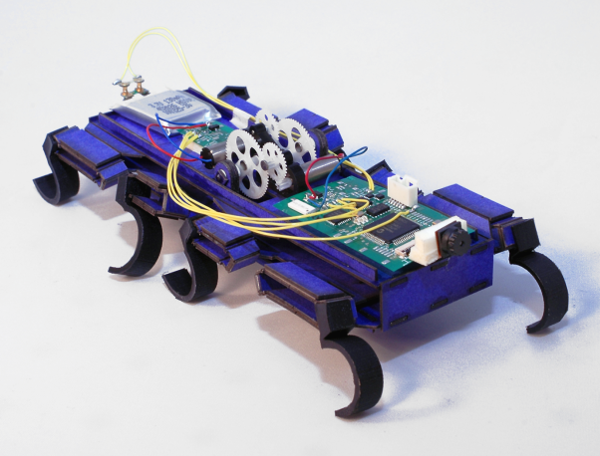
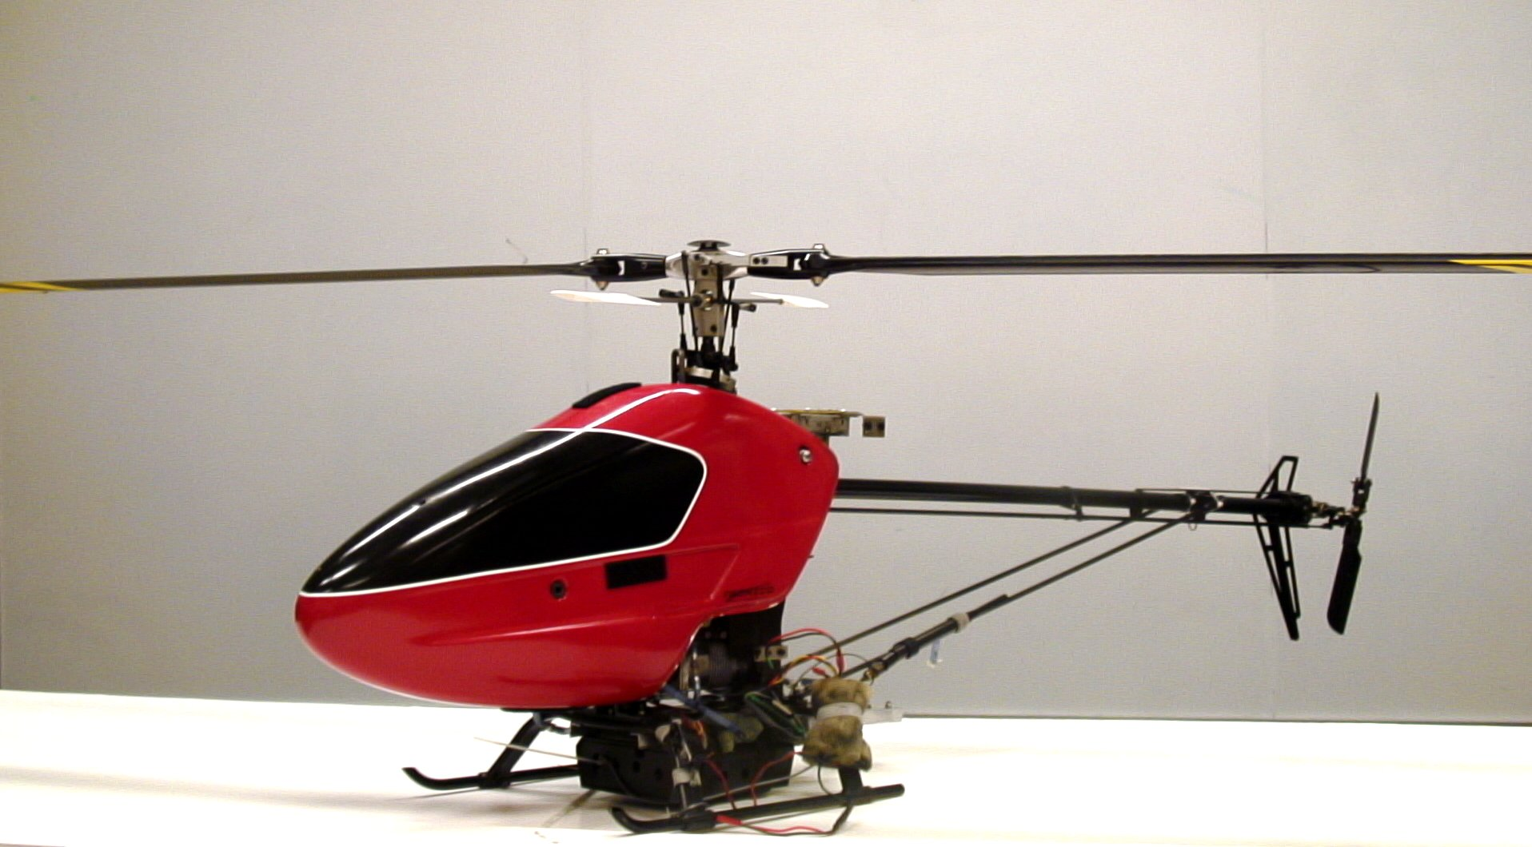
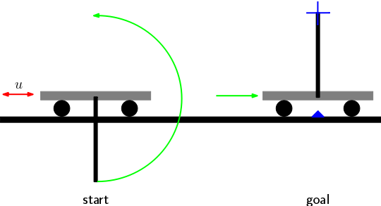
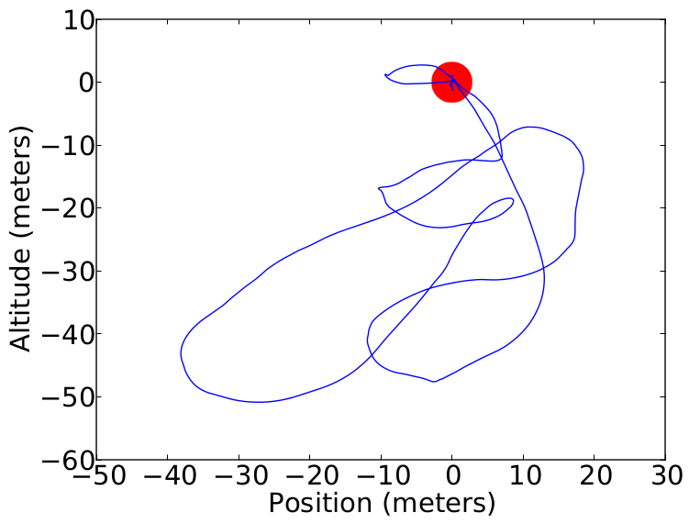
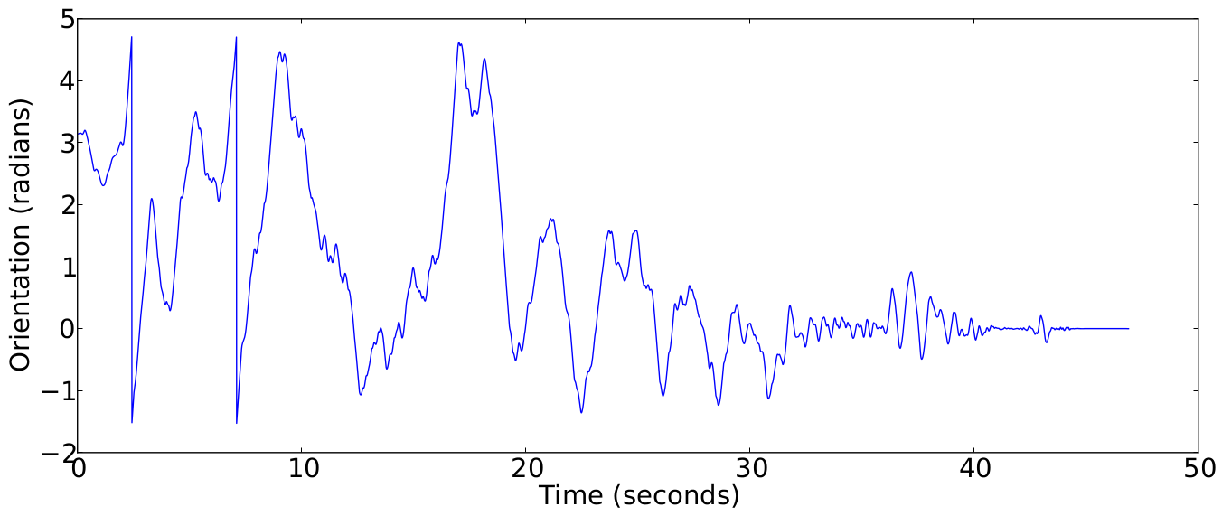
Learning for Control of Synthetic and Cyborg Insects
PI’s: Pieter Abbeel (PI), Ron Fearing (co-PI), Michel Maharbiz (co-PI)
Students: Teodor Moldovan, Fernando L. G. Bermudez, Cameron Rose, Joshua van Kleef, Travis Massey, Jonathan Chen, Keegan Mann
Summary
Cyborg Insects
All beetles were handled according to long-established institutional and
scientific guidelines for experimenting with animals. All insects in our lab are treated with respect and care. Animals are NOT devices.
Synthetic Crawler and Flyer
Objective
Summary
Research directions
Summary
Goal: Identify efficient locomotive gaits on rough terrain for legged robots, and flight models for flapping wing flyers.
Motivation: Legs enable locomotion on rough terrains where wheels usually fail, and flapping wings can provide high maneuverability safely and quietly.
Technical challenge: Robots are highly dynamic and nonlinear with uncertain fabrication and operating parameters.
Method: Use online methods of model identification, with external visual tracking for control. A look-up table flight force model from wind tunnel data was used.
Development of learning and adaptation capabilities that will enable operation of synthetic and cyborg insects in complicated environments, such as collapsed buildings.
Goal: Create hybrid synthetic/organic machines which exploit the best of both worlds: the merging of man-made computation and communication with the advantages of organic multi-cellular systems.
Relevance: commercial applications include:
very small micro/nano air/ground vehicles for disaster situations and exploration
hybrid biotic / abiotic fuel cells
informing robotic design
Pushing the boundaries of technological fusion between the biotic and abiotic:
free-flight control of living insects though sensory stimulation.
Chronic fusion of high bandwidth synthetic interfaces to insect sensory organs (recording from insect eyes)
Extreme miniaturization (e.g. housefly and dragonfly cyborgs).
Platforms
1st Generation Neural Interface
1st Generation Locust Steering Device
Cyborg Insects
Synthetic Insects
VelociRoACH
H2Bird Ornithopter
Years 1 - 3 Results
2nd Generation Locust Steering Device
Cyborg insects:
Flight initiation, cessation, wing-folding
Sensory interfaces
Miniaturization
Synthetic insects:
On-board electronics: video, gyro, accel.
Complete crawler, preliminary control
Learning and adaptation:
Risk sensitive reinforcement learning
Safe exploration in uncertain environments
2nd Generation Neural Interfaces
Wind tunnel models
Head turning for different contrast stimuli
Degrees of rotation
Test path trajectory
Carbon fiber with PEDOT
Parylene with platinum electrodes
Visually guided flight through window
Time (ms)
Minimally supervised reinforcement learning
Year 4 Results
Learning helicopter inverted hover
Learning cartpole swingup
Cyborg insects:
Further miniaturization
Locust steering device
Synthetic crawler:
Flying synthetic instances
Sensory guided navigation
Learning and adaptation:
Minimally supervised learning
Summary
Motivation: Controlling synthetic/cyborg insects requires known system dynamics. However dynamics are difficult to model analytically and parameters needed are different for every individual.
Idea: Learn dynamics directly while controlling system. No prior knowledge required.
Technical challenge: Need to develop data efficient exploration strategies and robust non-linear models.
Solution: We adapt to continuous systems an exploration algorithm that was originally proposed for discrete systems. We use non-parametric Bayesian learning to model dynamics.
Notes:
09/04/12
<number>

