Slide 1

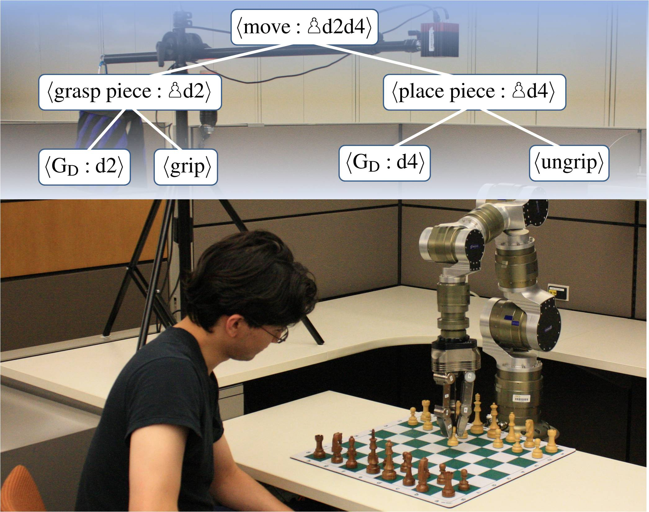
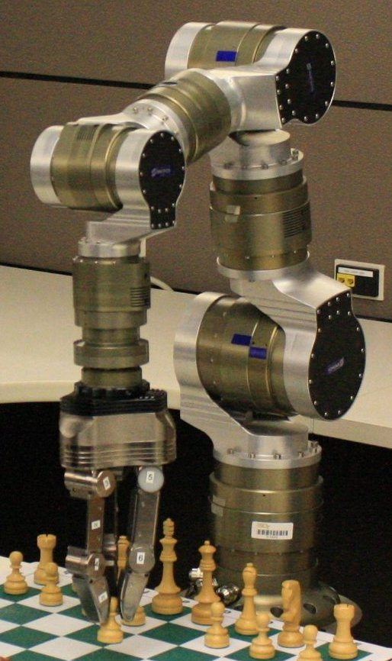
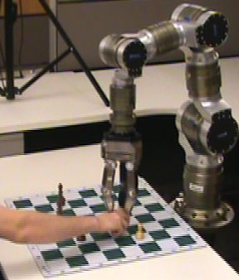
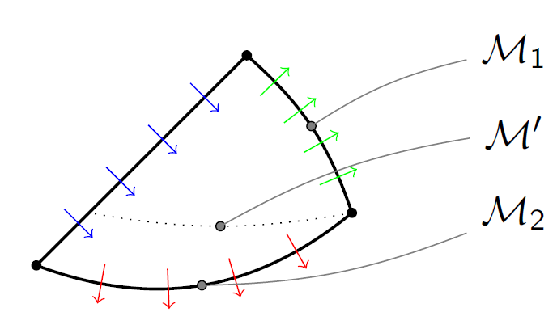
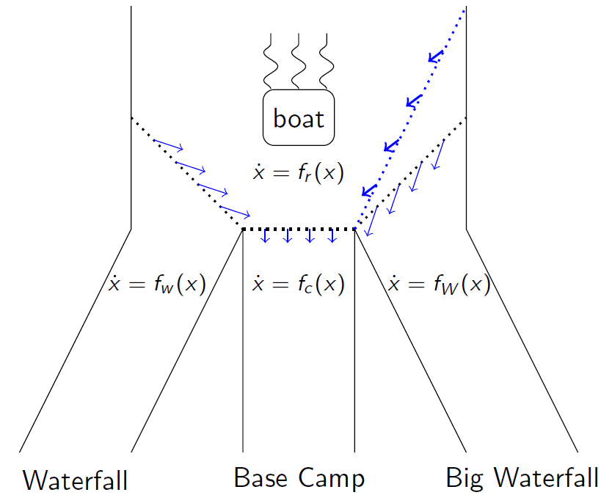
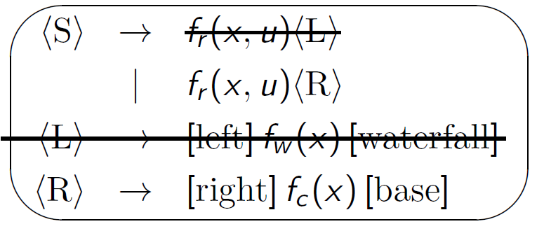
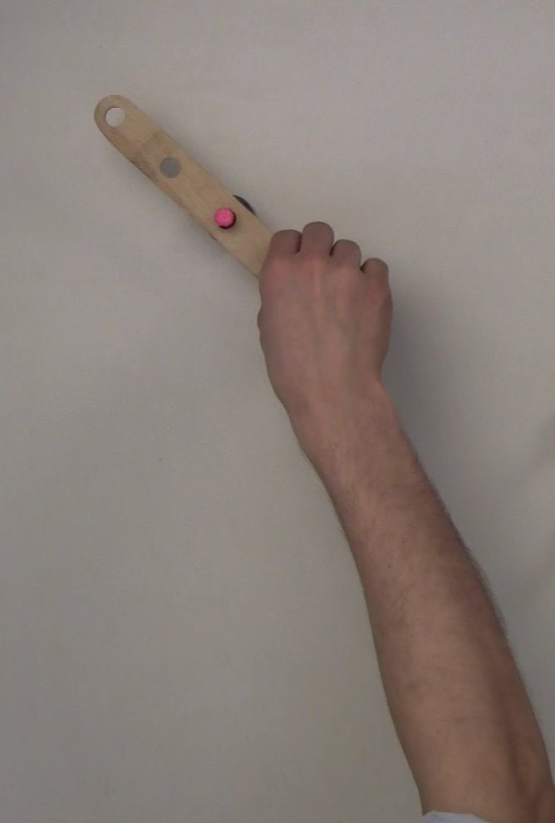
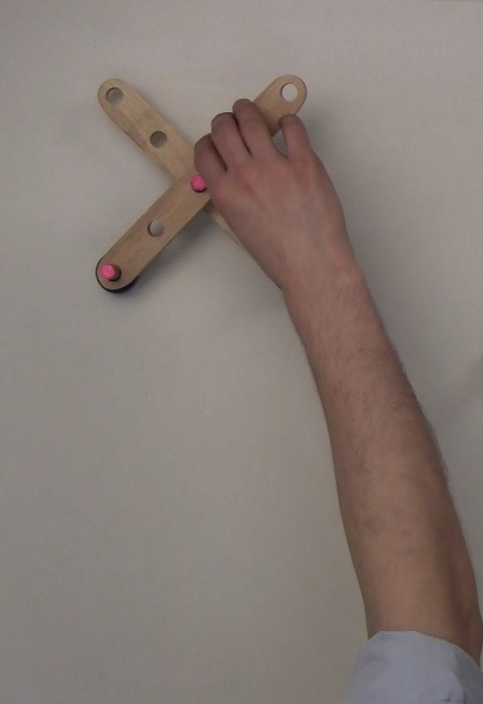
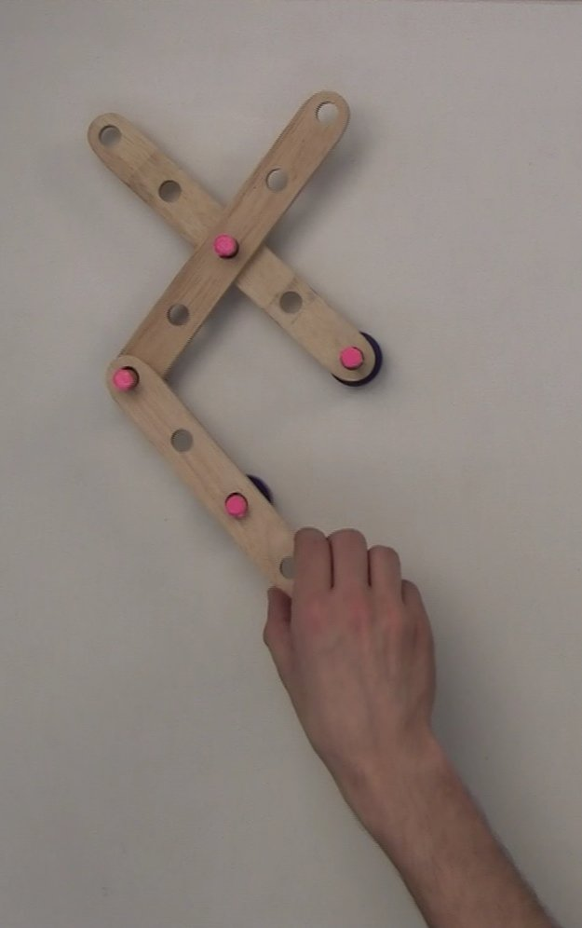
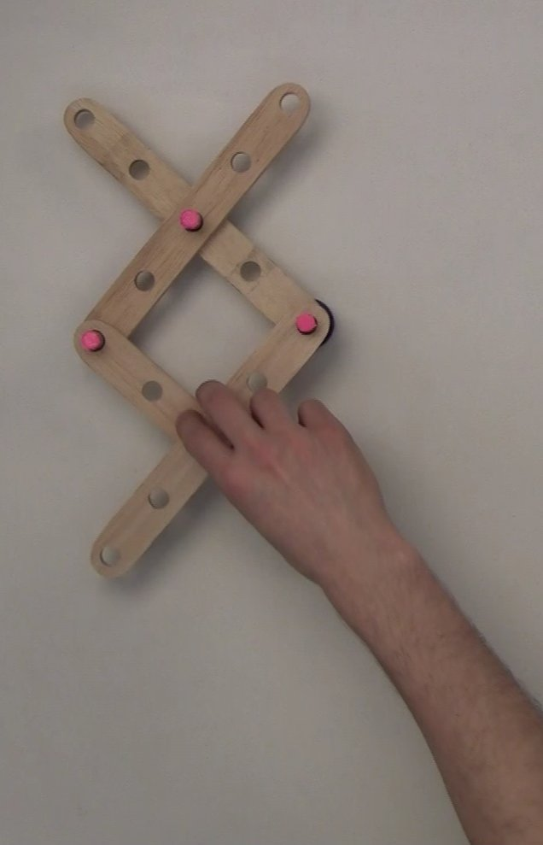
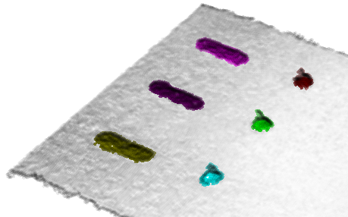
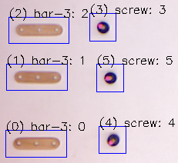


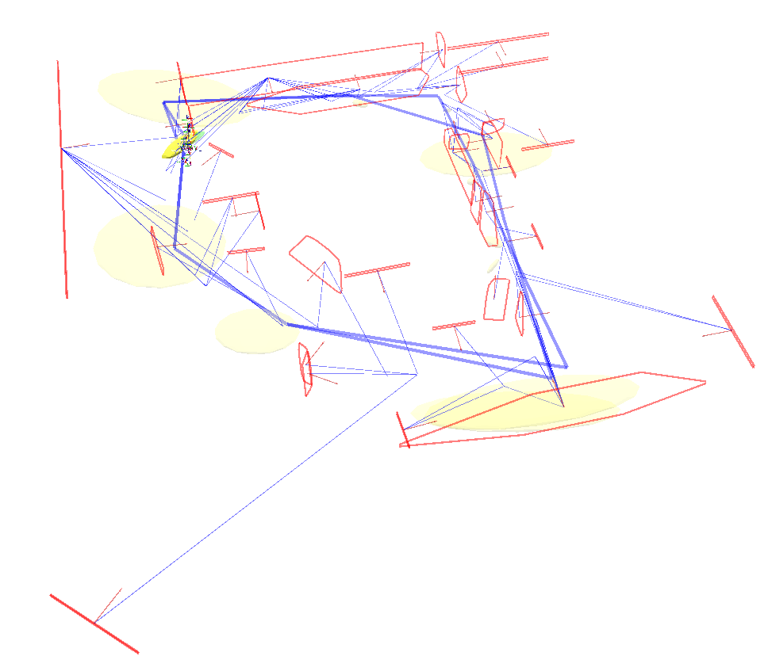
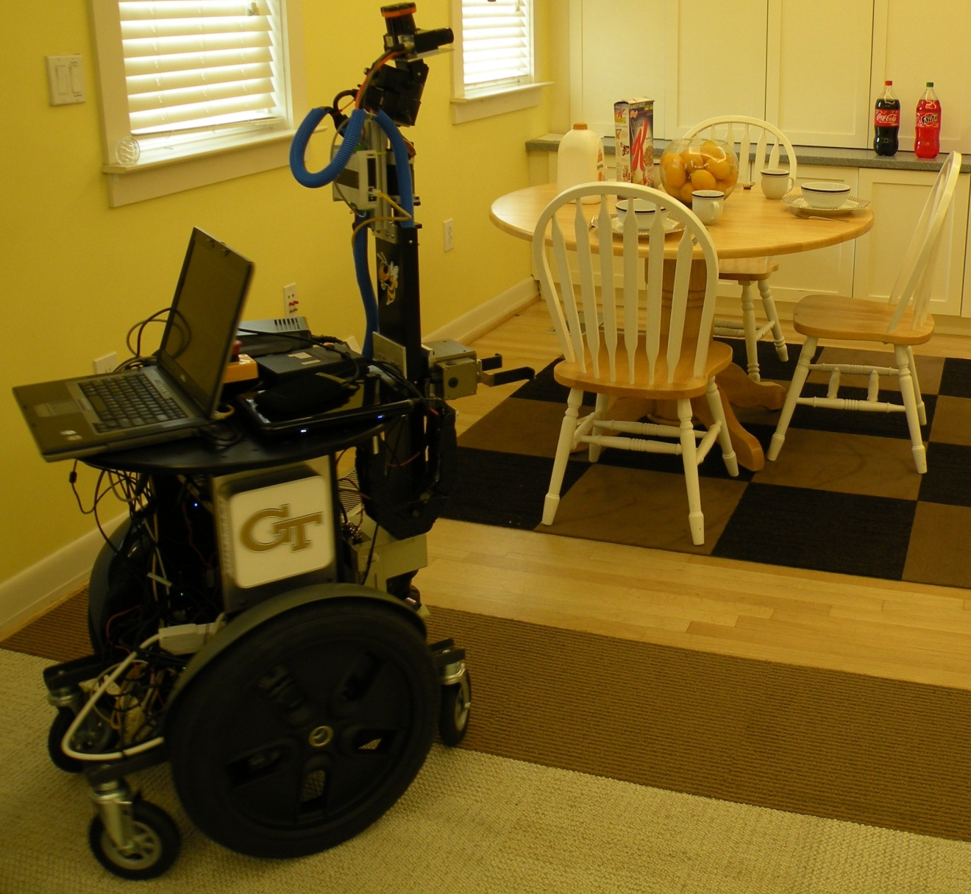
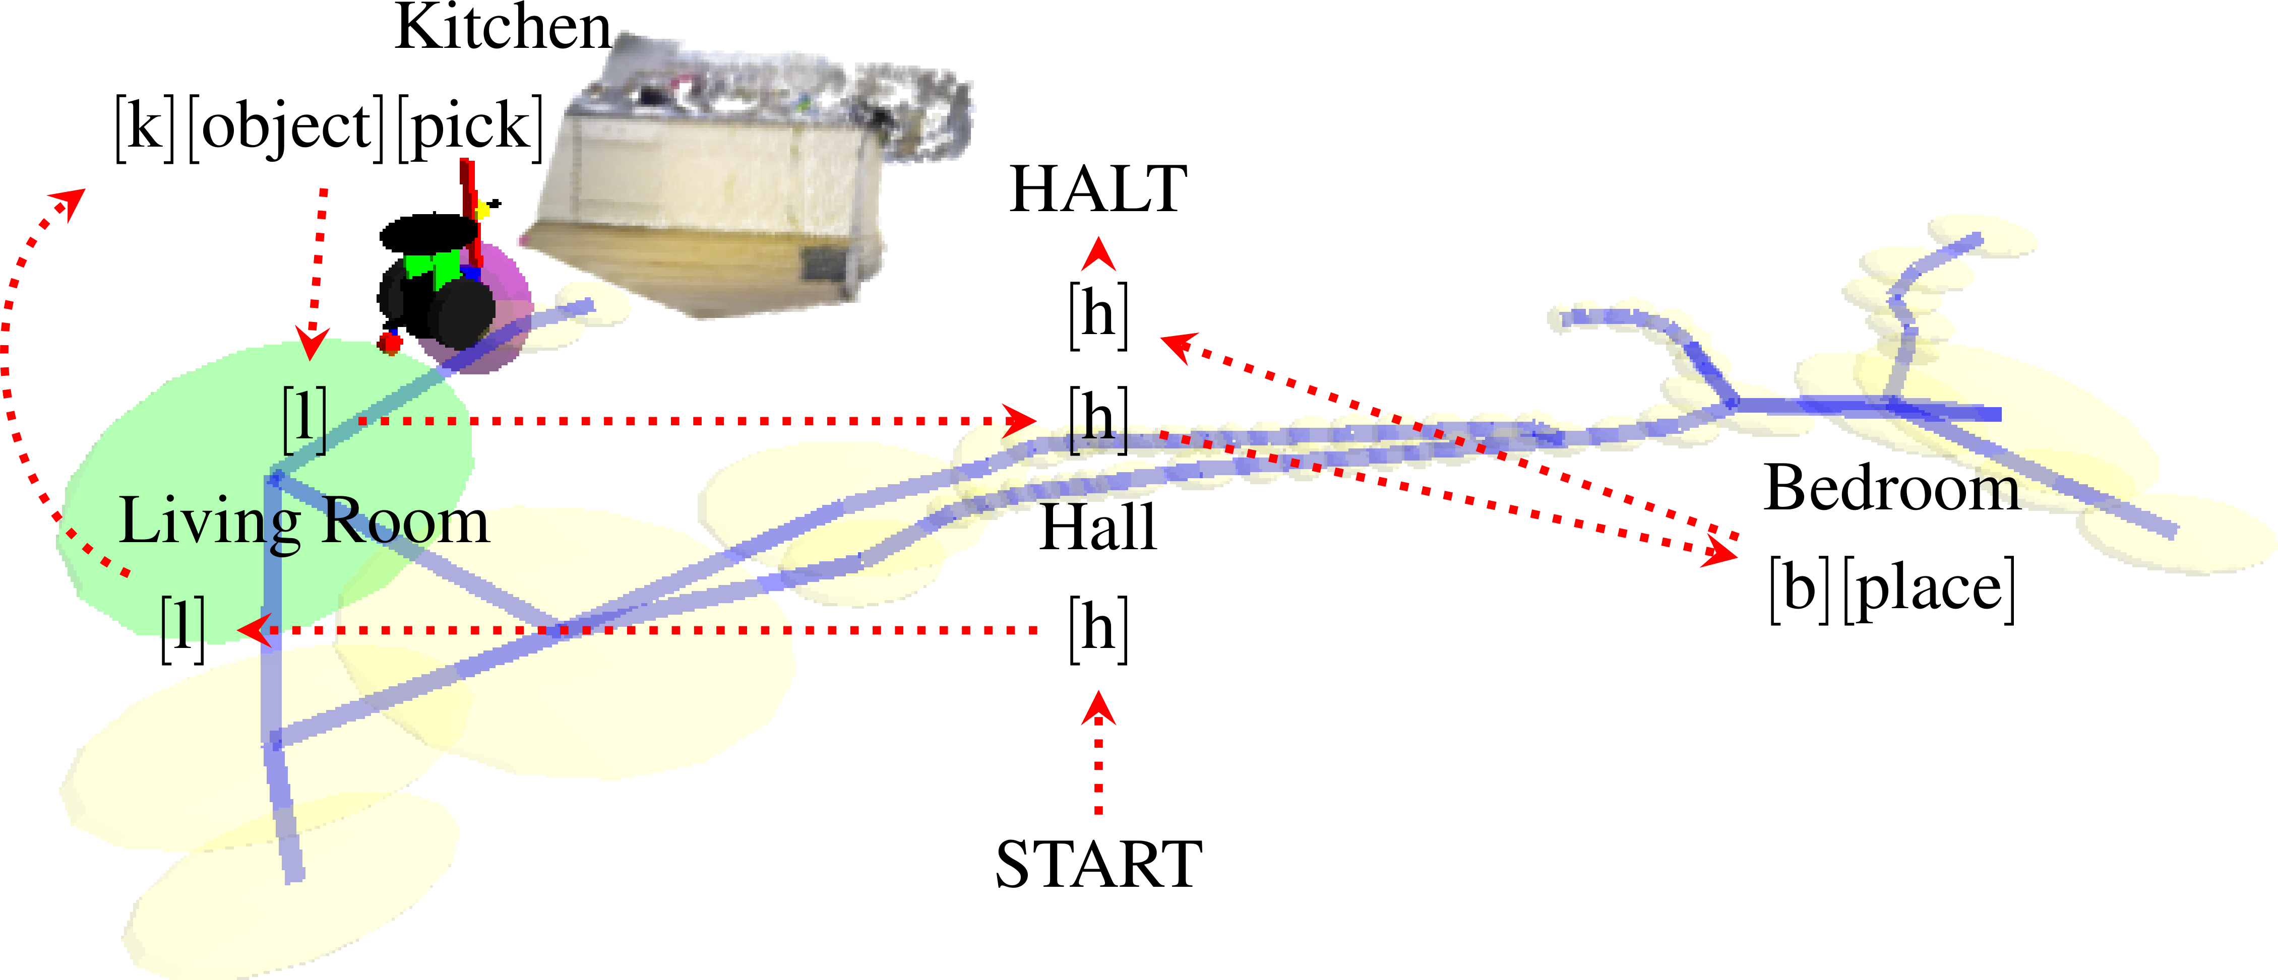
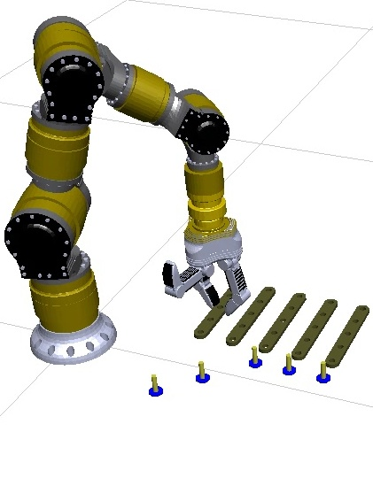
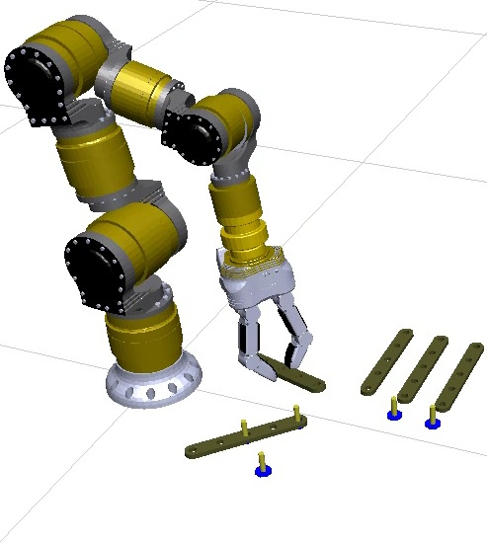
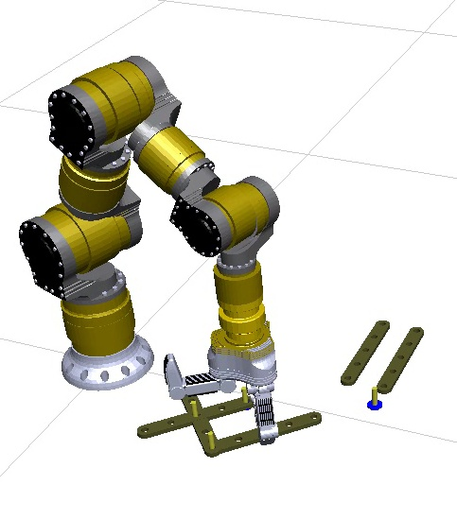
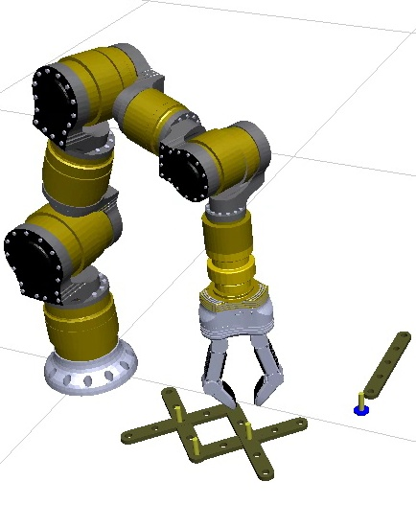
EAGER: Linguistic Task Transfer for Humans and Cyber Systems
PI: Michael Stilman, Irfan Essa
We introduce formal languages as tools for encoding, describing and transferring structured knowledge. In natural language, the latter process is called communication. Similarly, we develop a formal language through which arbitrary cyber-physical systems communicate tasks via structured actions. Our study focuses on the use of context-free grammars (CFG). In contrast to finite state machines, CFGs allow memory/modeling and hierarchical task decomposition while maintaining efficient parsing, analysis, verification. The value of CFG in representing and analyzing tasks was independently discovered in Robot Control and Human Activity Recognition. Building on the framework developed by the PIs that merges perception and control, The Motion Grammar (shown to the right), we seek to unify these fields to enable task transfer between distinct systems.
In the studies presented below, we have: (1) Developed methods to observe a cyber-physical system in action and automatically generate a grammar from the observations. (2) Created and evaluated tools to derive and combine languages of two distinct fields and apply supervisory control in order to specify the behavior of a system given a third language specified by the designer.
Motion Parser
CPS System
Task Transfer Between Distinct CPS
Event
Language Derivation, Composition, Control
We develop a pipeline of algorithms for the automatic transfer of a task from one cyber-physical system to another. This work extends our efforts showing the utility of linguistic models in verifiable system control policies by now performing real visual analysis of one CPS system (a human) to automatically extract a policy for another system (a robot) to perform the task. This method tokenizes each demonstration into a sequence of object connection symbols, then transforms the set of sequences from all demonstrations into an automaton, which represents the task-language. Finally, we combine this automaton with a kinematic model of the second system to reproduce the demonstrated task.
[1] N. Dantam, I. Essa, M. Stilman. Linguistic transfer of Human Assembly Tasks to Robots. In Proc. IEEE Int. Conf. on Intelligent Robots and Systems (IROS’12), 2012.
First, we address the question of how to derive an optimal control policy for Hybrid Dynamic CPS Systems with Context-Free discrete dynamics, nonlinear continuous dynamics, and nonlinear state partitioning. We introduce, The Motion Grammar Calculus [2], a set of symbolic transformation rules that can be progressively applied to a system language until it satisfies a correctness specification which is represented by a second language.
Second, we find that the transformation rules are also applicable when combining two distinct languages arising from different elements of a Cyber-Physical System. For instance, we combine the language of semantic maps with hybrid control models, generating a direct link between action and environment models to produce a control policy for mobile manipulation in unstructured environments. First, we generate a semantic map for our environment and design a base model of robot action. Then, we combine this map and action model using the Motion Grammar Calculus to produce a combined robot-environment model. Using this combined model, we apply supervisory control to produce a policy for the manipulation task. We demonstrate this approach on a Segway RMP-200 mobile platform. [3]
[2] N. Dantam, M. Stilman. The Motion Grammar Calculus for Context-Free Hybrid Systems. In Proc. American Control Conference (ACC’12), 2012.
[3] N. Dantam, C. Nieto, H. Christensen, M. Stilman. Linguistic Composition of Semantic Maps and Hybrid Controllers. In Proc. International Symposium on Experimental Robotics (ISER’12), 2012.
(1) Discrete Pruning (2) Hybrid Symbol Introduction
CPS 1 Demonstrates a Task (Assembly)
Scene Segmentation and Analysis
Iterative online segmentation and object recognition via optimization produces sequences of strings from multiple demonstrations. We use the McNaughton-Yamada-Thompson algorithm to create an NFA, and apply Brzozwski’s algorithm to generate a minimum-state DFA that represents the task language.
Semantic Map
Map Graph / Language
Action Language
NFA
Motion Grammar Calculus
“Bring a soda
from the kitchen.”
DFA
Specification Language
Task Language
Supervisory Control
Given domain knowledge of the second CPS in the form of a kinematic model, we then apply differential inverse kinematics to generate the required motions that follow the DFA to replicate the action of the original system.
Real-World Application
Policy
CPS 2 Performs the Same Task

