Slide 1
Making visualized graphs for micromobility parking locations
By Nam Dau

Slide 2
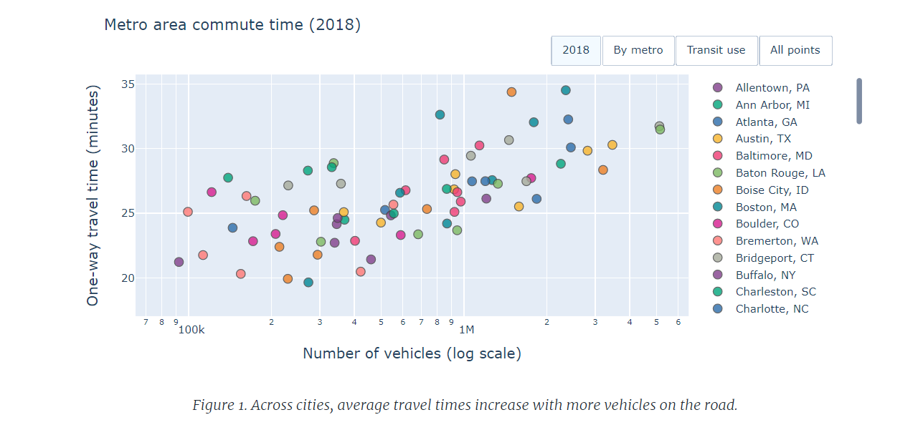
Goals
Get information from published papers.
Draw visualized graphs to illustrate data.
Make presumptive conclusions based on graphs.

Slide 3
Process
Receive data about scooter trips around Vanderbilt campus.
Analyze data and use them to draw graphs. (Using Bokeh and NetworkX).
Interactivity: Using tools like Bokeh allows user to change the content how they like.
=> Helpful to policy-oriented people.

Slide 4
Original cluster map

Slide 5
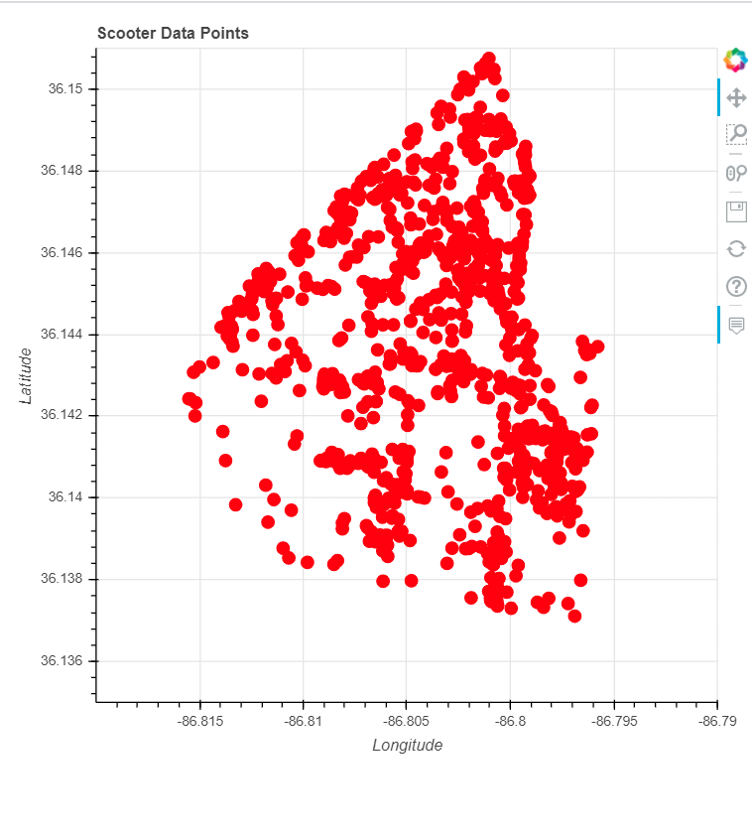
Example graphs

Slide 6
Challenges and What I have learned
Timezone difference
Faraway location
Effectively manage my time
Work with a different mindset

Slide 7
Thank you!

