Slide 1
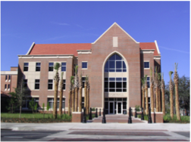
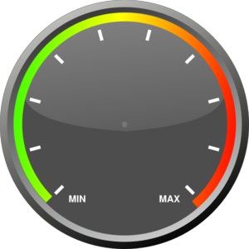


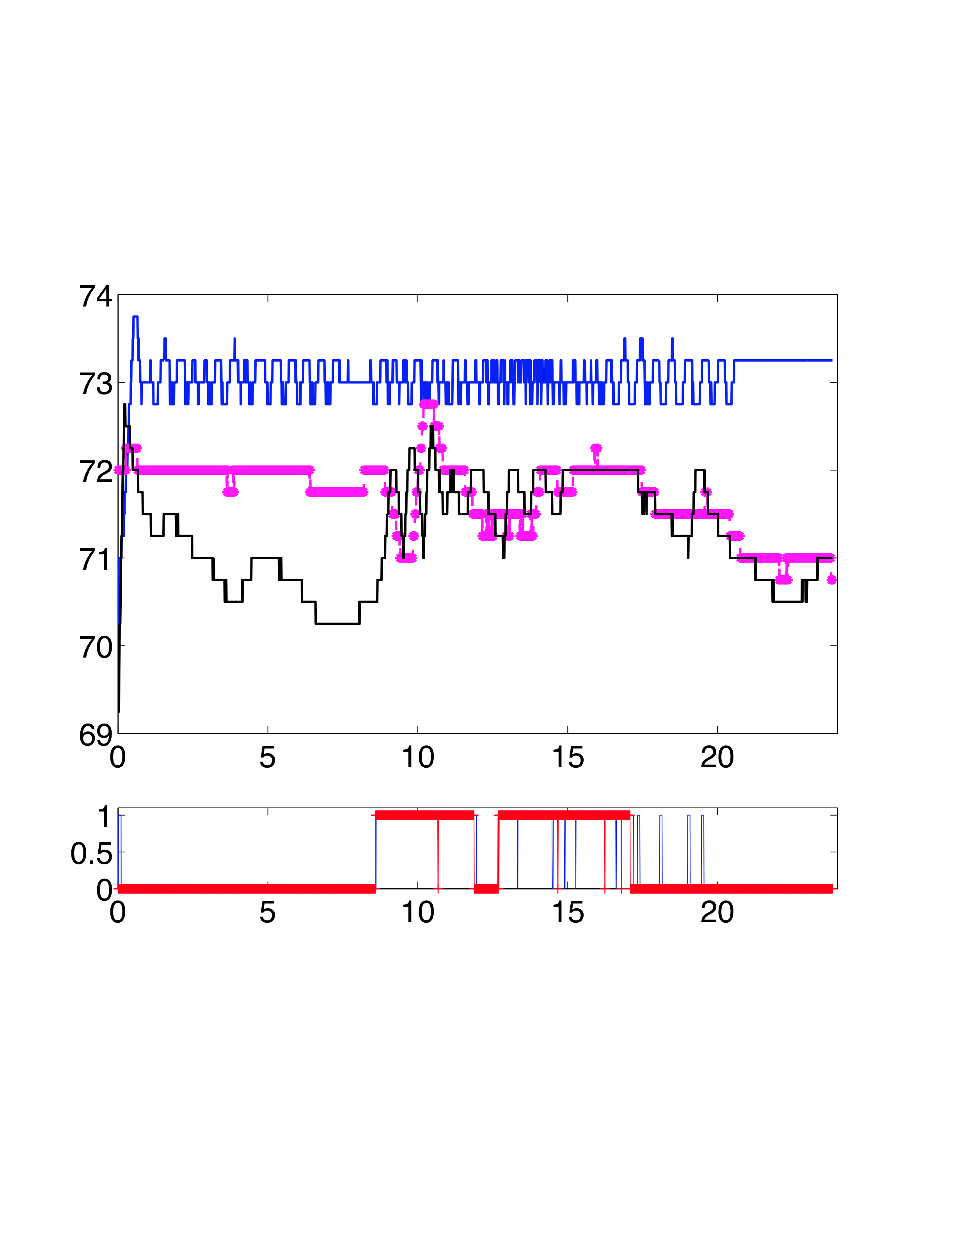
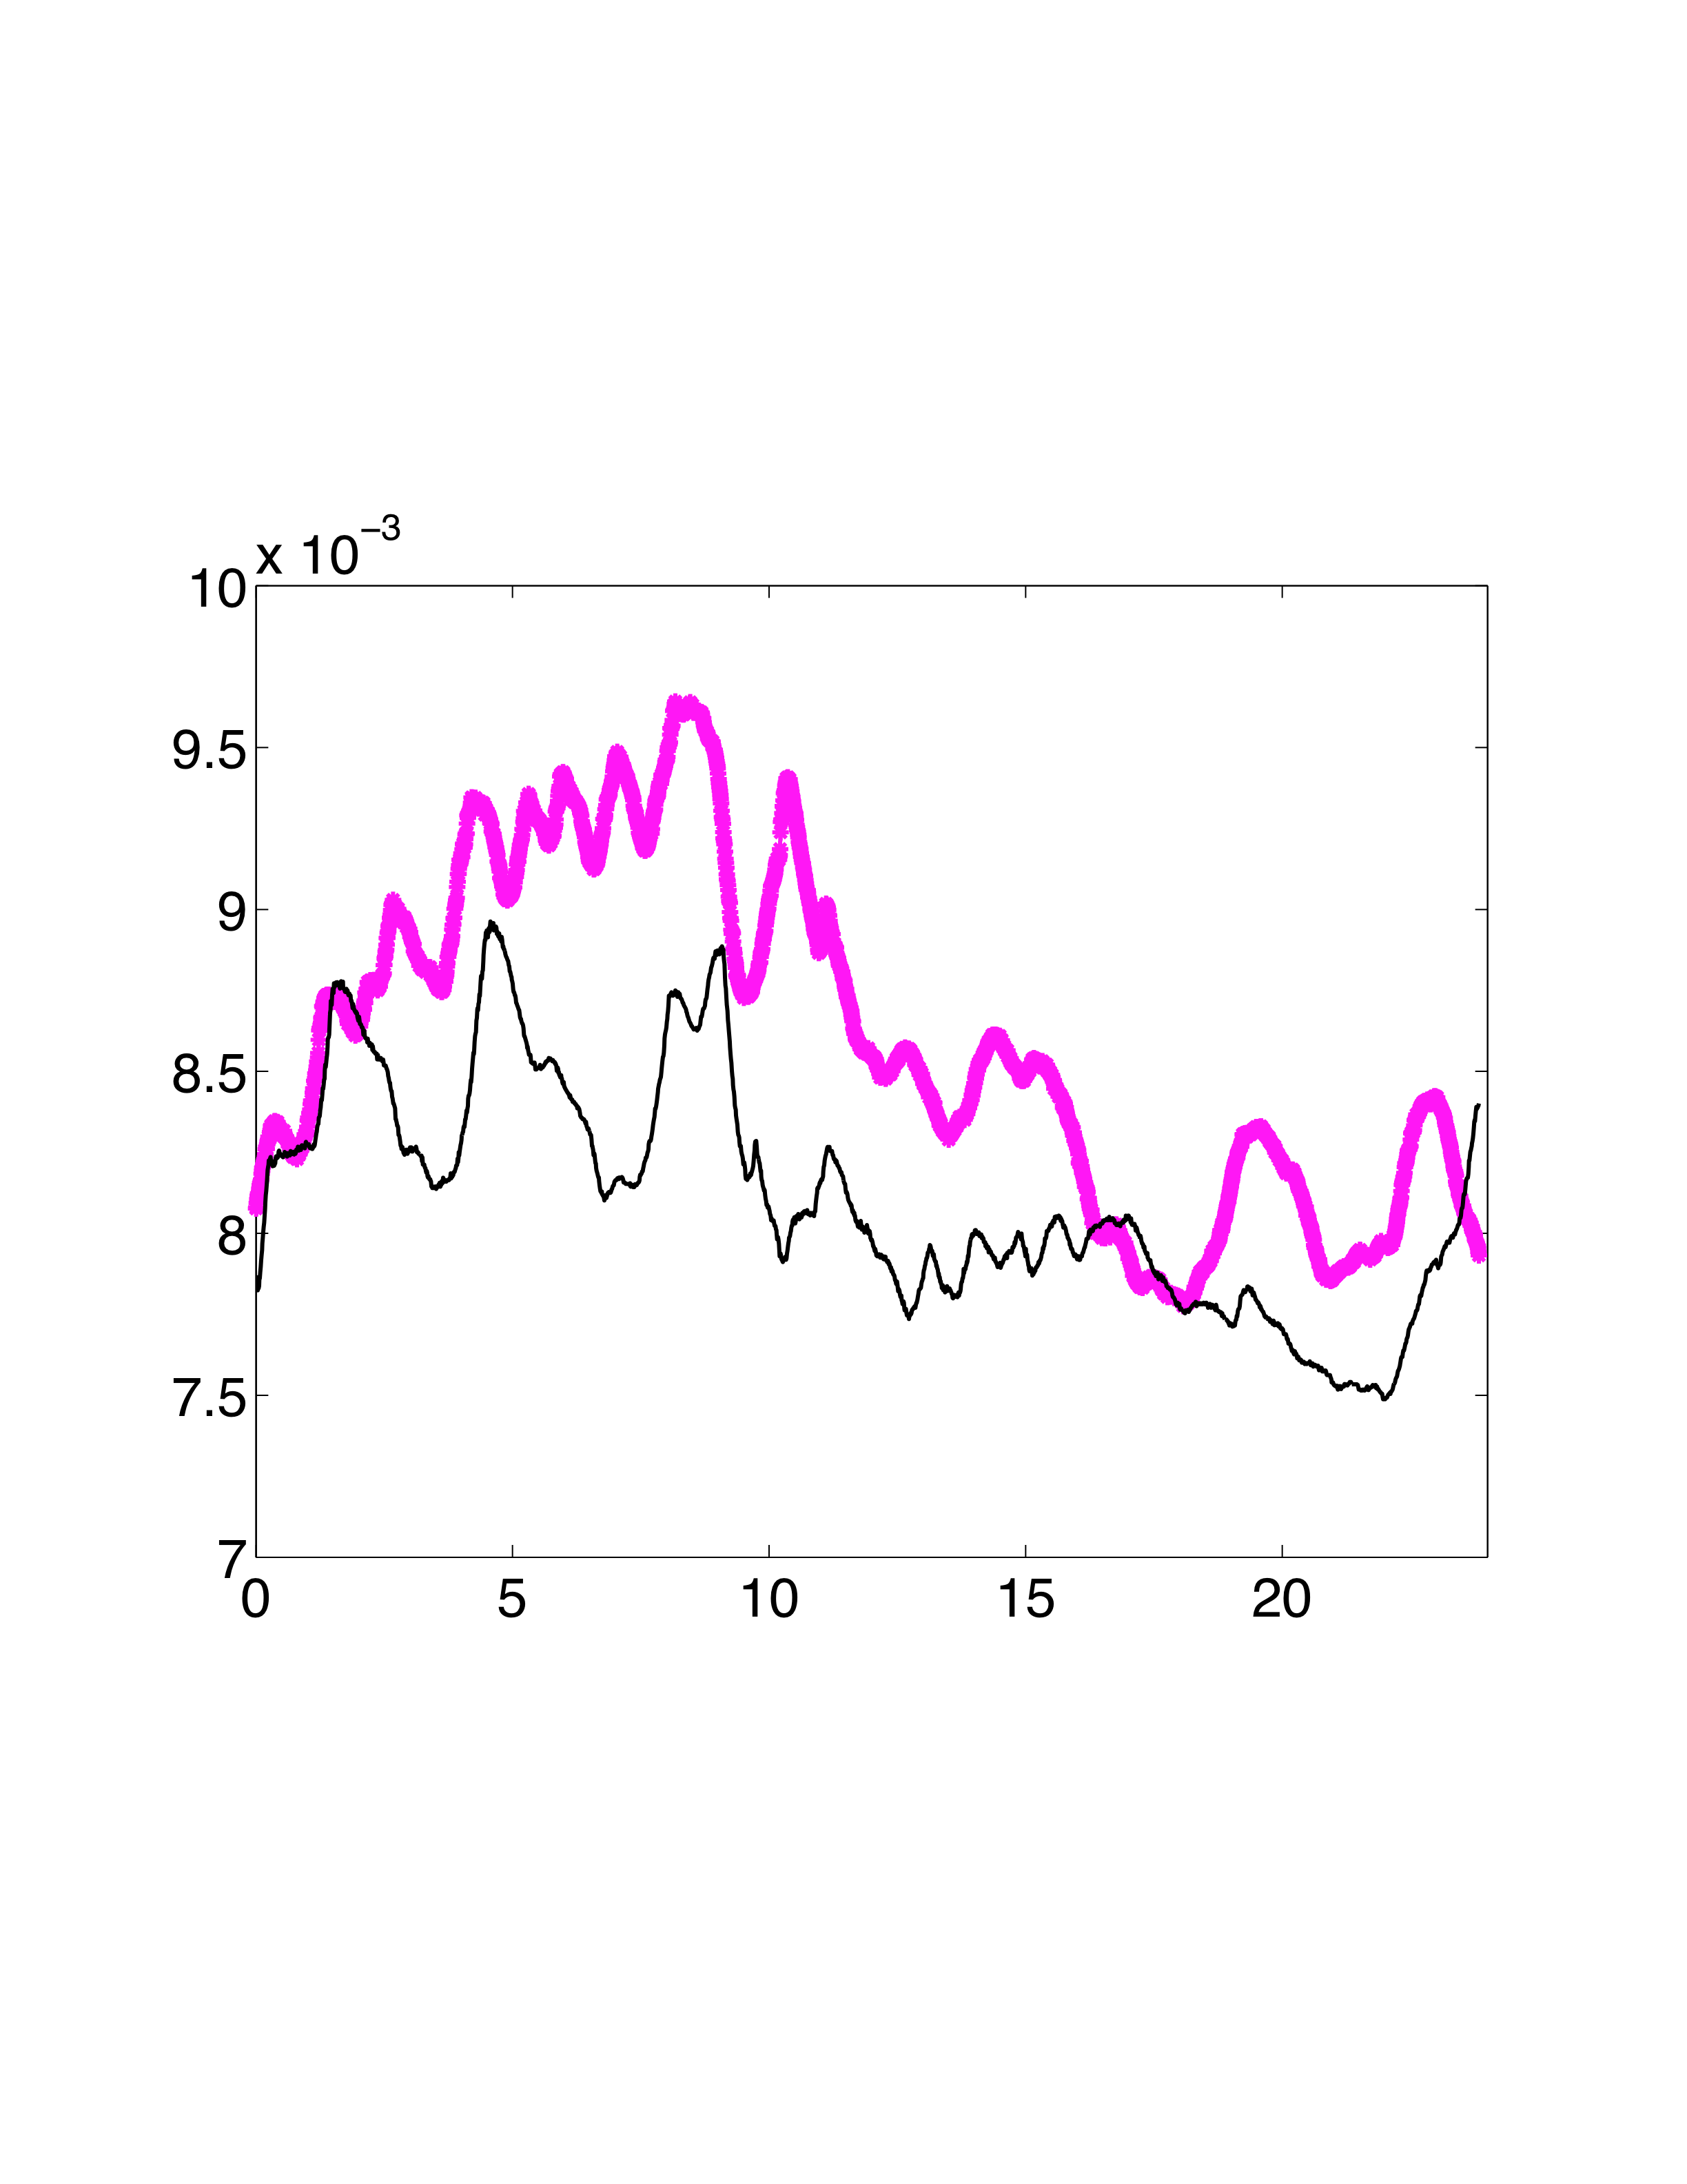
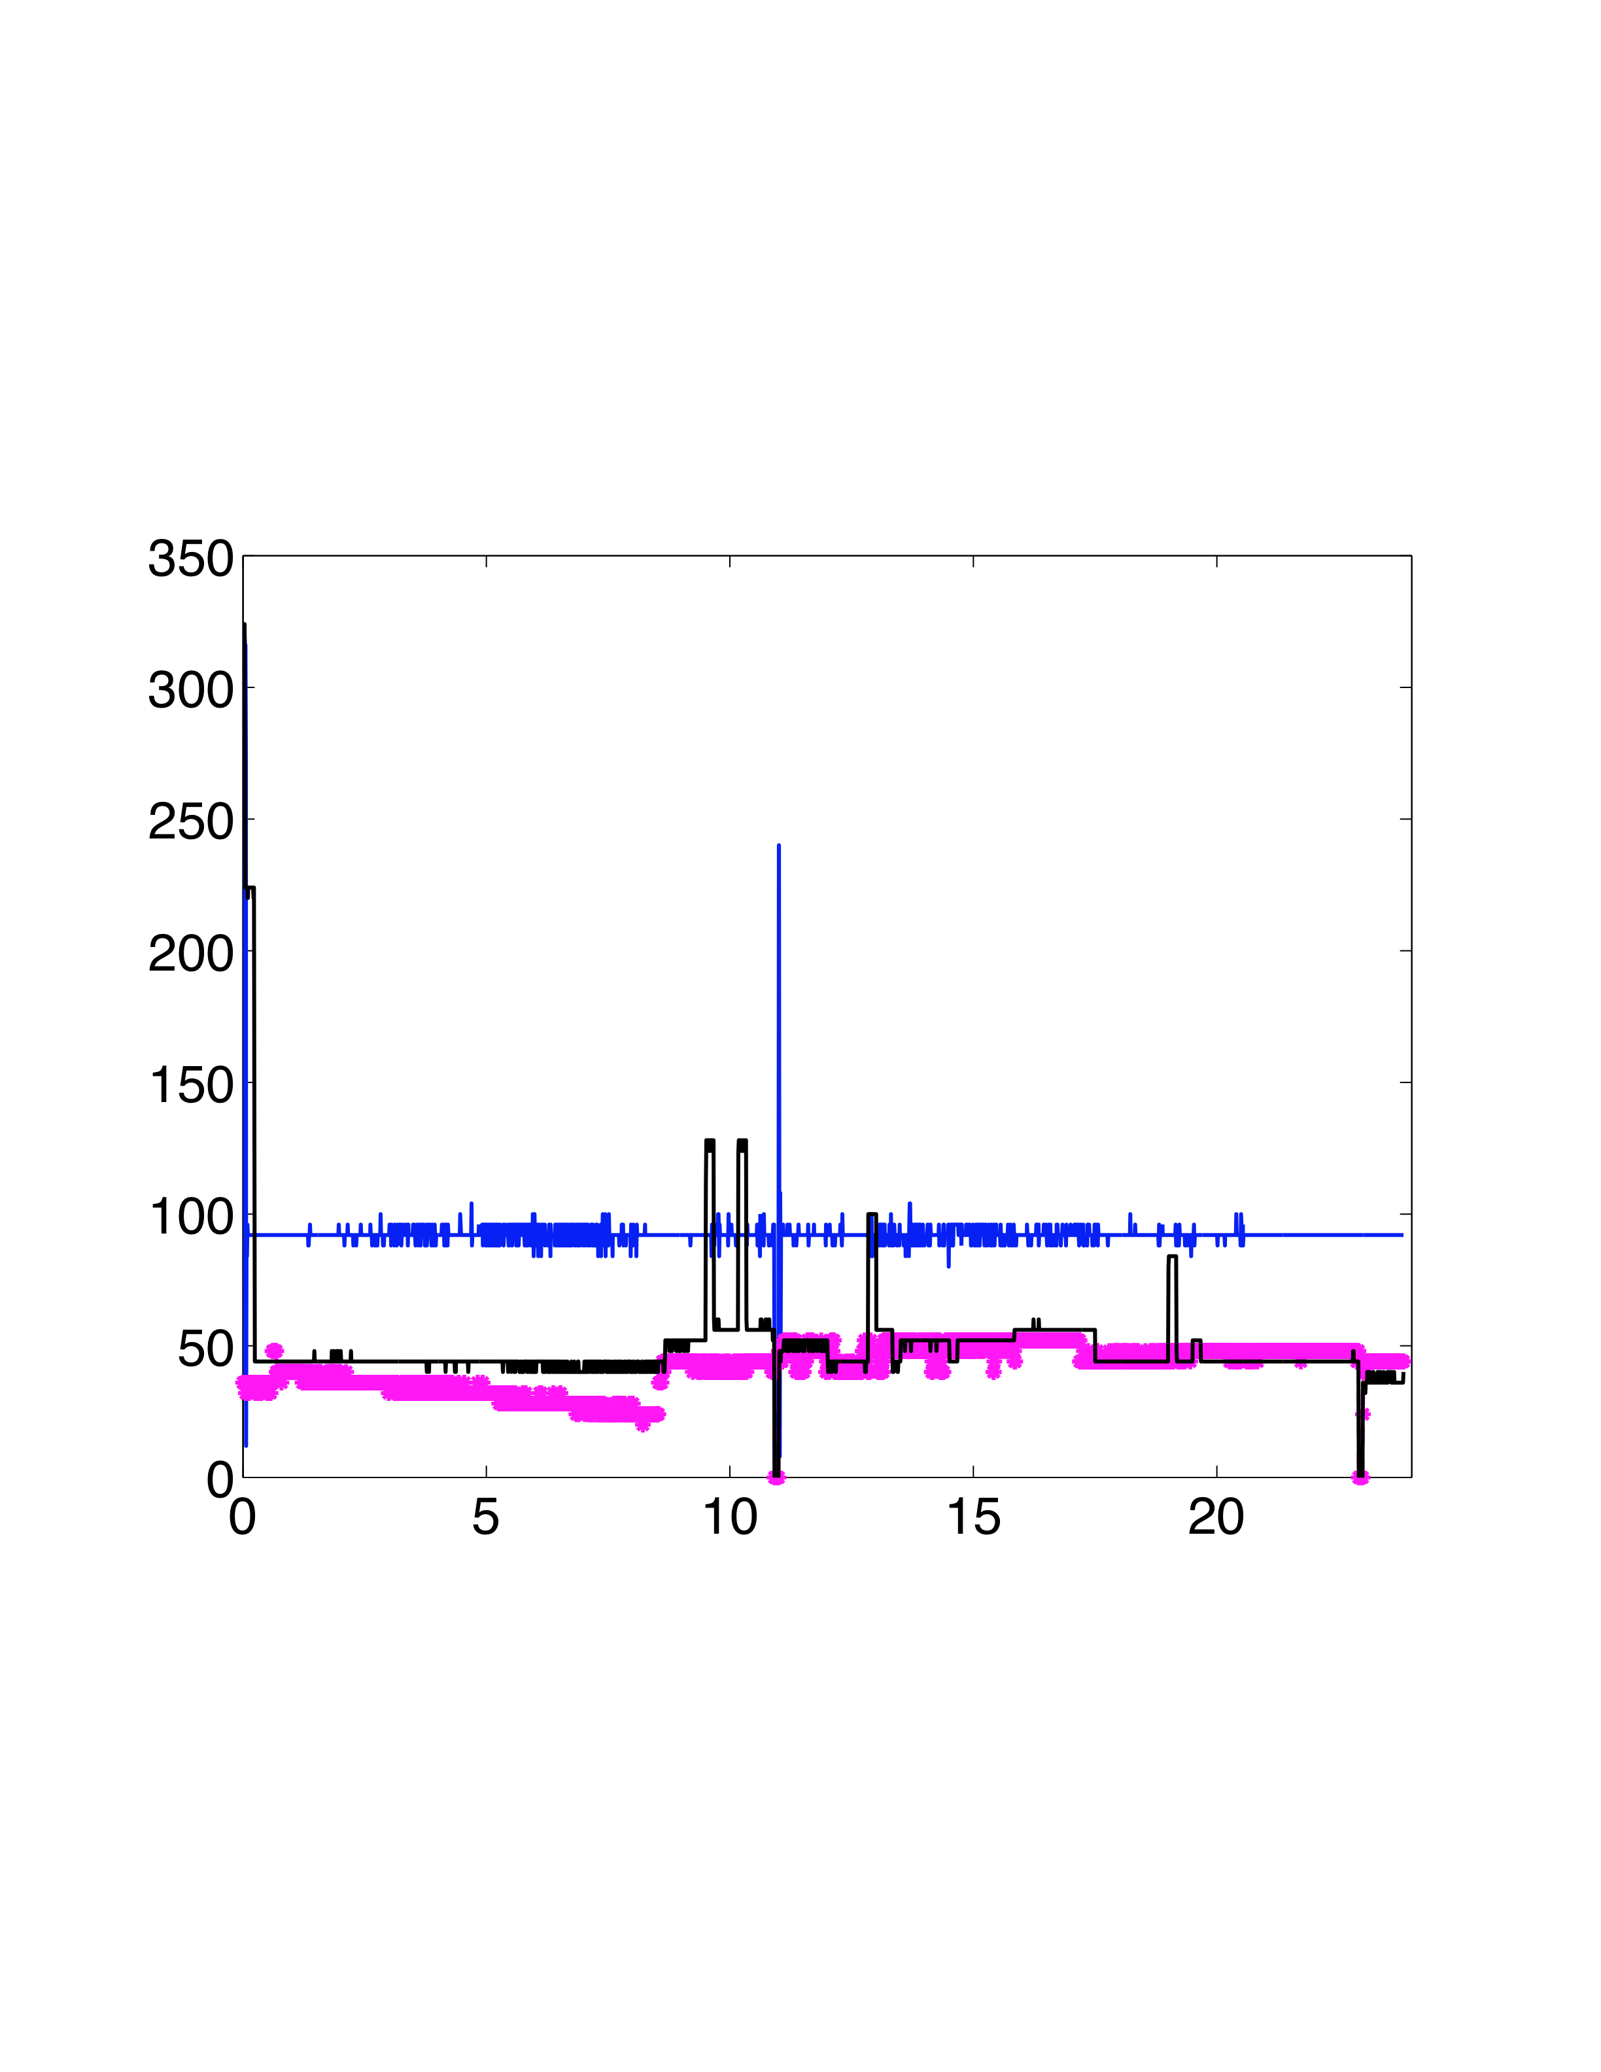
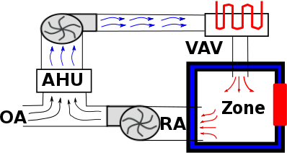
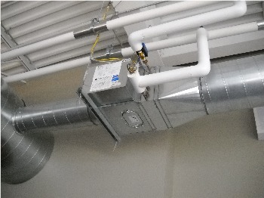
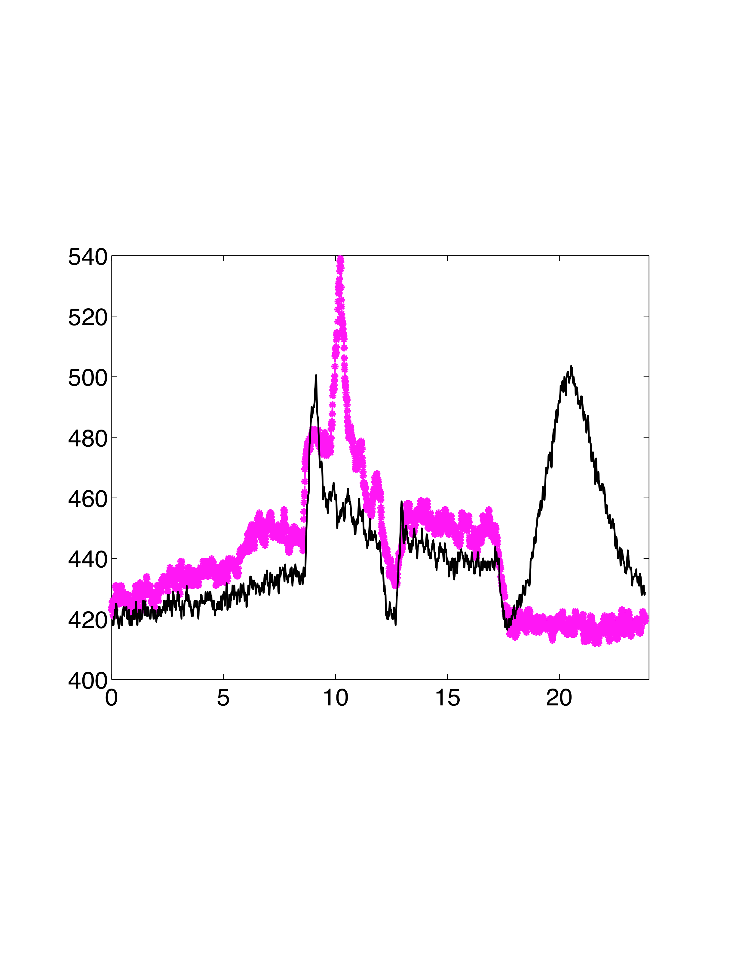
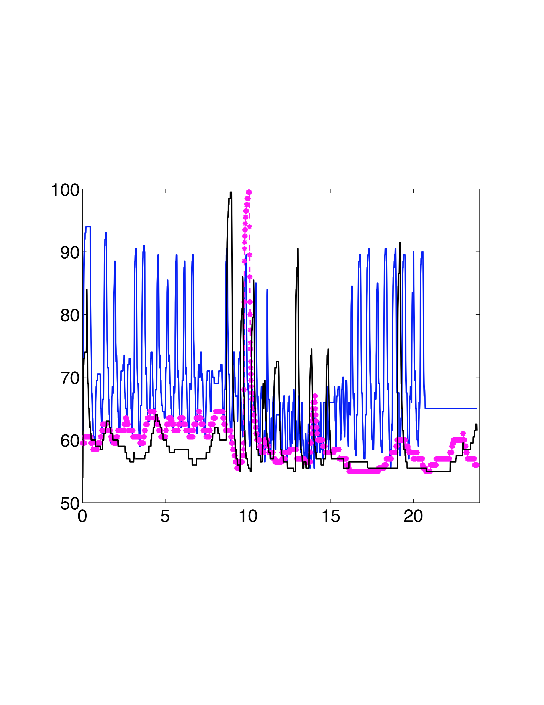
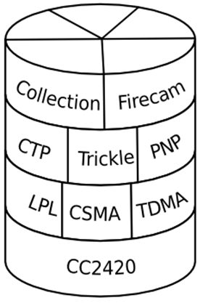
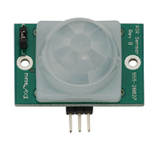
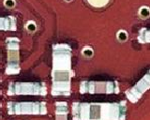
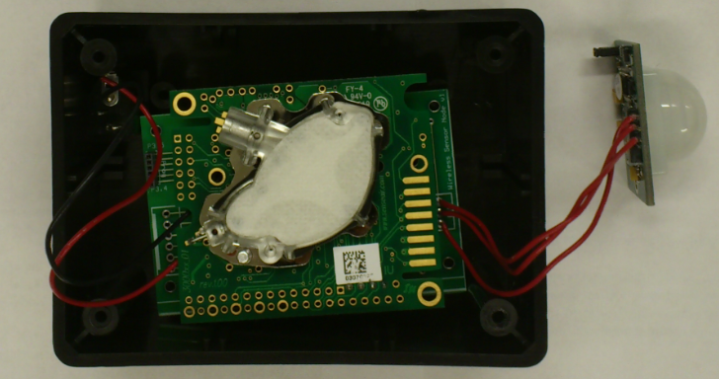
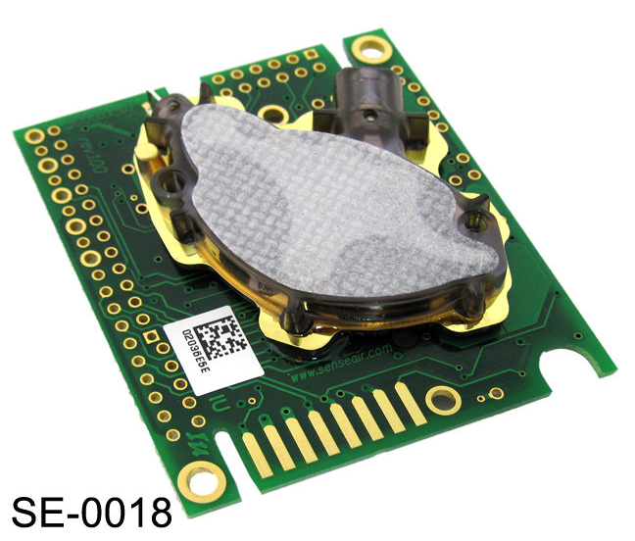
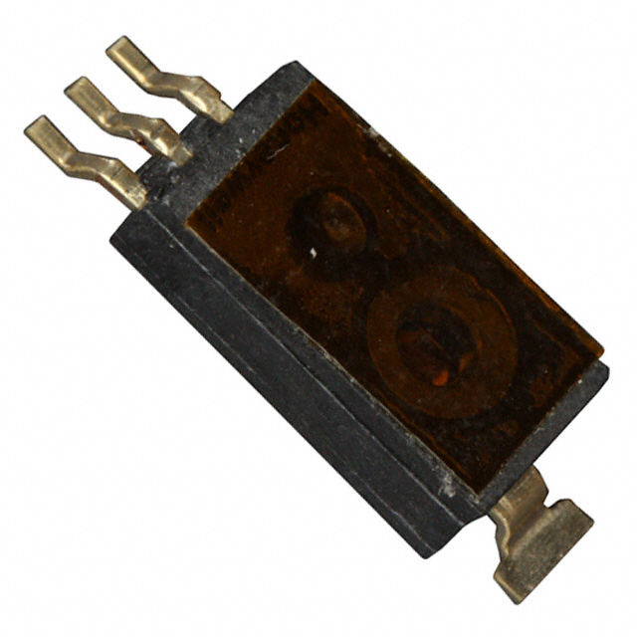
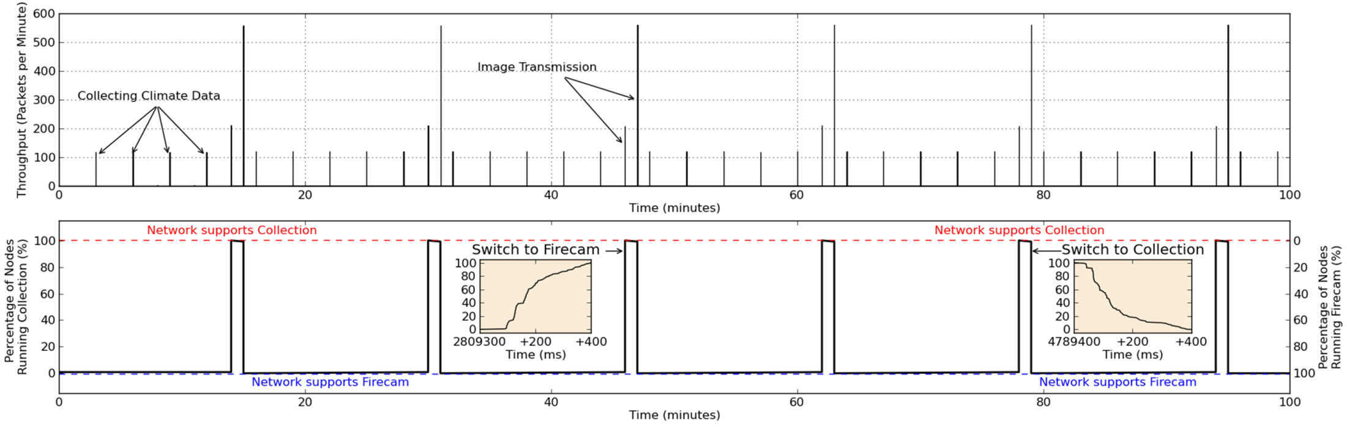


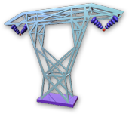
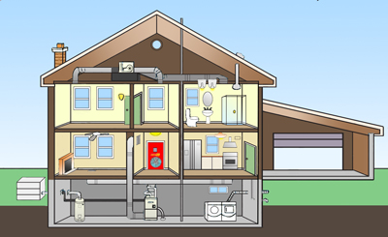

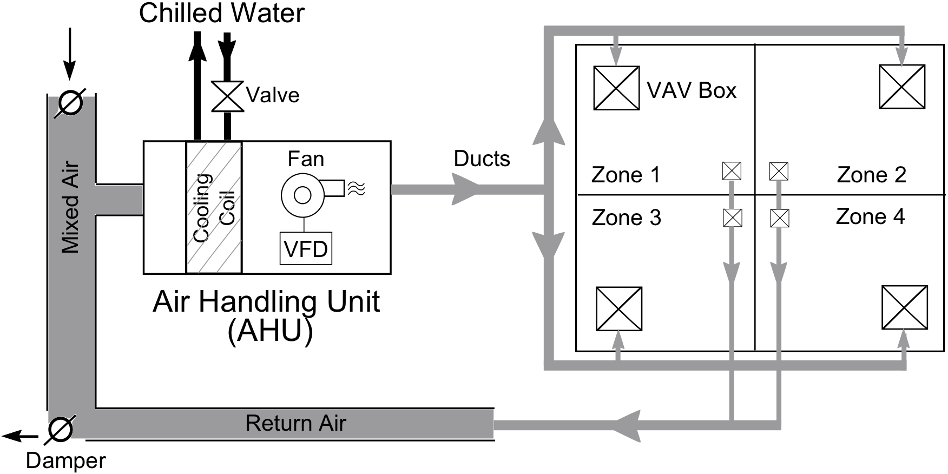
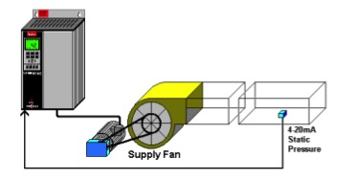
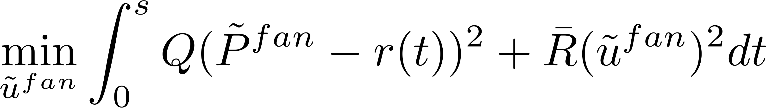
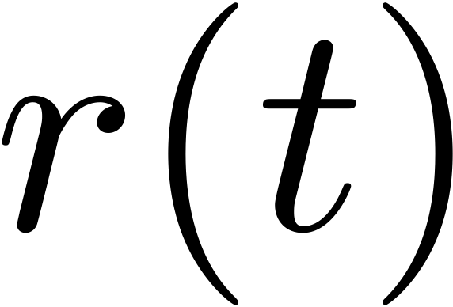
CPS: Methods for Network-Enabled Embedded Monitoring & Control for High-Performance-Buildings
PIs: P. Barooah and S. Meyn (UF), P. Mehta (UIUC), L. Carloni (Columbia), M. Krucinski (UTRC)
Tools developed to support high-performance building apps
App 1: Energy-Efficient Building:
Real-time occupancy-based HVAC control
Algorithms
  Distributed estimation
  Distributed Control
  Modeling and model reduction (occupancy, thermal dynamics)
Open-source software infrastructure
  Dynamically reconfigurable WSN
  Third party control integration with commercial BAS
Applications:
  Energy efficient building HVAC control
  Grid responsive building HVAC loads
Pugh Hall at University of Florida
Cooling
Cooling
Now: control serves the space, not the occupants
Room Temperature
Experimental Results
Idea: Occupancy Driven HVAC Control
Humidity Ratio
SA Flow Rate (cfm)
Current Practice
Feedback
Current Practice
Wireless Sensor Networking solutions for heterogeneous CPS apps
Occupancy
Room CO2 (ppm)
MPC
SA Temperature (F)
“VAV box”
Feedback
MPC
Presence
Temperature
Result: sub-optimal rule based control methods can save ~30% energy over baseline, close to what optimal control can.
Developed:
1. Control algorithms, low cost WSN to support occupancy based control, open source software for control integration
Time (Hr)
Time (Hr)
Time (Hr)
CO₂
Humidity
Dynamically reconfigurable WSN
Daily Energy Consumption and Annual Money Savings With Various Controllers
Fennec Fox
Programming and
Design Framework
Simulation Results | Experimental Results
+
Wireless Sensors
=
Controller | Daily Energy Consumption (MJ) | Savings (%) | Money Savings ($) | Daily Energy Consumption (MJ) | Savings (%) | Money Savings ($)
Current Practice | 129 | - | - | 127 | - | -
Simple Feedback | 58.7 | 54 | 16 billion $ | 37 | 71 | 21 billion $
MPC (Occupancy Measurement) | 58.6 | 54 | 16 billion $ | 51 | 60 | 18 billion $
MPC (Occupancy Prediction) | 52.0 | 60 | 18 billion $ | - | -
Ex: network switches between HVAC and fire safety applications
Feedback and MPC control save half energy than current practice.
App 2: Buildings as Batteries:
Use load flexibility to Provide Ancillary Service to the Grid
Technology demonstration:
Help!?
OK!
Low cost wireless sensor network: design, prototyping, deployment in 2012. Long term performance under study
Wireless sensor network enabled occupancy-based HVAC control performed in April-May 2013.
  30% savings potential demonstrated
Next phase:
  Testing on UTRC building
  Demonstration of grid-friendly HVAC control
Configuration of a typical HVAC system:
Control objective:
Track a regulation signal without noticeably impacting the building inside environment
VFD (variable frequency drive)
supply fan
Educational outcomes:
Supported 10 PhD Dissertations (4 at UF, 5 at UIUC, 1 at Columbia), 2 MS Theses (UF)
31 journal and conference publications so far
Several invited sessions, workshops, and program committee service in international conferences, IEE CDC, ACC, ICCPS
five undergraduate researchers supported by REU supplements
Data sets and open-source software released (1 each)
Outreach:
PI Meyn testified before U.S. Congress on energy policy in 2013
Innovation
4 US and international patent applications submitted
Pugh Hall at UF
where is the regulation signal.
Only the fans in commercial buildings in the U.S. can provide 100% of the entire freq. regulation service needed today
The occupants would NOT notice any change in indoor climate
Output / regulation signal (kW)
Temperature deviation (º C)
HVAC Fan Control for Regulation Service Provision
Many other loads beyond buildings considered in 2013
http://humdoi.mae.ufl.edu/~pbarooah/Research/PBResearch_buildings.html

