Slide 1
Milankovitch Cycles and Ice Ages Project
By Zhengkai Xie
CS Mentors: Akos Ledeczi, Brian Broll, Gordon Stein
Education Mentors: Heather Johnson, Corey Brady, Chris Vanags
Paleoclimate Mentors: Jessica Oster, Jonathan Gilligan
Co-workers: Cameron de Wet, Steven Priester, Rachel Ernst,
Yutong Ouyang, Anne Tatooles

Slide 2
Goals
Designing classes that teaches paleoclimate in high school or middle school.
Examining the effectiveness of Netsblox in teaching and learning.
Creating tools that help students understand different factors’ influences on future climates (my work focuses on astronomical factor’s influence).

Slide 3
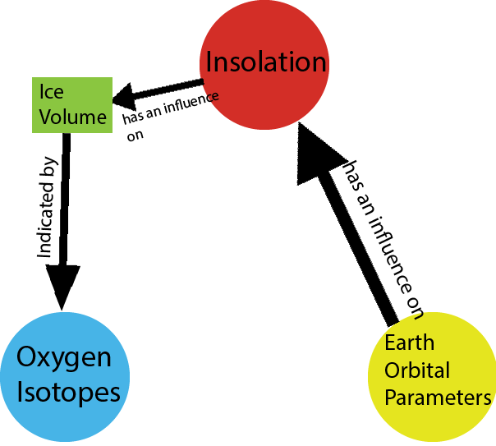
What I Did
Learning about paleoclimate
Figuring out topic and format details of my project
Learning and understanding needed data archives (earth orbital parameters’ data and delta 18O data)
Importing data through data services into the Netsblox server
Trying and making different applications that help students make sense of different paleoclimate concepts and data used in my project on Netsblox
Creating a webpage which includes everything about my project

Slide 4
Applications
Orbital Parameter Application
Water Cycle Application

Slide 5
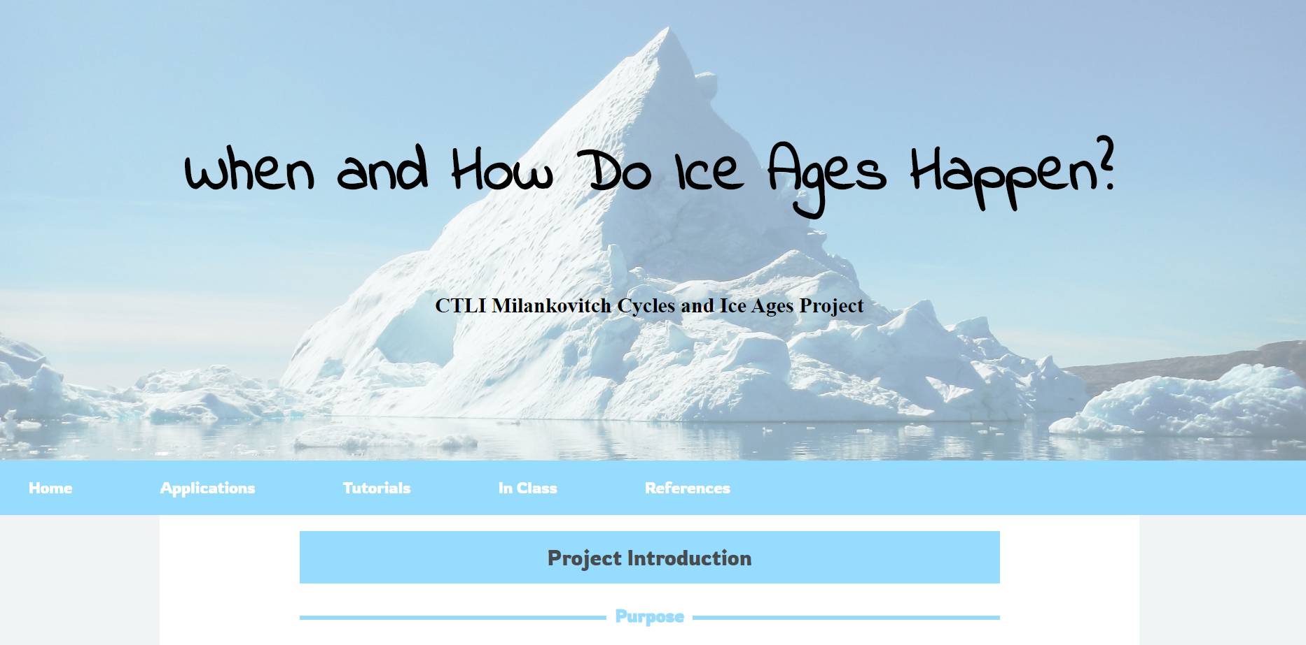
Application 3 & Project Webpage
Delta 18O and Insolation Data Application
Webpage

Slide 6
Conclusion
Things I learned:
- How to create and merge services to the Netsblox server.
- How to make applications on Netsblox
- Paleoclimate
Challenges:
- A lot of ideas
- No paleoclimate background
- Working remotely
- Helping users make sense of the project
Questions for future:
- What kind of applications can we make to allow students to manipulate the existing data and even write code by themselves on Netsblox?

