Slide 1
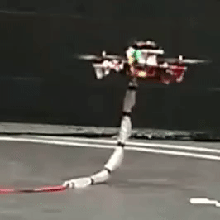
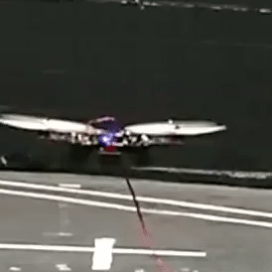
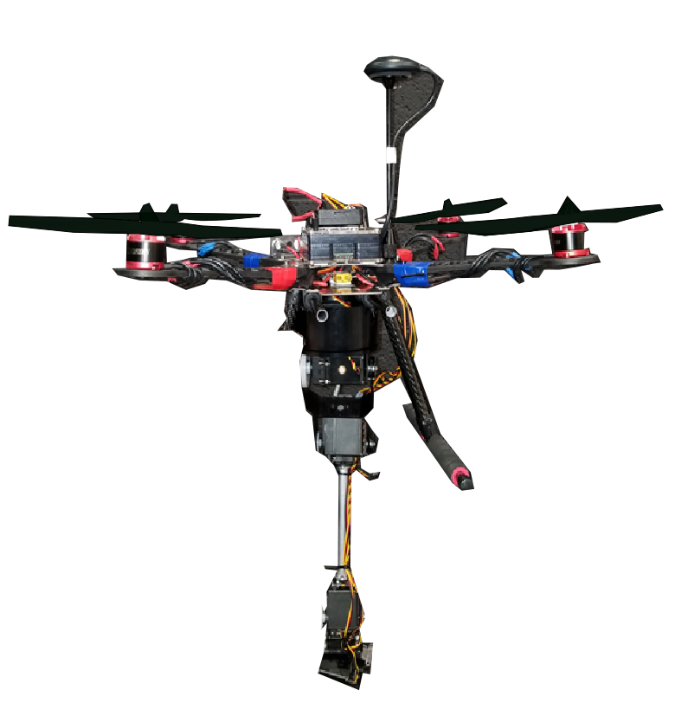
CAREER: Facilitating Autonomy of Robots Through Learning-Based Control Minghui Zheng, University at Buffalo
Award: # 2046481 (Sep. 1st/21~Aug. 30th/26)
Overview: This project will (1) establish a novel learning-based framework to equip drones with new capabilities of learning from different ones, (2) reduce design efforts in planning and control for each individual drone, (3) unlock current limitations toward mass production of heterogeneous robots, and
(4) prepare future workforce for unmanned aerial system industry via educational pathways.
Intellectual Merit
Challenge: Extensive efforts before flying a new drone
Broader Impact
Learn from different drones;
Learn for trajectory generation and disturbance compensation;
Learn from learning experiences (dynamic learning);
A learning framework that can be elegantly integrated into holistic planning and control solutions.
Solution: Learning from different drones
Promote mass application of heterogeneous drones
Skill 1: Trajectory generation
Skill 2: Disturbance compensation
Skill 3: Dynamic learning
Training drone
Internship, lab sessions, & drone race
Target drone
Preliminary Results
Prepare future workforce for drone industry
Long-term
Goal:
Build fundamental understanding of learning among heterogeneous drones

