Slide 1
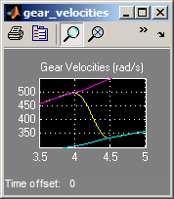
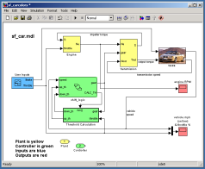
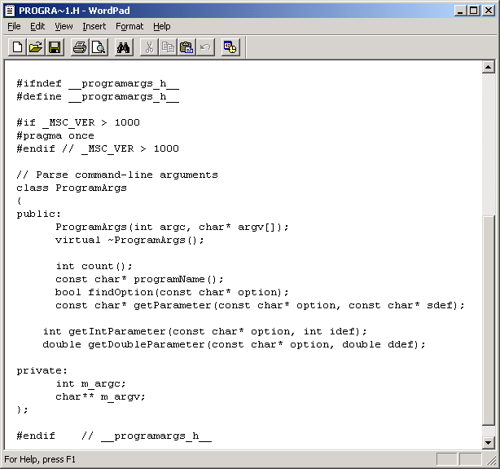
Model-Based Design
Raise level of abstraction
Enable continuous testing
Elaborate
Explore
Verify
Test
Synthesize
Explore
Verify
Test
Explore
Verify
Test
Host stack
Target stack

