Slide 1
Model Synthesis
New Challenges in Model Based Design
Rajeev Alur
University of Pennsylvania
CPS PI Meeting, Oct 2012

Slide 2
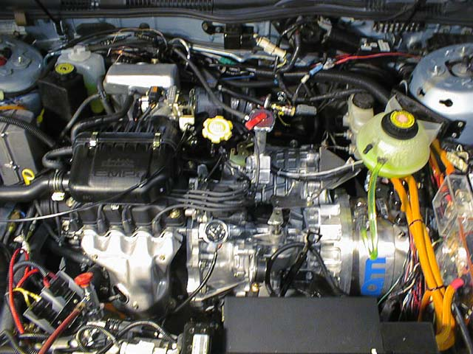
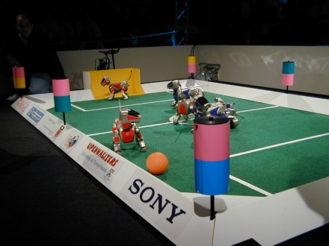
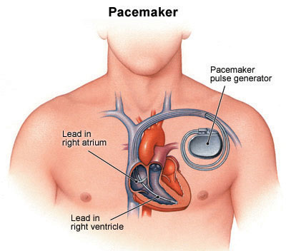
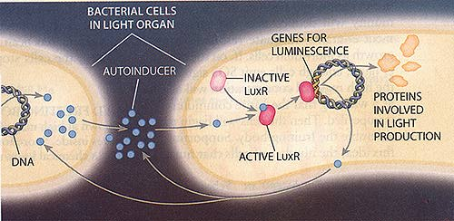
Hybrid Systems
Computer Science
Automata/Logic
Concurrency
Formal verification
+ Control Theory
Optimal control
Stability analysis
Discrete-event system
Software + Environment
State machines
+ Dynamical systems
x>68
on
off
dx/dt = kx
x<70
dx/dt = -k’x
x>60
x<63
Coordination
Protocols
Medical
Devices
Systems
Biology
Automotive
Robotics

Slide 3
Model Based Design for Embedded Software
Can we formally prove safety properties of models?
Formal Specification
Environment Model
Performance Metrics
Can we infer properties of code from properties of models?
Programming/Modeling Language
Based on Hybrid Automata
Design and Analysis Tools
Simulation, Verification, Optimization
Platform Description
Compiler +
Scheduler
Libraries in Base Language
Executable Code on
Embedded Processor

Slide 4
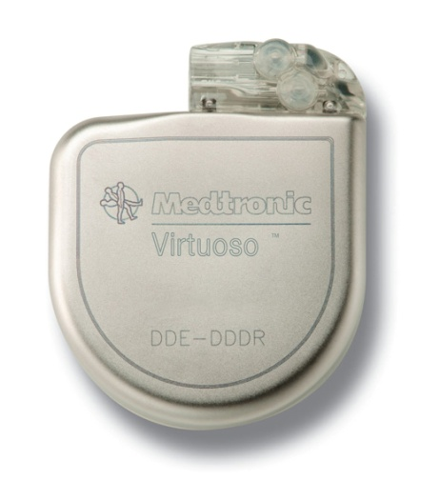
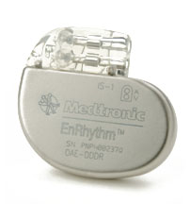
Medical Devices
From 1985-2005, nearly 30,000 deaths and 600,000 injuries from device failures
From 1996-2006, the percentage of software-related causes in medical device recalls have grown from 10% to 21% (as complexity grows, so does potential for safety violations)
There is currently no well-established standards for development of software for medical devices

Slide 5
Model-based Pacemaker Software Design
Heart
Pacemaker
Random
Heart Model
UPPAAL
Model
Verification
Virtual
Heart Model
Interface
Interface
Simulink
Model
Simulation
Heart Model Implementation
Interface
Interface
Pacemaker
Implementation
Testing

Slide 6
Model Verification
Heart
Pacemaker
Random
Heart Model
UPPAAL
Model
Verification
Virtual
Heart Model
Interface
UPPAAL: A tool for verification of network of Timed-automata
Interface
Simulink
Model
Simulation
Heart Model Implementation
Interface
Interface
Pacemaker
Implementation
Testing
Jiang, Pajic, Moarref, Alur, Mangharam, TACAS 2012

Slide 7
Model Simulation
Heart
Pacemaker
Random
Heart Model
UPPAAL
Model
Verification
Virtual
Heart Model
Interface
Interface
Simulink
Model
Simulation
Heart Model Implementation
Interface
Interface
Pacemaker
Implementation
Timing-based heart model and interface in Simulink
Testing
Jiang, Pajic, Mangharam, ICCPS, Proc. IEEE, 2011

Slide 8
Model Translation and Implementation
Heart
Pacemaker
Random
Heart Model
UPPAAL
Model
Verification
Virtual
Heart Model
Interface
Interface
Simulink
Model
Simulation
Heart Model Implementation
Interface
Interface
Pacemaker
Implementation
Testing
Pajic, Jiang, Lee, Mangharam, Sokolsky, RTAS 2012

Slide 9
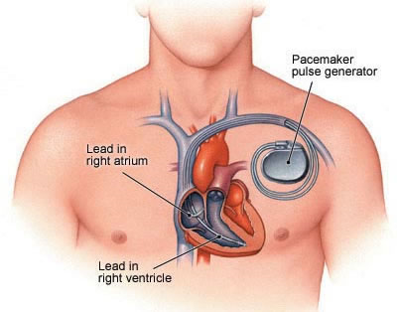
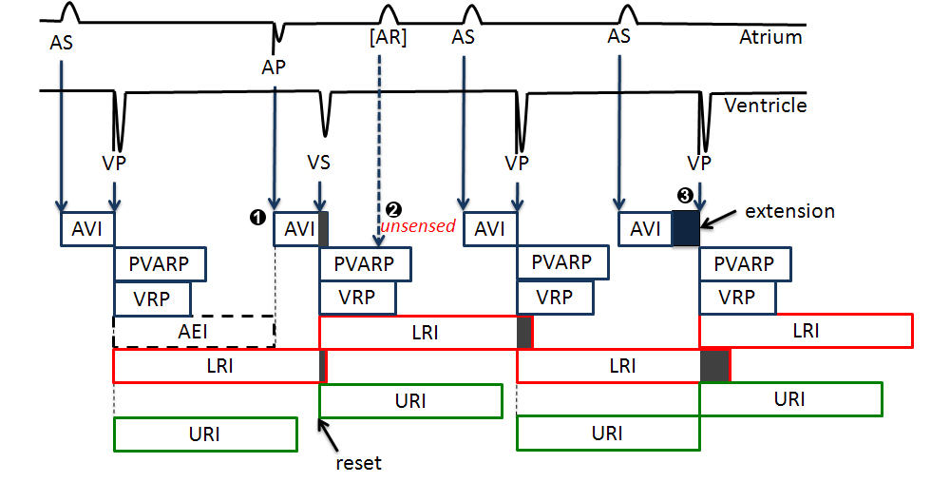
Implantable Pacemaker Modeling

Slide 10
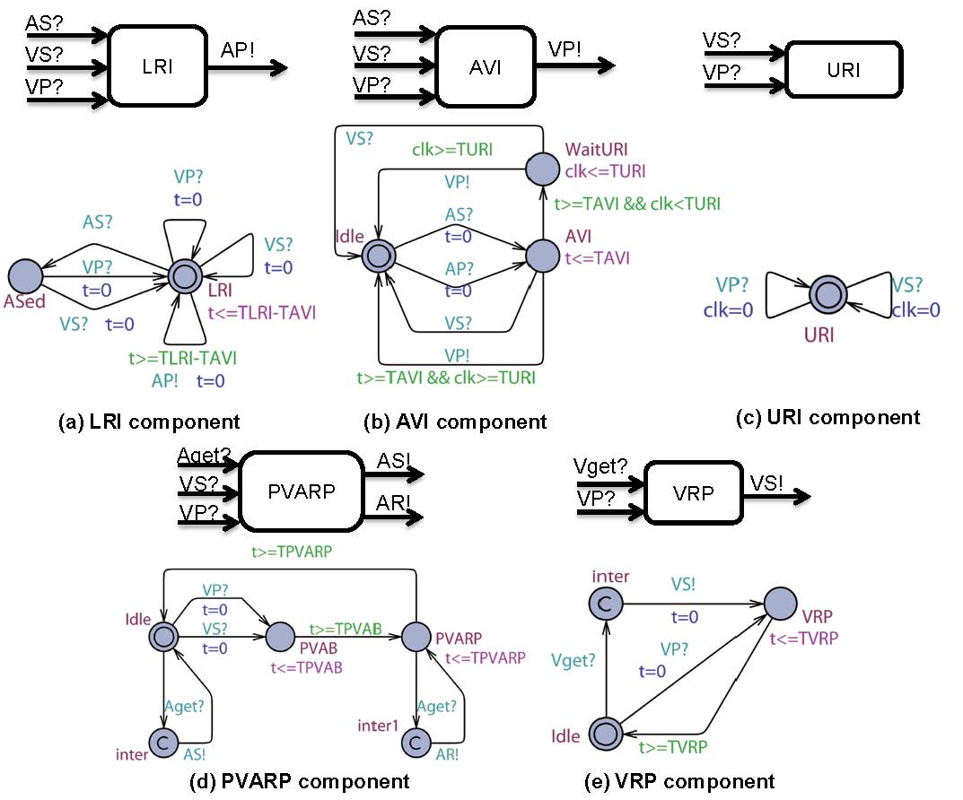
Uppaal Model of Dual Chamber Pacemaker

Slide 11
Summary of Verification Results
Modeled and verified a dual chamber pacemaker and additional advanced functions
Showed that adding new functions to the pacemaker may result in safety violations
Showed that more detailed heart model is needed for more advanced safety requirements

Slide 12
New Challenges: Model Synthesis
Can we extract (controller) models from code?
Can we extract (plant) models from data?
Can we use analysis/verification technology to assist the designer to construct models?
Can we automatically construct interface models for compositional design?

Slide 13
1. From Code to Models
What if pacemaker software is not developed using MBD
How to verify / certify code for pacemaker software
Potential solution: Extract EFSM (Extended finite-state-machine) models from code
Starting point: Predicate abstraction used for software verification
Challenges: Extract timing properties

Slide 14
Model Checking of C code
Phase 1: Given a program P, build an abstract finite-state (Boolean) model A such that set of behaviors of P is a subset of those of A (conservative abstraction)
Phase 2: Model check A wrt specification: this can prove P to be correct, or reveal a bug in P, or suggest inadequacy of A
Shown to be effective on Windows device drivers in Microsoft Research project SLAM
do{
KeAcquireSpinLock();
nPacketsOld = nPackets;
if(request){
request = request->Next;
KeReleaseSpinLock();
nPackets++;
}
}while(nPackets!= nPacketsOld);
KeReleaseSpinLock();
Do lock operations, acquire and
release, strictly alternate on every
program execution?

Slide 15
2. From Data to Models
What’s a good model of heart for verifying correctness requirements of pacemaker software?
Ideally, model should be patient specific
Potential solution: Extract timed/hybrid automata models for ECG data for a patient
Computational challenge: Can we develop suitable learning algorithms ?
Background: L* algorithm for learning DFA
Background: Learning linear constraints among variables

Slide 16
3. Assisting Designers in Model Construction
How can computational tools assist designers?
Maturing verification technology, fast constraint solvers
Enormous computational power available
Goal: Allow designer to express “model under construction” using multiple, intuitive formats
Synthesis tool can integrate different formats, interactively with designer to produce desired model
EFSMs + Example scenarios + High-level requirements

Slide 17
Sketch: Program completion Ref: Chaudhuri, Solar-Lezama (PLDI 2010)
Err = 0.0;
for(t = 0; t<T; t+=dT){
if(stage==STRAIGHT){
if(t > ??) stage= INTURN;
}
if(stage==INTURN){
car.ang = car.ang - ??;
if(t > ??) stage= OUTTURN;
}
if(stage==OUTTURN){
car.ang = car.ang + ??;
if(t > ??) break;
}
simulate_car(car);
Err += check_collision(car);
}
Err += check_destination(car);
When to start turning?
Backup straight
How much to turn?
Turn
Straighten
Solution based on constraint solving + numerical optimization

Slide 18
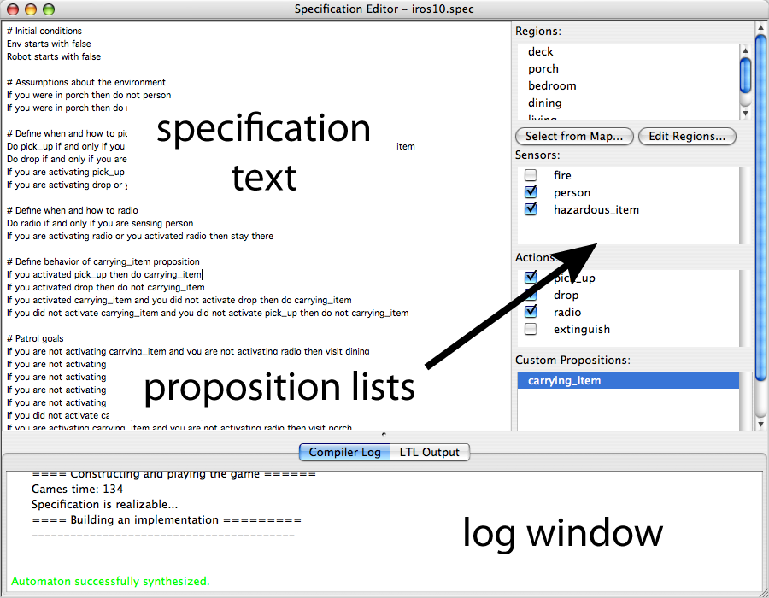
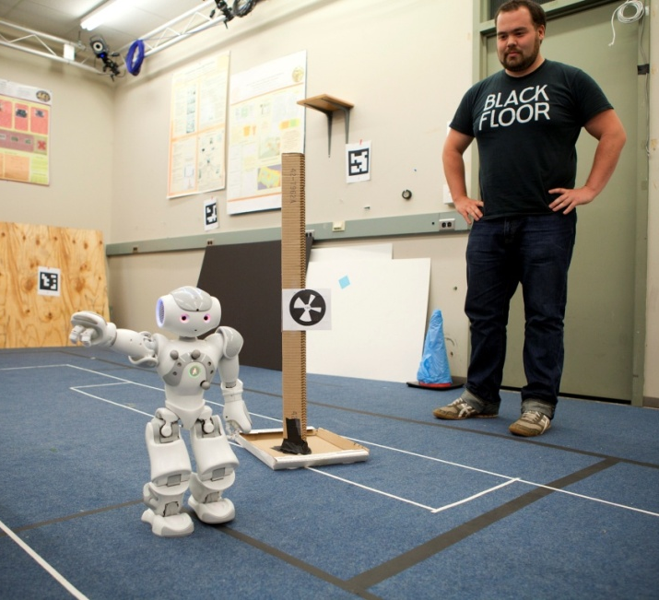
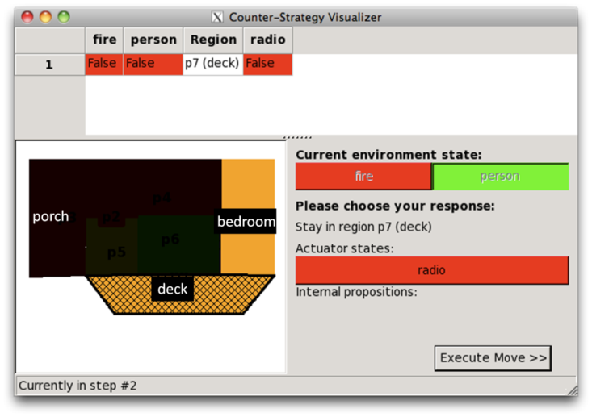
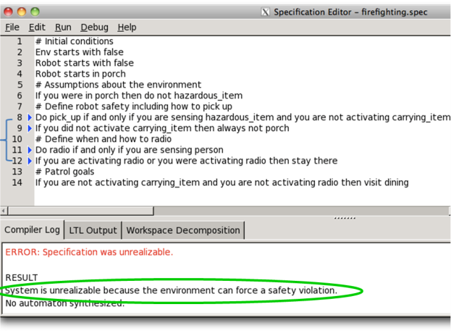
LTLMoP: Robot control from structured English Ref: Kress-Gazit et al (IROS 2010, CAV 2011)
Feasible specification
Visit all rooms
Unsynthesizable specification
Users specify what the robot should do, not how it should be done

Slide 19
4. Interfaces for Compositional Design
Interface: Simplified description of components for system integration
Theoretical foundation: Compositionality, compatibility
Opportunity for scalability of formal analysis
Challenge: Theories and tools for interface-based design of cyber-physical systems
Interfaces need to capture quantitative properties
Can interfaces be automatically extracted from code/models?
Recent work: Resource allocation over time-triggered platforms for control components

Slide 20
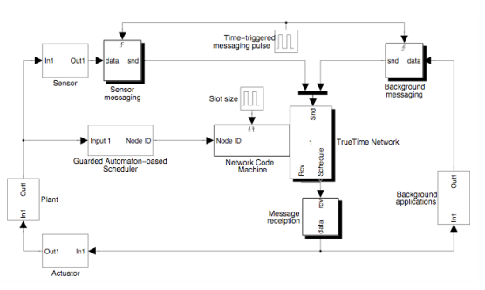
Automata-based Interfaces
Control Designer:
Specify all acceptable allocation sequences as a regular language
E.g. Periodicity, Exponential stability, Fairness
Interface: Regular language for desired allocation on time-triggered platform
System Integrator:
Can resource requirements of all the components be met?
Find a schedule acceptable to all using automata constructions
Plant
Plant
Controller
Plant
Application: Multi-hop wireless control networks (ADJPW 09/10)

Slide 21
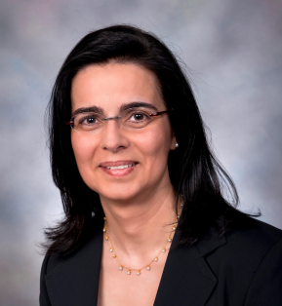
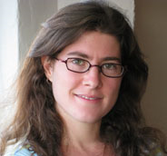
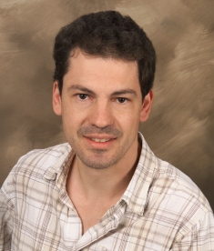
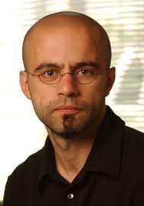
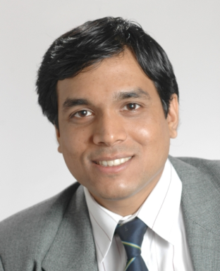
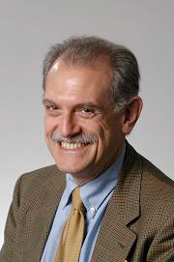
Foster
Hartmann
Lafortune
Kavraki
Kress-Gazit
Loo
Madhusudan
ExCAPE
Expeditions in Computer Augmented Program Engineering
http://excape.cis.upenn.edu/
Cornell, Maryland, Michigan, MIT, Penn, Rice, UC-Berkeley,
UCLA, UIUC
Bodik
Martin
Alur
Pappas
Zdancewic
Vardi
Tripakis
Tabuada
Solar-Lezama
Seshia
Sangiovanni
Notes:
21

Slide 22
Synthesis: ExCAPE View
Paradigm shift in synthesis:
Old: Allow more concise, high-level description
New: Designer uses multiple, natural formats,
Synthesis tool assists in discovering tricky logic
Paradigm shift in design tools:
Old : Any compiler transformation must be polynomial-time
New: Computational intractability not a show-stopper
Common theme: Guided search in a space of designs to find one that meets multiple design goals
A bit like model checking, but can be interactive!

Slide 23
Conclusions
Model based design (MBD) is a promising approach to design of embedded software
Over the past years, CPS research has demonstrated benefits of MBD for rigorous design of pacemaker software
Synthesis has the potential to transform the way a designer can employ MBD
Promise of Synthesis: Model-based Design made less tedious

