Slide 1
Models of Time for a Computational World
Sponsors:
Bosch
MARCO/DARPA
NSF
NSA
National Instruments
OSD/NRL
Thales
Key collaborators:
Patricia Derler
John Eidson
Slobodan Matic
Sanjit Seshia
Yang Zhao
Michael Zimmer
Haiyang Zheng
Jia Zou
Edward A. Lee
Robert S. Pepper Distinguished Professor
UC Berkeley
National Workshop on The New Clockwork for Time-Critical Systems
October 25, 26, and 27, 2012
Baltimore, Maryland

Slide 2
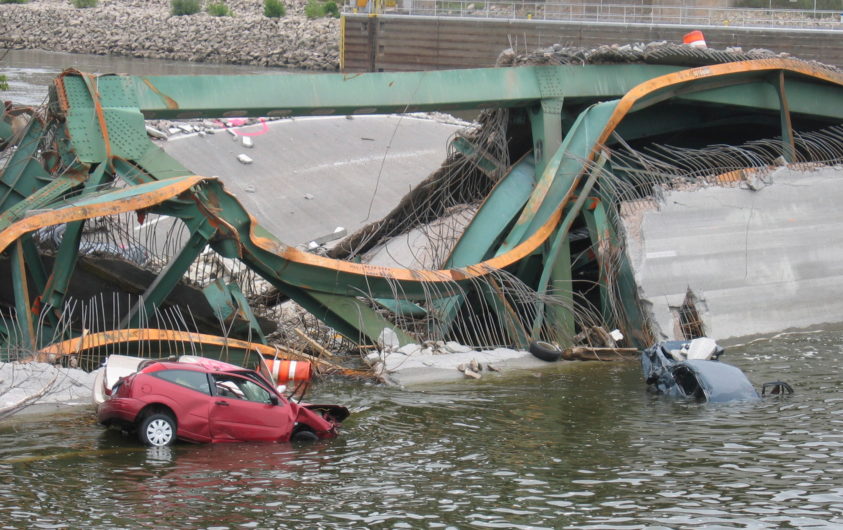
Bridging Discrete and Continuous
Computation is discrete
Time is a continuum
Naïve bridges between the two fall short

Slide 3
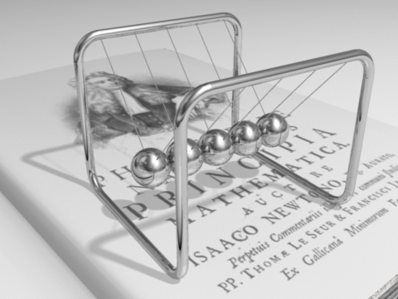
What is the momentum of the middle ball as a function of time?
Notes:
\textbf{p}(t) = m \textbf{v}(t)

Slide 4
What is the momentum of the middle ball as a function of time?
It might seem:
Notes:
\textbf{p}(t) = m \textbf{v}(t)
\textbf{v}(t) = 0 \quad \Rightarrow \quad \textbf{p}(t) = 0

Slide 5
But no, it is:
where t_{i} is the time of collision
Notes:
\textbf{v}(t) = \left \{ \begin{array}{ll}
\textbf{K}, & t = t_i \\
0 & \mbox{otherwise}
\end{array} \right .

Slide 6
Since position is the integral of velocity, and the integral of v is zero, the ball does not move.
K
t_{i}
Notes:
\textbf{v}(t) = \left \{ \begin{array}{ll}
\textbf{K}, & t = t_i \\
0 & \mbox{otherwise}
\end{array} \right .

Slide 7
A discrete representation of this signal with samples is inadequate.
K
t_{i}
Notes:
\textbf{v}(t) = \left \{ \begin{array}{ll}
\textbf{K}, & t = t_i \\
0 & \mbox{otherwise}
\end{array} \right .

Slide 8
Samples yield discrete signals
A signal is sampled at tags
t₀
t₁
t₂
t₃
...
t
t_{s}
A signal s is discrete if there is an order embedding from its tag set π ( s ) (the tags for which it is defined and not absent) to the natural numbers (under their usual order).

Slide 9
No discrete subset of real-valued times is adequate to unambiguously represent this signal.
K
t_{i}
Notes:
\textbf{v}(t) = \left \{ \begin{array}{ll}
\textbf{K}, & t = t_i \\
0 & \mbox{otherwise}
\end{array} \right .

Slide 10
There is no semantic distinction between a discrete event and a rapidly varying continuous signal.
K
t_{i}
Notes:
\textbf{v}(t) = \left \{ \begin{array}{ll}
\textbf{K}, & t = t_i \\
0 & \mbox{otherwise}
\end{array} \right .

Slide 11
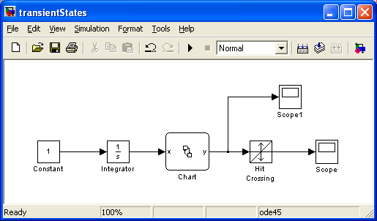
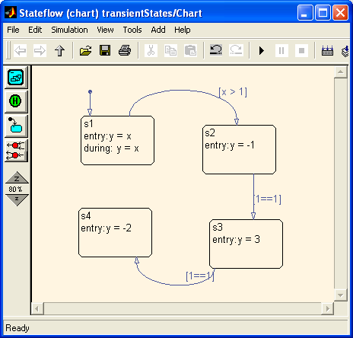
Simulink/Stateflow cannot accurately model such events.
In Simulink, a signal can only have one value at a given time. Hence Simulink introduces solver-dependent behavior.
The simulator engine of Simulink introduces a non-zero delay to consecutive transitions.
Transient States

Slide 12
Ptolemy II uses Superdense Time
[Maler, Manna, Pnuelli, 92] for Continuous-Time Signals
http://ptolemy.org
Initial value:
Intermediate value:
Final value:
At each tag, the signal has exactly one value. At each time point, the signal has a sequence of values. Signals are piecewise continuous, in a well-defined technical sense, a property that makes ODE solvers work well.
Notes:
\textbf{v}\colon (\rr \times \nn) \to \rr^3
\textbf{v}(t_i, 0) = 0

Slide 13
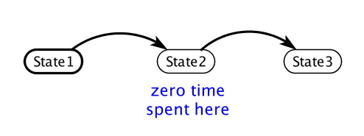
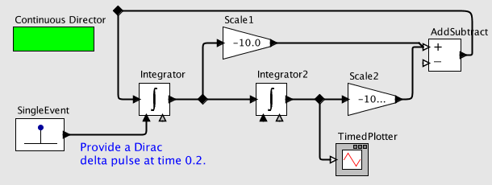
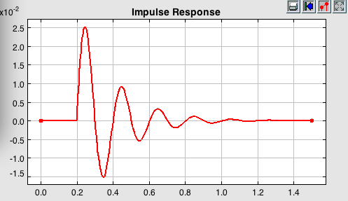
Consequences of using Superdense Time
Transient states are well represented:
Infinitessimals (even Dirac delta functions):

Slide 14
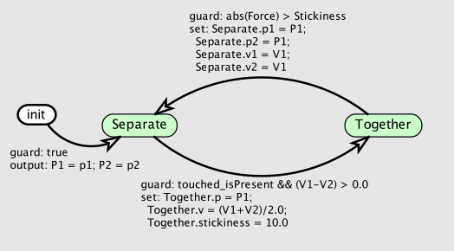
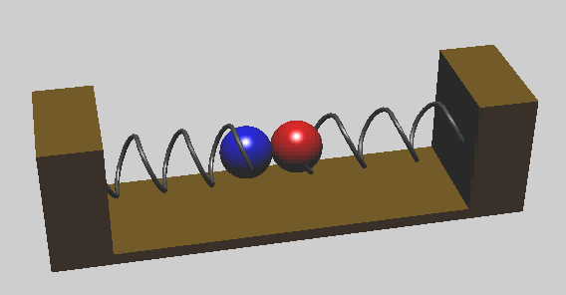
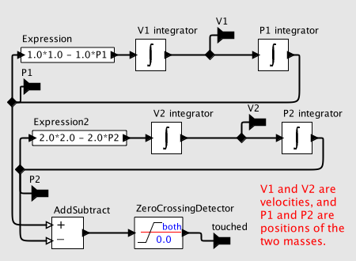
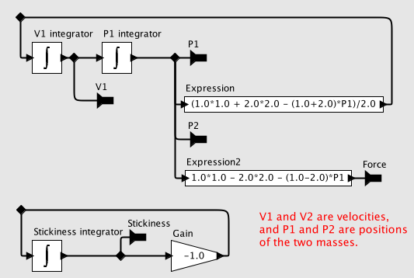
More Consequences:
Hybrid System
Finite State Machine
Dyanmics 1
Dynamics 2

Slide 15
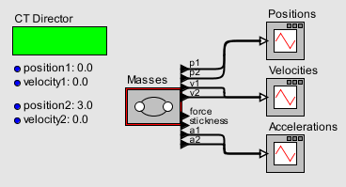
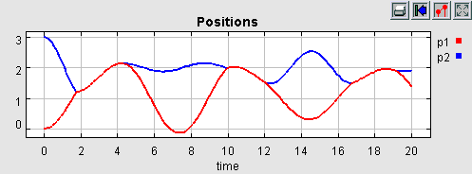
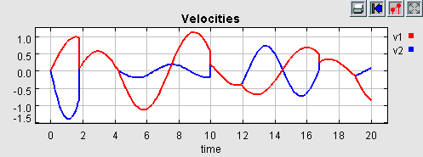
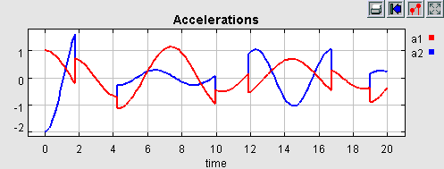
Transitions between modes are instantaneous
In the signals at the right, the velocities and accelerations proceed through a sequence of values at the times of the collisions and separations.

Slide 16
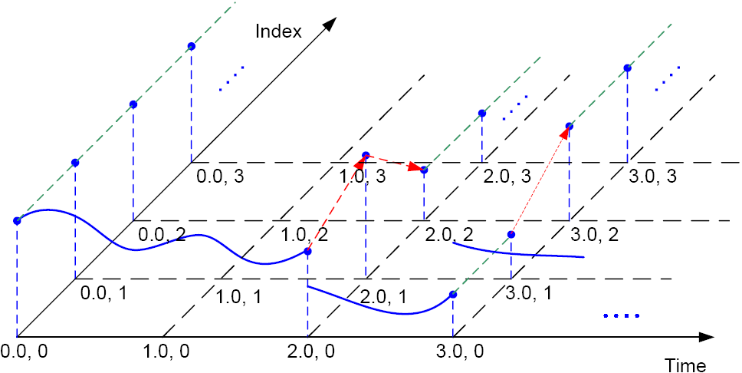
Superdense Time
The red arrows indicate value changes between tags, which correspond to discontinuities. Signals are continuous from the left and continuous from the right at points of discontinuity.

Slide 17
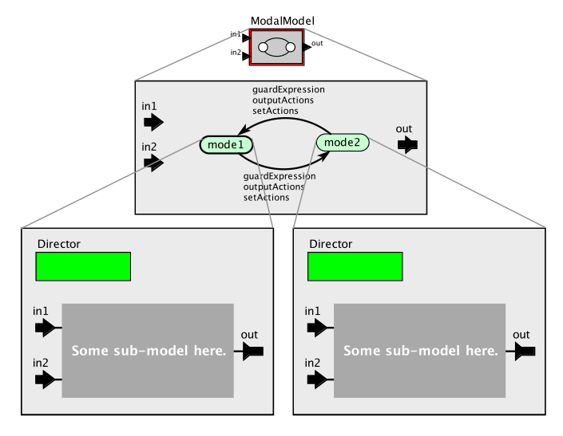
Modal Models and
Multiform Time
Actor
Ports
FSM
Once we have a clean, instantaneous handoff between modes, a question arises about how to model time is a dormant mode.
State
Transition
Ports
Refinement
Refinement
When this mode is inactive, should time advance?

Slide 18
The Modal Model Muddle
It’s about time
After trying several variants on the semantics of modal time, we settled on this:
A mode refinement has a local notion of time. When the mode refinement is inactive, local time does not advance. Local time has a monotonically increasing gap relative to environment time.

Slide 19
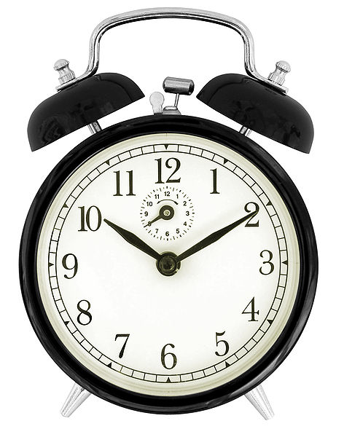
MultiForm Time in Ptolemy II
In Ptolemy II Modal Models,
Time is suspended and resumed
local time
Environment time
Local time inside a
mode refinement
suspend
resume
reference time
Notes:
Edward A. Lee, “Finite State Machines and Modal Models in Ptolemy II,”
EECS Department, University of California, Berkeley,
Technical Report No. UCB/EECS-2009-151, November 1, 2009

Slide 20
Variants for the Semantics of Modal Time that we Tried or Considered, but that Failed
Mode refinement executes while “inactive” but inputs are not provided and outputs are not observed.
Time advances while mode is inactive, and mode refinement is responsible for “catching up.”
Mode refinement is “notified” when it has requested time increments that are not met because it is inactive.
When a mode refinement is re-activated, it resumes from its first missed event.
All of these led to some very strange models…
Final solution: Local time does not advance while a mode is inactive. Monotonically growing gap between local time and environment time.

Slide 21
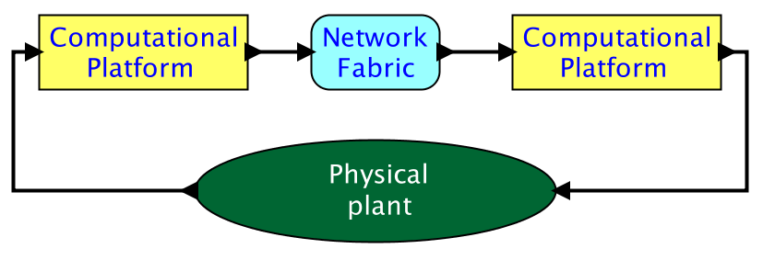
Once we have multiform time, we can build accurate models of cyber-physical systems
Notes:
We want to run for two seconds.
The fact that it runs for two seconds is a combination of the program and hardware.

Slide 22
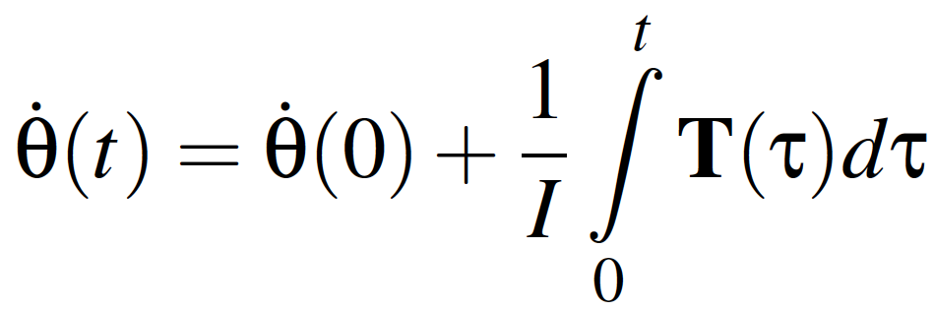
Engineers model physical dynamics using differential-algebraic equations.
The variable t represents an idealized Newtonian notion of time.

Slide 23
But computational platforms have no access to t.
Instead, local measurements of time are used.
A superdense Newtonian notion of time becomes environment time

Slide 24
Local time within a hierarchy can advance at different rates.
Model internally uses local time
Model internally uses local time
Discrete Event MoC
Model uses “oracle time,”
which becomes “environment time”
for the subsystems.

Slide 25
Clocks drift
Fabrication tolerance
Aging
Temperature
Humidity
Vibrations
Quality of the quartz.
Clock drifts measured in “parts per million” or ppm
1 ppm corresponds to a deviation of 1μs every second
Notes:
differences in clocks - epoch defines start of time/reference time, leap second adjustment in UTC, even atomic clocks drift! Keeping precise and accurate time is very difficult.

Slide 26
MultiForm Time in Ptolemy
local time
Heaven for engineers.
Local time and environment
time are in sync!
reference time

Slide 27
Multiform Time in the Real World
Reality:
There is an offset between
local time and environment time
local time
offset
reference time

Slide 28
Multiform Time in Ptolemy
More real: clocks drift
local time
fast clock
slow clock
reference time

Slide 29
Multiform Time in Ptolemy
Even more real: clock drift changes!
tl
environment time:
te
start time:
se, sl
offset:
o = se - sl
clock rate:
cl
local time:
tl = (te - o) × cl
set clock drift
cl’ = 0.5
cl = 1.0
o
sl
te
se
Notes:
timeresolution: used for precision: every time value is rounded to that precision
All time values are rounded to the nearest multiple of this value

Slide 30



Multiform Time in Ptolemy
Ptolemy II provides a hierarchy of local clocks
tl
environment time:
te
start time:
se, sl
offset:
o = se - sl
clock rate:
cl
local time:
tl = (te - o) × cl
set clock drift
cl’ = 0.5
cl = 1.0
o
sl
te
This can be used, for example, to accurately model time synchronization protocols.
se
Notes:
timeresolution: used for precision: every time value is rounded to that precision
All time values are rounded to the nearest multiple of this value
During this period, the director base class was extended with a local
clock, which keeps track of the local time, i.e. the model time at the
level of the model hierarchy. Local time is related to environment
time, the time of the enclosing model, if there is one. Local time can
be offset from the environment time and evolve at a different clock
rate. Local time and environment time evolve simultaneously. The
director exposes the local clock and parameters to change the clock
value as well as the clock rate in Vergil. These parameters are used
to model clock drift and clock synchronization. Two demos of realistic
applications that typically have drifting clocks and need clock
synchronization were implemented in Ptolemy to illustrate the
concepts: (a) the detection of a fault on a power line between two
substations due to disturbance such as lightening and (b) a
triangulation application that computes the source of a sound.
Ptolemy contains timed and un-timed directors. In un-timed directors,
the time of the local clock never advances.

Slide 31

Multiform Time is Intrinsic!
Time
Time in digital systems
  Circuits, discrete clocks, generating well defined periodic signals
Time in physical laws, mathematical, continuous
Physical
Measured
Relativistic
Newtonian
TAI
Master Clock
Synchronized Clock
Microprocessor Clock
  Clock synchronization
NTP
PTP, IEEE 1588
GPS
Source: Patricia Derler and John Eidson
Notes:
International Atomic Time is a high-precision atomiccoordinate time standard based on the notional passage of proper time on Earth's geoid. It is the basis for Coordinated Universal Time (UTC), which is used for civil timekeeping - weighted average of the time kept by over 200 atomic clocks in over 50 national laboratories worldwide
Coordinated Universal Time (UTC) is the primary time standard by which the world regulates clocks and time
UTC is occasionally adjusted by adding a leap second in order to keep it within one second of UT1, which is defined by the Earth's rotation
NTP: within tens of milliseconds over the public Internet,[1] and can achieve 1 millisecond accuracy in local area networksunder ideal conditions, uses UDP
PTP: sub-microsecond range, cheaper than GPS, also known as IEEE 1588
clock synch: define clock hierarchies, master-slave, where hierarchy talks about the distance from the reference clock/quality, configuration, devices such as atomic (caesium, rubidium) clocks, GPS clocks or other radio clocks, compute transmission time/roundtrip delay

Slide 32

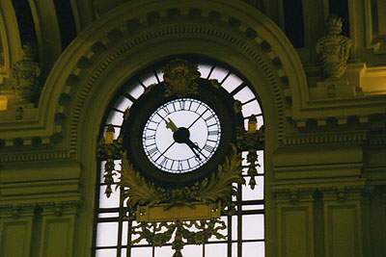
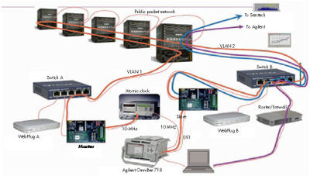
A Perspective on Time Synchronization
Time synchronization is going to change the world
(again)
Lackawanna Railroad Station, 1907, Hoboken.
Photograph by Alicia Dudek
2005: first IEEE 1588 plugfest
Gregorian Calendar (BBC history)
1500s
days
1800s
seconds
2000s
nanoseconds

Slide 33
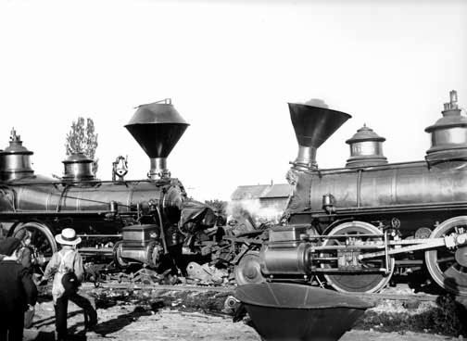
Today’s networks
“On August 12, 1853, two trains on the Providence & Worcester Railroad were headed toward each other on a single track. The conductor of one train thought there was time to reach the switch to a track to Boston before the approaching train was scheduled to pass through. But the conductor's watch was slow. As his speeding train rounded a blind curve, it collided head-on with the other train—fourteen people were killed. The public was outraged. All over New England, railroads ordered more reliable watches for their conductors and issued stricter rules for running on time.”
Source: National Museum of American History

Slide 34
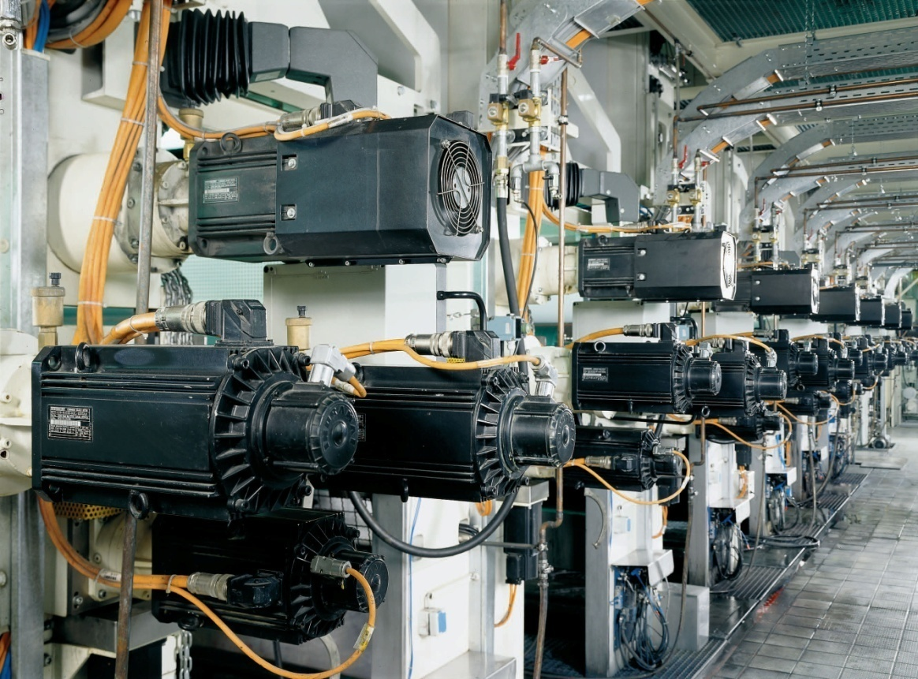
A Cyber-Physical System
Printing Press
Hundreds of microcontrollers and an Ethernet network are orchestrated with precisions on the order of microseconds.
Software for such systems can be developed in a completely new way.
Bosch-Rexroth
Time synchronization enables tightly coordinated actions and reliable networking with bounded latency.

Slide 35
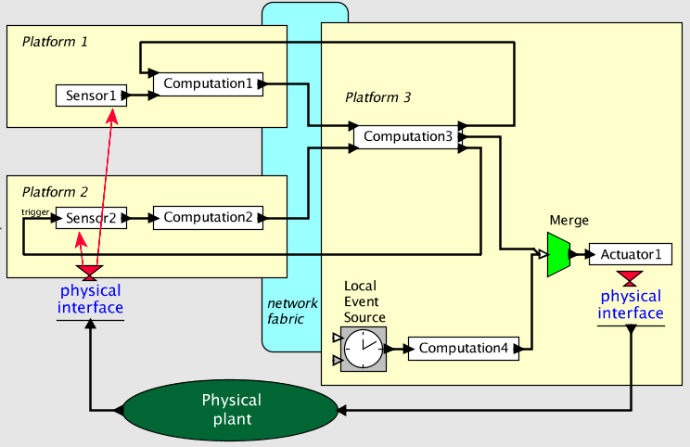
Ptides: Programming Temporally Integrated Distributed Embedded Systems
First step: Time-stamped messages.
http://chess.eecs.berkeley.edu/ptides
Actors specify computation
Messages carry time stamps that define their interleaving

Slide 36
Ptides: Second step:
Network time
Synchronization
http://chess.eecs.berkeley.edu/ptides
GPS, NTP, IEEE 1588, time-triggered busses, … they all work. We just need to bound the clock synchronization error.
Assume bounded clock error
Assume bounded clock error e
Assume bounded clock error e

Slide 37
Ptides: Third step:
Bind time stamps to real time at sensors and actuators
http://chess.eecs.berkeley.edu/ptides
Actors wrap sensors
Output time stamps are ≤ real time
Input time stamps are ≥ real time
Input time stamps are ≥ real time
Actors wrap actuators
Output time stamps are ≤ real time
Clock synchronization gives global meaning to time stamps
Messages are processed in time-stamp order.

Slide 38
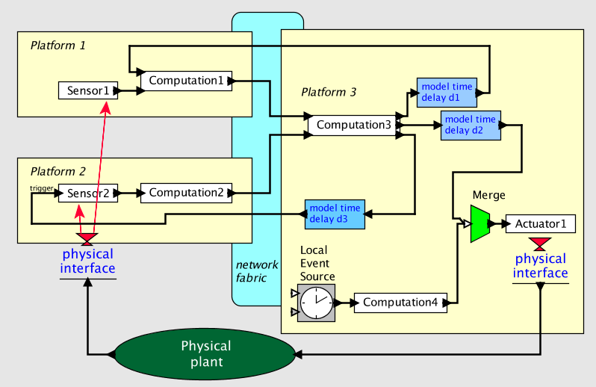
Ptides: Fourth step:
Specify latencies in the model
http://chess.eecs.berkeley.edu/ptides
Global latencies between sensors and actuators become controllable, which enables analysis of system dynamics.
Model includes manipulations of time stamps, which control latencies between sensors and actors
Actuators may be designed to interpret input time stamps as the time at which to take action.
Feedback through the physical world

Slide 39
Ptides: Fifth step
Safe-to-process analysis (ensures determinacy)
http://chess.eecs.berkeley.edu/ptides
Safe-to-process analysis guarantees that the generated code obeys time-stamp semantics (events are processed in time-stamp order), given some assumptions.
Assume bounded network delay d
Assume bounded sensor delay s
Application specification of latency d2
An earliest event with time stamp t here can be safely merged when real time exceeds
t + s + d + e – d2
Assume bounded clock error
Assume bounded clock error e
Assume bounded clock error e

Slide 40
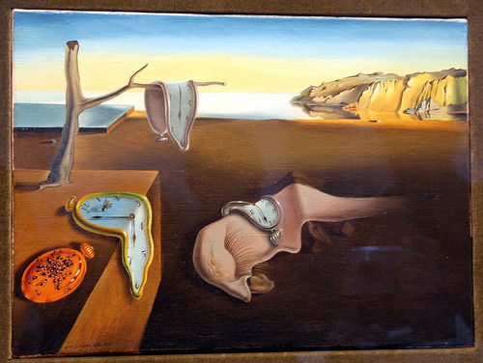
Other Questions about Time:
Precision
  In floating-point formats,
  precision degrades as magnitude increases
Clear Semantics of Simultaneity
  Requires precise addition and subtraction, e.g.
  (a + b) + c = a + (b + c).
  Floating-point numbers don’t have this property.
Floating point numbers are a poor choice for modeling time!

Slide 41
Topics for further discussion
Programming models leveraging time synchronization?
  PTIDES: http://chess.eecs.berkeley.edu/ptides
How to determine the required accuracy of time sync?
  PTIDES offers a tradeoff between latency and time sync accuracy.
How to handle faults?
  PTIDES can detect violations of assumptions (bounded clock error, bounded network latency, and bounded sensor delay).
Zeno behavior?
  Some models have infinite events in finite time.
Security?
  Does time synchronization create a point of vulnerability?
  Or does it provide mechanism for improving security?
  Or both?

Slide 42
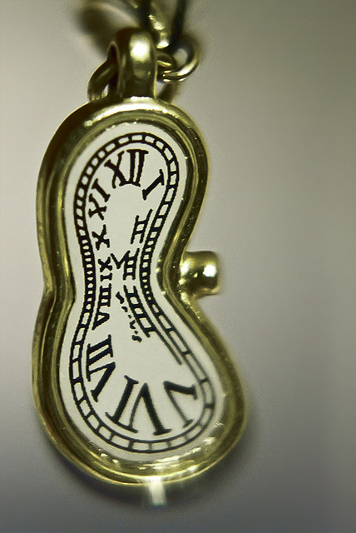
Conclusions
Modeling time as a simple continuum is not adequate.
  Superdense time offers clean semantics for instantaneous events.
Homogeneous time advancing uniformly is not adequate.
  Hierarchical multiform time enables accurate and practical models of heterogeneous distributed systems.
Programming models for distributed cyber-physical systems.
  Ptides is an existence proof that determinate real-time distributed computation is possible.
Floating point numbers for time are not adequate.
  A model with invariant precision and precise addition and subtraction is.
Many more open questions…

