Slide 1
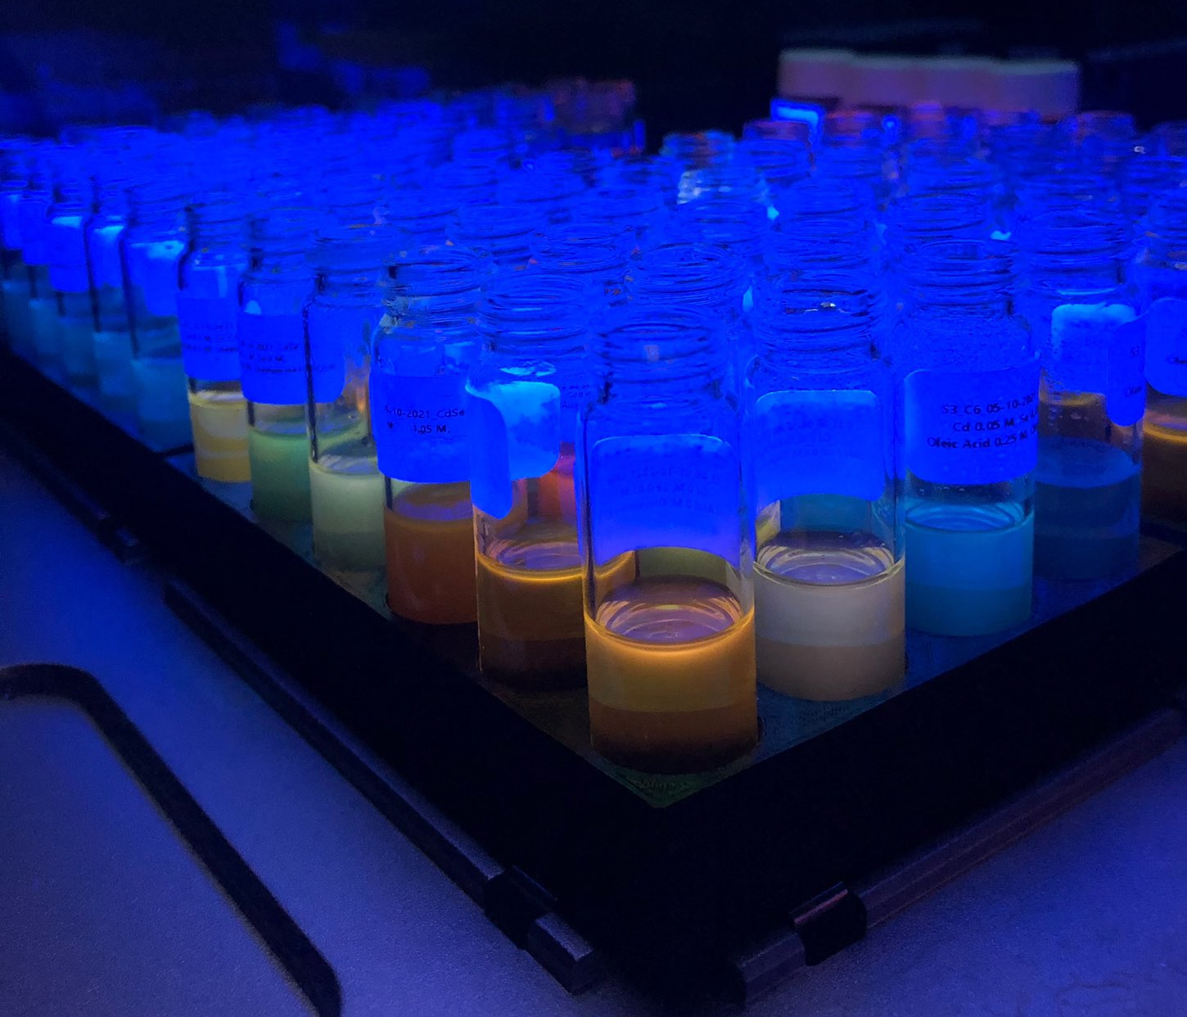
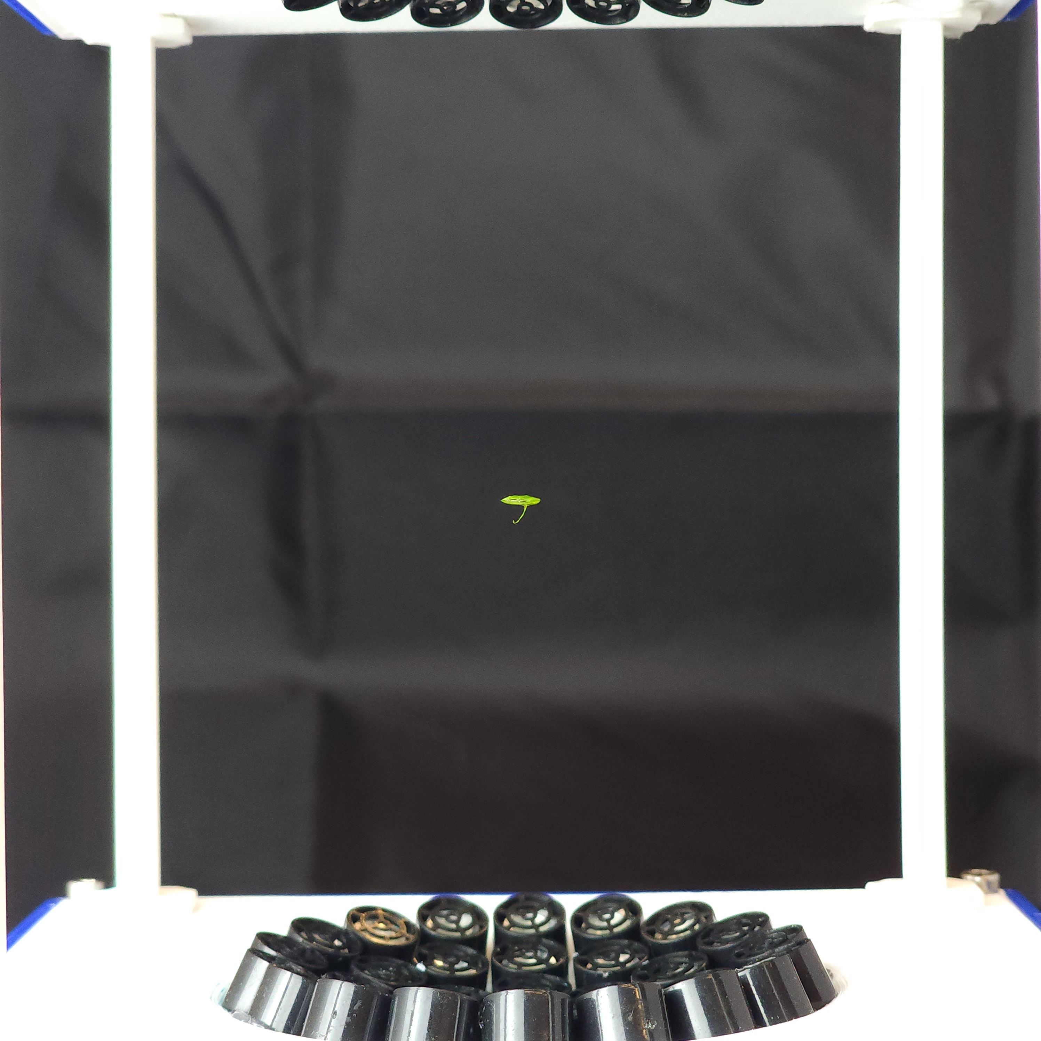
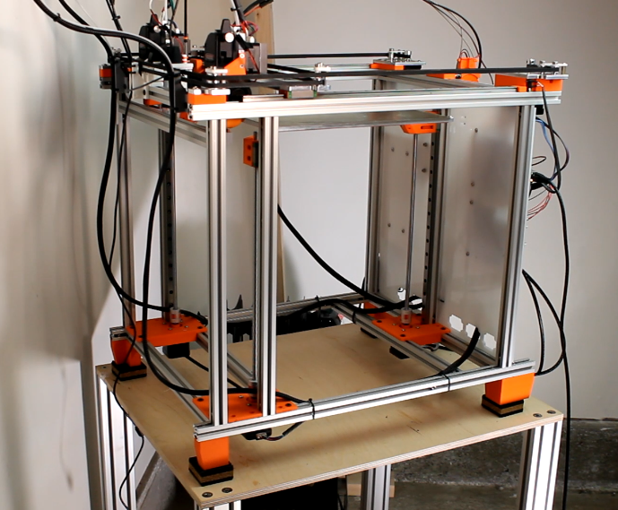
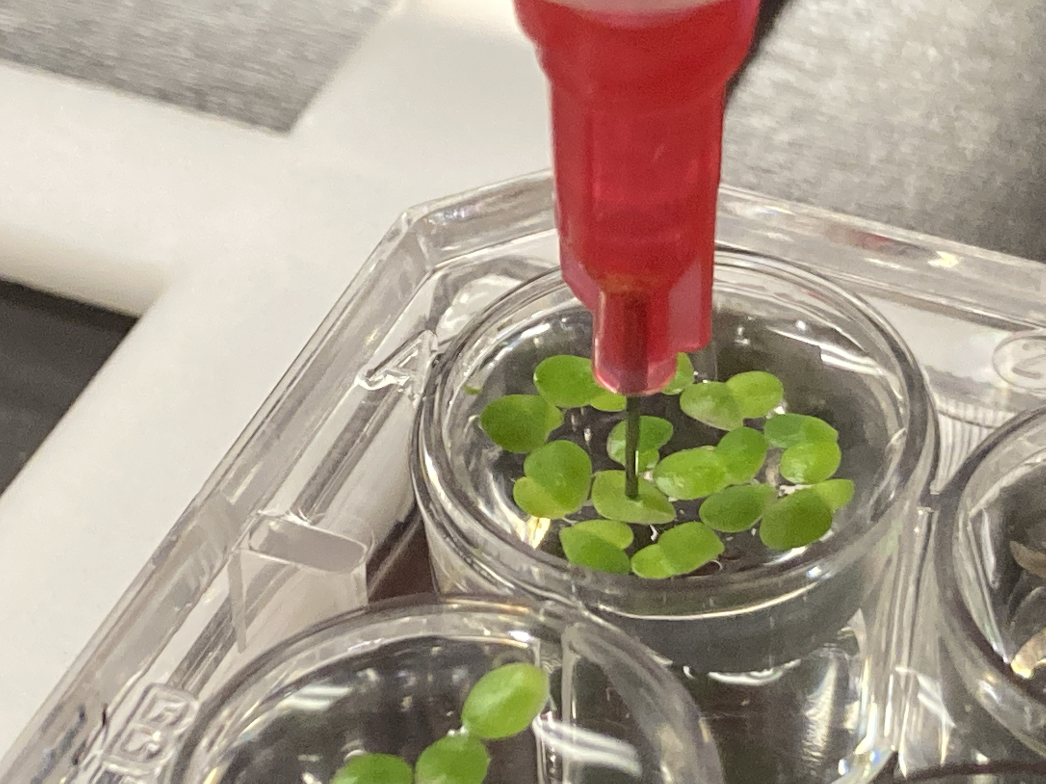
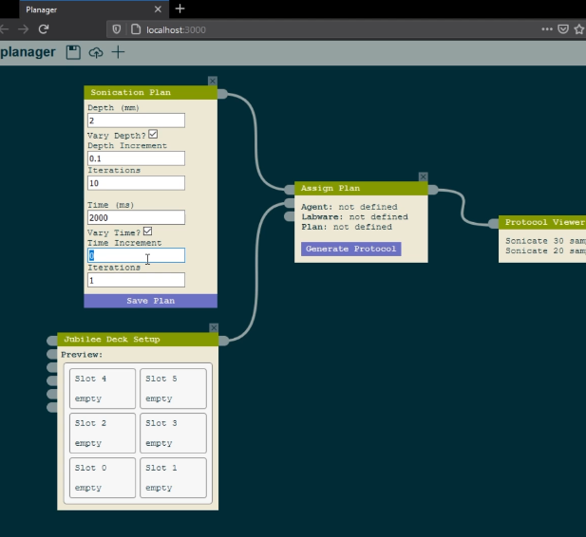
Multi-Manipulator Extensible Robotic Platforms
Nadya Peek (Machine Agency), Joshua R. Smith (Sensor Systems Lab), University of Washington
http://depts.washington.edu/machines
Robots have historically been used for dull, dirty, and dangerous tasks. We instead seek to develop robots that assist experts with scientific exploration, including iterative development of new processes and workflows. To do so, we will contribute open-source co-robotic automation and programming tools.
Tool-changing motion platform
Manipulating and Imaging Duckweed
Automatically sonicated samples
Ultrasonic manipulator levitating a duckweed frond
Browser-based end-user programming environment
Open-source extensible motion platforms with automated tool-changing
Novel ultrasonic manipulators enable contact-less, un-occluded examination of duckweed fronds
End-user programming environments for authoring automation workflows
Intellectual Challenges:
High speed control of motion platform and end effectors
Novel ultrasonic manipulation capabilities
Open-source systems that can be built and customized by non-experts
Broader Impacts:
Enabling scientists to use co-bots in their own experiment workflows and applications
Teaching students machine design and customization with a low-cost but highly precise platform
Lowering the threshold to developing computer-controlled processes
2023 FRR & NRI Principal Investigators' Meeting
May 2-3, 2023
Award ID#: 2024435

