Slide 1


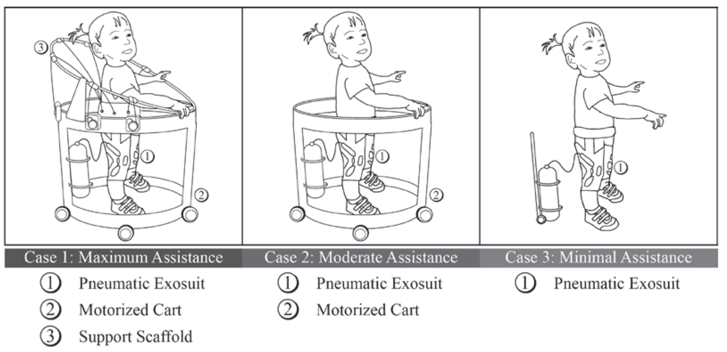
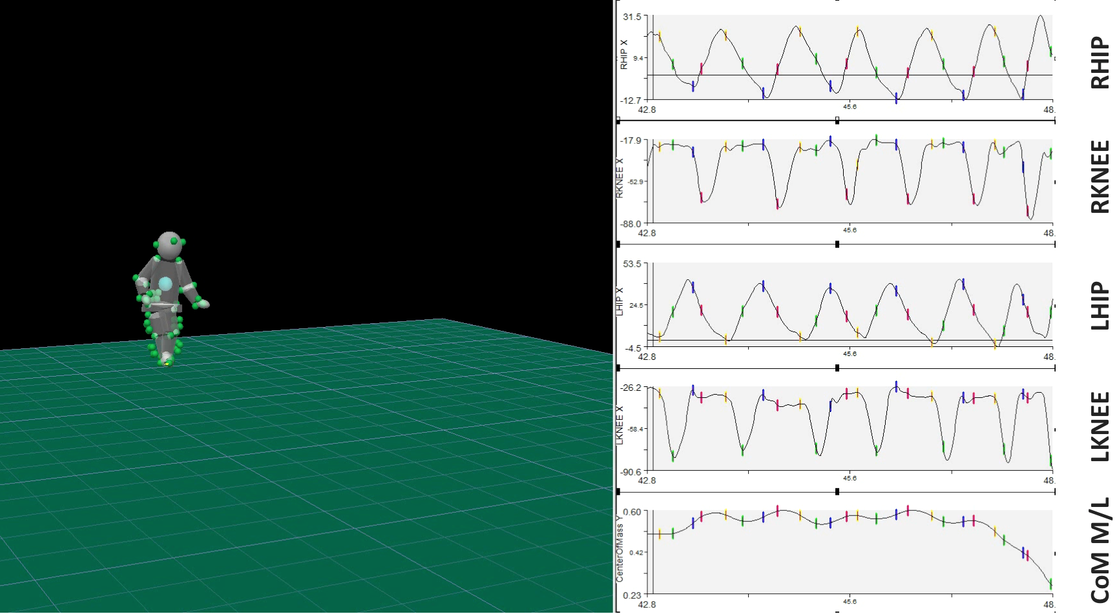
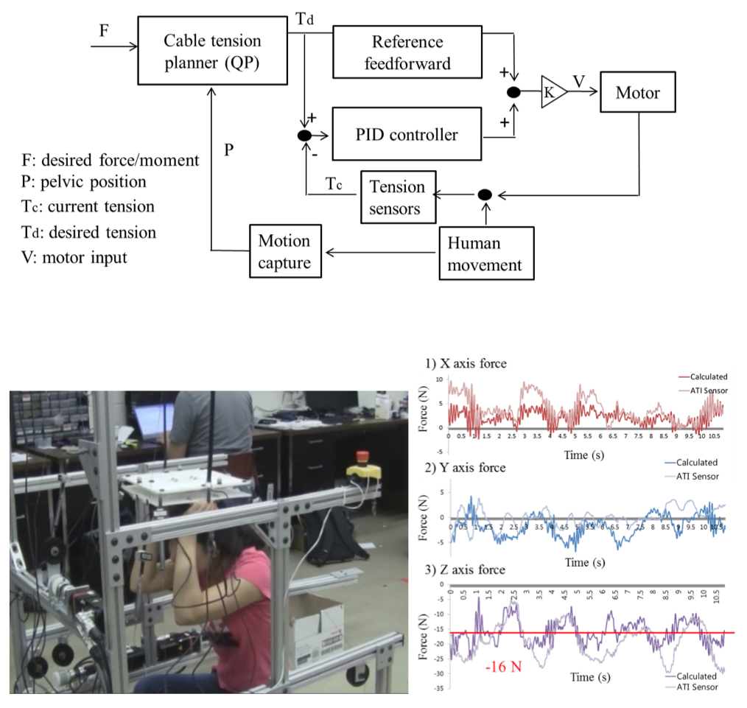
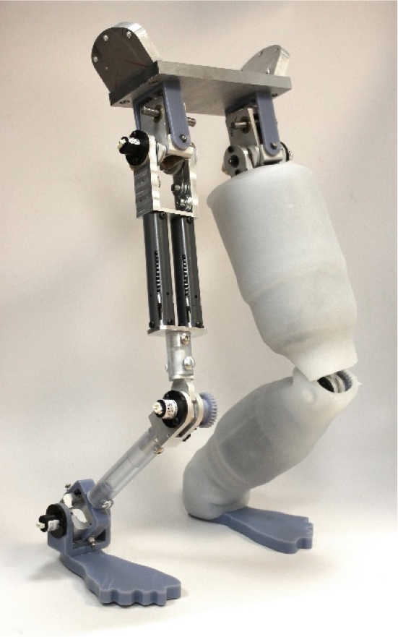
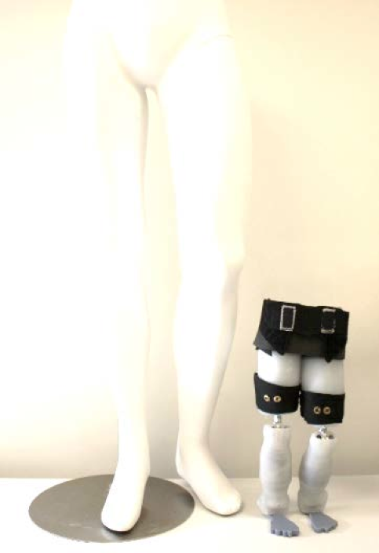
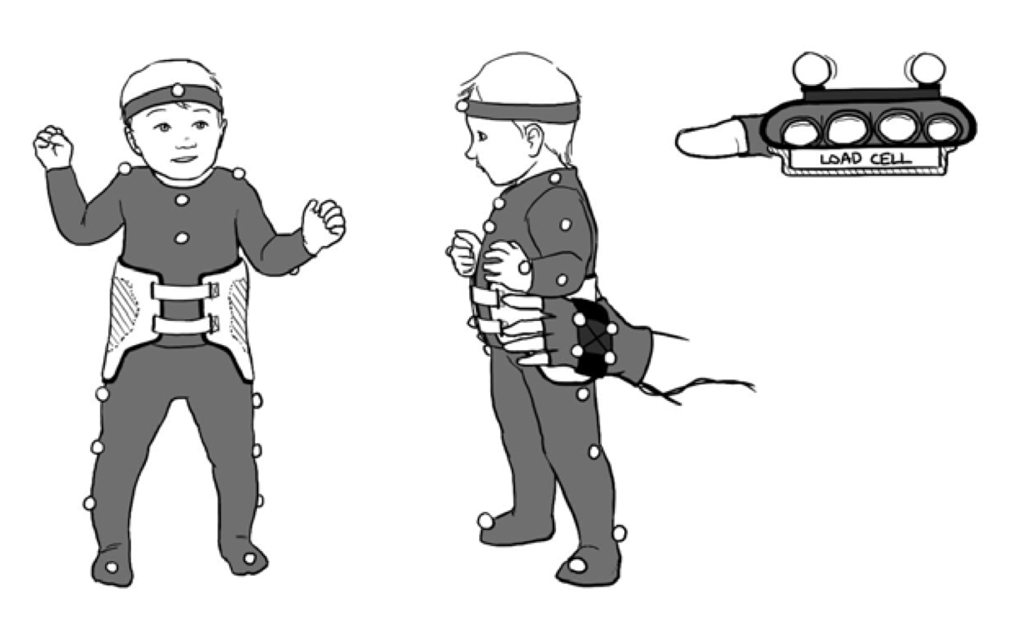
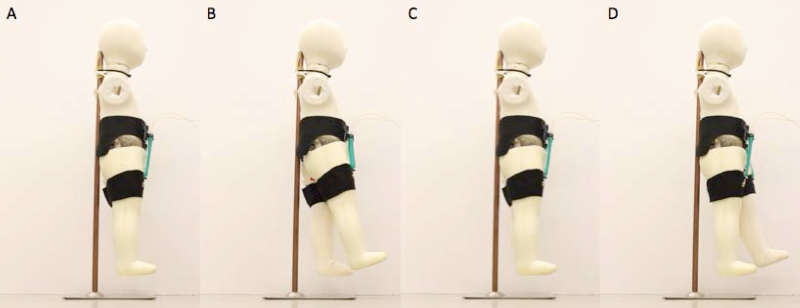
MULTI-ROBOT CYBERPHYSICAL SYSTEM FOR ASSISTING YOUNG DEVELOPMENTALLY-DELAYED CHILDREN IN LEARNING TO WALK
Eugene C. Goldfield^{1,2}, Daniel Miranda^{1,2}, Wen-Hao Hsu^{1,2}, Evelyn Park¹, Sunil Agrawal³, Jiyeon Kang³, Conor Walsh²
¹Wyss Institute For Biologically Inspired Engineering at Harvard, ²Boston Children’s Hospital, ³Columbia University
MOTIVATION
AIMS
This project is a modular, computationally-distributed multi-robot cyberphysical system (CPS) for assisting young developmentally-delayed children learning to walk. Three challenges are stabilizing medio-lateral body sway, developing gait that exploits energy exchange, and coordination of multiple degrees of freedom. Adults assisting children learning to walk provide a “scaffold” of postural supports that enables the child to safely explore the forces acting on its body. In order to capture the adaptability of the adult in responding to the child’s learning, our CPS consists of 1) a scaffold that modulates and stabilizes center of mass sway, and 2) a soft, wearable exosuit with embedded sensing and actuation to assist walking.
To measure kinematics, kinetics, and center of mass (COM) behavior at hip, knee, and ankle during
  Standing
  Walking
Lower body toddler model for bench top testing
  Joint actuator/suit design and testing
  Scaffold design and testing
Adult-toddler interaction biomechanics
  Gloves, design
  Gloves, data
  Study procedures
METHODS
RESULTS
KINEMATICS, KINETICS, AND CENTER OF MASS BEHAVIOR
SCAFFOLD DESIGN AND TESTING
The control system schematic for the actuated cable scaffold system takes input from the toddler’s motion using various sensors and a motion capture system to stabilize the center of mass. Initial testing and evaluation of the performance of anterior/posterior (top), medial/lateral (middle), and vertical (bottom) motion has been conducted. Preliminary results on a dummy pelvis (white rectangular object held from below) suggest that the pelvis is appropriately stabilized by the cabling system.
Preliminary data from a typically developing toddler with three months of walking experience. These data are used to inform joint actuation, suit design, and scaffold design in order to provide appropriate kinematic/kinetic inputs to assist with joint motion and center of mass behavior.
The toddler leg model is designed to be used for benchtop testing of both the actuated exosuit as well as the scaffold design. The model has the same proportions and has the same range of motion as a young toddler’s legs. This is critical to ensuring that any system designed and tested on the model will be given accurate feedback. Three joints were modeled: the hip, knee, and ankle. The model is covered in ecoflex, which is used to protect the hardware and mimic the geometry, skin, and soft tissue of a real leg. At right is the scale compared to an adult.
LOWER BODY TODDLER MODEL FOR BENCHTOP TESTING
ADULT-TODDLER INTERACTION BIOMECHANICS STUDY
The goal of studying adult-child interactive forces is to measure and analyze the forces adults apply to children who are learning to walk in order to stabilize them and assist with forward movement. To facilitate these studies, we have begin developing instrumented glove hardware which can be used to measure these forces. The graph below is an example of the output from gloves on both hands of an adult picking up the lower body toddler model.
HIP ACTUATED EXOSUIT SIMULATING HIP JOINT FLEXION
The main task of the exosuit is to actuate the toddler limbs and maintain whole limb behavior in coordination with the scaffold’s manipulation of the toddler center of mass. A proof of concept soft exosuit for actuating the hip was implemented that consists of a two-part sleeve around the trunk-pelvis, as well as around the middle of each thigh. To facilitate rapid testing, pneumatic artificial muscles were chosen for the actuators because they are lightweight and generate the correct range of forces. The hinged/jointed mannequin above shows that the suit can induce hip flexion.
ACKNOWLEDGEMENTS: This work is supported by NSF CPS grant 1329363 awarded to Harvard University and Boston Children’s Hospital, the Wyss Institute for Biologically Inspired Engineering and the School of Engineering and Applied Sciences at Harvard.

