Slide 1
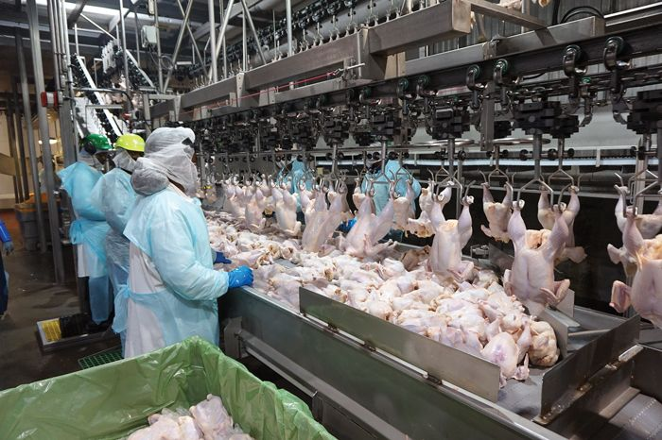
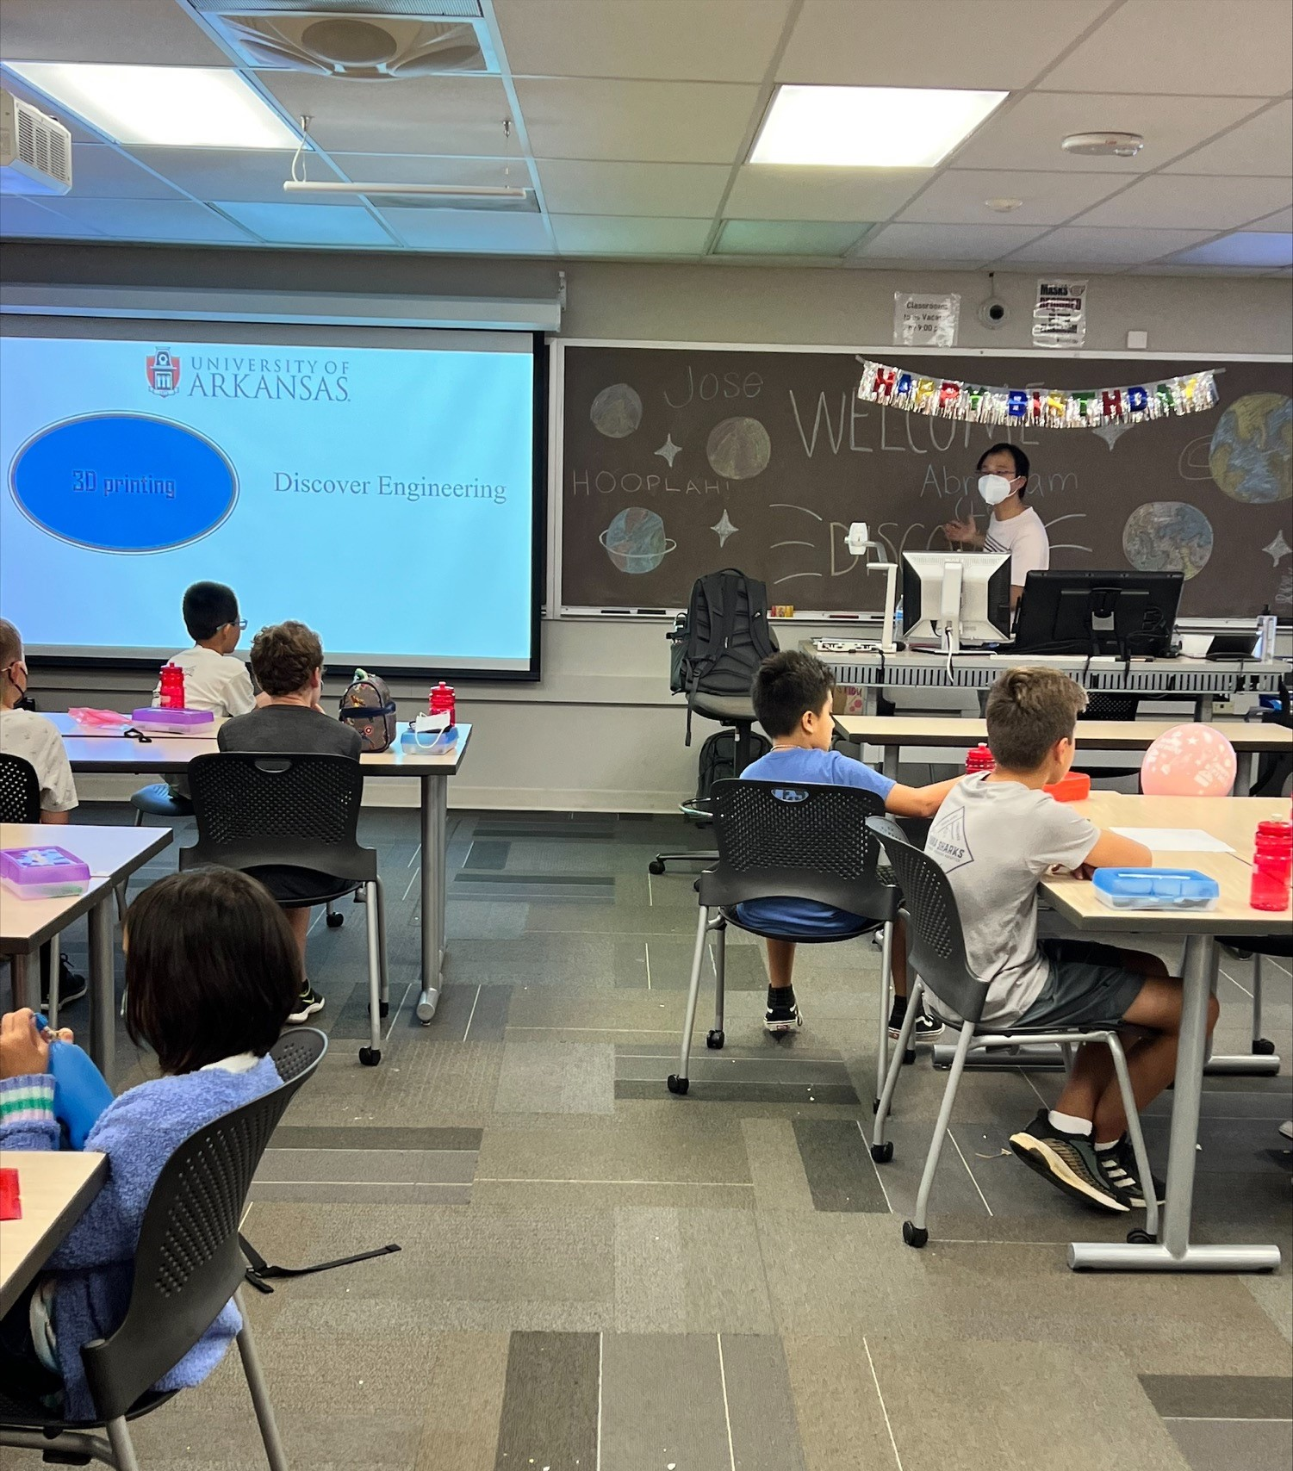
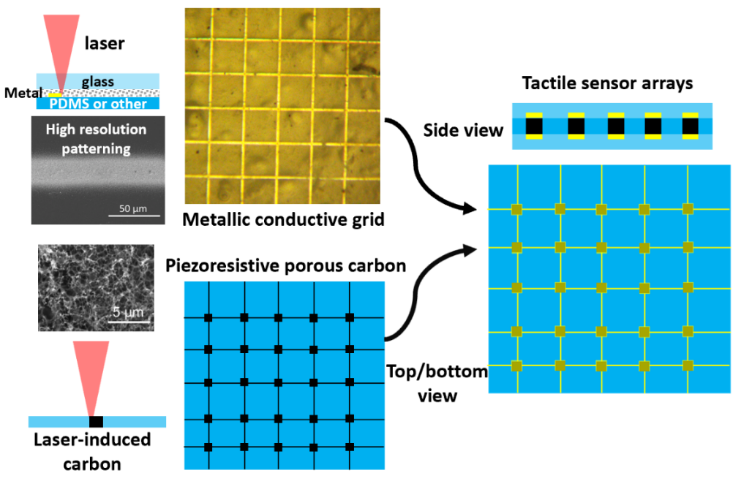
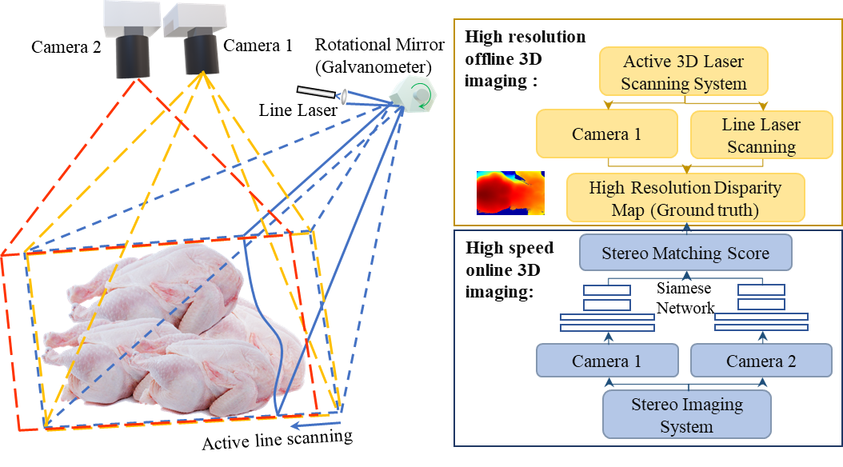
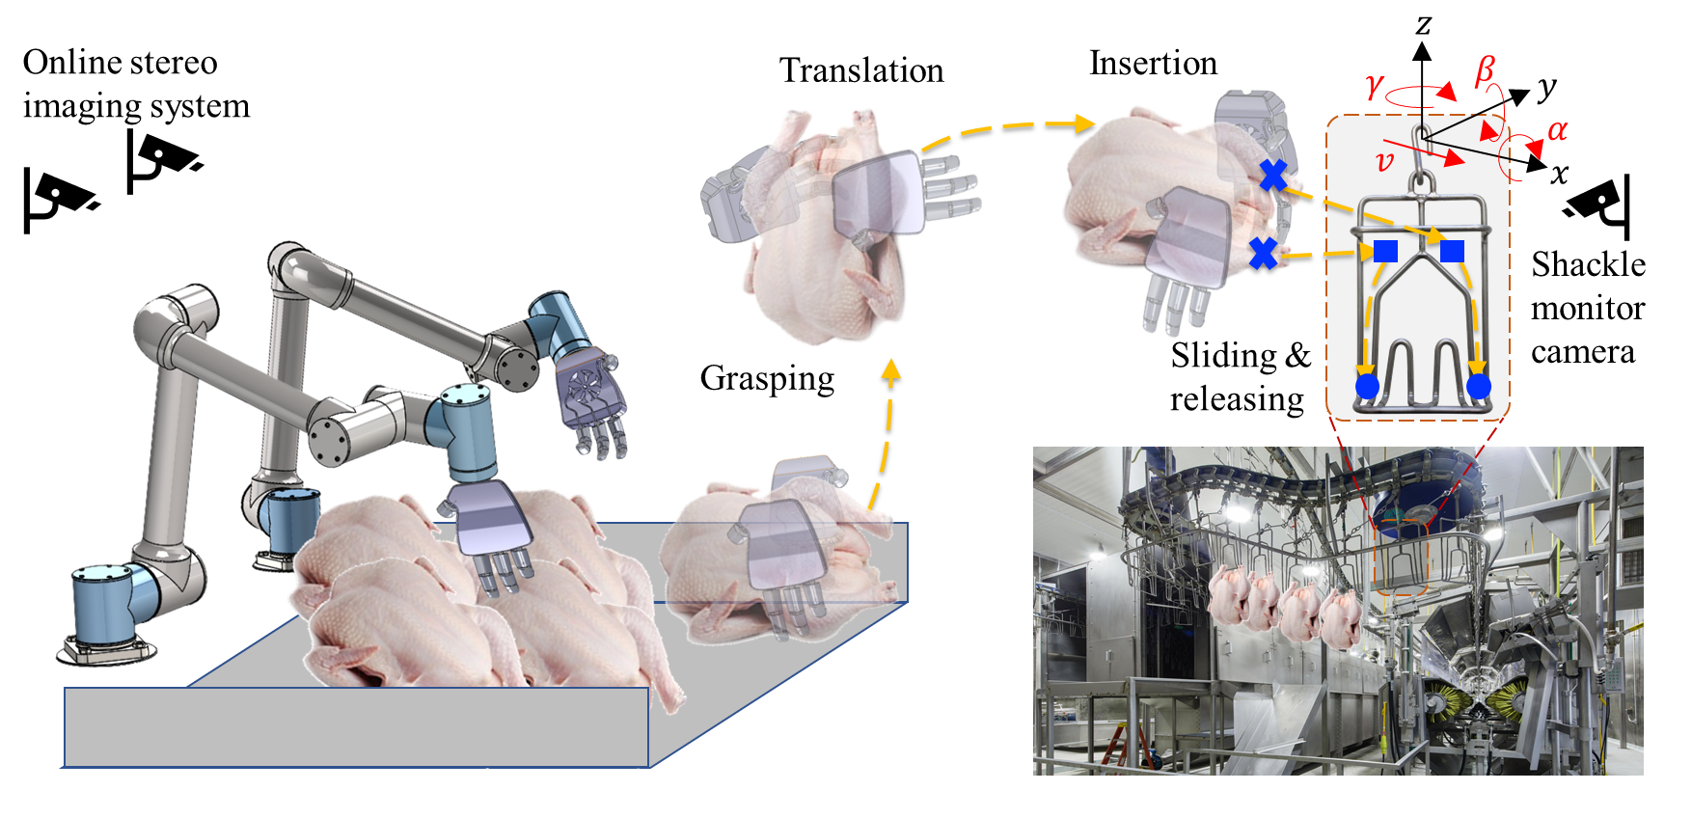
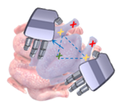
Multimodal sensors guided robotic chicken grasping and rehanging for integrated and autonomous poultry processing
Dongyi Wang, Ph.D., Department of Bio & Ag Engineering, Department of Food Science, University of Arkansas, Fayetteville
Wan Shou, Ph.D., Department of Mechanical Engineering, University of Arkansas, Fayetteville
Yu She, Ph.D., Department of Industrial Engineering, Purdue University
Background: The poultry industry is the largest meat industry in the world (225 billion pounds in 2021) and the United States is the world's primary producer of poultry meat. some processing steps, such as chicken rehanging, still heavily rely on human laborers. Chicken rehanging, a step after the chilling and USDA inspections, hangs chickens from the evisceration processing line into an additional line for the following deboning, wing cutting, and packaging steps.
Overview:
Broader Impact:
Improve labor working environment
Lower food costs
Increase food supply chain resilience
Alleviate persistent labor shortage
Shackle movement velocity (v)
Shackles (moving with velocity v, and permits pitch, yaw, roll rotation)
The stereo matching algorithm will be trained by an offline-online codesign strategy
Shackle monitoring camera
Online Stereo Imaging system
Social impact:
Education impact:
Technical impact:
Dual robotic arms with customized tactile sensor embedded gripper
Undergraduate class (BENG3113, MEEG 2303)
Engineering summer Camp (GirlTREC, SHE)
Tactile sensor fabrication
3D vision and real time machine vision
Dynamic robot control
Dual-arm collaboration
Undergraduate class (IE474)
Technical Objectives (approaches, key innovations):
Obj. 1. Tactile sensor embedded gripper development for robust chicken grasping
Obj. 2. High-speed high-resolution 3D vision system development and key points localization
Obj. 3. Multimodal info fused dual-arm manipulation for integrated chicken rehanging
(c)
(a)
(b)
Fig Obj 3. The diagram of chicken grasping and hanging procedures. The dual-arm system translates the chicken from the table to the moving shackles (translation and rotation).
Fig Obj 2. (a) Customized 3D imaging systems with laser scanning and stereo image co-design. (b). Data-driven high-resolution high-speed depth reconstruction. (c). Diagram for chicken key points detection.
Fig Obj 1. Left: Illustration of laser direct printing of tactile sensors using piezoresistive mechanism. Right: Bio-inspired tactile sensor embedded gripper design
2023 FRR & NRI Principal Investigators' Meeting
May 2-3, 2023
Award ID# (USDA):
2023-67022-39074, 2023-67022-39075,
2023-67021-39072

