Slide 1
Multiple-Level Predictive Control of Mobile Cyber Physical Systems with Correlated Context
John A. Stankovic*, PI
Co-PIs: Tian He , Shan Lin , George Pappas%
#
$
* University of Virginia
# University of Minnesota
$ Stony Brook University
% University of Pennsylvania

Slide 2
Goals of Project
Thoroughly investigate mobile transportation and home health care systems with a model predictive feedback control approach based on spatiotemporal context
Investigate human in the loop control
Develop fundamental scientific solutions for mobile CPSs
Driving applications are saving energy in workstations, home healthcare, and vehicular taxi systems

Slide 3
Two Research Themes
Fundamental CPS science
  Systems of systems
  Human-in-the-Loop
Improve CPS applications
  Taxi Systems
  Save Energy on Workstations
  Home Health Care
  ICU

Slide 4
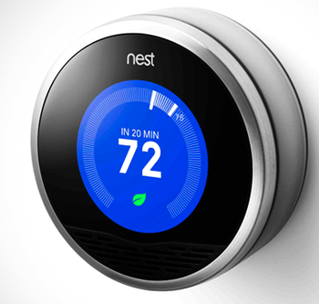
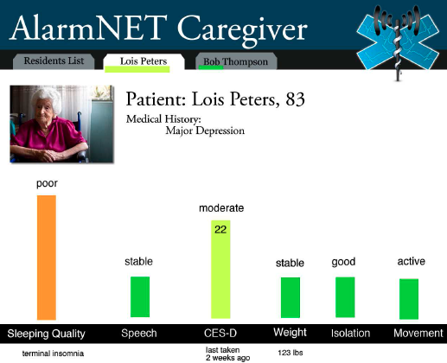
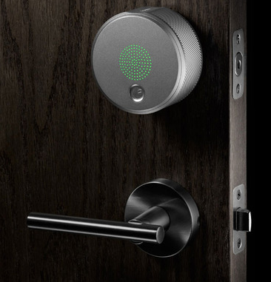
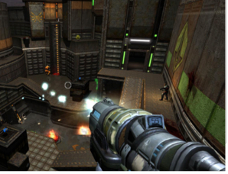
Integration of CPSs in Smart Homes
Smart Thermostat
Home Health Care
∫
Security
Game

Slide 5
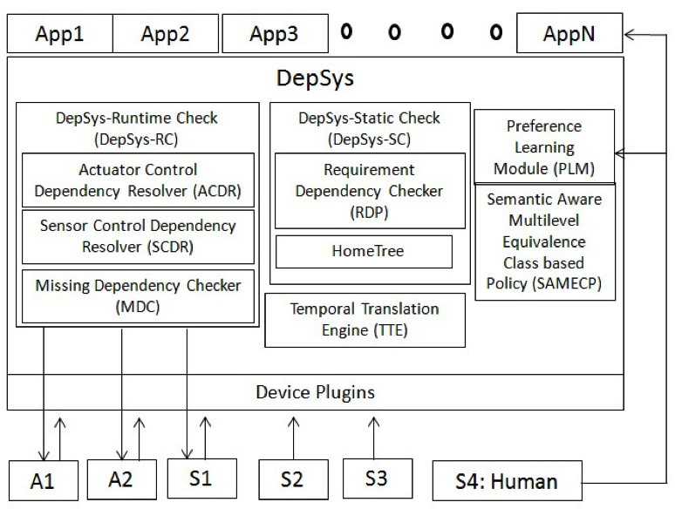
System of System Design

Slide 6
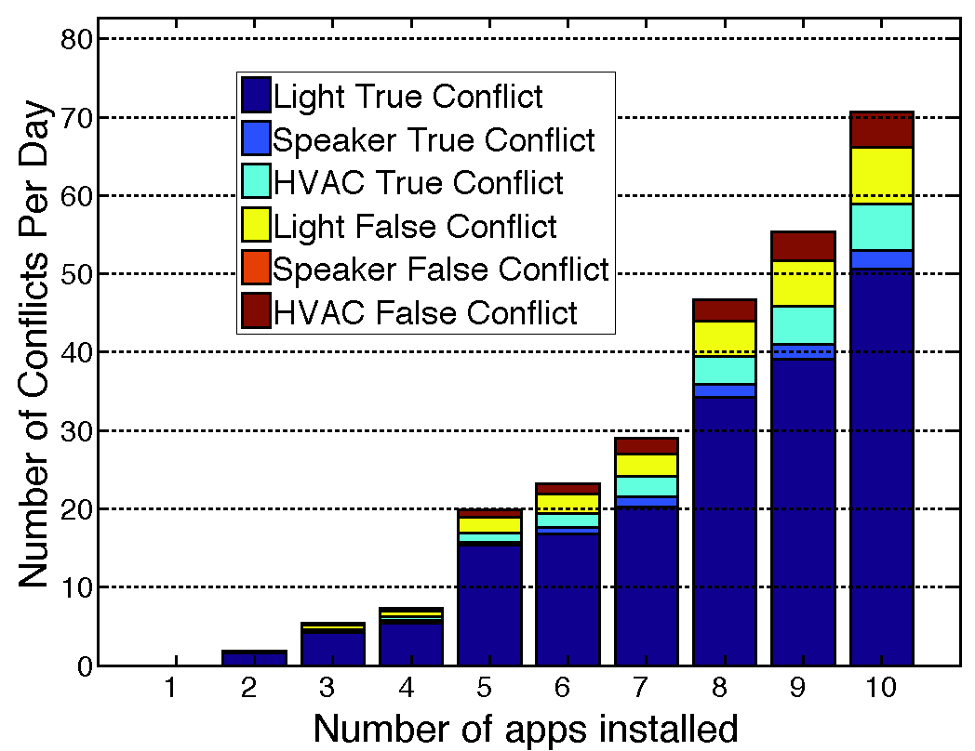
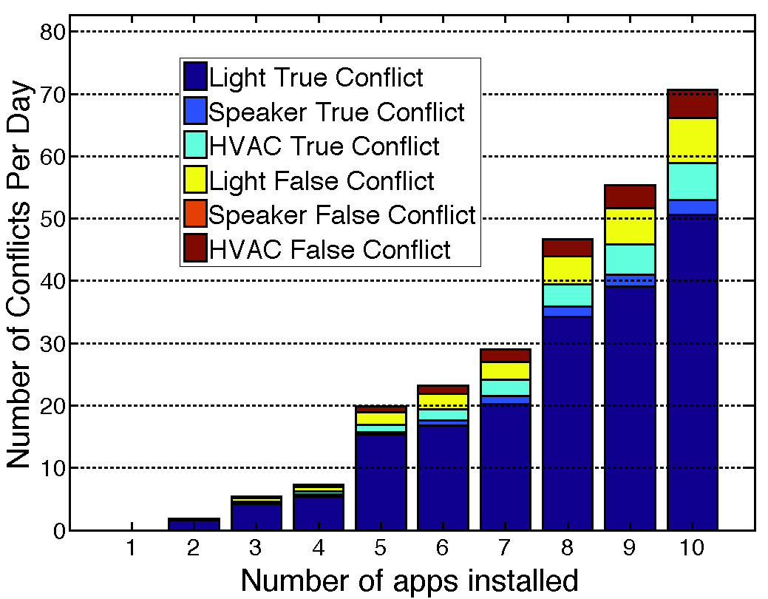
Runtime Analysis
Number of conflicts for different number of apps installed
Notes:
Number of conflicts rises exponentially

Slide 7
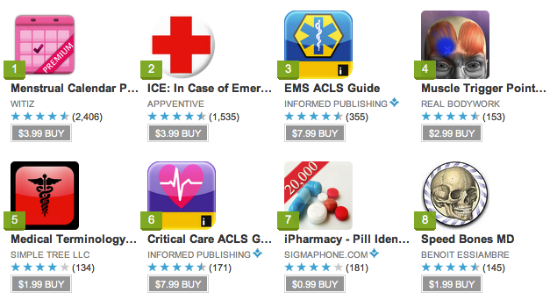
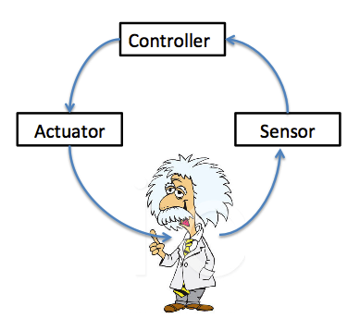
Detecting Primary and Secondary Conflicts in Mobile Medical Apps
Motivation
  There will be 2.03 billion smart phone users in 2015 worldwide
  500 million smart phone users will download healthcare apps by 2015
Challenge
  These medical apps are human-in-the-loop apps
  They may conflict due to conflicting interventions:
    Drug + Drug
    Drug + Non-Drug (e.g., food/exercise)
    Non-Drug + Non-Drug
Notes:
References:
[1] http://www.emarketer.com/Article/Smartphone-Users-Worldwide-Will-Total-175-Billion-2014/1010536
[2] http://www.healthcareappseurope.com

Slide 8
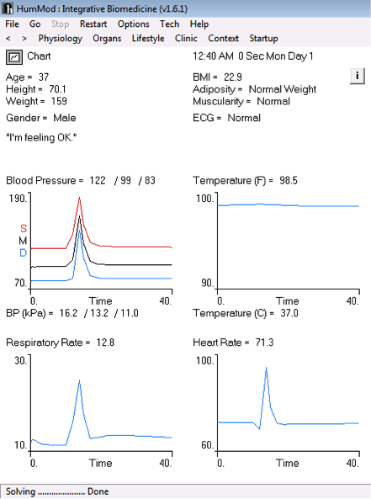
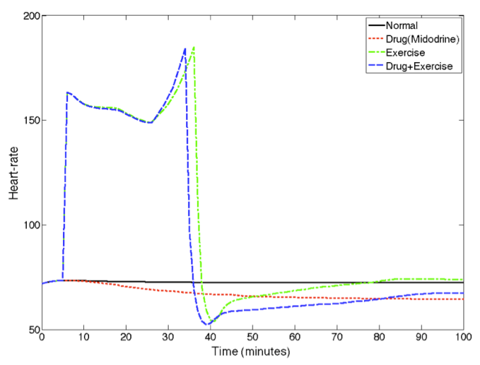

Detecting Conflict due to Human-in-the-Loop
Can we ask app developers to specify effects ?
  Problem: Lots of secondary dependencies
Solution: Model physiological response
using a simulator, HumMod
    Models interactions of 7800+ variables
    describing different physiological params

Slide 9

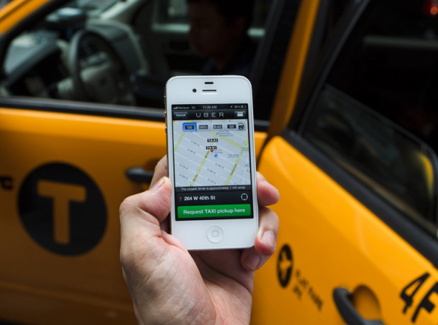
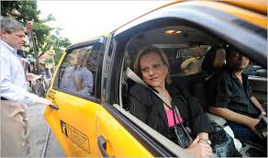
CallCab: Taxi Carpooling
Goal: Find an occupied taxi for a passenger to carpool with and that has short detour distances
Motivation:
  Long detour: Likely, if you carpool randomly
  Short detour: Find an occupied taxi traveling in a similar direction to the new passenger
Challenge:
  Unknown directions for occupied taxis

Slide 10
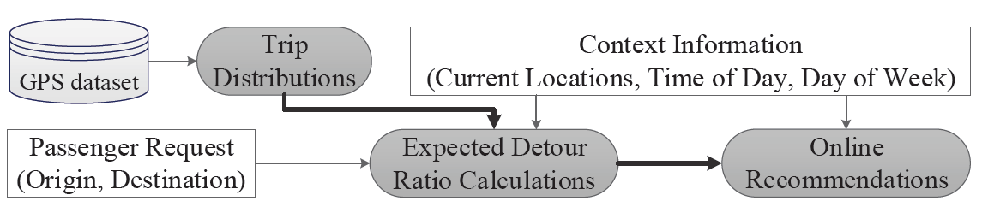
Context-based Online Recommendation
Solution: inferring direction of an occupied nearby taxi
    Utilizing historical trip distributions
    Conditioning on pickup and real-time locations and current time
    Inferring a destination with highest possibility to decide an expected detour ratio

Slide 11
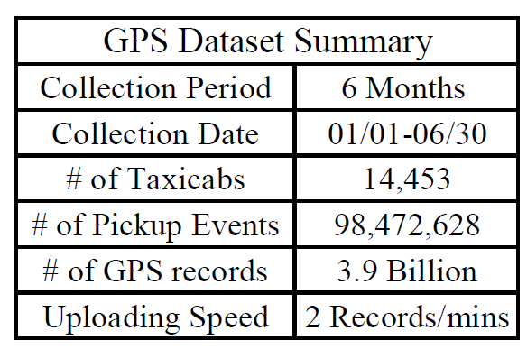
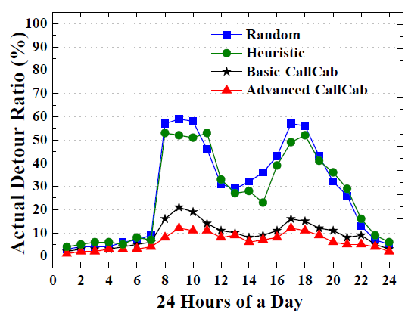
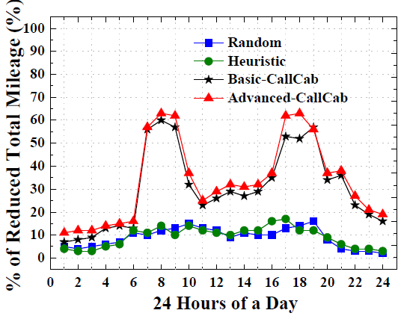
Trace Driven Evaluation
  6 month real world GPS data set
  Metrics: Actual Detour Ratio and % of Reduced Mileage
  Compared Recommendation Schemes:
    Randomly Choosing and Heuristically Choosing nearest taxi
    Choosing under limited contexts (Basic)
    Choosing under richer contexts (Advanced)

Slide 12
MPC Approach to Taxi Dispatching
Input: estimated passenger demand in each region, a supply model, a trip model.
Output: the region to which every unoccupied taxi should go at each step.
Cost measures: idle cruising distance, mismatch of supply/demand ratio
Control requirement: process passenger requests as much as possible, with minimal idle distance.
Approach: a multi-objective optimization problem formulation, applying the Model Predictive Control idea that utilizes both historical and real-time GPS information, consider both current and future costs.

Slide 13
MPC Multi-objective Optimization Formulation

Slide 14
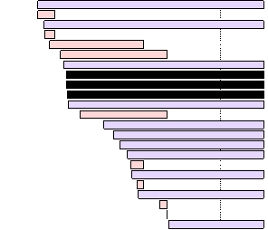
Emergency Care in ICUs
Goal: develop technologies to assist emergency care for patient safety.
Motivation
  Alarm fatigue
  Overloaded nurses
  Overlooked critical alarms
  Example
Patient A
Patient B
Important Alarms on Patient A
Alarm Response Time

Slide 15
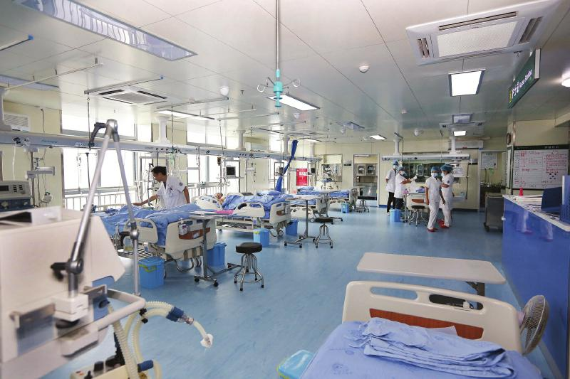
Human in the Loop Control at ICU
Approach: control alarm response time for patient safety in ICU.
  Alarm classification and characterization
  Data driven
  Actuator: nurses
  System: patient
Controller
Nurses
System
Patient
Medical Devices

Slide 16
Future Work
Modeling and Control of ICU to minimize false alarms and problems caused by distractions
Taxis as sensors and MPC for dispatching
Fundamentals of modeling and control for humans in the loop
Supported by NSF CNS1239483

