Slide 1

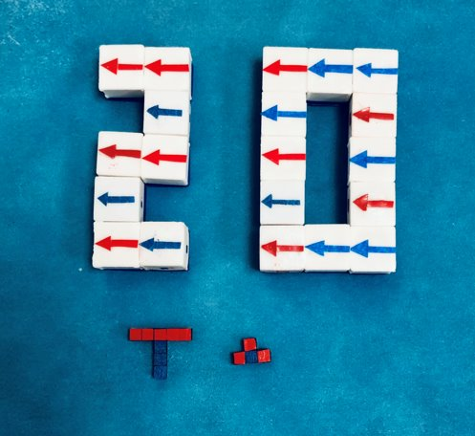


Award ID: #2130775 #2130793
Collaborative Research: Magnetically-Controlled Modules with Reconfigurable Self-Assembly and Disassembly
MinJun Kim¹, Aaron T. Becker²
¹Department of Mechanical Engineering, Southern Methodist University, Dallas, TX 75205
²Department of Electrical and Computer Engineering, University of Houston, Houston, TX 77204
2022 NRI & FRR Principal Investigators' Meeting
April 19-21, 2022
Robotic Swarm Control Lab

Slide 2
Key Challenges & Solutions
In situ manufacturing at the mesoscale (milli- and microscale) faces unique challenges that are inappropriate for current additive manufacturing for multiple reasons:
both the components and the assembler must be small enough to navigate to the build site
additive manufacturing is designed to make items smaller than themselves (within their build volume)
additive manufacturing requires the assembler to have greater precision than the assembly
Reconfigurable robotics is often hailed as a solution, since discretized modules can build structures with greater precision than individual modules
However, reconfigurable robotics often requires high levels of complexity in each module: self-locomotion, stored power, sensing, communication, attachment/detachment mechanisms
2

Slide 3
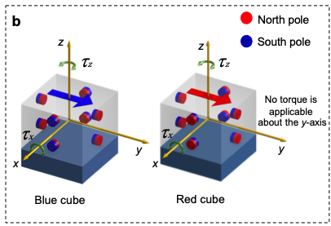
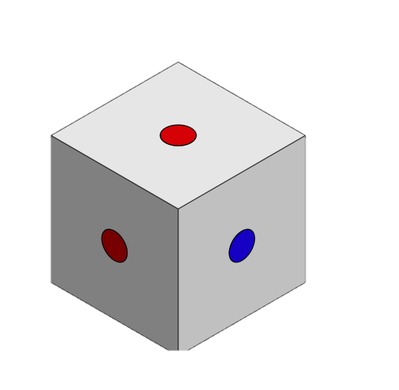
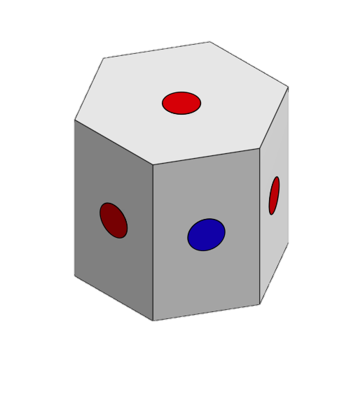
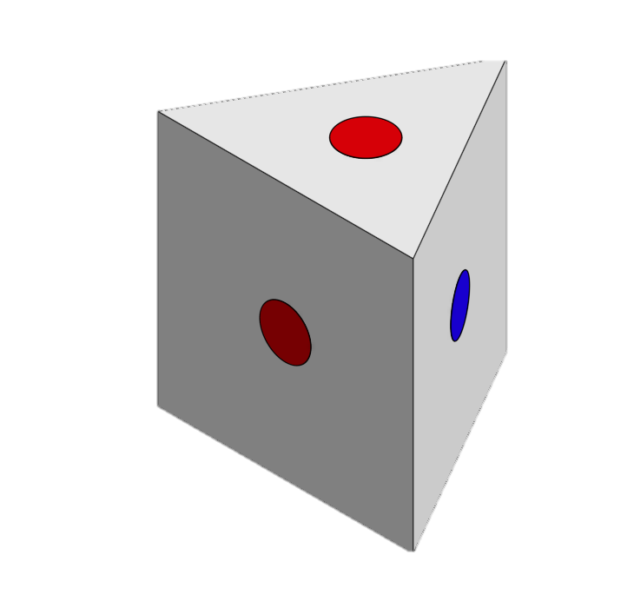
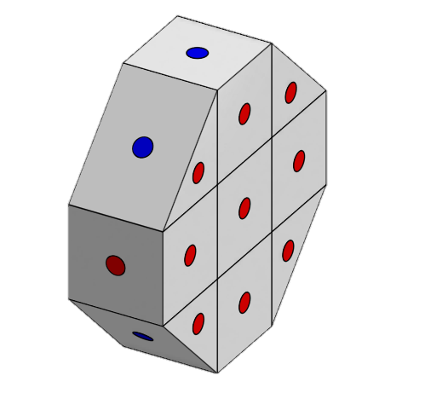
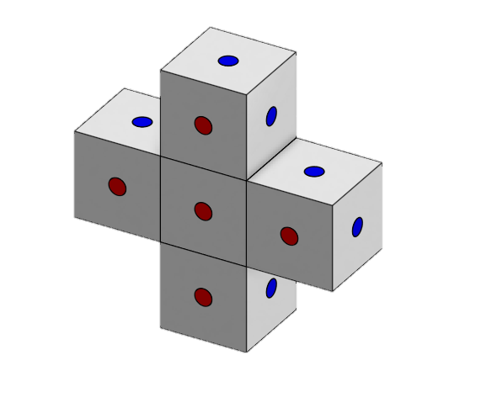
Our Approach
We seek to develop a new type of small-scale manufacturing method with the precision of modules, the reusability of Legos, and the self-assembly of DNA – but one that is controllable by an external magnetic field
The magnetically controllable modules will be fabricated through high resolution 3D-printing techniques and by embedding bipolar micro-magnets to enable programmable spatial variation of magnetic properties to create heterogeneous behavior among subunits under a single global control input
The modules are simple and scalable, are controlled externally, and do not require batteries/on-board circuits
3

Slide 4
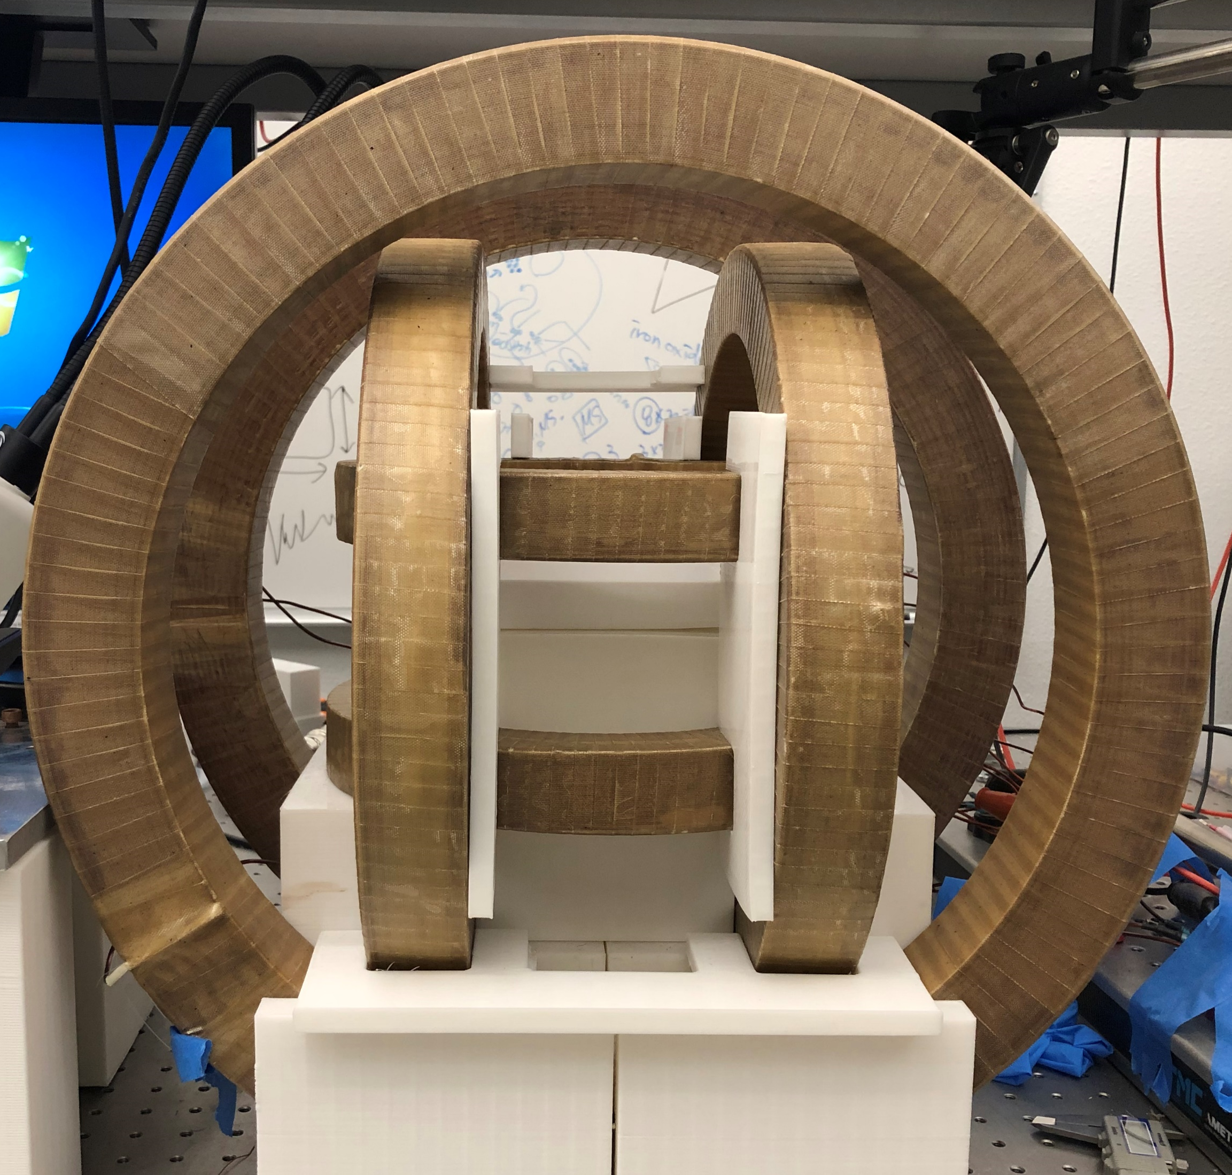
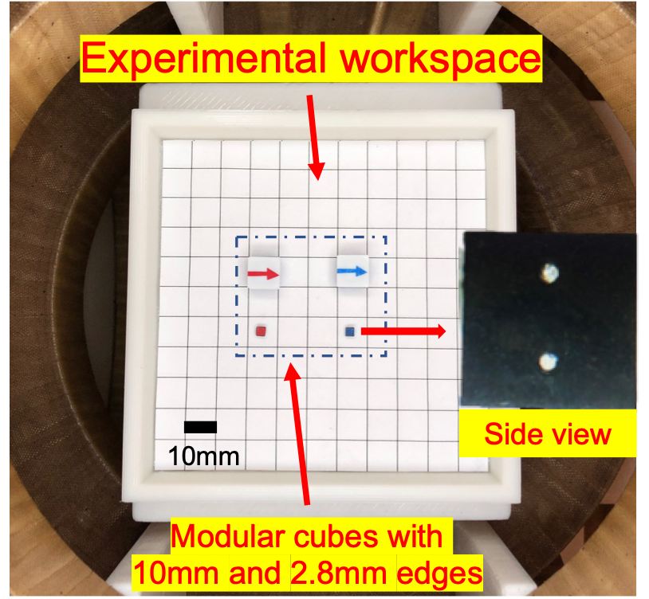
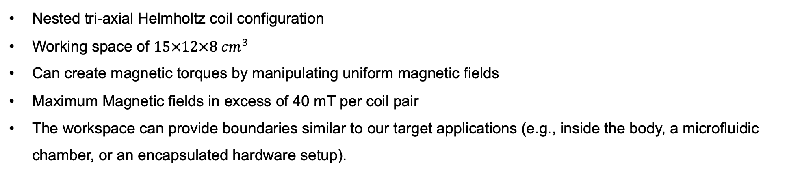
Magnetic Control Setup for Robot Manipulation
Nested tri-axial Helmholtz coil configuration
Working space of $15×12×8 cm^{3}$
Can create magnetic torques by manipulating uniform magnetic fields
Maximum Magnetic fields in excess of 40 mT per coil pair
The workspace can provide boundaries similar to our target applications (e.g., inside the body, a microfluidic chamber, or an encapsulated hardware setup).
x-coils
z-coils
y-coils
4

Slide 5
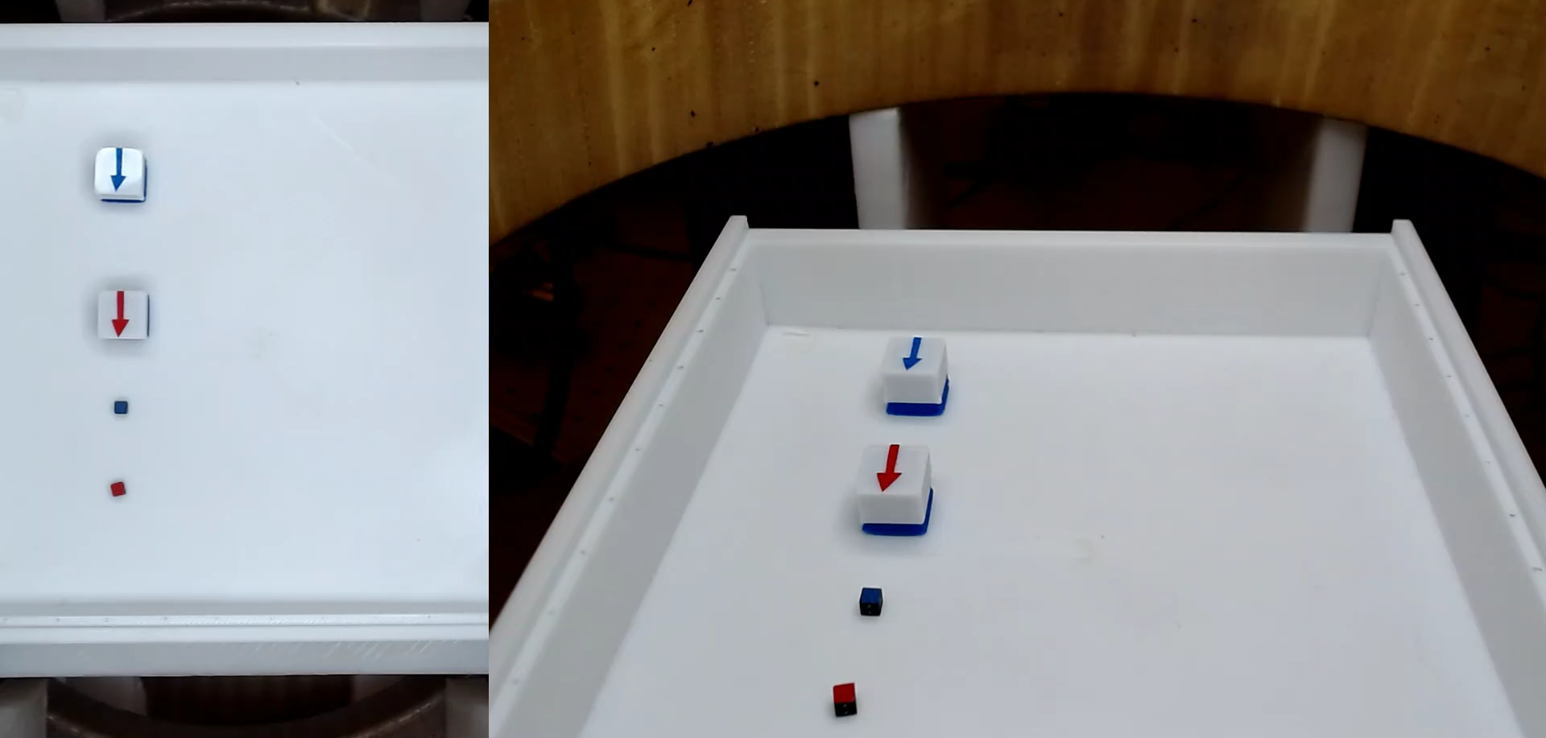
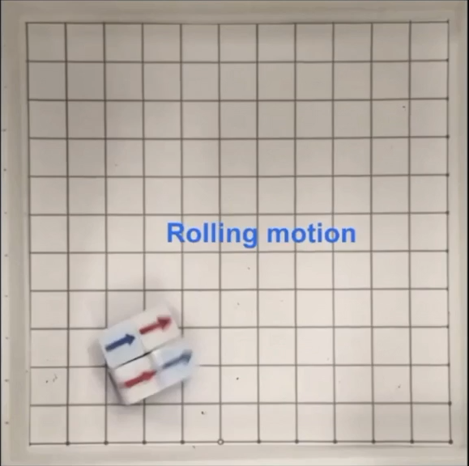
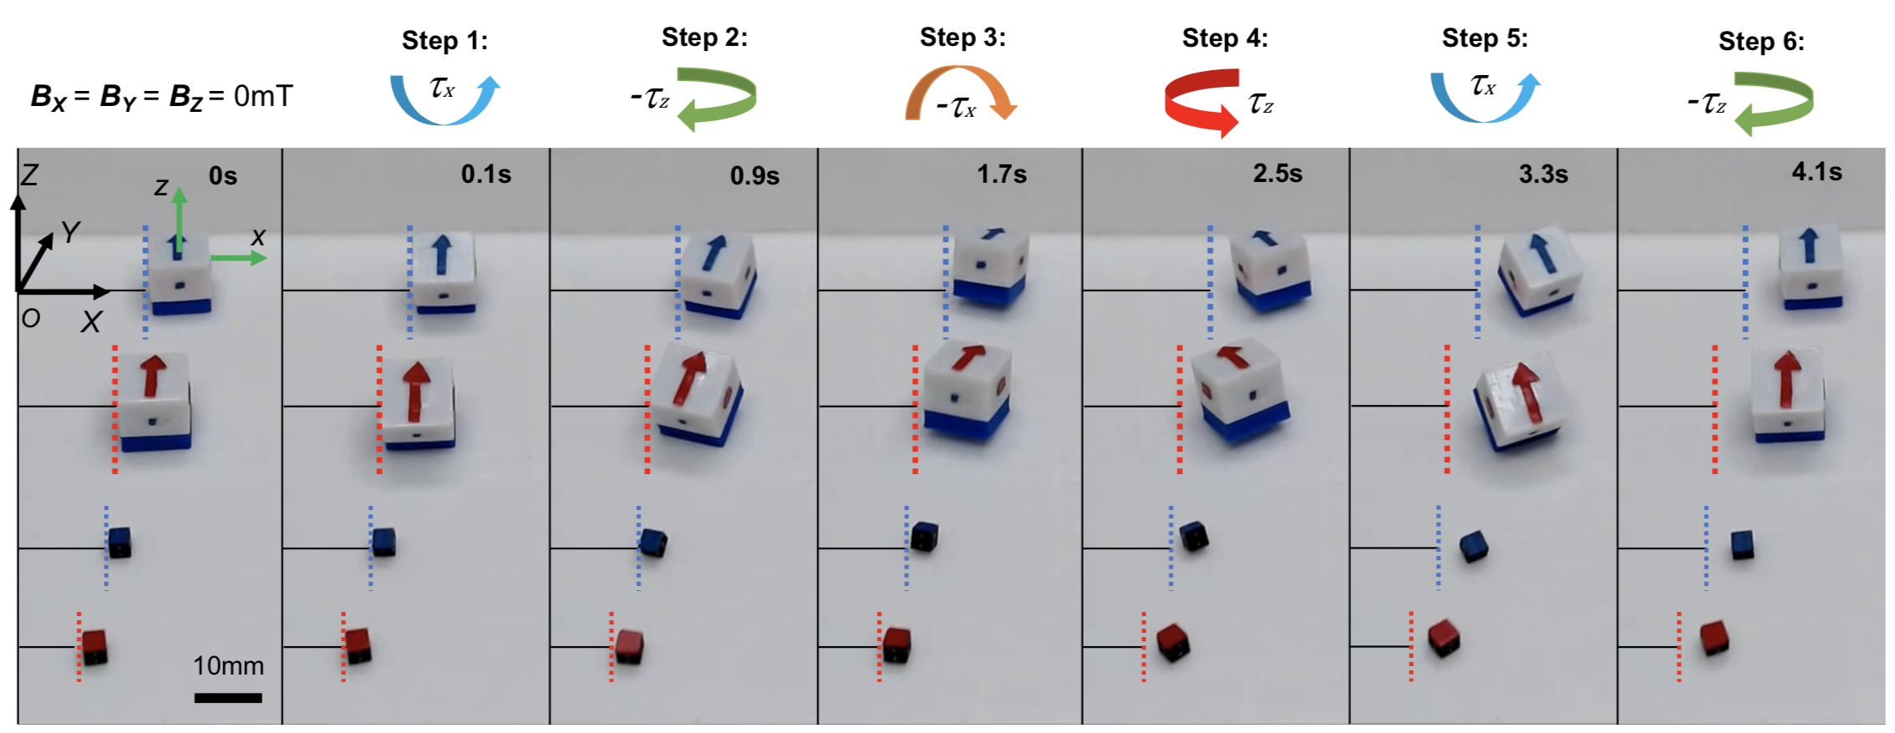
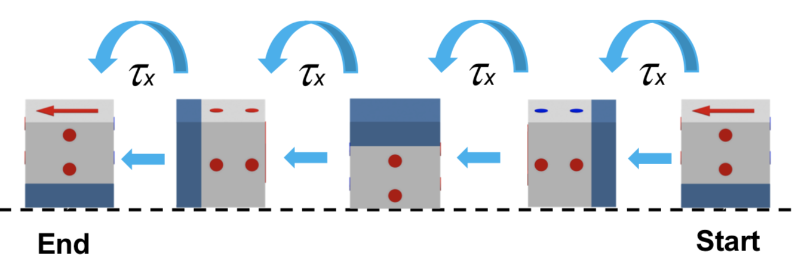
Motion Modes
Pivot Walking
Speed 2X
10 mm
5

Slide 6
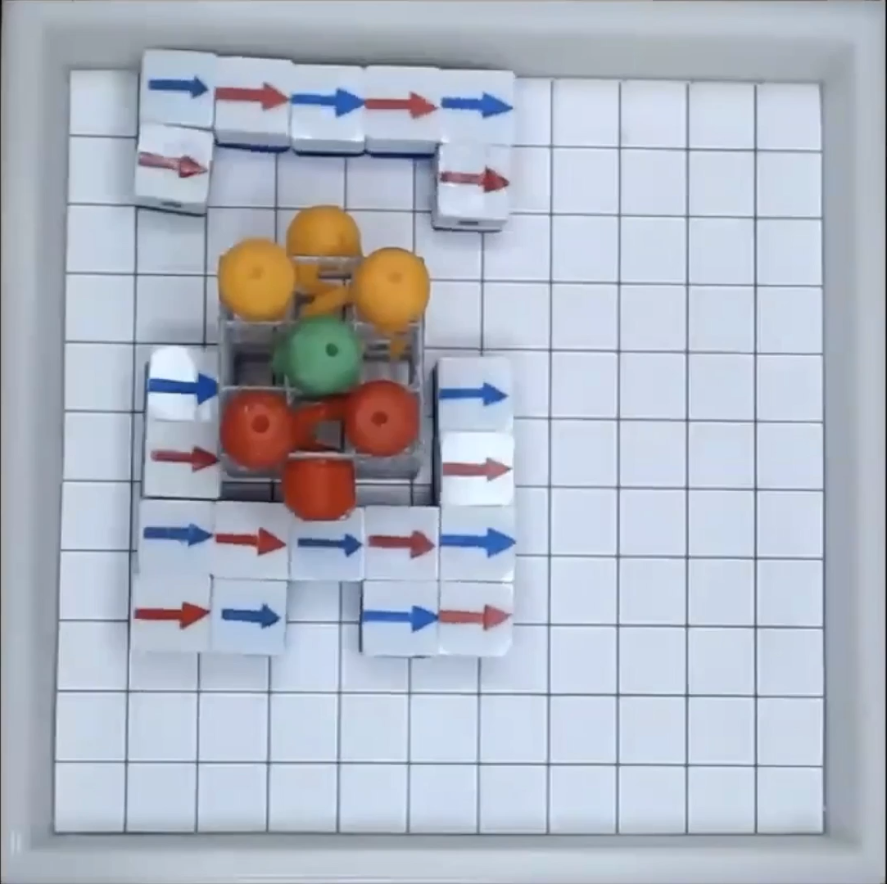
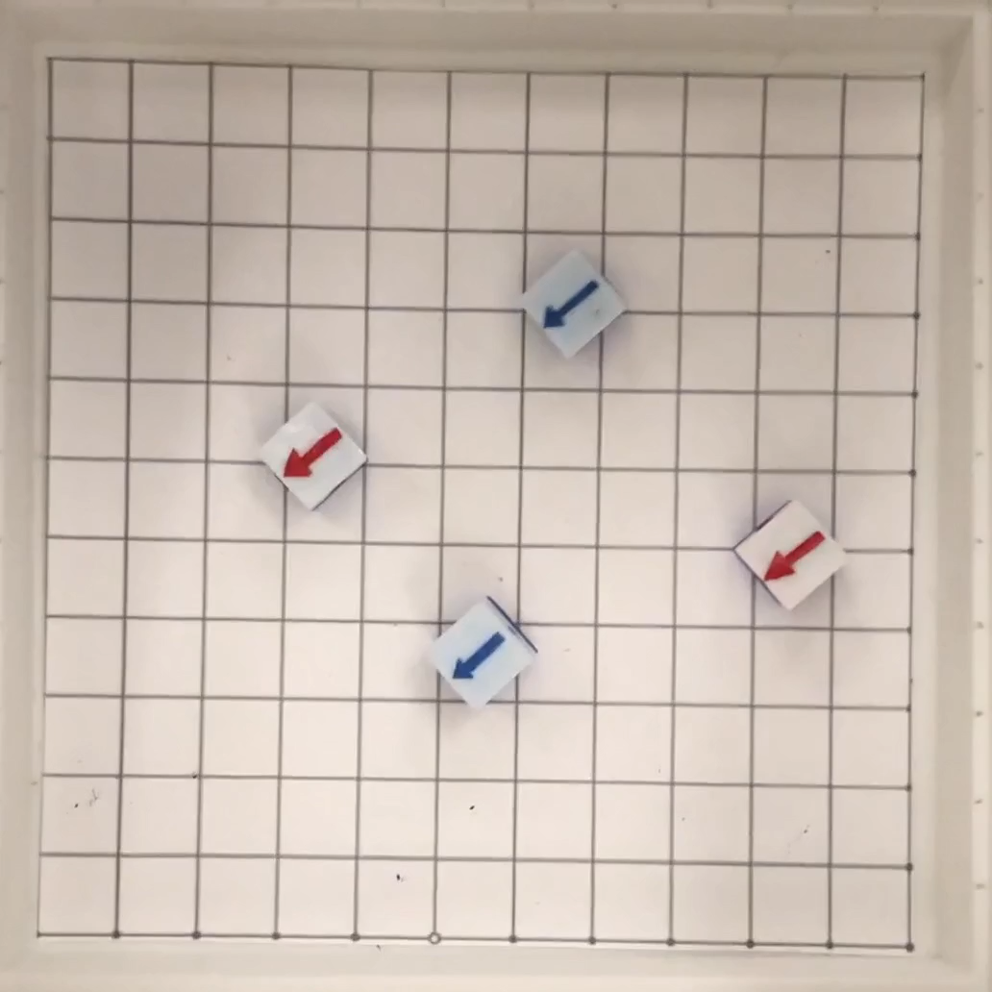
Self-assembly/disassembly and Reconfiguration Behavior
The magnetic modules can walk as a swarm under a global magnetic input to create targeted assemblies and sub-assemblies which can further be utilized to manipulate objects
The sub-assemblies can be assembled/disassembled and reconfigured to create new shapes
Manipulating a 3D-printed toy
Assembly Disassembly Reassembly
10 mm
A. Bhattacharjee, Y. Lu, A. T. Becker, and M. Kim, “Magnetically-controlled modular cubes with reconfigurable self-assembly and disassembly,” in IEEE Transactions on Robotics (T-RO), 2021
6

Slide 7
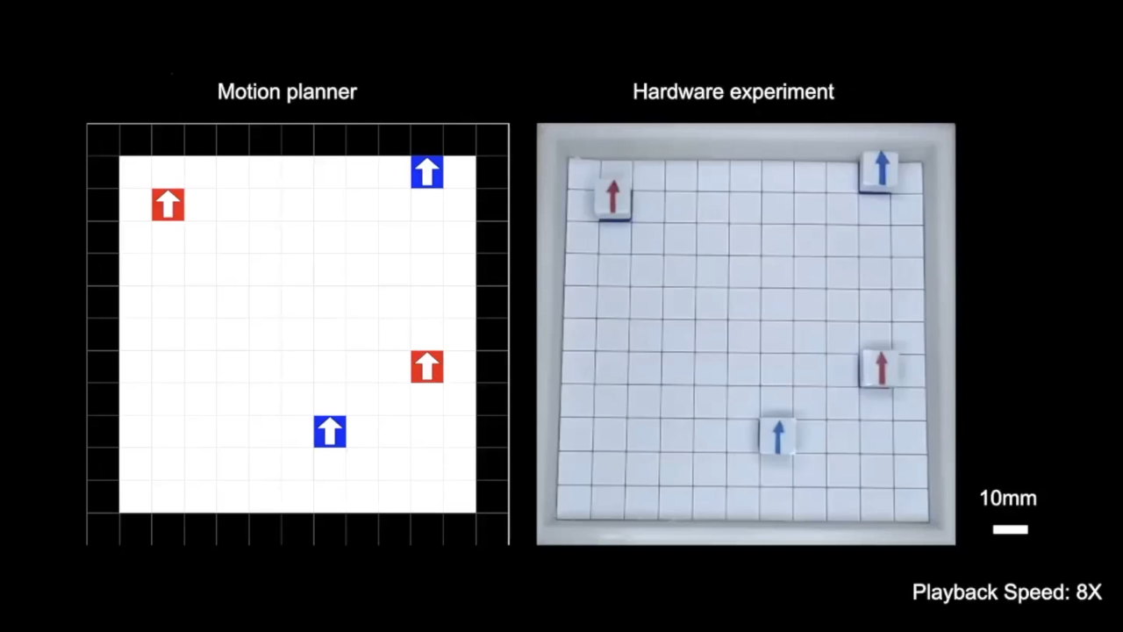

2D Motion Planner with Experimental Validation
We have developed a 2D simulator (motion planner) to compute all reachable polyomino configurations (and their shortest movement sequences) from the initial configuration
If the target polyomino is unreachable, we disassemble and/or scramble the cubes and repeat the assembly process
Target Shape:
The hardware experiment follows the shortest paths found by motion planner
A. Bhattacharjee, Y. Lu, A. T. Becker, and M. Kim, “Magnetically-controlled modular cubes with reconfigurable self-assembly and disassembly,” in IEEE Transactions on Robotics (T-RO), 2021
7

Slide 8
Major Contributions
A modular robotic platform with a simple, economic, and scalable design that enables effective use of modular subunits in an intelligent meso-scale manipulation system
Modules are actuated through discrete motion modes and are wirelessly controlled
It has a robust assembly–disassembly capability, is reconfigurable
All modules can be commanded in parallel, and the same commands can actuate individual modules and assemblies of modules.
Require no motors, sensors, batteries, or computation.
Key novelty: the resulting structure itself is a robot
8

Slide 9
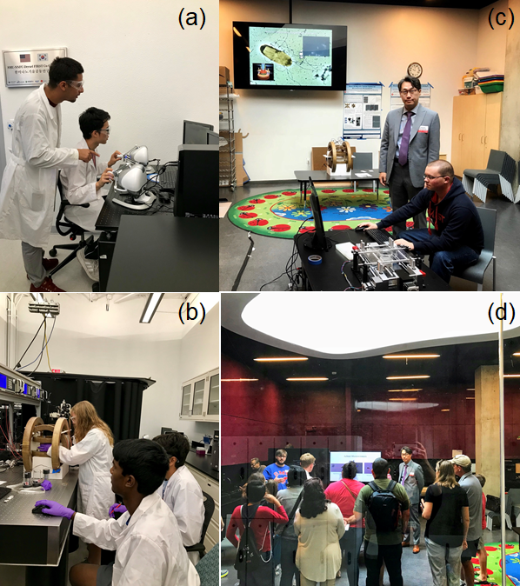
Broader Impacts
The educational goal of this proposal is to effectively communicate cutting-edge research to a broad, young audience and inspire them toward the goal of obtaining a degree in science, technology, engineering, or mathematics (STEM) fields.
Research-integrated education plan
Refinement of haptic simulators for modular robotics
Advanced discovery while promoting undergraduate training and learning
Outreach effort to K-12, underrepresented, and community college students at SMU and at UH
Interactive web-based tutorials and exhibits for broaden dissemination
9

