Slide 1
NSF Rapid Project
Abhi Vadali
Professor Dubey

Slide 2
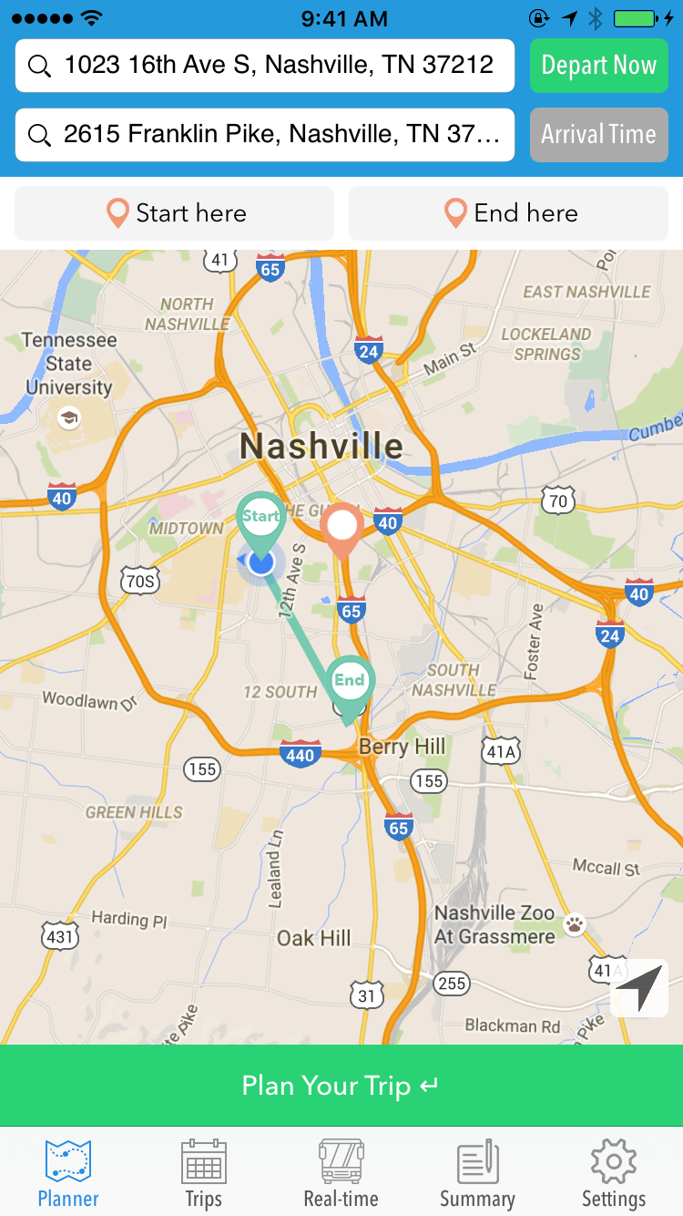
Transition of TransitHub App
Native iOS app
Key features: real-time bus tracker, navigation, service alert notifications, personal transit schedule management
Trying to adapt this application to help citizens of Nashville navigate public transit among COVID-19 pandemic

Slide 3
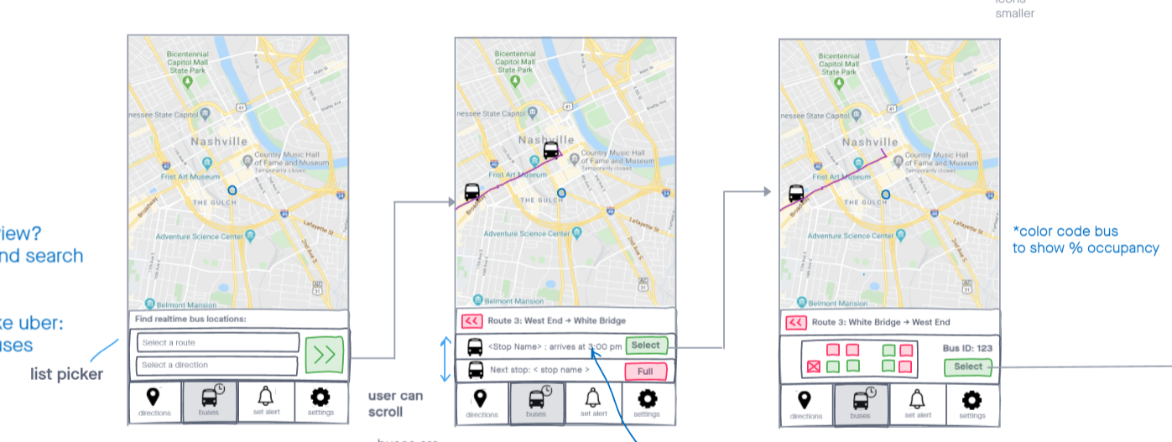
New app
Began the process of creating a new app in React Native, which has bus stop information, bus route information, bus schedules, real-time navigation assistance, real-time bus locations, bus arrival predictions, live seat-map (etc.)

Slide 4
Video Analysis
Received video feed examples from different buses in Nashville
Decomposed these videos into frames
Used OpenCV and YOLOv3 to train the model to identify people within these frames
Now working on splitting each frame into specific Regions of Interest and then using Structural Similarity Index to determine which seats are populated

Slide 5
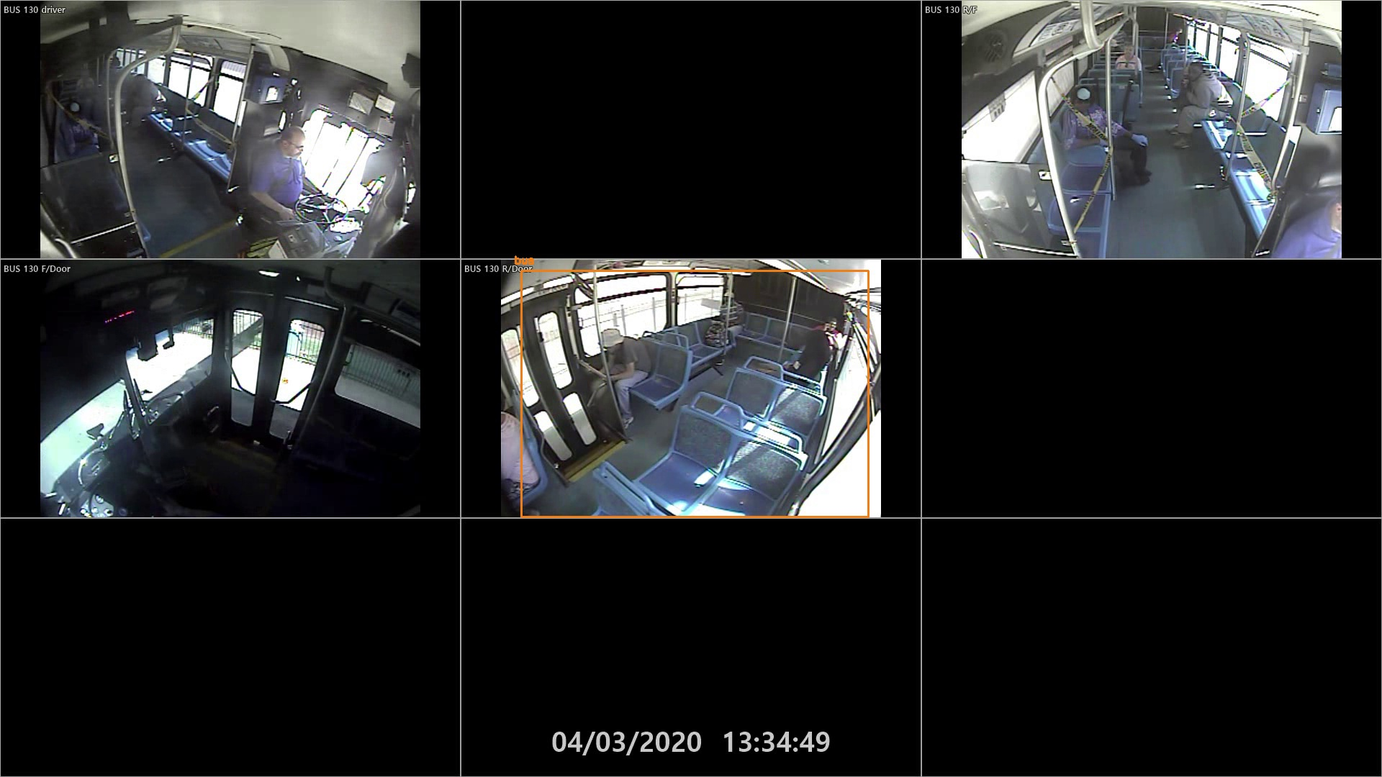
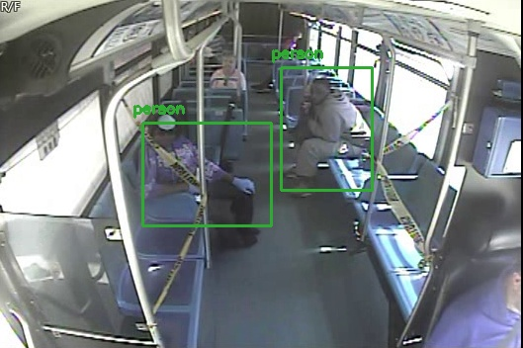
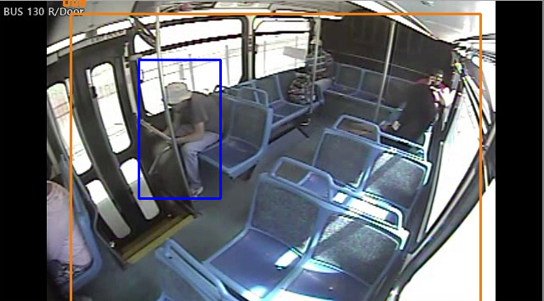
Preliminary Video Analysis Results

Slide 6
Challenges, Lessons, Positives
Challenges: minimal experience with JS, React, and CV going into this internship; adjusting to getting help in a remote setting
Lessons: experimenting and building greatly flattens learning curve, be more proactive about getting help solving problems
Positives: internship lectures and lunch + learns with PhD students were very informational, Professor Dubey and SCOPE Lab were very intentional about checking in on the projects and providing support wherever needed

Slide 7
Thank you to Vanderbilt ISIS and Professor Dubey for the opportunity to participate in this work this summer

