Slide 1
Network Conversion to Enable Foolbox Use
Yi Ji
PI: Dr. Taylor Johnson
Mentors: Neelanjana Pal, Diego Manzanas Lopez
Vanderbilt ISIS
Summer 2020

Slide 2
Foolbox
Generates adversarial images
Interfaces with frameworks such as PyTorch, Keras, TensorFlow, Theano and MXNet
Helps with safety verification of the cyber-physical systems
Sources:
Decision-Based Adversarial Attacks: Reliable Attacks Against Black-Box Machine Learning Models
Foolbox: A Python toolbox to benchmark the robustness of machine learning models

Slide 3
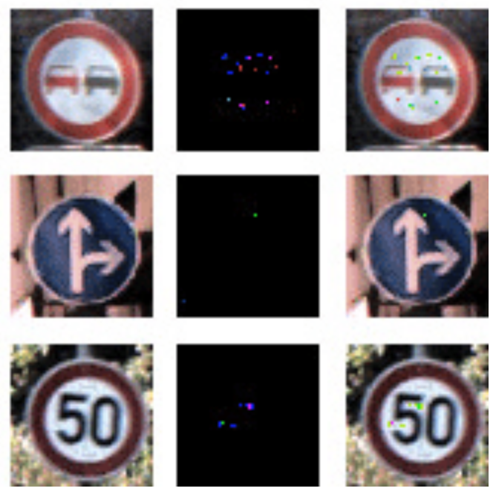
Adversarial Images

Slide 4
Workflow
Load the pretrained network in Matlab
Export network to ONNX format
Convert the model from ONNX to Tensorflow
Compare Matlab and Tensorflow classification results
Add adversarial attacks
German Traffic Sign Recognition Benchmark (GTSRB)

Slide 5
Model Conversion

Slide 6
What I Learned
How to train a classifier with deep learning frameworks (Pytorch, Matlab, Tensorflow, …) and calculate the classification accuracy
How to deal with classic image classification problems (MNIST, CIFAR-10, GTSRB, …)
How to add adversarial attacks using Foolbox
How to work with PIs and mentors remotely
…

Slide 7
Thank you！

