Slide 1
Networked Grid Simulation by Co-simulating GridLAB-D and OMNeT++
Scott Phillips 7/31/2020
Advised by Himanshu Neema
scott.h.phillips@vanderbilt.edu

Slide 2
GridLAB-D and OMNeT++
GridLAB-D is a power distribution system simulation and analysis tool developed by the US Department of Energy (DOE) and PNNL
GridLAB-D functions as a core simulator that interacts with various modules
These modules contain implementations for objects that are relevant for distribution system simulations (e.g. Market, Powerflow)
OMNeT++ is a simulation library and framework used for building communication network simulators
Notes:
Both are widely used open source simulators

Slide 3
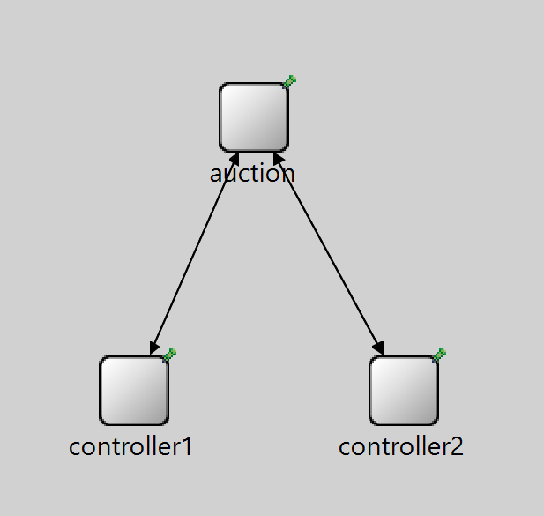
Motivation for Co-simulating GridLAB-D with OMNeT++
GridLAB-D has instant communication between entities that would communicate over a network in the real world
Using a network simulator would allow us to model network attacks
Notes:
network attacks, variable delivery time

Slide 4
Implementing Co-simulation
Enable data exchange between GridLAB-D and OMNeT++
Create buffers in GridLAB-D for messages to be stored in
GLDInBuf, GLDOutBuf
The order of messages is preserved in both directions
Prevent GridLAB-D from internally delivering data that is sent over network
Notes:
The design of these buffers will be extensible such that thousands of messages in a single GridLAB-D timestep could be stored if necessary
The order of messages is preserved in both directions

Slide 5
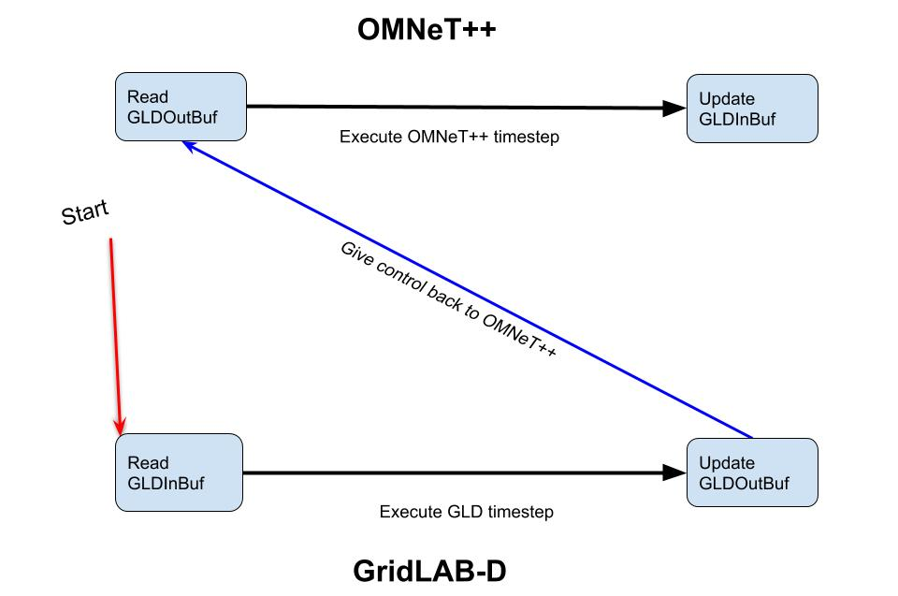
Co-simulation timestep

Slide 6
Thank you!

